Slide 1
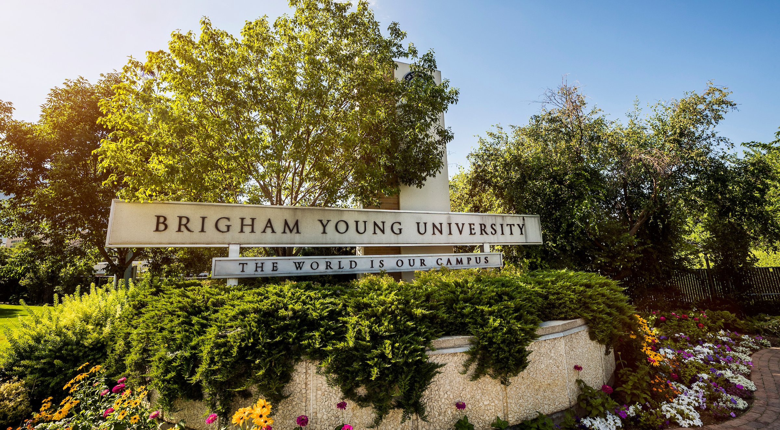
NATO BILC Seminar 2022
WELCOME
to
16-21 October 2022

Slide 2
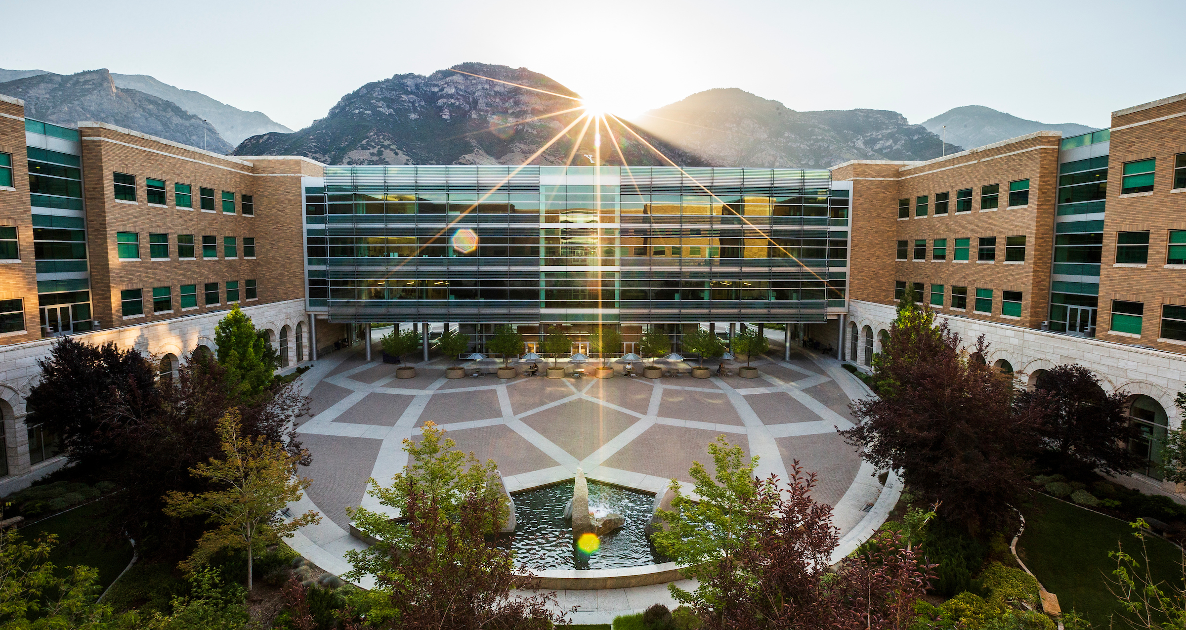
The host will be the Center for Language Studies
in the College of Humanities at Brigham Young University

Slide 3
College of Humanities
Brigham Young University Campus with Mountains to the East

Slide 4
Located in the City of Provo, Utah with Utah Lake and Mountains to the West
Conference Center

Slide 5
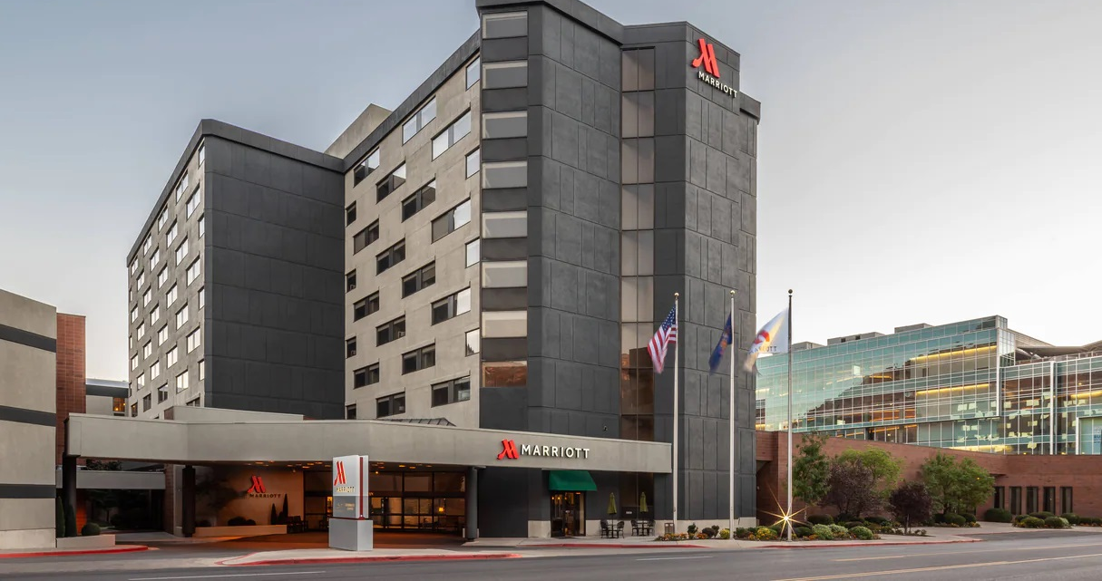
OCT 16-21, 2022
Meeting Venue of the 2022
NATO BILC Professional Development Seminar

Slide 6
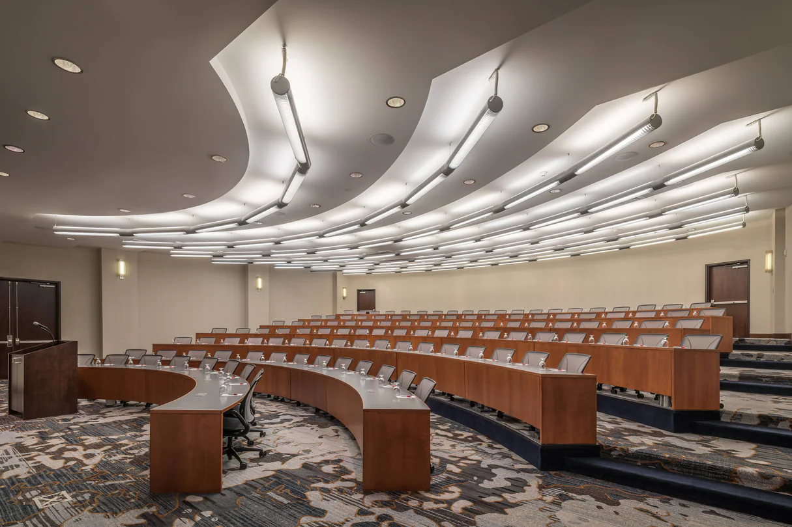
Marriott Hotel and Conference Center

Slide 7
NATO BILC
Professional Development Seminar
16 – 21 October 2022 in Provo, Utah
There are direct flights into Salt Lake City from Amsterdam, Paris, Munich, and London.
To offset the high cost of airfares, we:
Will provide transportation from the Airport in Salt Lake City to Provo.
Will not have a seminar registration fee.
Will provide most meals.
Have negotiated a hotel room rate of $115 / night.

