Slide 1
BUREAU FOR INTERNATIONAL LANGUAGE CO-ORDINATION (BILC)
REPUBLIC OF TÜRKİYE
MINISTRY OF NATIONAL DEFENCE
GENERAL STAFF
ANNUAL CONFERENCE, 2023
TÜRKİYE

Slide 2
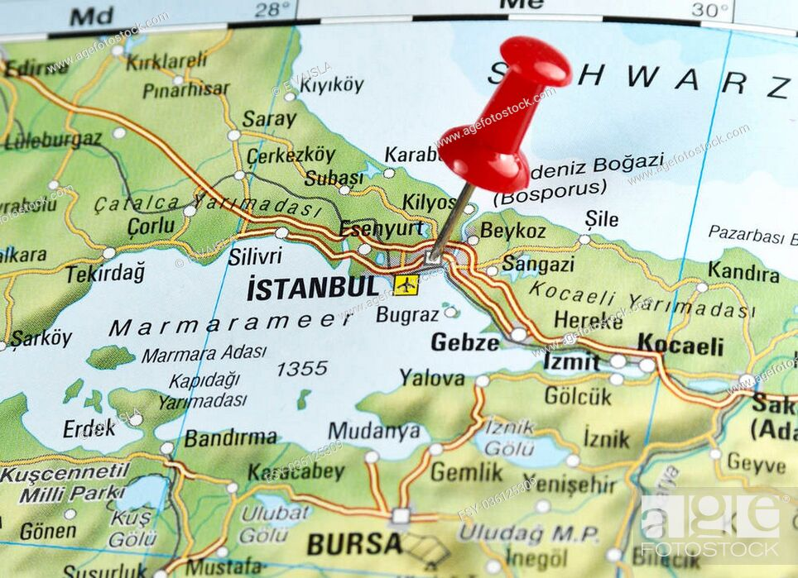
BILC CONFERENCE 2023, TÜRKİYE
REPUBLIC OF TÜRKİYE
MINISTRY OF NATIONAL DEFENCE
GENERAL STAFF
DATE: May, 2nd or 3rd Week (TBC)
VENUE: Army Language School, Kartal/İstanbul (TBC)
THEME: TBD

Slide 3
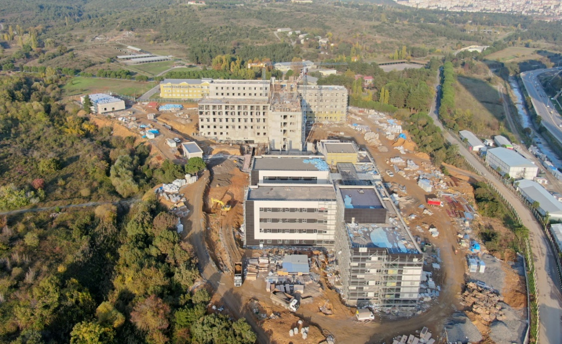
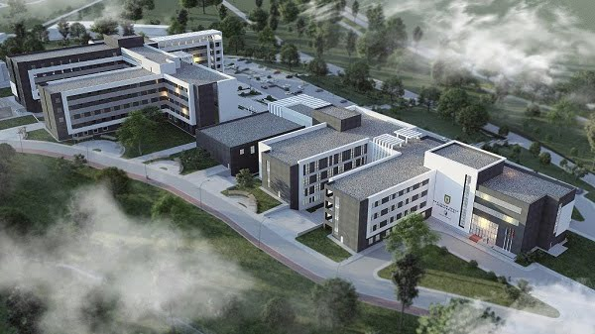
TUKISH ARMY LANGUAGE SCHOOL
REPUBLIC OF TÜRKİYE
MINISTRY OF NATIONAL DEFENCE
GENERAL STAFF
As commanded by Turkish Training and Doctrine Command, Turkish Army Language School has been in service since 1956. It now serves in 12 different languages.

Slide 4
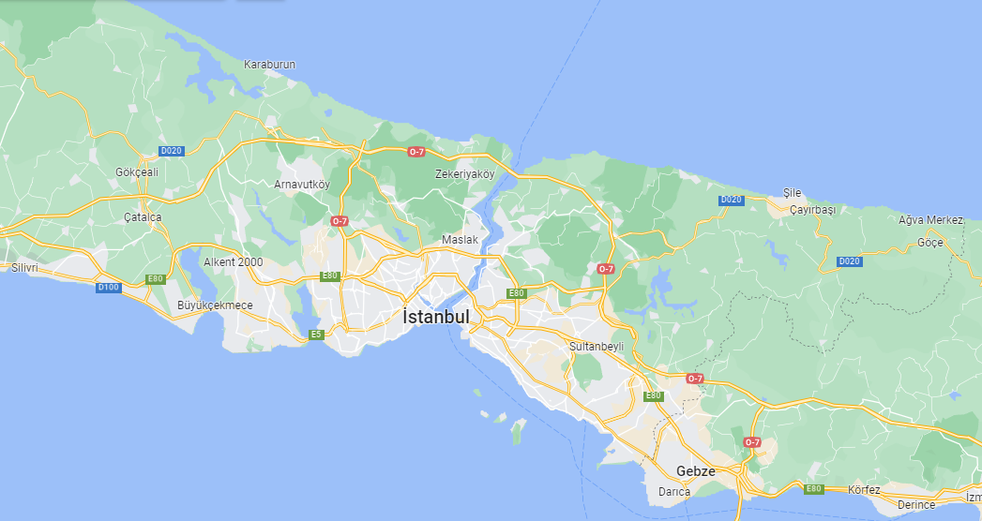
TUKISH ARMY LANGUAGE SCHOOL ON MAP
REPUBLIC OF TÜRKİYE
MINISTRY OF NATIONAL DEFENCE
GENERAL STAFF
İstanbul Airport
Army Language School

Slide 5
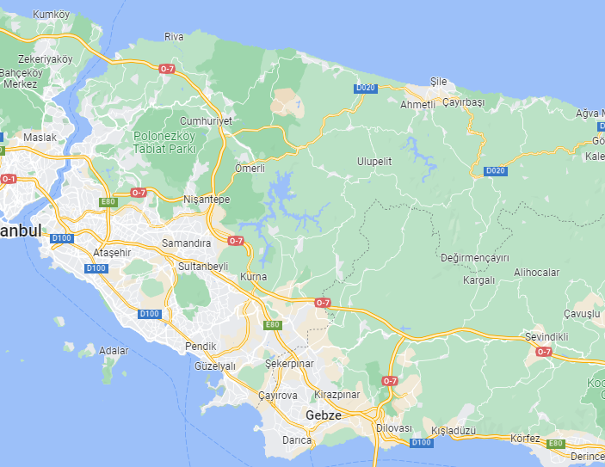
TUKISH ARMY LANGUAGE SCHOOL ON MAP
REPUBLIC OF TÜRKİYE
MINISTRY OF NATIONAL DEFENCE
GENERAL STAFF
Park Dedeman
Elite World Asia
Days Hotel by Wyndham
Army Language School

Slide 6
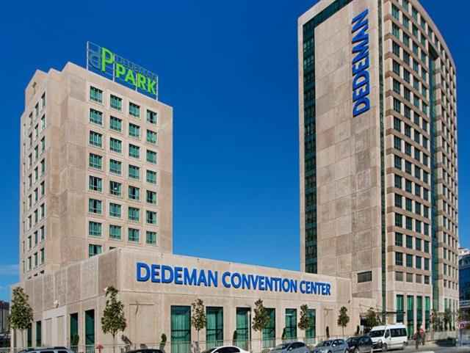
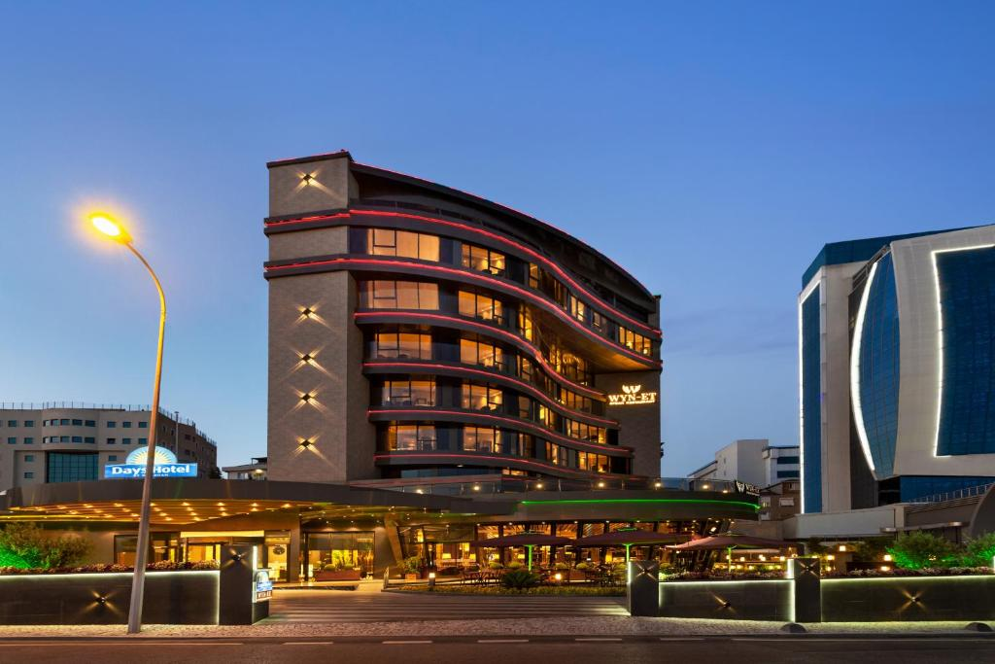
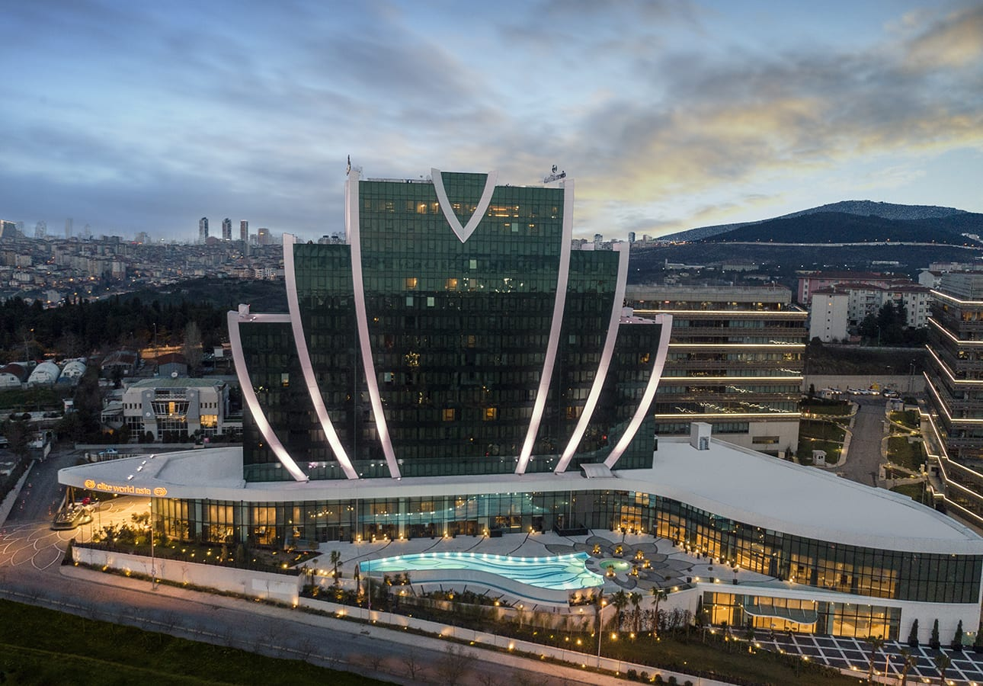
HOTELS & ACCOMMODATIONS NEARBY
REPUBLIC OF TÜRKİYE
MINISTRY OF NATIONAL DEFENCE
GENERAL STAFF
Park Dedeman Hotel
(Bostanci, Istanbul)
Days Hotel by Wyndham
(Maltepe, Istanbul)
Elite World Asia Hotel
(Maltepe, Istanbul)

Slide 7
HOTEL & ACCOMMODATION PRICES
REPUBLIC OF TÜRKİYE
MINISTRY OF NATIONAL DEFENCE
GENERAL STAFF
HOTELS | SINGLE ROOM | DOUBLE ROOM | SUIT ROOM
Park Dedeman | 105€ | 125€ | 160€
Days Hotel by Wyndham | 110€ | 140€ | 170€
Elite World Asia | 115€ | 135€ | 165€

Slide 8
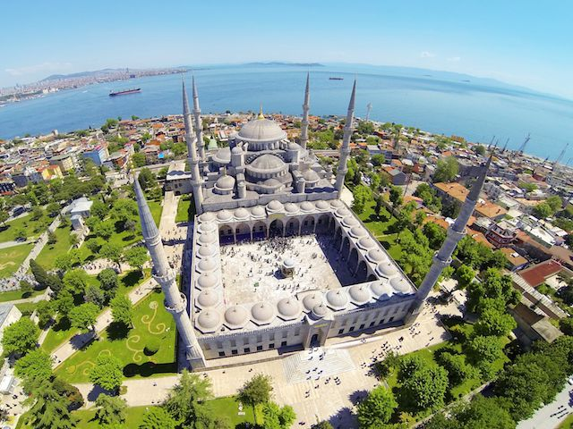
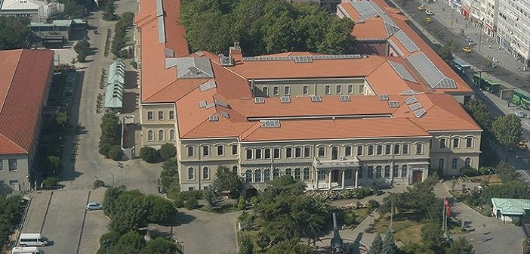
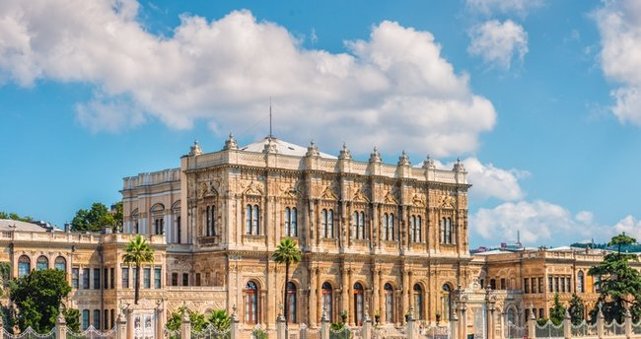
TOURISTIC PLACES
REPUBLIC OF TÜRKİYE
MINISTRY OF NATIONAL DEFENCE
GENERAL STAFF
Blue Mosque
Military Museums
Dolmabahçe Palace

Slide 9
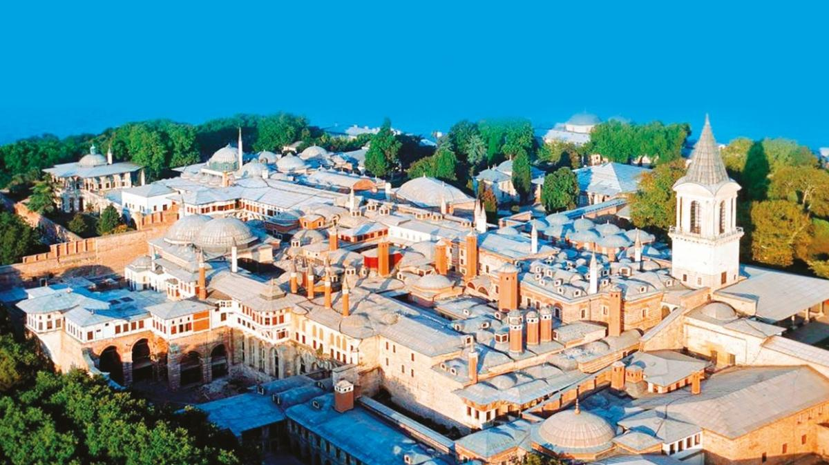
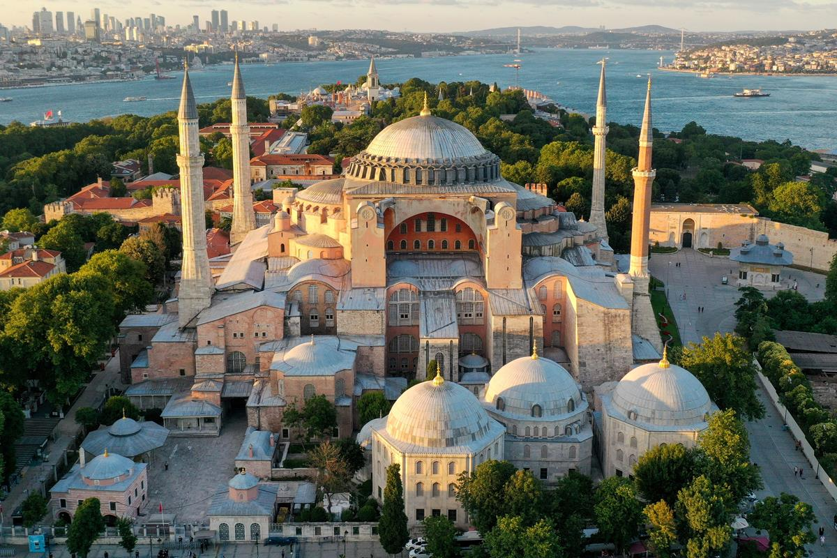
TOURISTIC PLACES
REPUBLIC OF TÜRKİYE
MINISTRY OF NATIONAL DEFENCE
GENERAL STAFF
Topkapi Palace
Hagia Sophia
And many more…

Slide 10
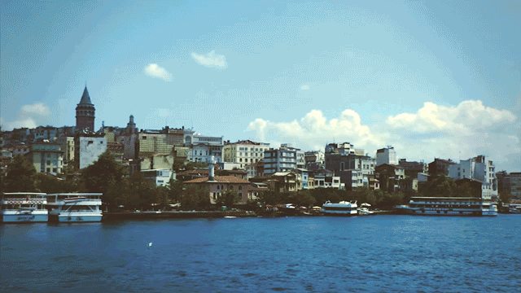
BOSPHORUS TOUR
REPUBLIC OF TÜRKİYE
MINISTRY OF NATIONAL DEFENCE
GENERAL STAFF

Slide 11
TÜRKİYE’YE HOŞGELDİNİZ WELCOME TO TÜRKİYE
REPUBLIC OF TÜRKİYE
MINISTRY OF NATIONAL DEFENCE
GENERAL STAFF

