Slide 1
BILC PROFESSIONAL DEVELOPMENT SEMINAR 2023 BAKU, AZERBAIJAN

Slide 2
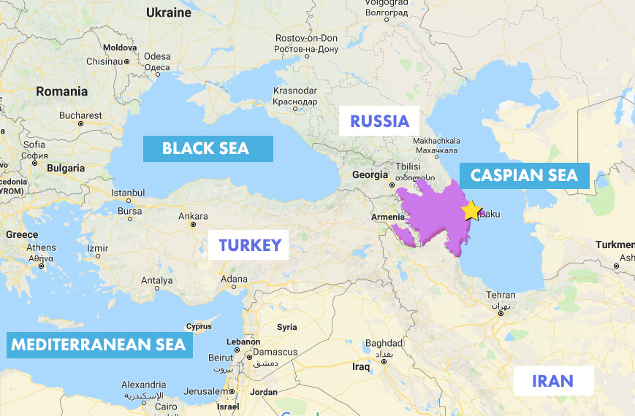

Slide 3
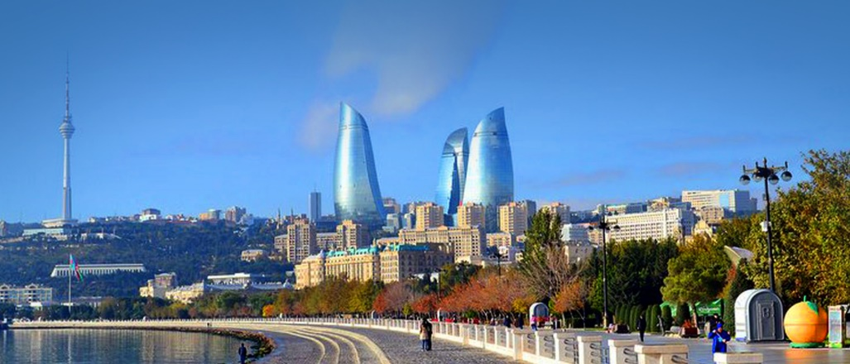
WELCOME TO BAKU

Slide 4
