Slide 1
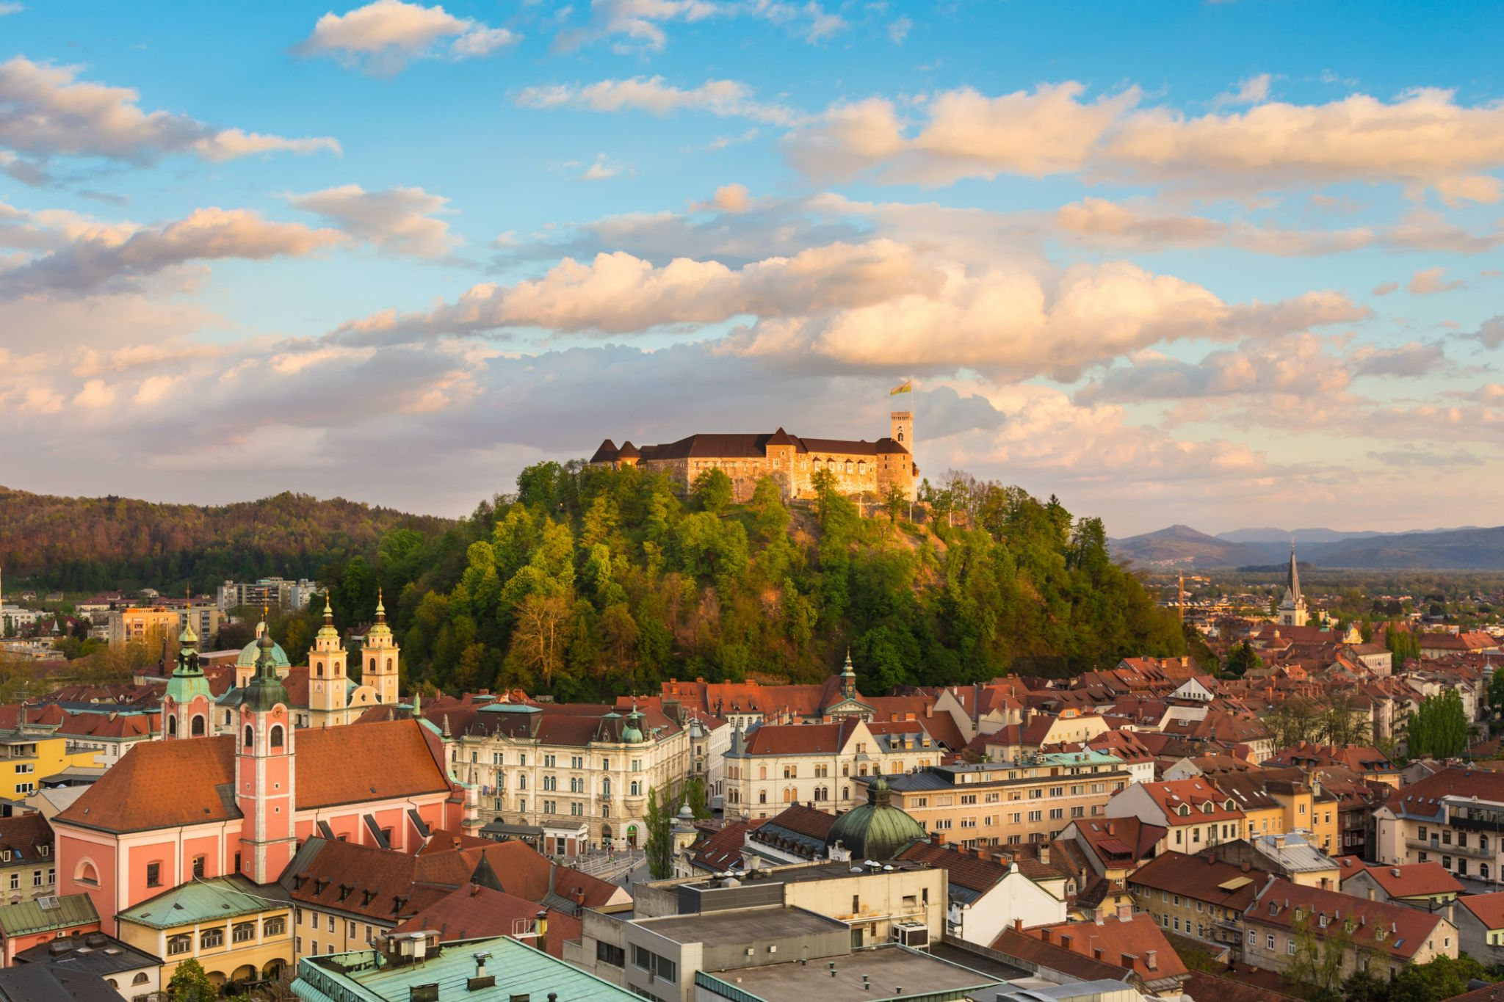
MILITARY TERMINOLOGY CONFERENCE
Giving Meaning to Military Language
Perspectives and Challenges
Branka Petek and Tamara Derman Zadravec
School of Foreign Languages
5 - 7 April 2022
Ljubljana
Slovenia

Slide 2
Challenges
Agreed military terminology is the fundament of interoperability
Military terminology is used in all documents, in military training, daily routines, communication in international military environment, in operations and missions
Development and standardization of military terminology is the responsibility of everyone in defence systems with help and linguistic support of teachers and translators
Military subject matter experts are responsible for the content but linguists take care of development, standardisation and use of proper military terms

Slide 3
Aims of the conference in Slovenia
Bring together military experts and linguists dealing with military terminology for the first time
Provide insight into terminology management and standardization and use of terminology in various (inter-)national contexts
Exchange experience and good practice
Create opportunities for further cooperation

Slide 4
Topics
TERMINOLOGY
MANAGEMENT & STANDARDIZATION & USE
National and international approaches to terminology standardization and management
Aspects of terminology standardization: involvement of SMEs, cooperation, implementation
Terminology in (language) training: resources, tools, material design
Terminology in military setting: interoperability, capability and security aspects
Challenges of terminology development

Slide 5
Achievements
17 nations (members and partners)
3 NATO organizations
More than 50 participants
National and international civilian and military institutions
Language practitioners (terminologists, translators, instructors, proofreaders), military professionals, academia
19 presentations and discussion groups on 3 topics
Networking and cooperation opportunities

Slide 6
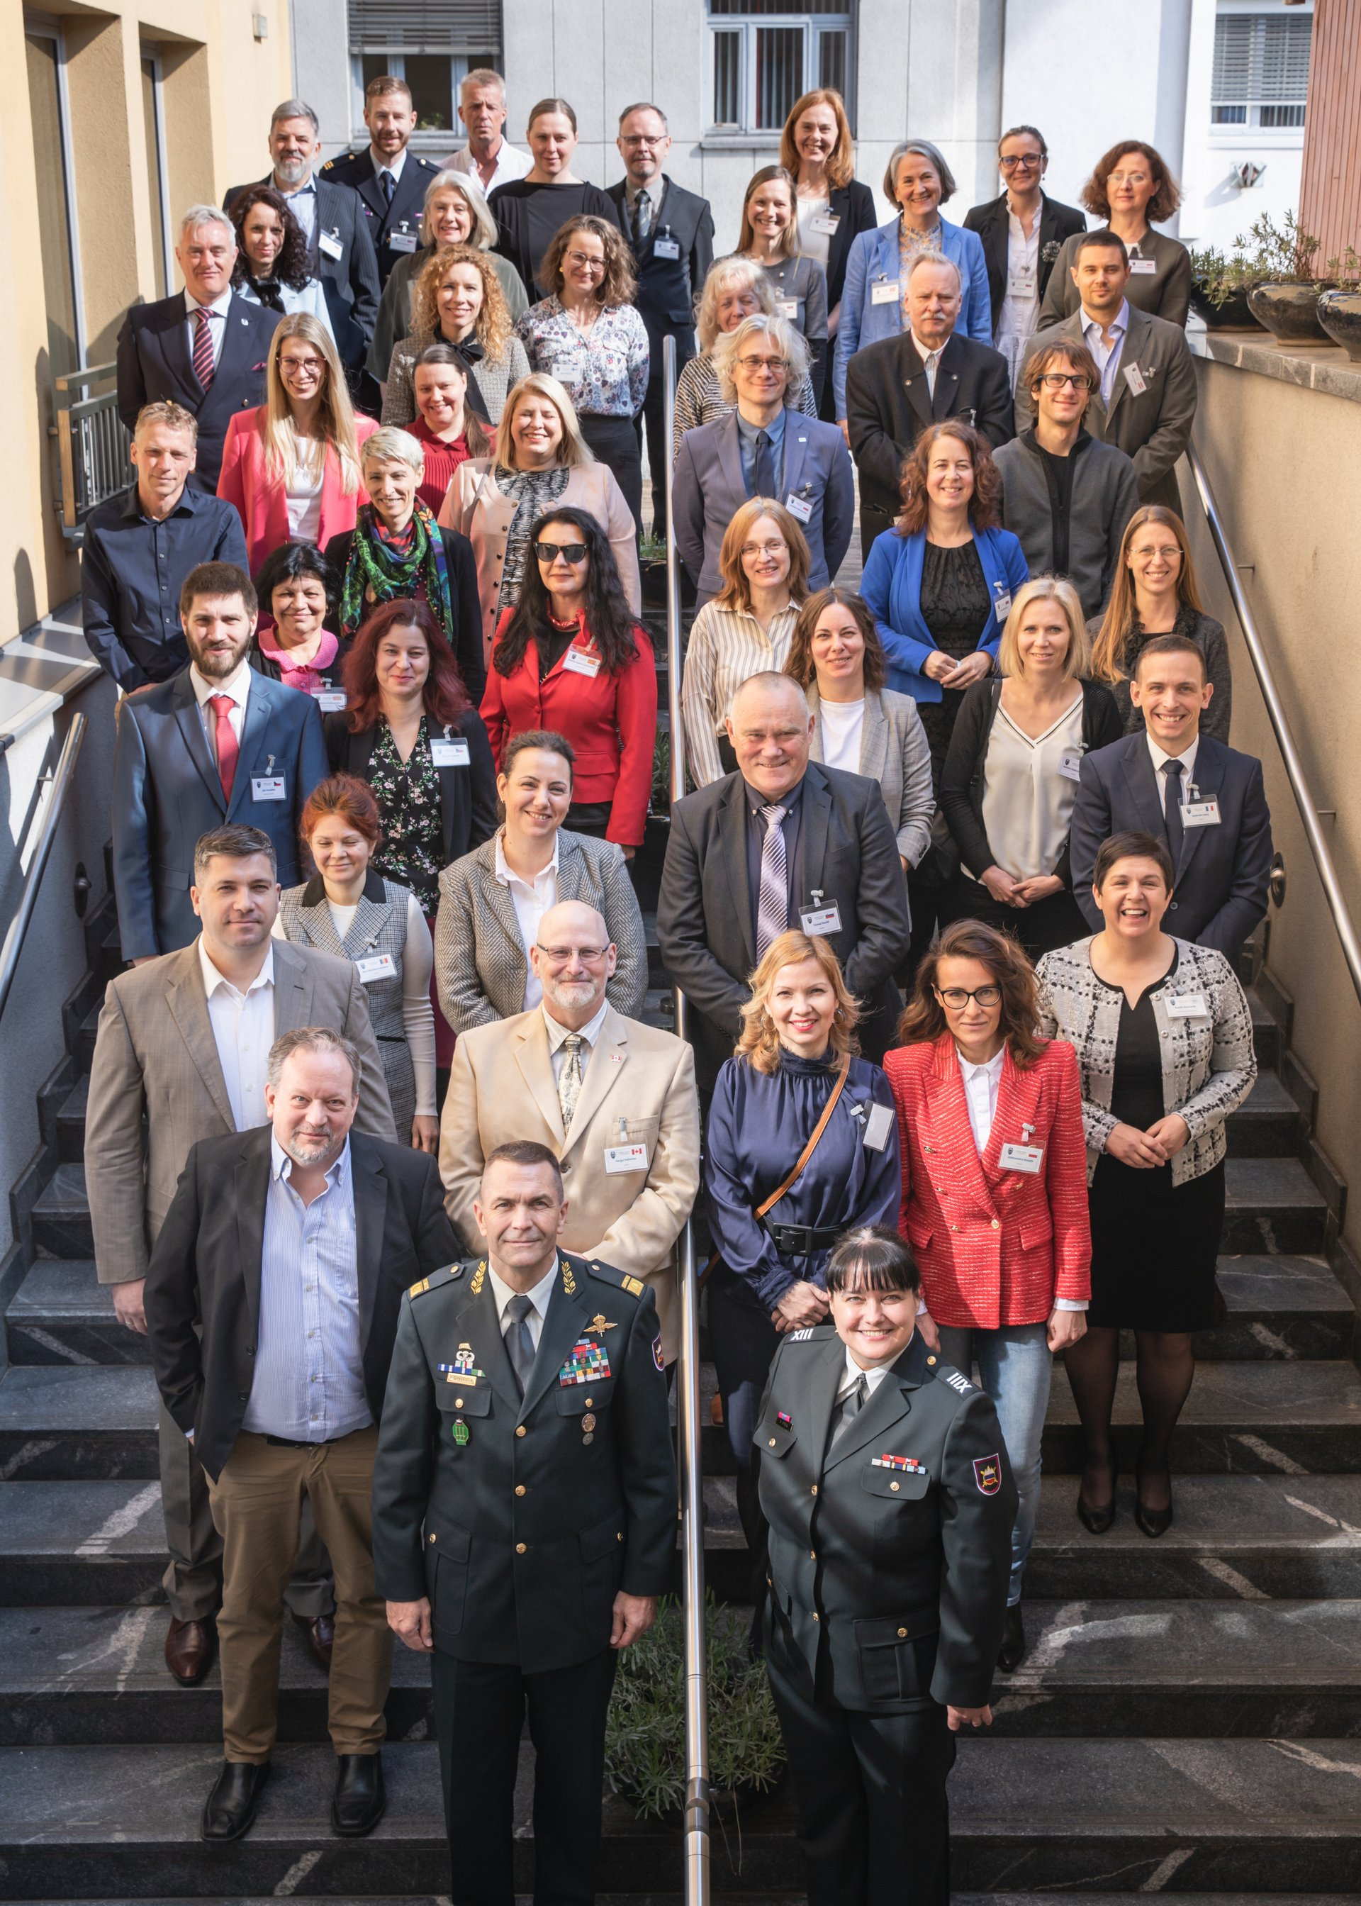

Slide 7
Way Ahead
SPECIFIC ISSUES TO BE CONSIDERED in the future:
- Raise awareness about the importance of terminology in the field of defence
- Integrate translators and terminologists in terminology work to meet the specific needs of the military and training
- Increase involvement of SMEs in terminology development
- Build a multi-language defence termbase (general, area-specific, mission-relevant)
- Create a pool of terminology resources/materials for training purposes
- Enable access to authentic materials through exchange programmes
- Facilitate research on military terminology
- Provide basic training in terminology development

Slide 8
Slovenian Armed Forces
School of Foreign Languages
Translation, Interpreting and Proofreading Department
Poljče 28, 4275 Begunje na Gorenjskem, Slovenia
e-mail: tamara.derman.zadravec@mors.si
T: +386 4 532 3725

