Slide 1
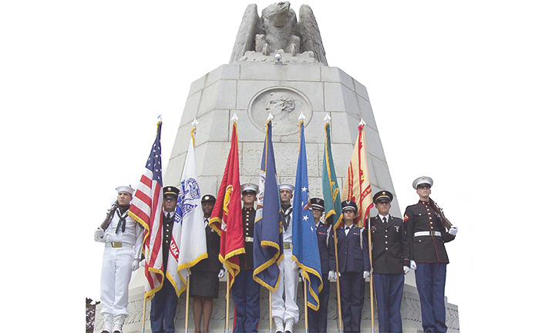
DLIFLC
Isolation Immersion Overview
NATO-BILC Professional Seminar
OCT 2024

Slide 2
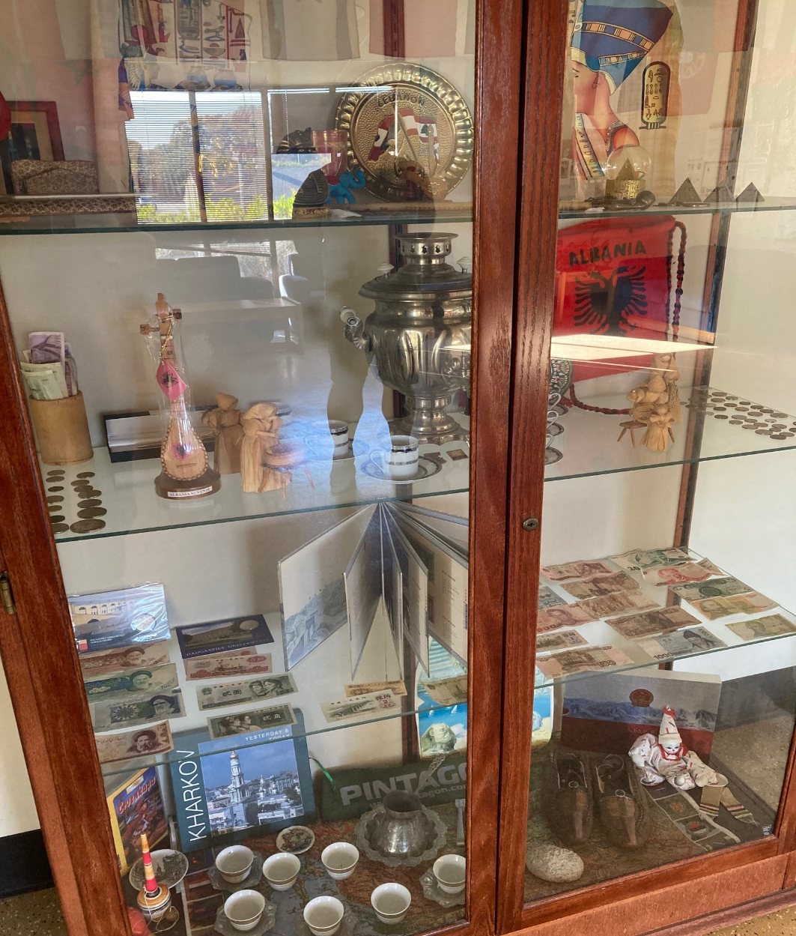
Presentation Overview
Immersion philosophy
Immersion statistics
Immersion environment
Immersion overview
Immersion schedule
Immersion surveys

Slide 3
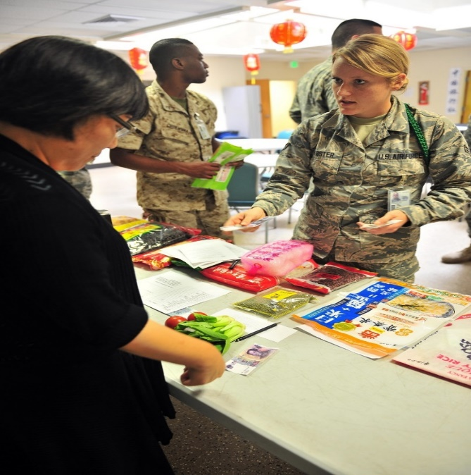
Iso-Immersion Philosophy
Remove our students from any and all exposure to English and have them conduct real-life tasks using the target language
The DLI Iso-immersion facility is an ideal environment for accomplishing this goal.

Slide 4
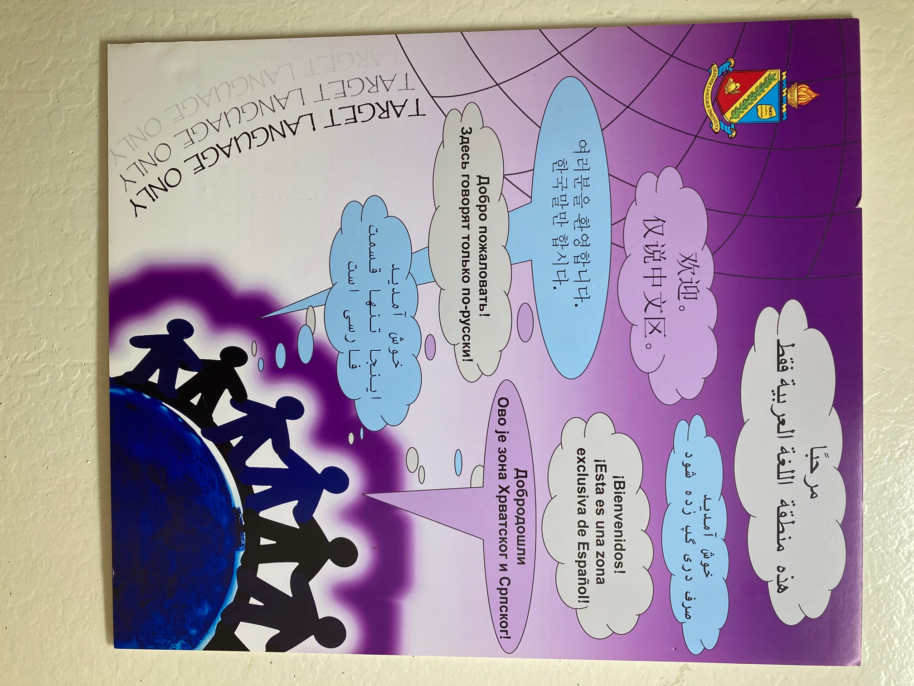
Iso-Immersion Philosophy

Slide 5
Iso-Immersions by FY
FY | # Events | # Students
2007 | 152 | 3,415
2008 | 183 | 3,713
2009 | 178 | 3,165
2010 | 213 | 3,688
2011 | 208 | 3,917
2012 | 252 | 4,295
2013 | 262 | 4,000
2014 | 253 | 4,002
2015 | 237 | 4,347
2016 | 240 | 4,257
FY | # Events | # Students
2017 | 251 | 3,752
2018 | 259 | 3,957
2019 | 260 | 4,071
2020 | 251 | 3,752
2021 | 255 | 3651
2022 | 415 | 4591
2023 | 426 | 5012
2024 | 447 | 5469
Total | 4,491 | 69,302
Notes:
FY 17, first two quarters, 120 events and 1849 students

Slide 6
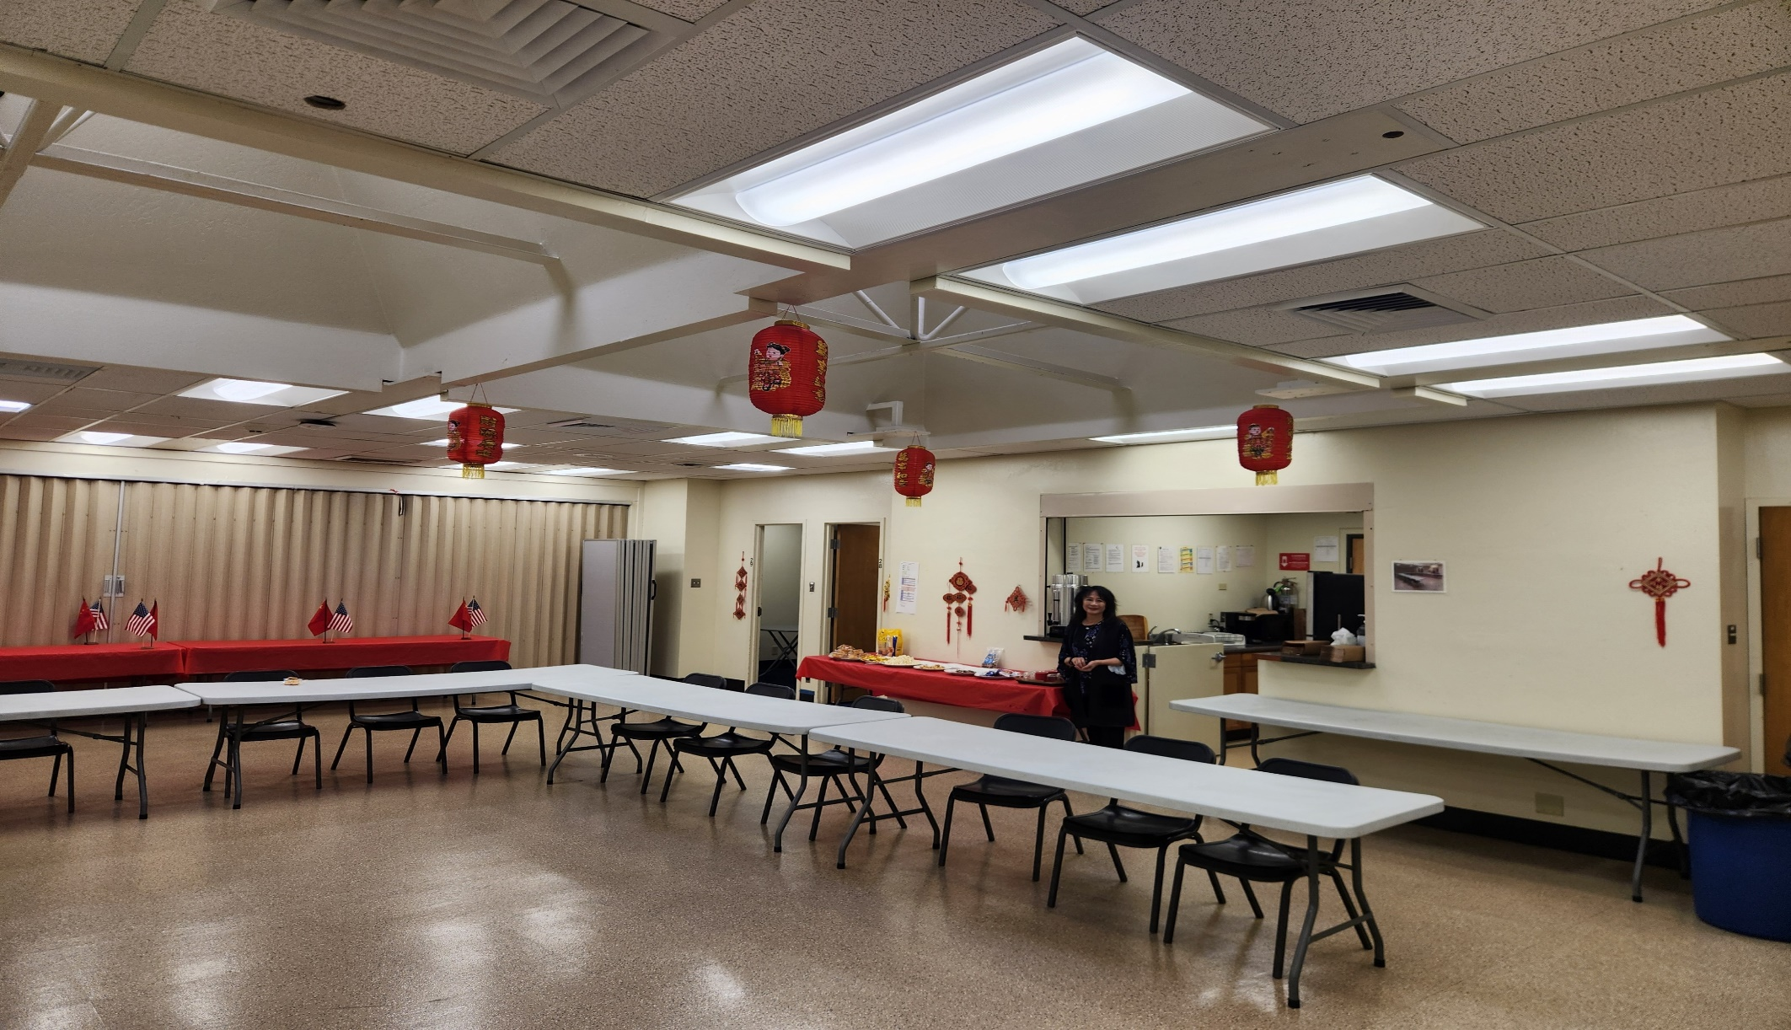
Iso-Immersion Environment

Slide 7
Iso-Immersion Environment

Slide 8
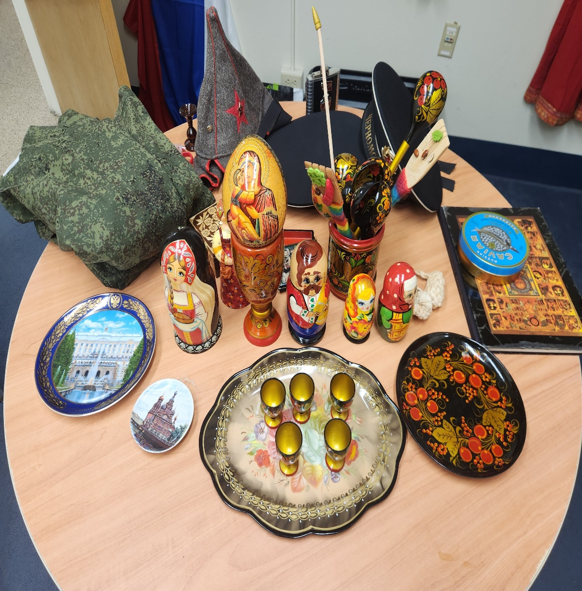
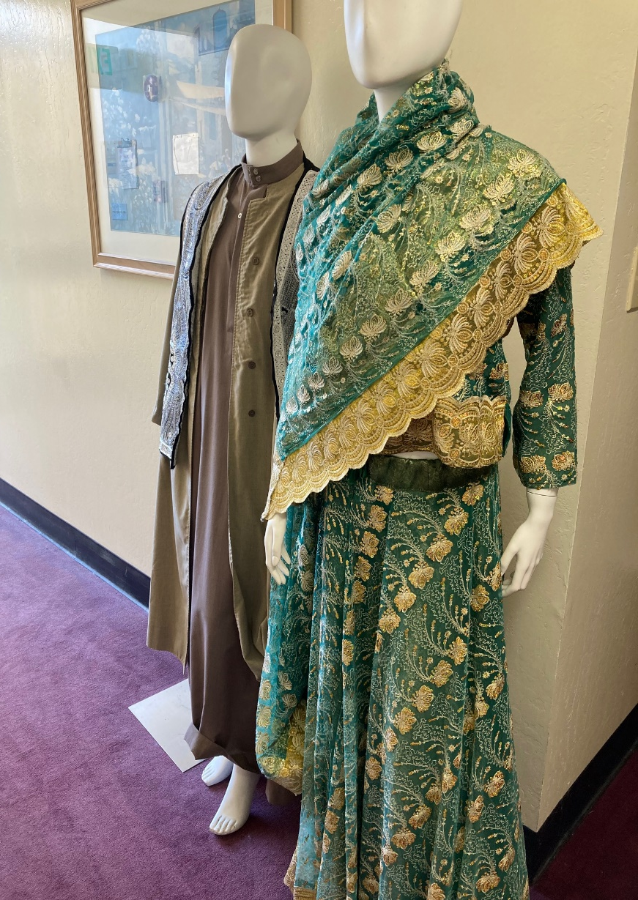
Iso-Immersion Environment

Slide 9
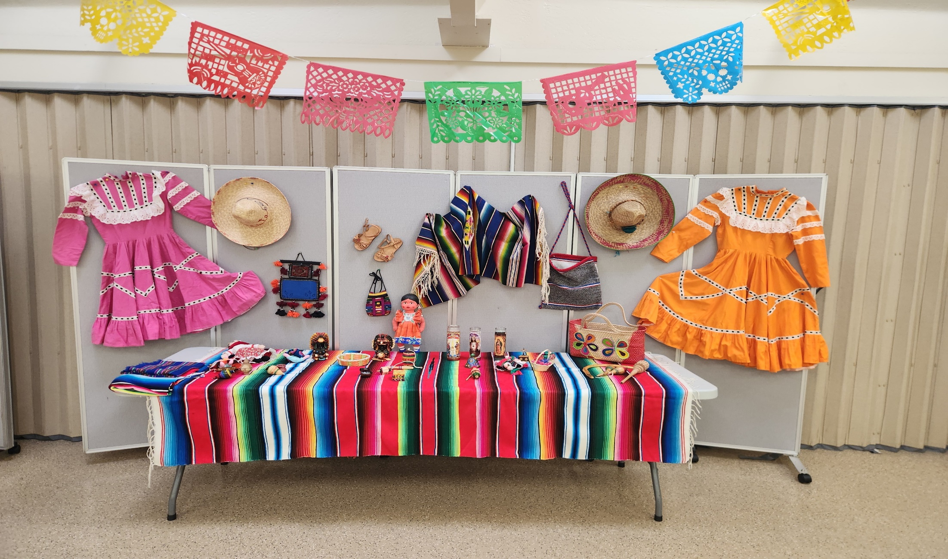
Iso-Immersion Environment

Slide 10
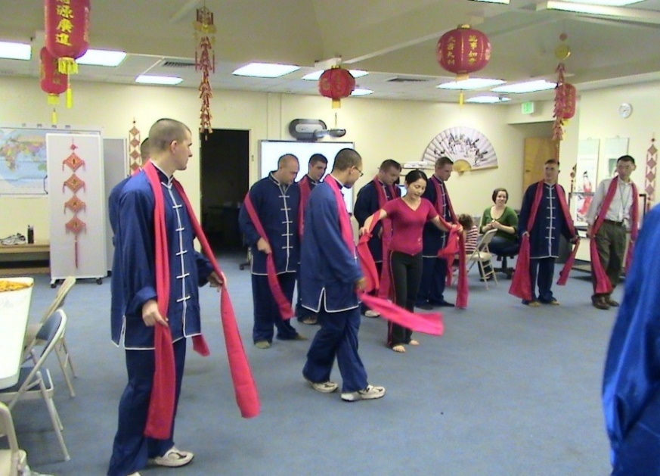
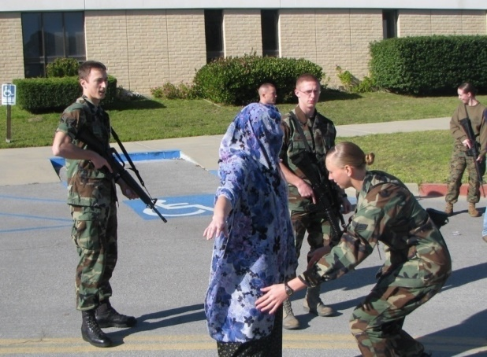
Iso-immersion Activities Overview
Semester I:
One Day (Cultural immersion)
Semester II: Two days
Day 1: Cultural immersion
Day 2: Mission-related training (STX)
Semester III: Two days
Day 1: Cultural immersion
Day 2: Mission-related training (STX)
Target Language ONLY/ Exposure
to Culture

Slide 11
Immersion Topics

Slide 12
Sample Immersion Schedule
Objectives:
To provide students with an environment where the target language must be used in simulated real-life situations through the immersion setting
To use Tagalog exclusively in a wide variety of activities designed to encourage maximum participation among all students
To reinforce lessons, content and vocabulary learned in class and further develop students’ language skills through the use of simulated real-life situations
Participating Class:
10 Students
Date & Time:
Friday, 22 OCT 2021, 0755-1500
Students participating in class immersion activities will complete the assigned tasks with their teachers

Slide 13
Sample Immersion Schedule

Slide 14
Sample Immersion Schedule

Slide 15
Sample Immersion Schedule

Slide 16
Sample Immersion Schedule

Slide 17
Sample Immersion Schedule

Slide 18
Sample Immersion Schedule

Slide 19
Immersion Language Office

Slide 20
Student Survey Results

Slide 21
Student Survey Results

Slide 22
Student Survey Results

Slide 23
Survey Comments

Slide 24
DLIFLC Immersion Language Office

