Slide 1
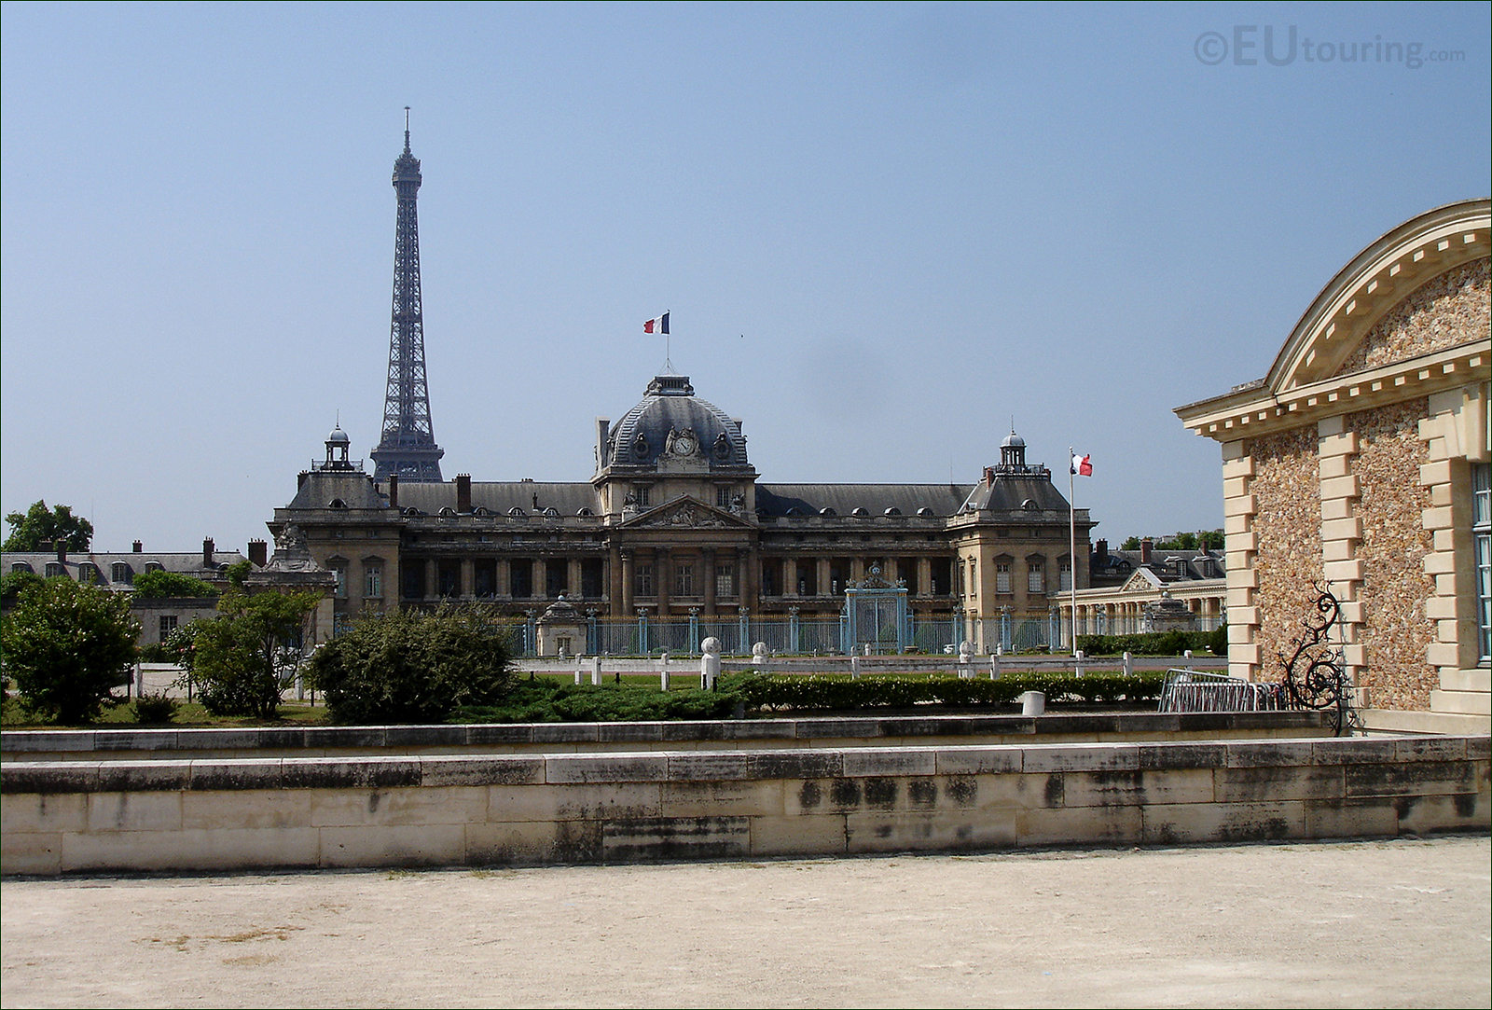
Multilingualism in an International Context
Jérôme COLLIN – Département langue française – Ecole de guerre

Slide 3
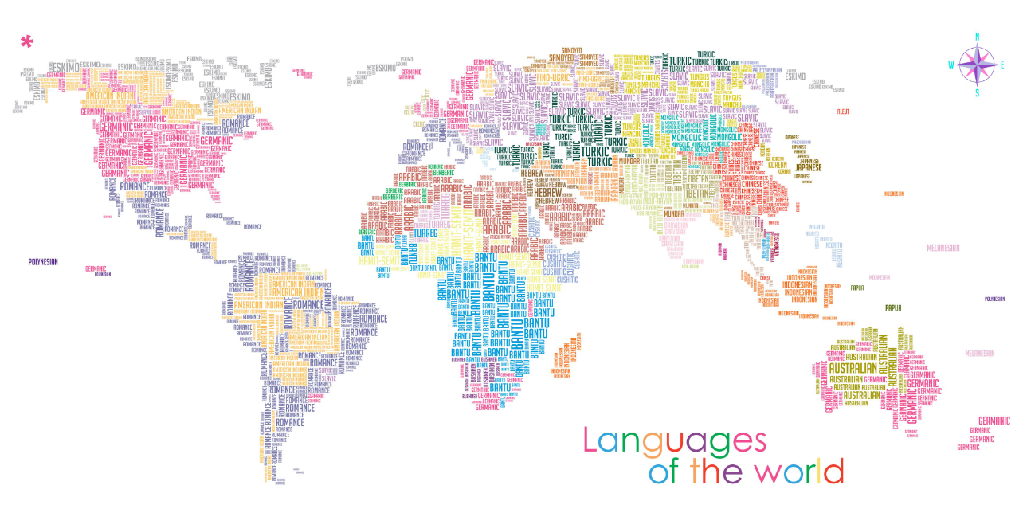

Slide 4
8 OFFICIAL LANGUAGES
24 OFFICIAL LANGUAGES
Working languages :
English – French
2 OFFICIAL LANGUAGES
Working languages :
English – German – French
Working languages :
English – French
Working languages :
English – French

Slide 5
English
English
English
English

Slide 6
Trilingualism
Local language

Slide 7
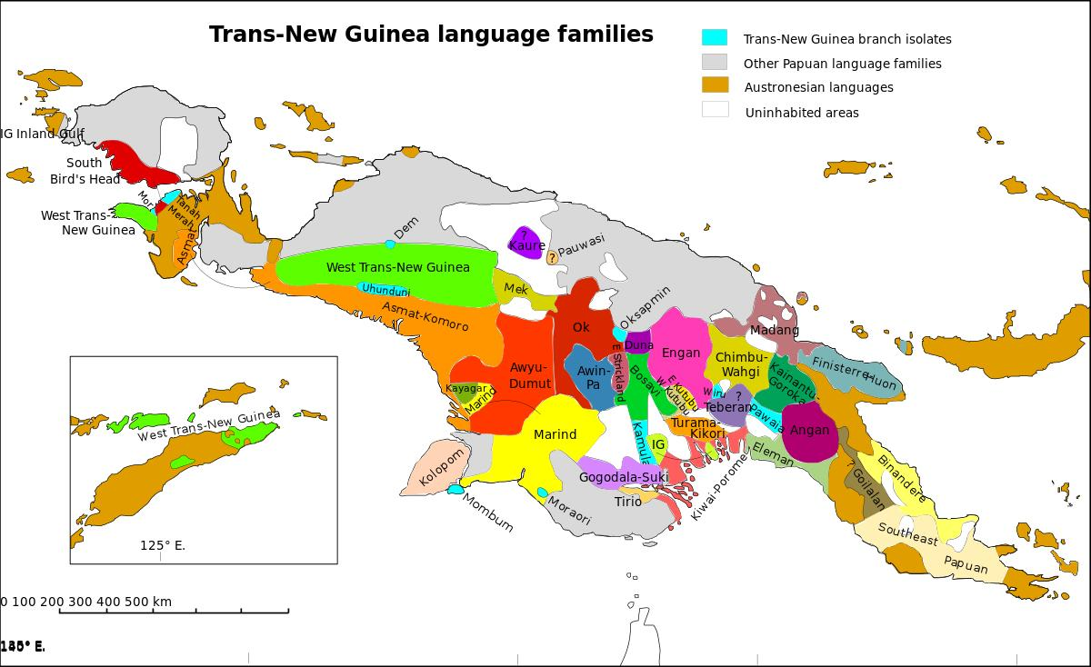

Slide 8
Trilingualism
Local language | Administrative language

Slide 9
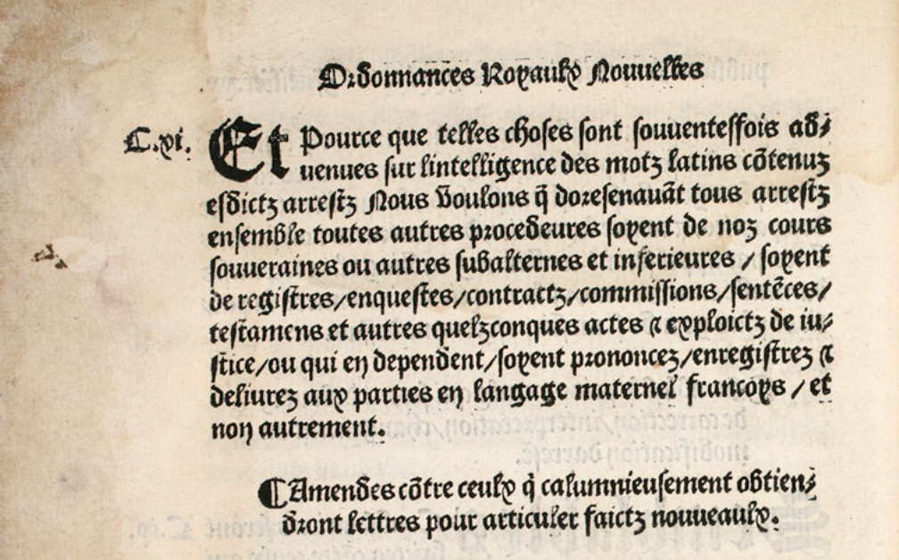

Slide 10
Trilingualism
Local language | Administrative language | Scholarly language

Slide 11
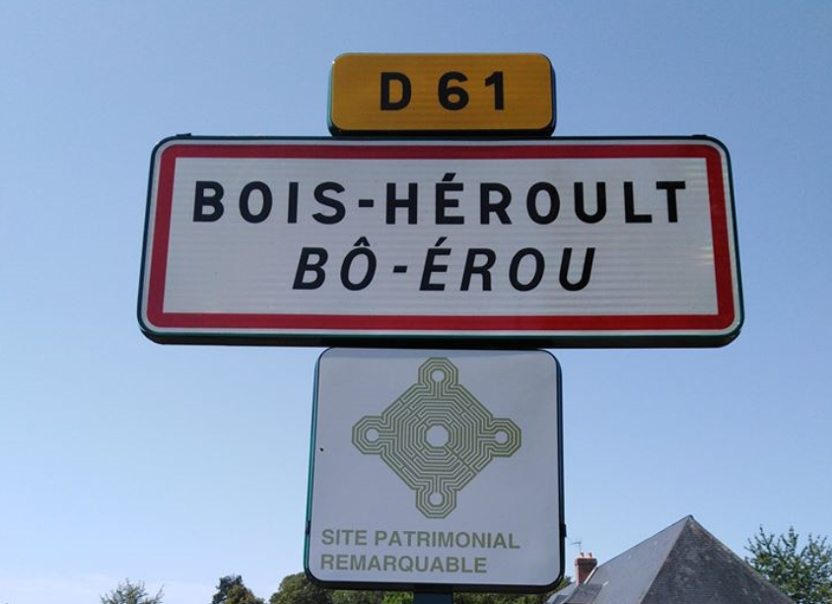
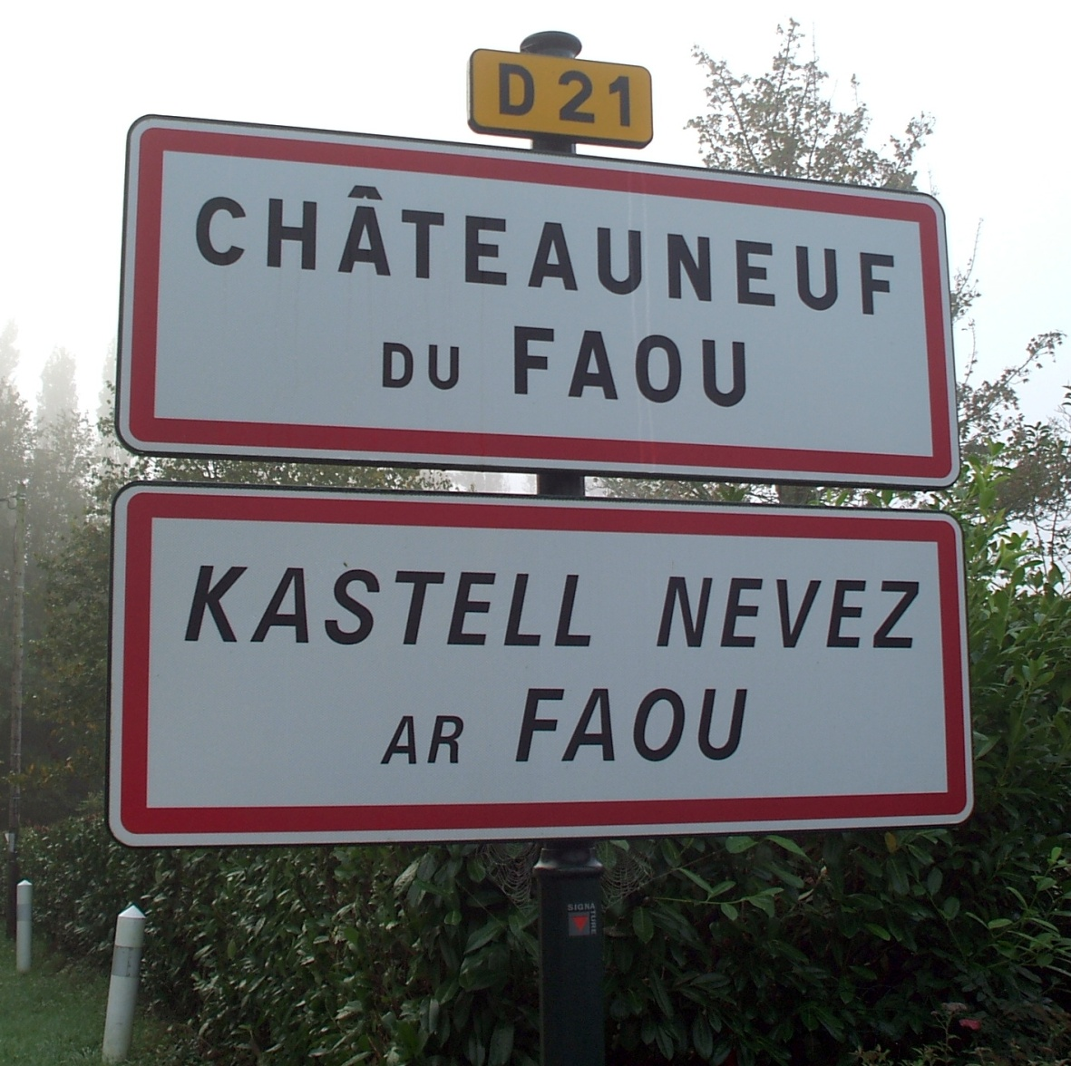
Breton
Norman

Slide 12
Trilingualism
Local language (Alsatian) | Administrative language (French) | Scholarly language (English)

Slide 13
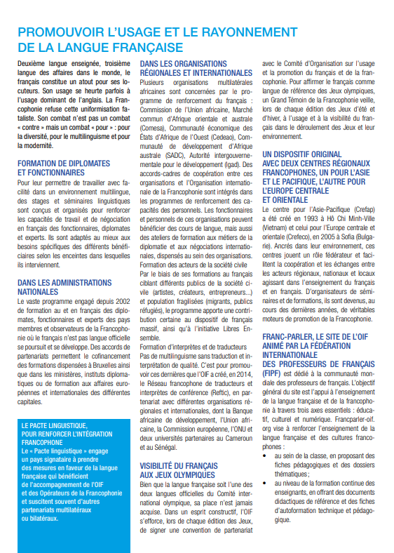

Slide 14
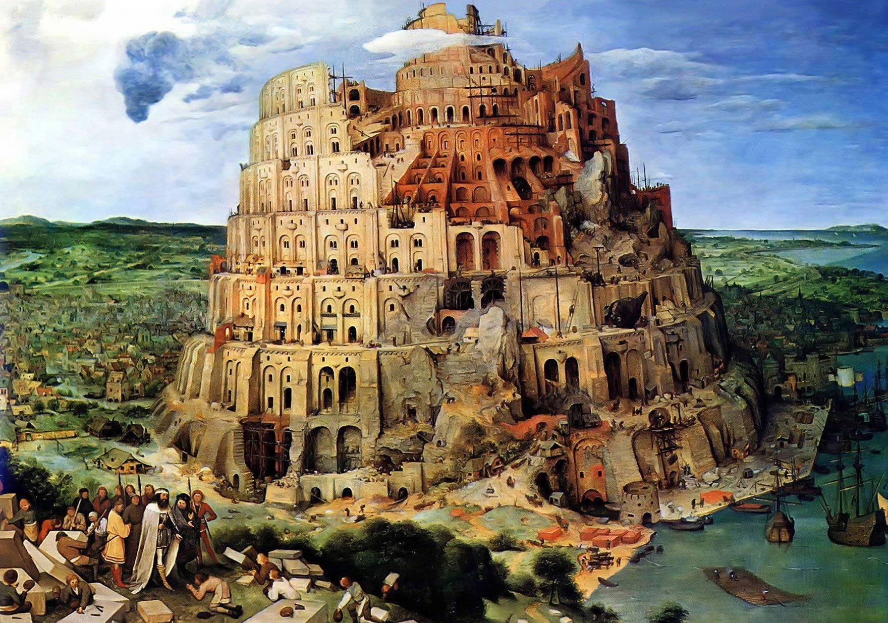

Slide 15
English
English
English
English

Slide 16
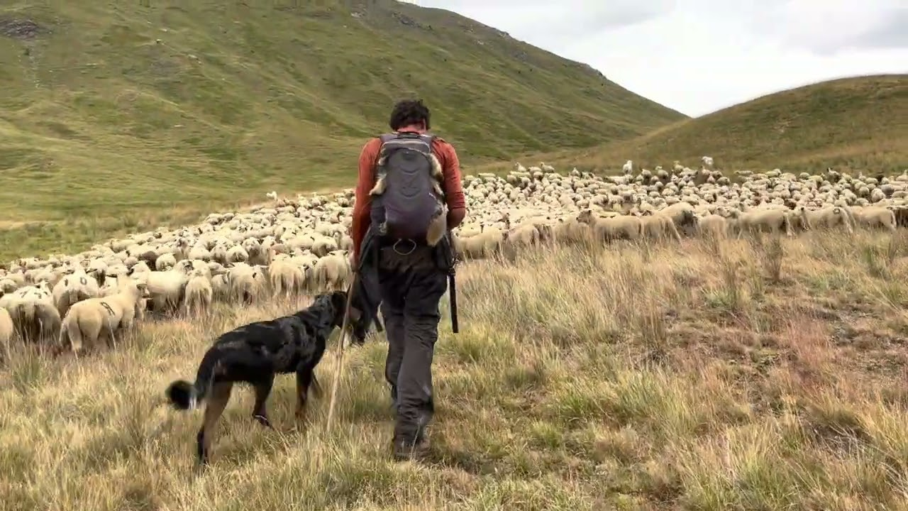
AGIR
Agere / agein
HANDELN
Hand

Slide 17
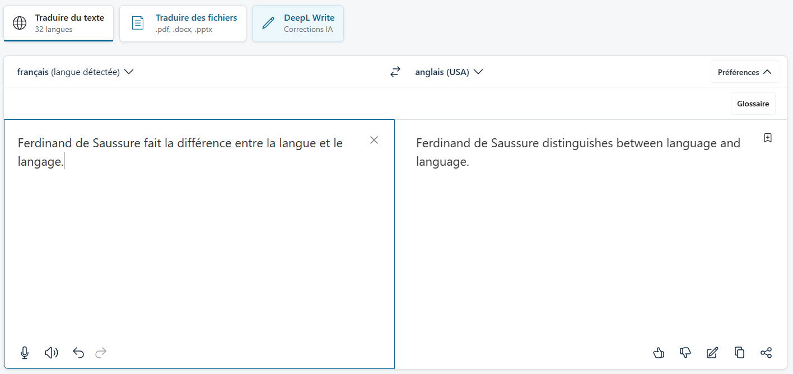

Slide 18
Multilingual Writing

Slide 19
Multilingual Writing
Multilingual Writing Group

