Slide 1
NATO BILC 2022
Scott Manuel – Swedish Armed Forces
Learning Strategies: Can We Develop Knowledge Retention on Military Courses?

Slide 2
Areas of focus
My career within education/training
The issues I faced
Finding the key to my Swedish language learning
Using learning strategies to influence my teaching
How to progress from here

Slide 3
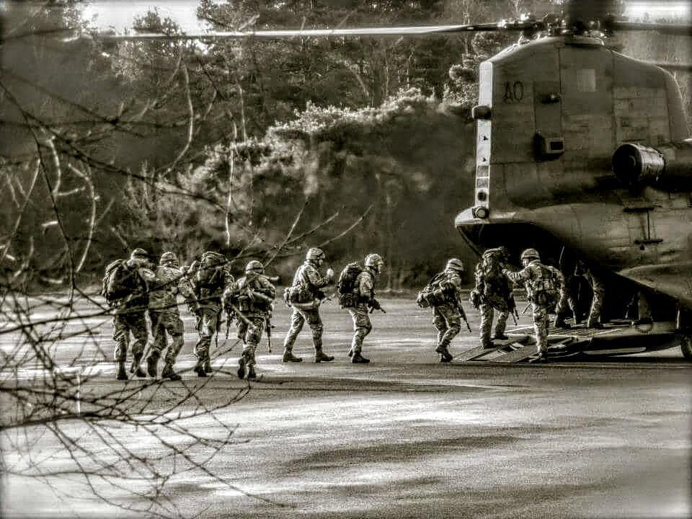
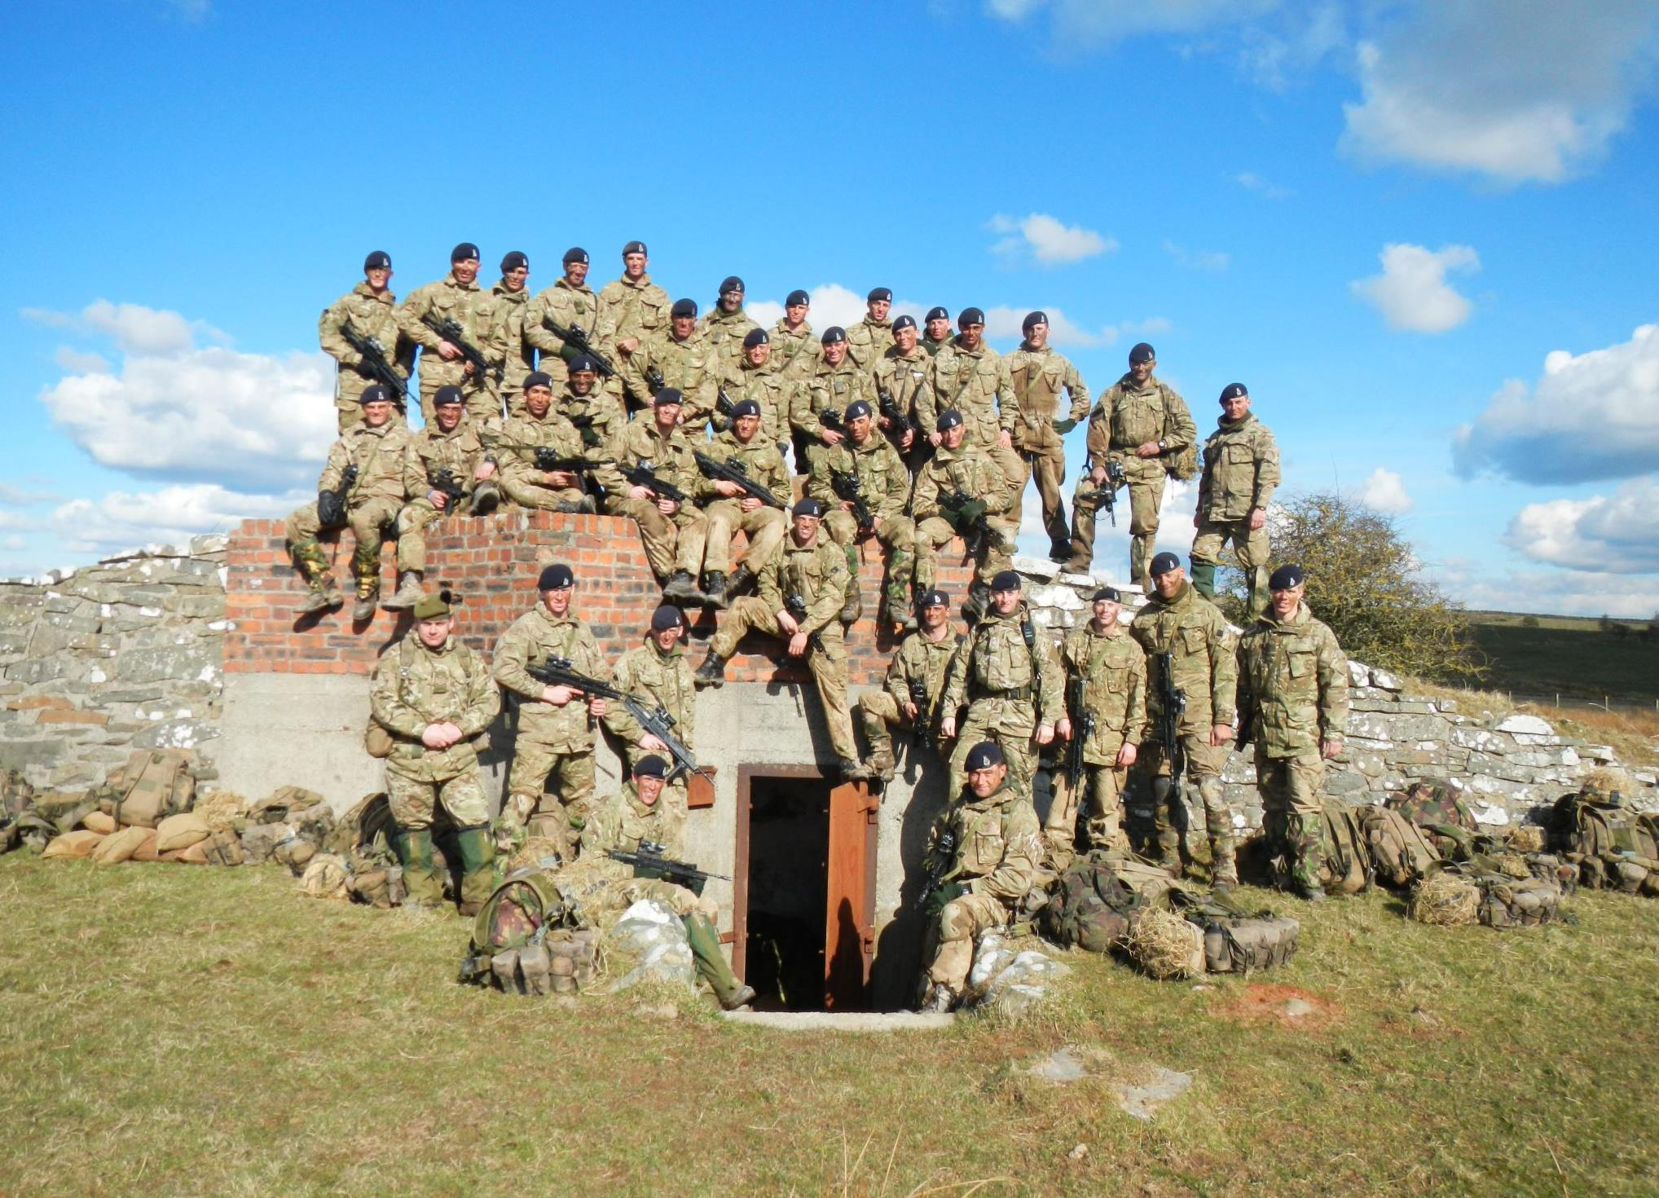
Career within Education
Royal Military Academy Sandhurst (British Army)
Educational and Training Services (ETS)
Civilian Physical Education (P.E.) Teacher
Military Academy, Halmstad (Swedish Armed Forces)
Future intention to complete military training in 2023 as a Reservist

Slide 4
The Issue I Faced
The rate and speed of information delivery, and the infrequency of revisiting it meant my brain couldn't keep up
Not fully understanding how I learn best was something mirrored with students I had worked with
Knowledge
Time
Notes:
Discuss issues I faced in the military here instead

Slide 5
Spaced Repetition System (SRS)
Sebastian leitner, 1970s
Spaced repetition – flashcards reviewed at increasing intervals
Notes:
Discuss issues I faced in the military here instead

Slide 6
The SRS System
Greater chance of recall
Level 1
- See the word
Level 2
– Write the word
Level 3
- Say the word
Level 4
- Link to a picture/memory
Category
1
- Every day
Category
2
- Every 3 days
Category
3
- Every 7 days
Highest Category
- Once a year or longer
Notes:
Tough upon SRT but make second PpT that changes days to periods in a lesson and the weeks after. Highlight memory recall.

Slide 7
Shadowing a Damage Vocabulary Lesson
20-40% on average
Number of students
Percentage of correct answers
Notes:
Make clearer and disciss how it was used.

Slide 8
Using Spaced Repetition to Shape My Lesson
1st activity, break
Recall, activity, break
Recall and test following lesson
Category
1
- Every day
Category
2
- Every 3 days
Recall,
activity, finish
Category
3
- Every 7 days
Highest Category
- Once a year or longer
Cadets were taught about SRS at the beginning of the lesson (alongside other strategies), then I took the idea of information recall, learning intervals and personal association and created the lesson structure that demonstrated the technique in some form
Notes:
Tough upon SRT but make second PpT that changes days to periods in a lesson and the weeks after. Highlight memory recall.

Slide 9
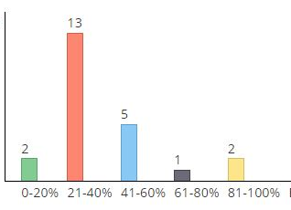
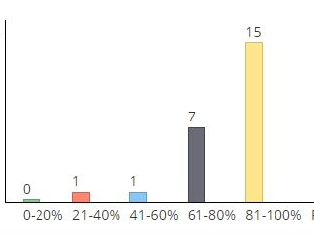
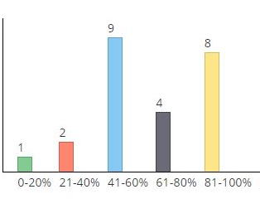
Damage Vocabulary – Aircraft Technicians
Lesson 1 – Taught as per shadowed lesson
Lesson 2 – Taught with SRS concepts
Lesson 3 – quick recall, revise and test (2 weeks later)
Number of students
Percentage of correct answers
Notes:
Make clearer and disciss how it was used.

Slide 10
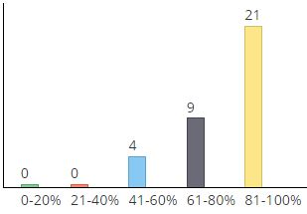
Lesson Last Week with Ground Mechanics
Lesson taught with SRS concepts last week – minus on the shadowed lesson (lesson 1)
Follow up lesson to be delivered next week
Number of students
Percentage of correct answers
Notes:
Make clearer and disciss how it was used.

Slide 11
Lessons Learned
Quality Instruction
Self-Aware Learners
Effective Course
Notes:
Discuss my issues at RMAS and beyond, say how the military invests in teaching methods and how I was able to tske some ideas from Fluent Forever and language learning.

Slide 12
How to progress From Here...
Pre-course resources and offer an optional learning strategy workshop
Provide resources within lessons
Develop our own knowledge of learning strategy for further implementation
Tailor the course timetable to allow us to use recall and recap on topics covered in other departments
Notes:
Highlight how it was just food for thought

