Slide 1
Language acquisition dynamics in Polish-Ukrainian intermediate level group
mgr Gabriel Skitaniak
Lecturer
Foreign Languages Department
General Tadeusz Kościuszko
Military University of Land Forces

Slide 2
PRESENTATION OVEVIEW
Characteristics of the group
The course of the course
Findings
Bibliography

Slide 3
THE AIM OF THE PRESENTATION
to outline the characteristics of the group
to share the experience
to show the present possibilities and challenges
to share good practices
to receive feedback from the audience

Slide 4
CHARACTERISTICS OF THE GROUP

Slide 5
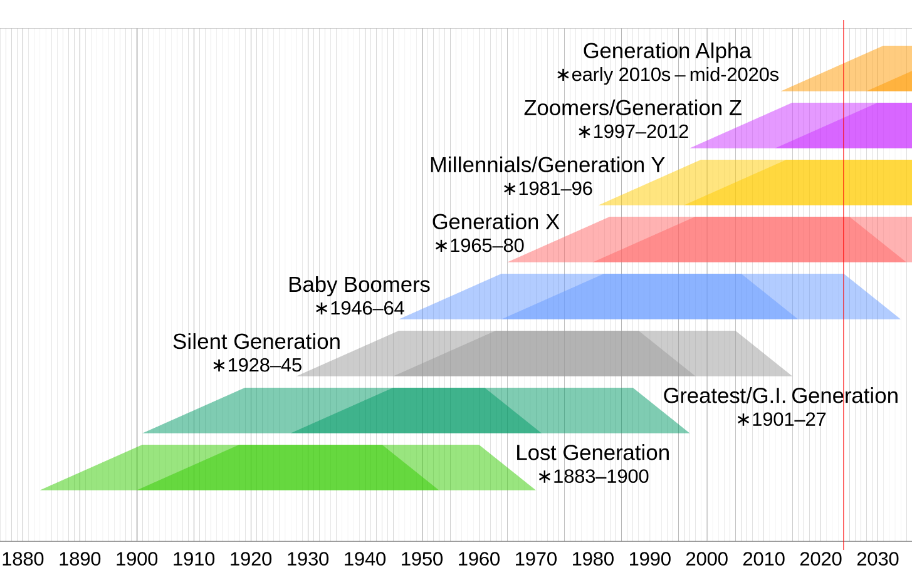
CHARACTERISTICS OF THE GROUP
Timeline of generations in the Western world
adapted from Wikipedia

Slide 6
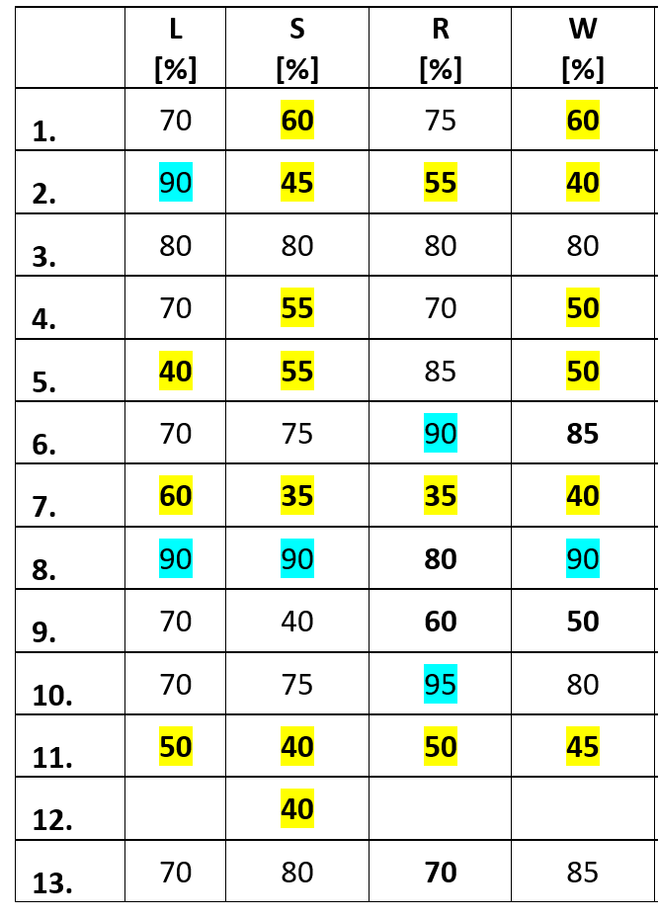
CHARACTERISTICS OF THE GROUP
Results of the midterm evaluation

Slide 7
THE COURSE OF THE COURSE
5-month course
6-7 lessons a day in 3 blocks
5 days a week
3 teachers
4 evaluation tests

Slide 8
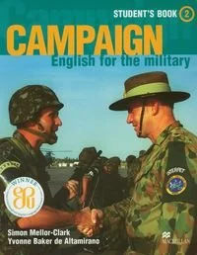
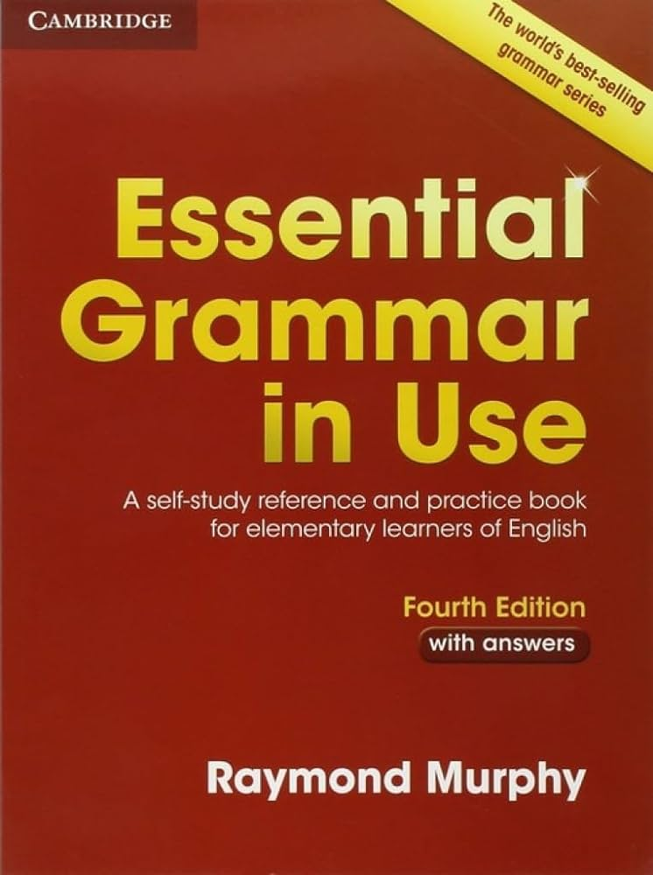
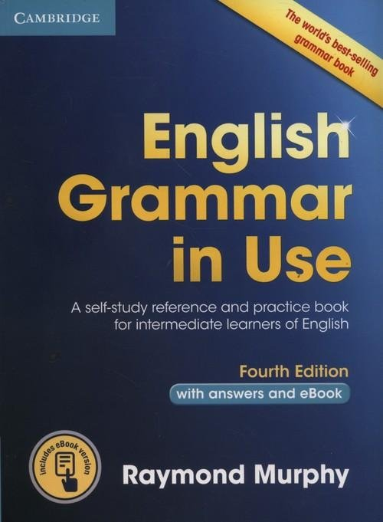
THE COURSE OF THE COURSE

Slide 9
THE COURSE OF THE COURSE

Slide 10
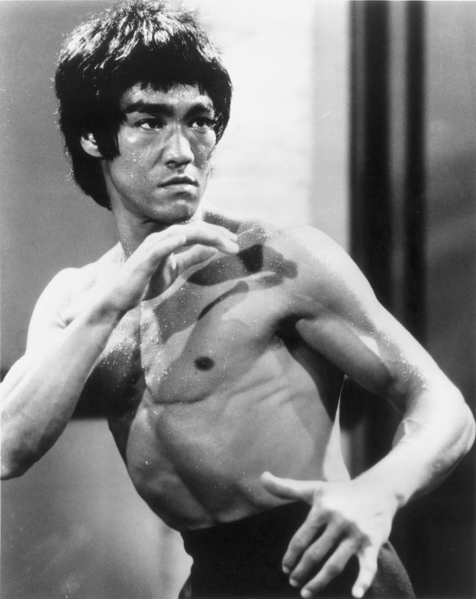
THE COURSE OF THE COURSE
„We don’t see the battle of the methods any more”

Slide 11
FINDINGS
General findings:
positive attitude
common struggle with grammar

Slide 12
FINDINGS
Possibilities
great language exposition
natural need for communication
task-oriented learning

Slide 13
FINDINGS
Challenges:
initial differences in linguistic competences
different level of intake capabilities
significant pronunciation problems

Slide 14
FINDINGS
Good practices:
rotation
short tests
homework
whole class speaking
memorizing texts
individual work

Slide 15
FINDINGS
Memorizing
Tell me about your last party.
Two months ago I was in Zakopane with my girlfriend. We were celebrating my friend’s birthday in “Sielski Dwór”.
We were eating traditional Polish dishes and drinking Polish vodka. After dinner we were dancing and singing karaoke.
The atmosphere was just amazing.
It was the best party I have ever been to.

Slide 16
FINDINGS
Memorizing
What do you do in your free time?
I don’t really have a lot of free time but when I do I usually meet my friends. We hang out in the city center and most of the times we go to a pub or a club to dance and drink something.
I also try to keep fit so I try to move as much as I can. I often go running in the nearby park. When I’m really tired I just go for a short walk. Sometimes I go to the gym and work out.

Slide 17
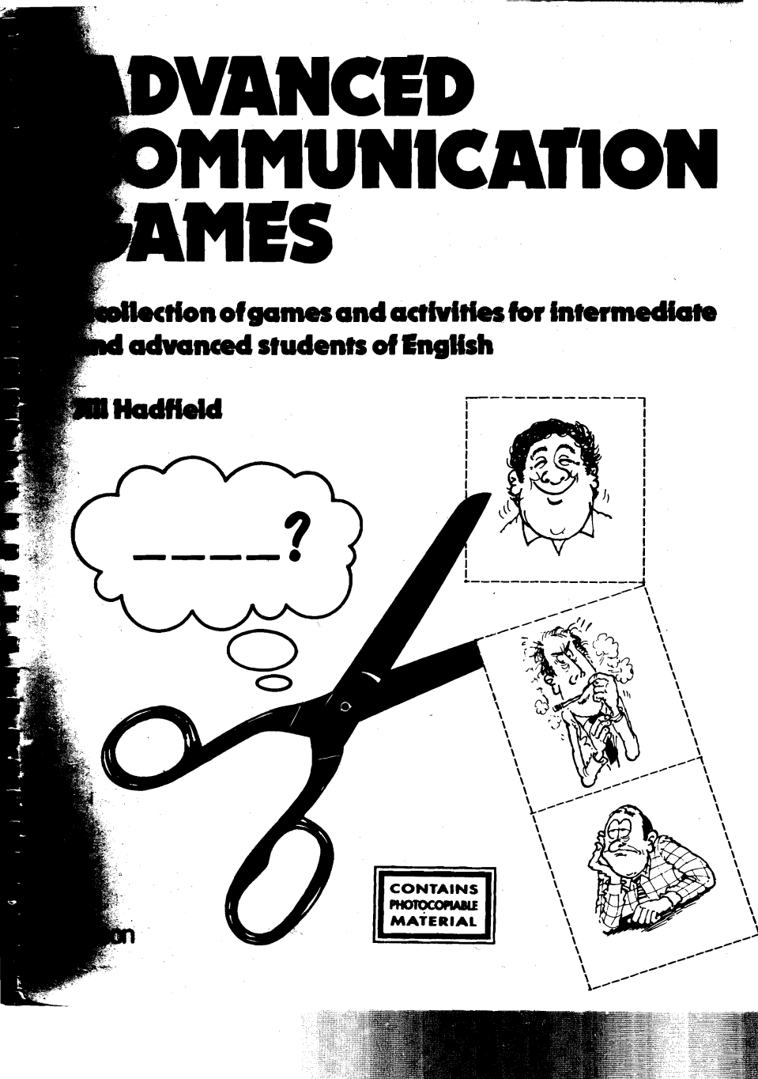
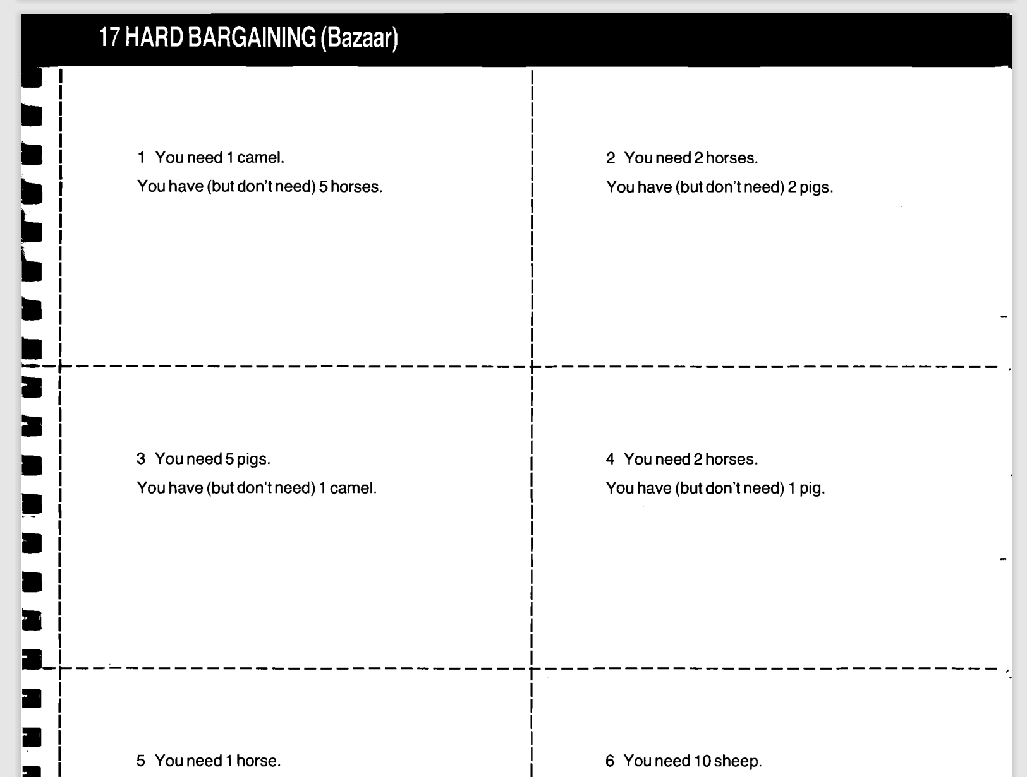
FINDINGS
Speaking practice

Slide 18
FINDINGS
Online resources
https://test-english.com http://www.english-practice.at https://www.perfect-english-grammar.com

Slide 19
BIBLIOGRAPHY
Mellor-Clark, S. and Baker de Altamirano, Y. (2004) Campaign 2 – English for the Military. Student’s Book, Macmillan Publishers Limited
Latham-Koenig, C., Oxeden, C. and Lambert J. (2019) English File fourth edition. Intermediate. Student’s Book, Oxford University Press
Murphy, R (2007) Essential Gammar in Use. Third edition. Cambridge University Press
Murphy, R (2012) English Gammar in Use. Fourth EditionCambridge University Press
Hadfield, J. (2003) Intermediate Grammar Games. Pearson Education Limited
Hadfield, J. (1988) Advanced Communication Games. Nelson

