Slide 1
BL update from the Australian Defence Force School of Languages
The use of social apps, Articulate Storyline, comics making apps, H5P and AARP technology on DFSL courses
By DFSL Head of Development
Anya Ivanova

Slide 2
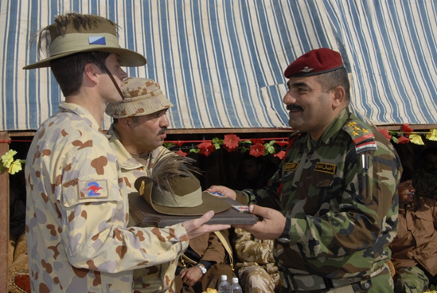
DFSL Mission
To train and assess Defence personnel in languages other than English to enhance Defence capability.

Slide 3
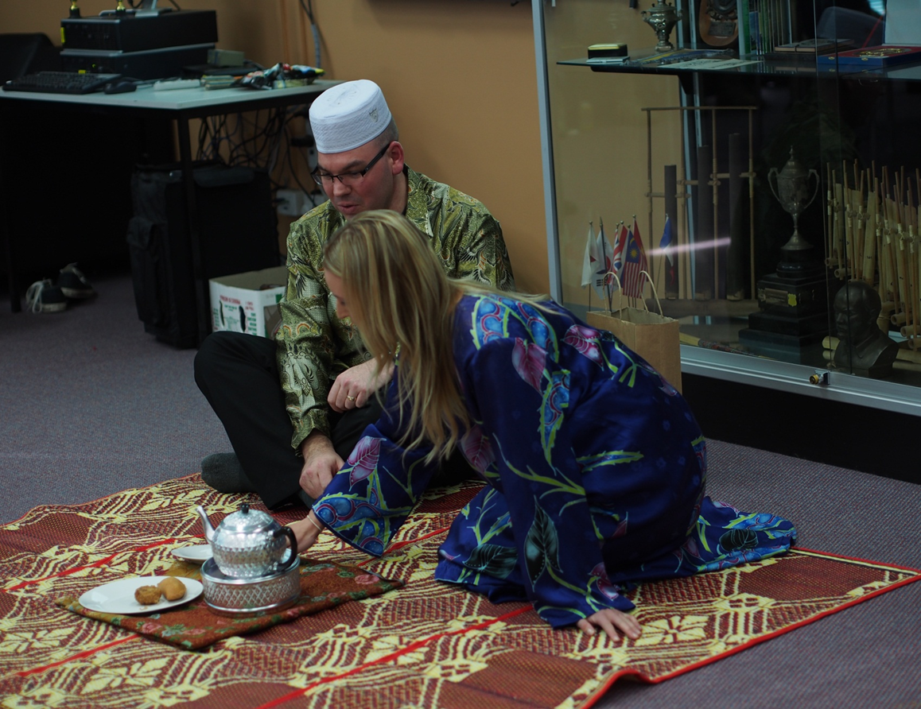
In-house course design and development
Our own material
Foundation stream
Workplace task based stream
Our own teaching
methods

Slide 4
Teaching methods
DFSL recognises merits of a range of teaching approaches and methodologies
Some examples: communicative approach, direct method, bilingual method, elements of audio-lingual method, situational language teaching, TPR, Silent Way, etc.
Blended Learning

Slide 5
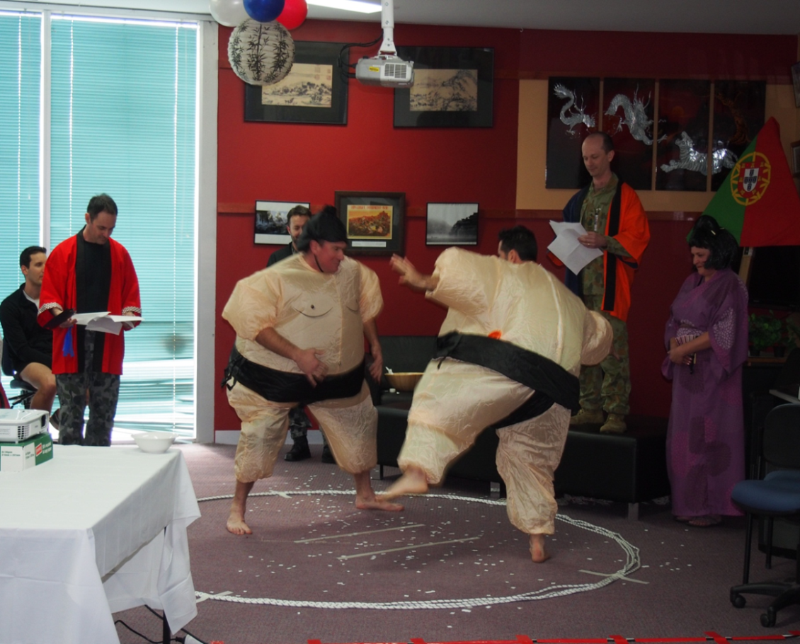
What we are aiming to achieve
Fluency
Accuracy and specificity
Lexical richness
Awareness of
Language Learning
Strategies (LLS)
Deeper
understanding
of TL culture

Slide 6
Some principles we adopt
Ensure context for the learning is meaningful
Choose different teaching strategies for different pedagogical needs
Maximising opportunities for learning
Encourage students to push themselves out of their comfort zones
Provide support for the learning/ remedial work as soon as the student starts to fall behind

Slide 7
Some principles we adopt cont.
Ensure materials are recycled
Make learning engaging
Use authentic in-class and assessment activities
Make best use of students’ expertise
When producing in-house materials ensure they are based around authentic models

Slide 8
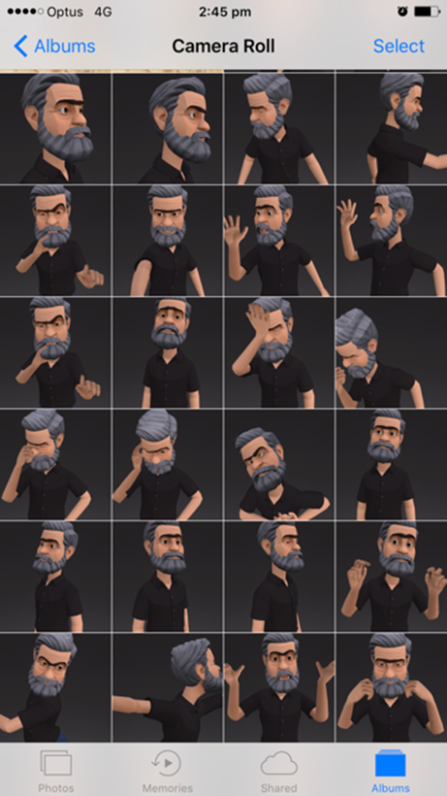
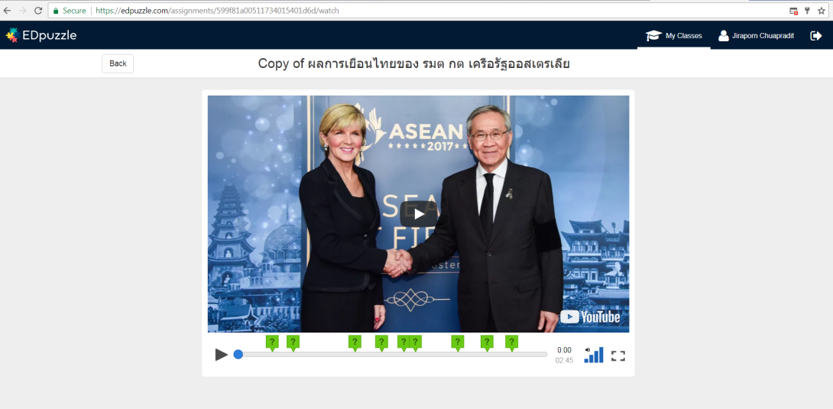
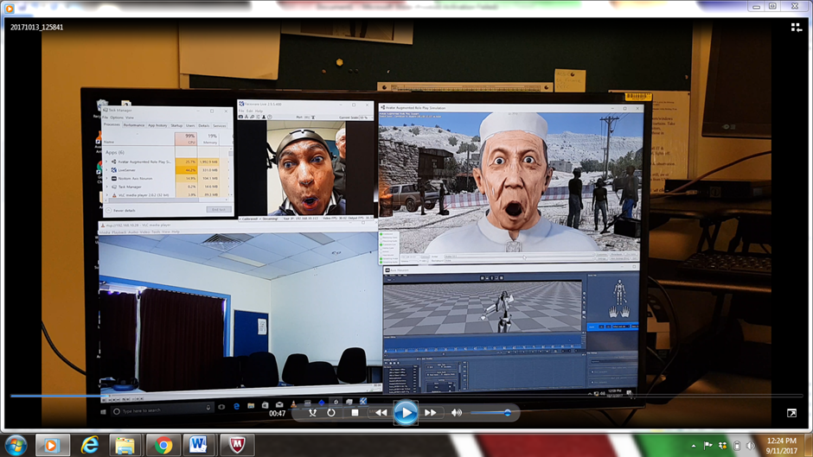
Current developments

Slide 9
Use of social media apps on DFSL courses

Slide 10
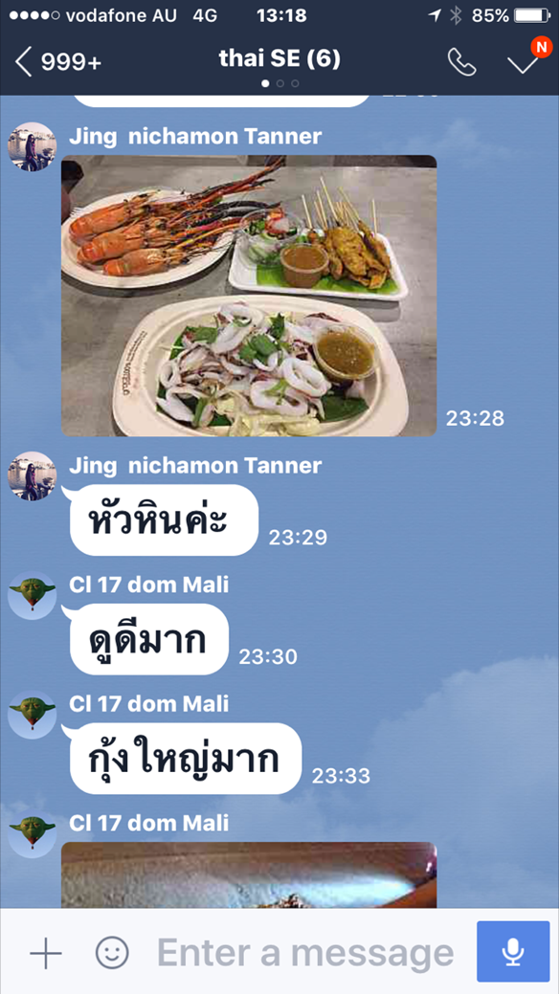

Slide 11
Students comments
‘Line provides us with the contemporary use of language especially the short form of language that is common to social media.’
‘Allows practice of vocabulary and/or sentence structures learnt during the day/week in an informal setting.’
‘[helps to] increase listening and reading exposure, and it’s handy!’

Slide 12
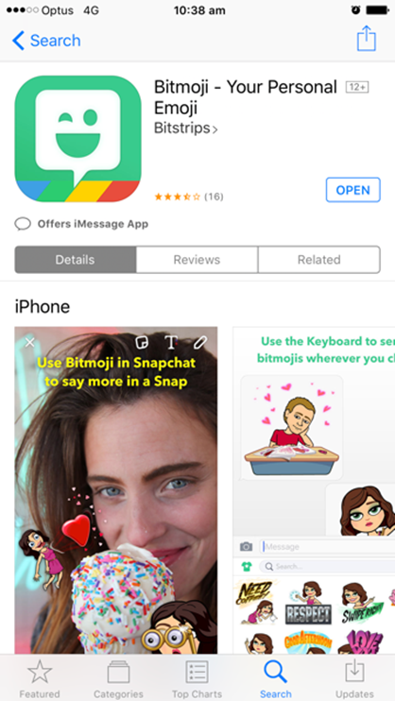
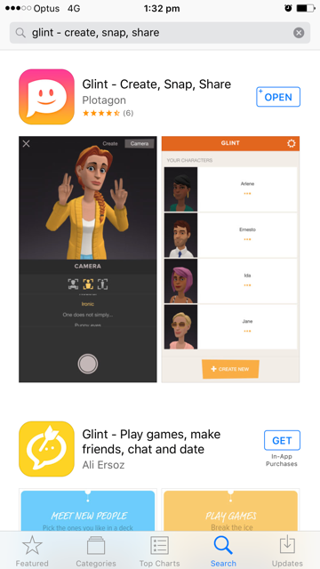
Bitmoji & Glint & Halftone 2 apps

Slide 13
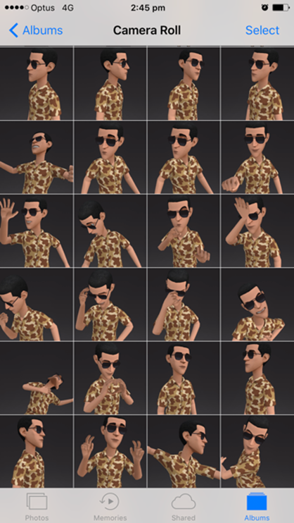
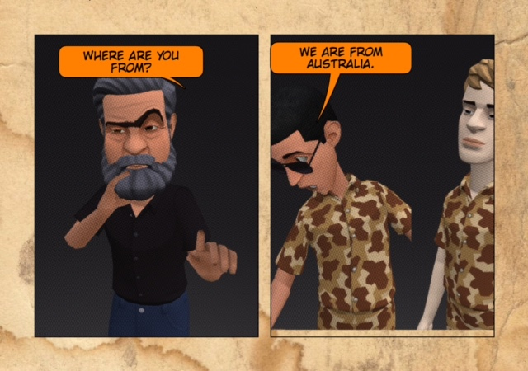
Bitmoji & Glint & Halftone 2 apps

Slide 14
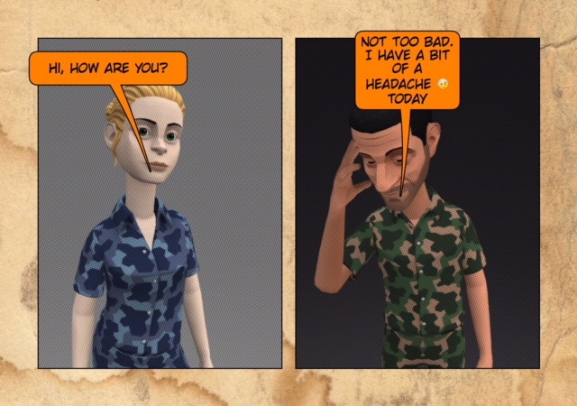

Slide 15
Identified benefits
This tool can support a number of classroom activities
Takes minutes to produce a comic strip
Visualisation provides more clues to meaning
Promotes target language through student-centred work

Slide 16
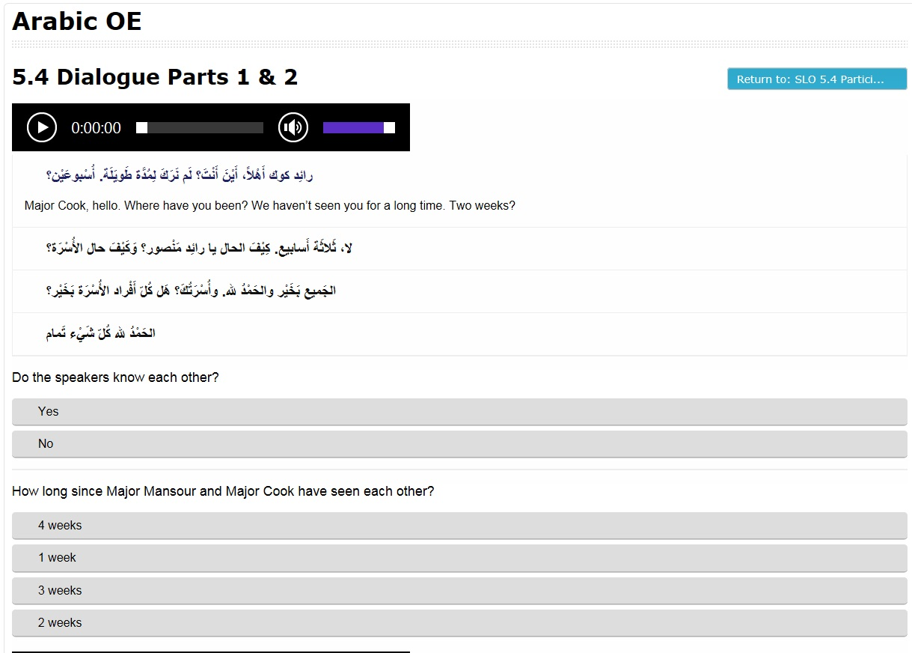
https://edpuzzle.com and H5P
Range of functions:
Open-ended questions
True or false questions
MC
Embedding questions in the videos
Feedback/comments sections

Slide 17
Articulate Storyline

Slide 18
Articulate Storyline cont.

Slide 19
Articulate Storyline - benefits
‘Next best thing' to teachers being physically 'inside the student's computer'.
Dynamic way to revise classroom material and reinforce content.
If [AS] development efforts focussed on the challenging areas of the course, student progress is enhanced as a result.
Scope for student participation in the development
Gamification of material

Slide 20
Staff comments
‘Branching scenarios work well for developing cultural awareness content.’
‘The most creative, effective content has been developed as a result of providing Articulate Storyline training and resources to teachers, allowing for daily inspiration from the classroom to feed into the strategies employed in development of digital content. This has been the single-most effective resource for me”.

Slide 21
Avatar Augmented Role Play trial

Slide 23
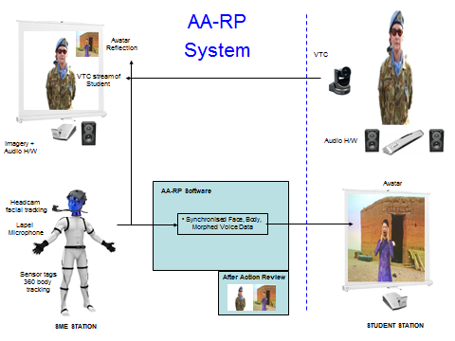

Slide 24
Avatar Augmented Role Play trial
High fidelity, life sized avatar projection animated by the SME
The SMEs voice can be morphed as required to reflect the avatar’s age and gender
Background graphics
The system is mobile and can be established in less than 2 hours

Slide 25
AARP System Benefits
Simulation of virtual humans of race, ages and genders that are difficult to replicate in role play drawing from the DFSL demographics
Simulated UN mission like settings and props
SME can easily switch between avatars/scenes
Sim technology can be quickly adapted to create avatars and environments for new missions and scenarios
After Action Review system can capture both avatar and student actions/reactions

Slide 26
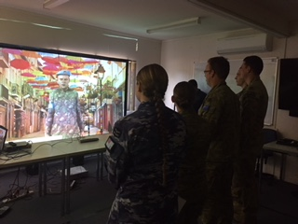
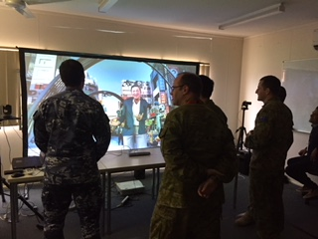
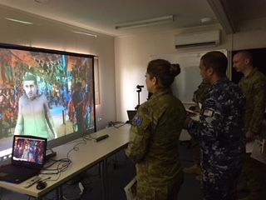
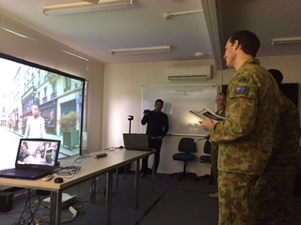

Slide 27
The success of the trial will be assessed on:
Simulation Fidelity - Did the student feel immersed? Did the environment feel real?
Student Attitude – Willingness of the student to engage/suspend disbelief?
Pedagogical usefulness – Was the avatar role-play an effective way to practice TL and cultural skills?

Slide 28
Students comments
‘The avatar role-play made me feel engaged and involved’.
‘Leading edge. Better than current computer games’.
‘It felt like I was talking and interacting with a ‘new’ person in TL’. ‘Feels like talking with a stranger’.
‘This tool would definitely be of greatest advantage to language classes without mixed gender instructors’.
‘It was so much FUN!’

Slide 29
Any questions?

