Slide 1
BILC Update
June 2014 – May 2015
Peggy Garza BILC Secretary

Slide 2
BILC Steering Committee
Chair
Keith Wert
GRB (1966-1981)
DEU (1982-1996)
USA (1997-2008)
CAN (2008-2014)
USA (2014- )
Senior Advisor
Dr. R. Clifford
Secretary
Peggy Garza
Julie J. Dubeau
Associate Secretaries
Jana Vasilj-Begovic

Slide 3
BILC Activities and Events
Annual Conference
STANAG 6001 Testing Workshop
Annual Professional Seminar
Testing Seminars
Faculty Development Workshop
BILC Cooperative Visits
Special Initiatives

Slide 4
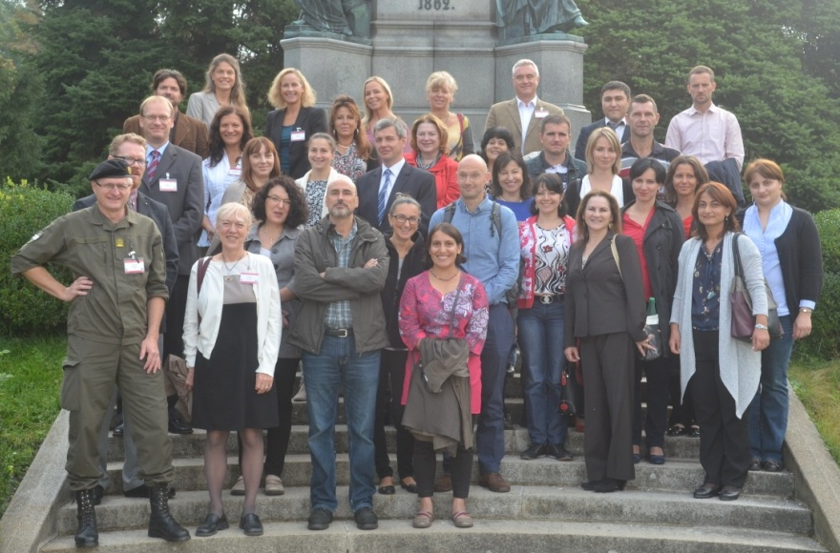
2014 STANAG 6001 Testing Workshop
Reichenau, Austria
8-12 September
Topic: Item Development Practices

Slide 5
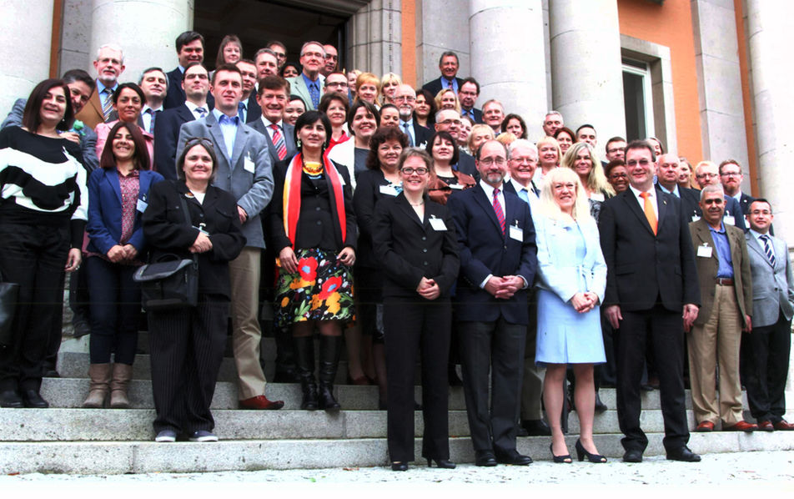
2014 Professional Seminar
Ellwangen, Germany
12-17 October
Theme: Catering to Diversity: Tailored Approaches to Language Training

Slide 6
Seminars/Workshops
2014
2015
Advanced Language Testing Seminar (ALTS) 2-20 June
Language Testing Seminar (LTS) 15-26 September
Language Standards & Assessment Seminar (LSAS) 3-11 December
Language Testing Seminar (LTS) 9-20 February
English Teaching Faculty Development Workshop 10-19 March
Language Standards & Assessment Seminar (LSAS) 21-30 April

Slide 7
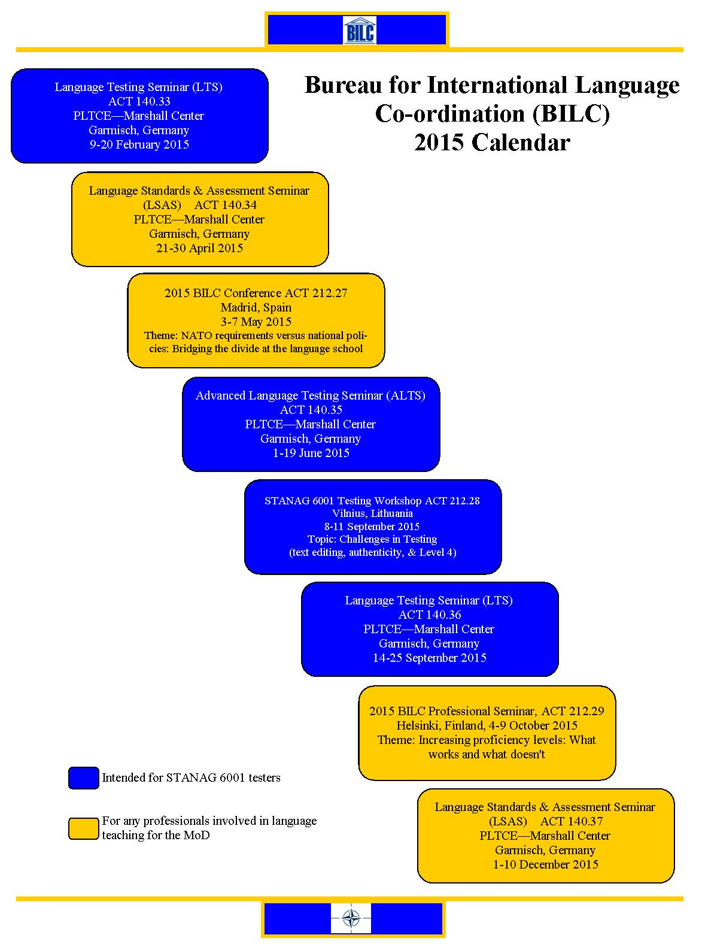
BILC Calendar

Slide 8
BILC Cooperative Visits
Algeria, June 2014
Montenegro, July 2014
Uzbekistan, August 2014
Ukraine, October 2014
Georgia, March 2015
United Kingdom, April 2015

Slide 9
Special Initiatives
Level 4 Working Group
NATO-Partnership Training and Education Centre (PTEC) collaboration
Language Needs Analysis (LNA)

