Slide 1
BILC and NATO
Keith L Wert and Julie J Dubeau

Slide 2
Notes:
Foe several years after the inception of BILC there was no desire or consensus for BILC to have a formal association with NATO. Circa 1975-76, The UK proposed that it did make sense for BILC to have a formal relationship with NATO and the verbiage in the slide is what resulted from a Nato Training Group Joint Services Sub Group decision.

Slide 3
BILC Within NATO 1978-2011
Notes:
As you can see, this relationship lasted for many years and does so today even in the reorganized Nato Training Group structure.

Slide 4
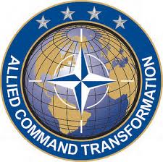
Co-chair is Joint Force Trainer (JFT)
NATO Allied Command Transformation
Chair is JFT JETE ETEE P&P Branch Head
NATO Allied Command Transformation
Notes:
This is the current Nato Training Group Structure. We have excellent support and entry as we need it. I invite you to get on the NATO Allied Command Transformation web site to learn more about the structure. BILC is not subordinate to NATO and BILC is not actually an element of NATO either. The relationship was further clarified in 2011.

Slide 5
BILC and SACT
Memorandum of Cooperation between HQ SACT and BILC regarding cooperation and mutual support (Nov 2011)
Direct POC, Communication with JFT
Increased visibility and support for BILC initiatives
Participation at annual Training Synchronization Conference
Notes:
With the reorganization of NTG in 2011, BILC had to find a new structure through which it would best serve both NATO organizations and the Nations BILC represents.
As a result of a few attempts at optimizing relationships, BILC found a new home. BILC was not strategically placed under the JSSG – and navigating the NTG maze was not always as productive and fruitful as we would have liked.
In November 2011, BILC became aligned as a strategic element with the Supreme Allied Command Transformation or SACT, while retaining its status as an independent advisory body.
The “Memorandum of Cooperation between HQ SACT and BILC regarding cooperation and mutual support” was signed in (Nov 2011)
Through this relationship, BILC has a direct point of contact for all of its issues, programmes, questions and concerns. Through this POC, BILC has access to Joint Forces Trainer, JFT, through whom it can send and receive information.
This has led to more visibility and support for BILC initiatives and has meant that BILC is included in the annual Training Synchronization Conference where hundreds of training and education specialists from all alliance member and partner nations meet to discuss common issues. The linguistic challenges you face in your respective militaries and in your academies and institutions can be addressed here.

Slide 6
JALLC Report: Interoperability Shortfalls in KFOR and ISAF
English language skills lacking
Inadequate harmonization of regulations & procedures
Need for proficiency is increasing
Documents & correspondence too lengthy, too complex
Content / intensity / duration of training falling short
Native speakers not proficient in communicating in multinational environment
Notes:
6
In 2010 Responses to a survey from ISAF and KFOR revealed that deficiencies in English language skills were perceived to be detrimental to mission. This was information BILC knew anecdotally, but having such a conclusive report to support our efforts was more than useful to many.

Slide 7
BILC Cooperative Visits
2 June 2000:
Lord Robertson, NATO SecGen, issues a letter to Permanent Reps of Allies and PARP Participants summarizing partnership goals for aspirant nations et.al. Language training is discussed and BILC is specifically recommended to study the issue.
12 Sept 2000
Asst SecGen for Defence Planning and Operations, E.V. Buckley, writes MG Kammerhoff, Chairman of the NATO Training Group (NTG), formally asking for BILC support.
24 Oct 2000
MG Kammerhoff writes Keith Wert, BILC Secretary for PfP, to conduct a study and submit a report on the “optimum balance” between indigenous language training and external language courses.
4 April 2001
BILC submits the first “Study on Partner Language Training Programmes” to Chairman of the NTG who forwards it a month later to Asst. SecGen Buckley
We were off and running...

Slide 8
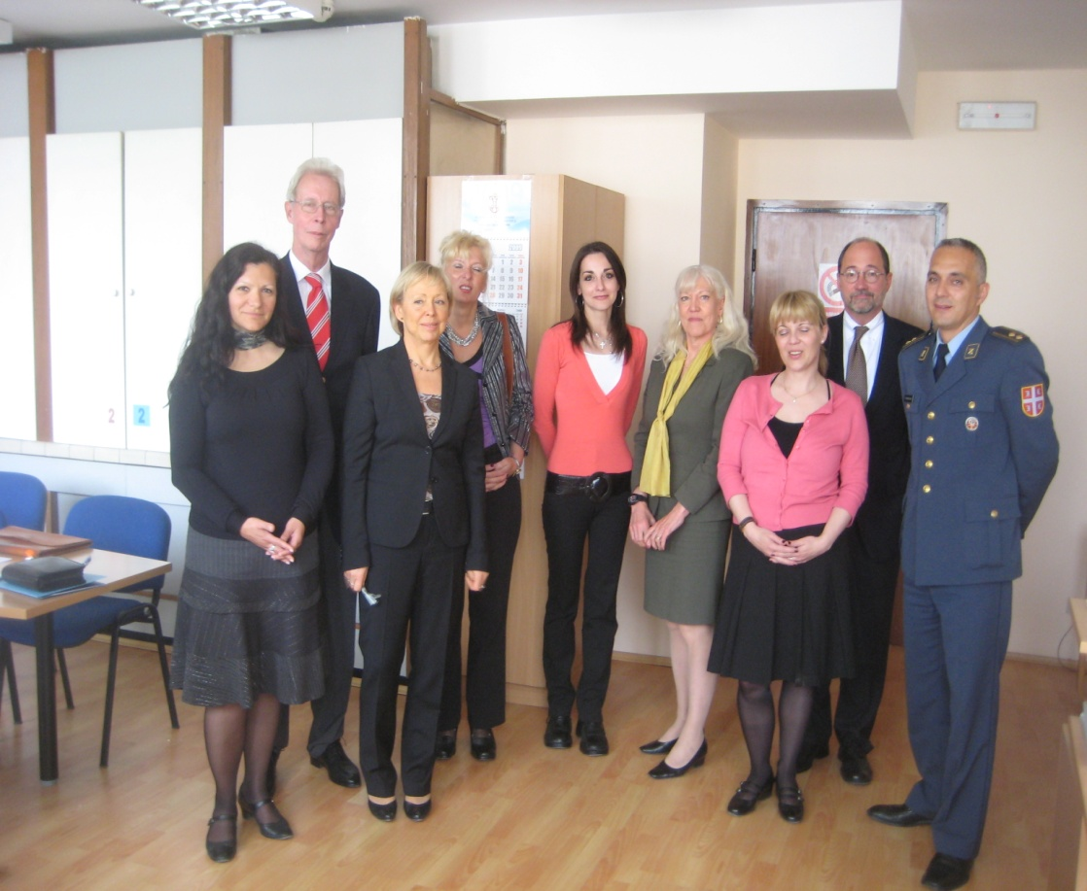
Language Studies – Assessments – Cooperative – Visits - Whatever
BILC Teams:
Canada, Germany, Slovenia, Sweden, UK, and US.
Interest:
Albania: DCHOD and DG of Personnel
Azerbaijan: Int’l Mil Coop
Bulgaria: Deputy Chief of Staff
Czech Rep: E&T Policy
Estonia: Head of Defence Academy
Georgia: Deputy Minister of Defense
Latvia: Deputy State Secretary
Macedonia: CHOD, MoD CoS
Netherlands: Head, Int’l Mil Coop
Romania: Head of MoD Human Resources
Russia: MoD Director of Education
Serbia: The J-7 and MoD Personnel Sector
Slovenia: Head of MoD Human Resources
Slovakia: Director of Military Education
Methodology
Language Policies
Military/Civilian personnel policies
Language instruction and testing
Serbia: May 2009
Notes:
8
8

Slide 9
The kinds of things we looked at
Development of a language policy integrated into military / civilian personnel policies
Development of a language training governance structure that meets the objectives of the language policy
Establishing effective and efficient use of language training and testing resources by refining a coordinated requirements process
Sub Themes:
- Appropriate balance between intensive and non intensive programs
- Effective and efficient language testing programs IAW NATO standards
- Ensuring resources are allocated in a transparent and prioritized manner
- Effective language training management execution practices
- Transparent procedures for faculty professional development
- Harmonizing bilateral support for language training
- Development of Syllabi and testing at STANAG 6001 Level 3
Notes:
9
9
While BILC did have some things to bring to the table such as testing expertise and training management suggestions, the greatest utility of these visits was that we could tell the senior leaders where the difficulties were. These difficulties were in general identified by the teachers, testers and language managers in each country. So in a very real way, these visits were a cooperative effort to get the information to the highest level possible.

Slide 10
BILC Cooperative Visits
An Untidy Evolution:
“Studies on Partner Language Training Programmes”
Which begat
“Language Training and Testing Assessments”
Which begat
“Cooperative Language Training and Testing Assessments”
Which begat
“BILC Cooperative Visits”
Which are many different professional exchanges depending on the focus and interests of the country requesting the visit. In association with NATO Defence Education Enhancement Program (DEEP), Allied Command Transformation and some others.
BUT always with BILC member experts
Notes:
The names kept changing and the focus began to evolve as well. Special focus areas began to be of paramount interest, such as testing and teacher professional development and the “program assessment” aspect has become generally less frequent and the cooperation finds areas of mutual areas of interest to develop.

Slide 11
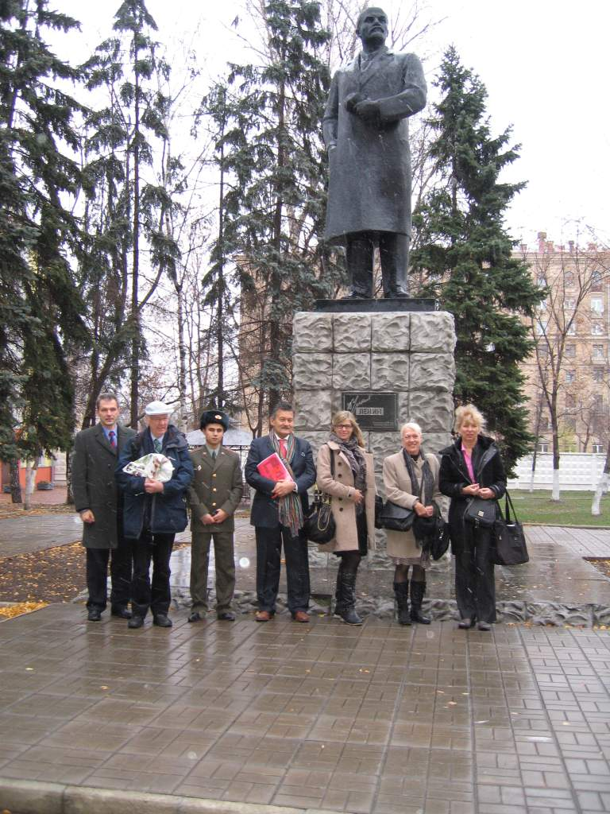
BILC Collaboration with Russia from 2011-2013 under NATO/Russia Council Work Plan
BILC approached by Russian Mission to NATO (Aug 2011)
First visit to Russia: with EGT
Peggy, Jana & Julie (Nov 2011)
Meeting with EGT in Prague,
to establish the ‘roadmap’
(May 2012)
Moscow, Nov 2011
Notes:
Low English proficiency among experienced officers has been clearly identified as a gap within the broader Russian military community. Russian military authorities had started to pay significant attention to this issue by 2010. A Linguistic Center, was created within the Military University IOT teach English to career officers prior to their deployments abroad.
After these 3-month long courses, students would receive certificates with a "good" grade, then Russian MOD send these officers abroad (UN missions, NATO mission, NSO and other courses) where they show low levels of English proficiency and subsequently could not perform their duties or understand the teaching material. It was understood that basic English in NATO is a national responsibility, so the staff from the linguistic centre sought NATO`s assistance to develop evaluation standards and tests iaw STANAG 6001. In Aug 2011, BILC was approached by the Russian Mission to NATO iot set up a preliminary meeting.
Although this was higlhy political from the IS perspective, when it came to person to person or F2F meetings, we found our counterparts to be dedicated language professionals.

Slide 12
Notes:
12
BILC was been working with Russia under the aegis of the NATO Russia Council work plan. The BILC was positioned within the EGT – the Expert Group on Terminology, the NRC(PREP-EGT)

Slide 13
BILC Collaboration with Russia
A timeline…
NATO HQ Brussels: Keith & Julie attend meetings to formalize roadmap for NRC approval - Jan 2012,
Russian Colleagues attend BILC Conference May 2012, Prague, BILC Seminars in Oct 2012 Bled and Oct 2013 Stockholm
Sept 2012- Keith, Roger, Julie go to Moscow for a collaborative visit
Peggy, Jana: June 2013 Workshop on testing IAW STANAG 6001
Jana & Julie return NATO HQ Brussels - Sept 2013
Sept 2013 visit from 3 RU colleagues to Bulgaria (Shumen & Varna)
April 2014 BILC received instruction to cease all communications until further notice.

Slide 14
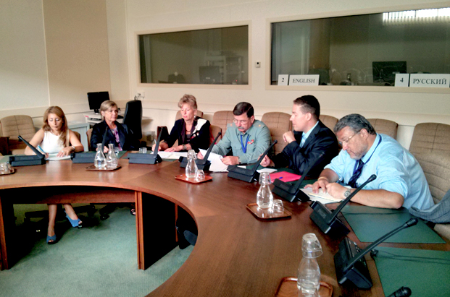
BILC / Russia - NRC Work Plan draft
http://www.nato-russia-council.info/en/articles/20130911-nrc-linguistics-experts/
Sep 2013
Notes:
14
Our last meeting with Russian authorities to discuss language-related training and education took place in Brussels, 11 Sept 2013. Before the plan could be actioned, collaboration ceased and all communications ended.
The link to the NRC website is no longer live. Our Russian colleagues had the opportunity to visit some of our BILC member nations’ institutions, for example, Bulgaria who graciously hosted them in Shumen and Varna.
Next slide

Slide 15
BILC Cooperative Visits Continue...
Mongolia, August 2015
Georgia, January 2015
Ukraine, March/April 2016
Ukraine, April 2016
Azerbaijan, May 2016
Notes:
Julie’s Ukraine Visit Summary: From 5- 7 April, the BILC Team participated in a Language Training Symposium prepared by and conducted at the Military Institute of Taras Shevchenko National University (MISNU). The BILC team was composed of Ms Julie Dubeau, BILC Secretary, Col Petko Petkov, Director of Foreign Languages Department (FLD) of the National Military University of Bulgaria (NATO PTEC) and Capt. (N) Volodymyr Khilkevych, BILC POC at HQ SACT. The agenda included presentations on Language training and testing system in the Armed Forces of Ukraine, personnel selection for training and some particularities of different language training institutions. The BILC delegation had an opportunity to present general information on BILC, its structure, tasks, activities and outreach programs in different countries as well as the BGR experience in restructuring and developing a national Language training and testing system. The topics of discussion included the importance of improving the Language training system in Ukraine, the ways to increase coordination of efforts between different NATO initiatives in Education and Training area in Ukraine (DEEP, PDP, BILC support, etc.), and the future support from BILC to UKR Armed Forces.

Slide 16
Questions?

