Slide 1
BUREAU FOR INTERNATIONAL LANGUAGE CO-ORDINATION
50 Years of BILC
A Historical Overview in Milestones
Gerard Seinhorst
Netherlands Defence Language Centre

Slide 2
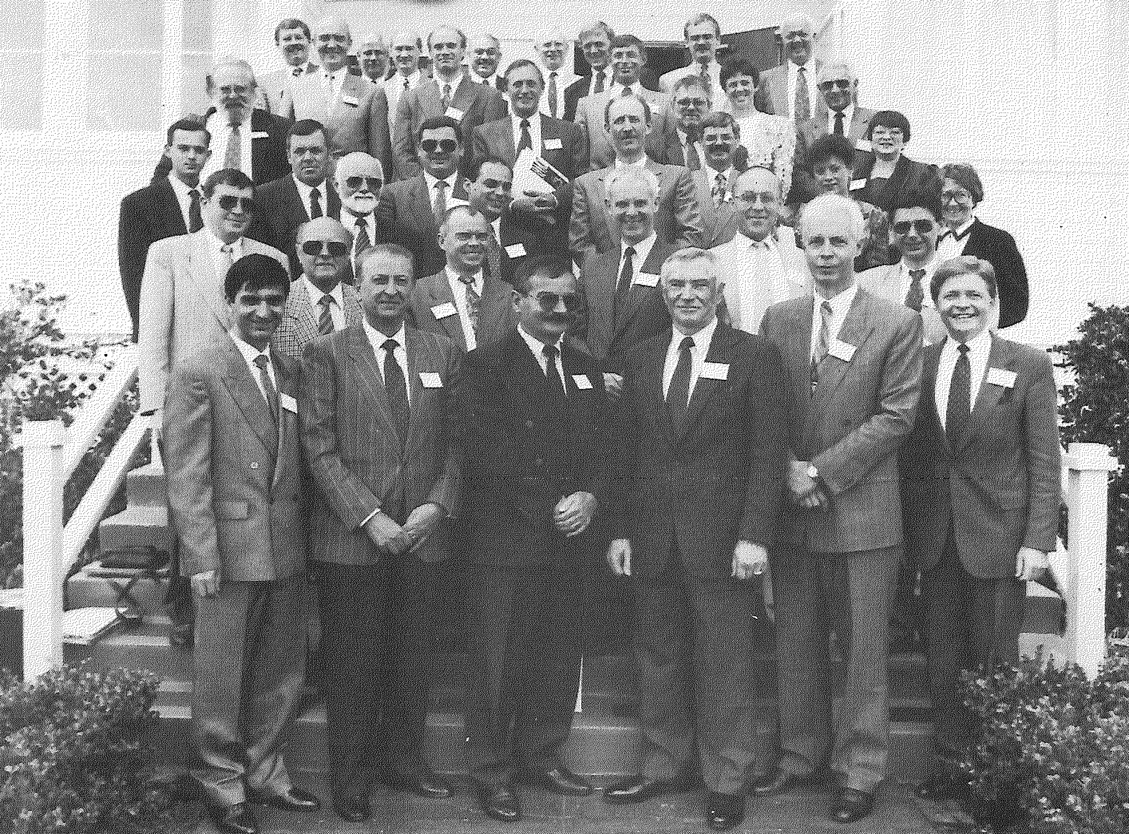
BILC Conference 1993, Monterey USA

Slide 3
BUREAU FOR INTERNATIONAL LANGUAGE CO-ORDINATION
50 Years of BILC
A Historical Overview in Milestones
Gerard Seinhorst
Long-time BILCer

Slide 4
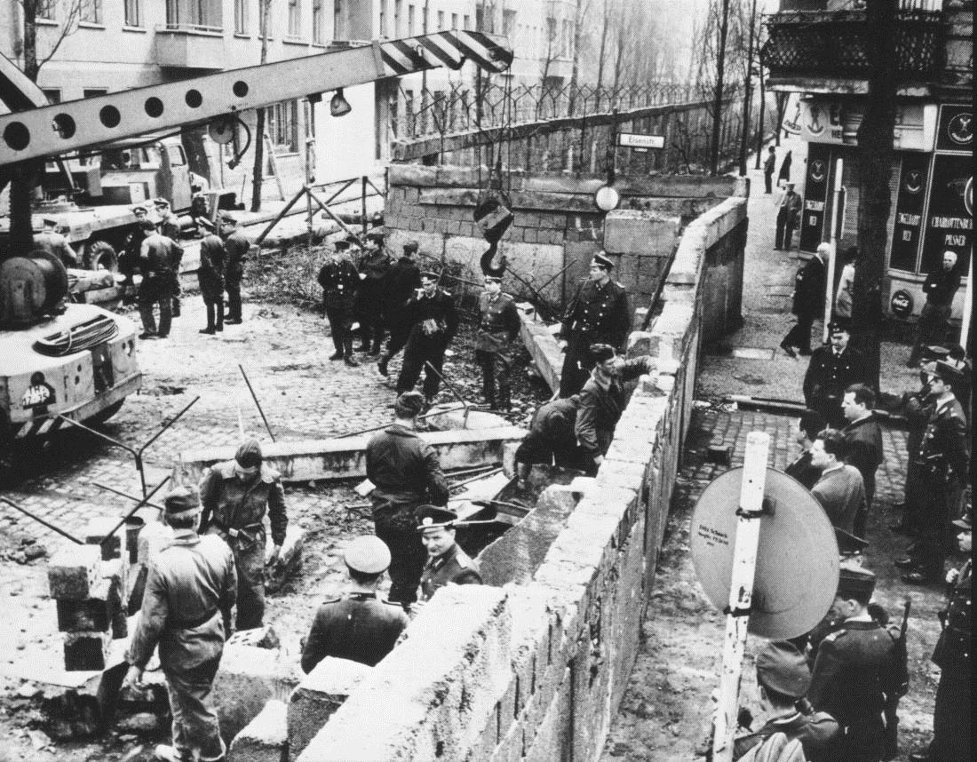
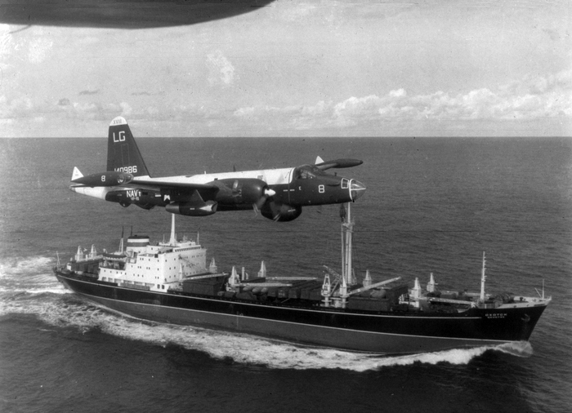
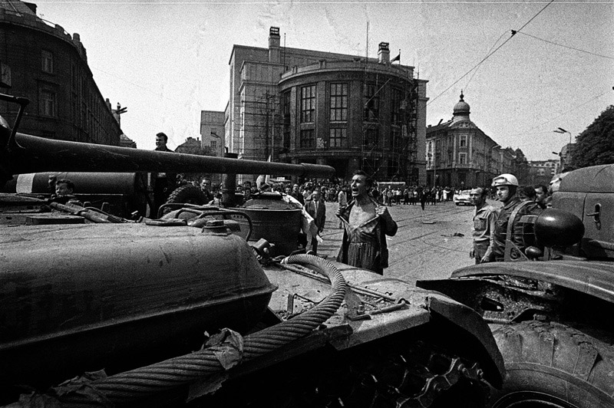
The Origins of BILC

Slide 5
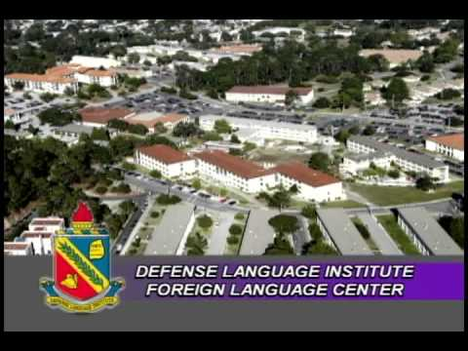
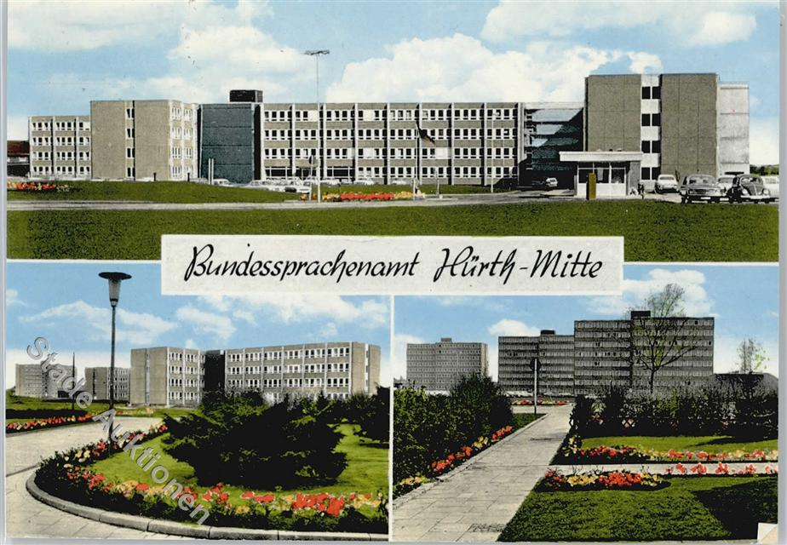
The Origins of BILC

Slide 6
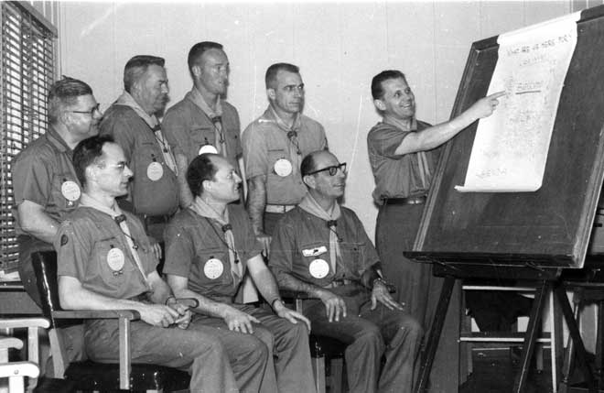
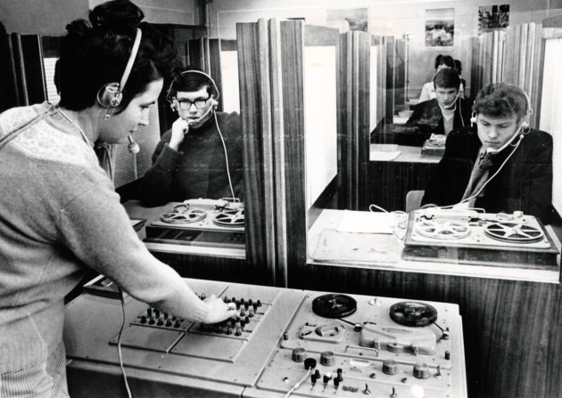
The Origins of BILC

Slide 7
The Origins of BILC
1962 & 1963: Conferences USAFE
Identification and discussion of common language training problems
1964: Conference SHAPE
1965 & 1966: Institute of Army Education (UK)
Permanent body to co-ordinate matters of international interest in the sphere of language training in the Armed Forces
Relation to NATO
UK first secretariat

Slide 8
The Origins of BILC
British MOD Memorandum DS15/160/7, dated 26 July 1966
“Bureau for International Language Co-ordination”
Responsibilities:
Publish annual bulletin
Convene annual conference
Encourage members to share reports on research and development with respect to language education and management

Slide 9
Why “BILC”?
"... after multi-lateral private discussion, as a neutral, self-explanatory title with an easily remembered and pronounceable abbreviation."

Slide 10
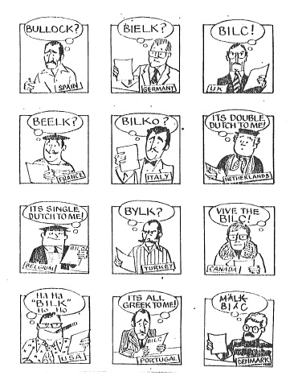

Slide 11
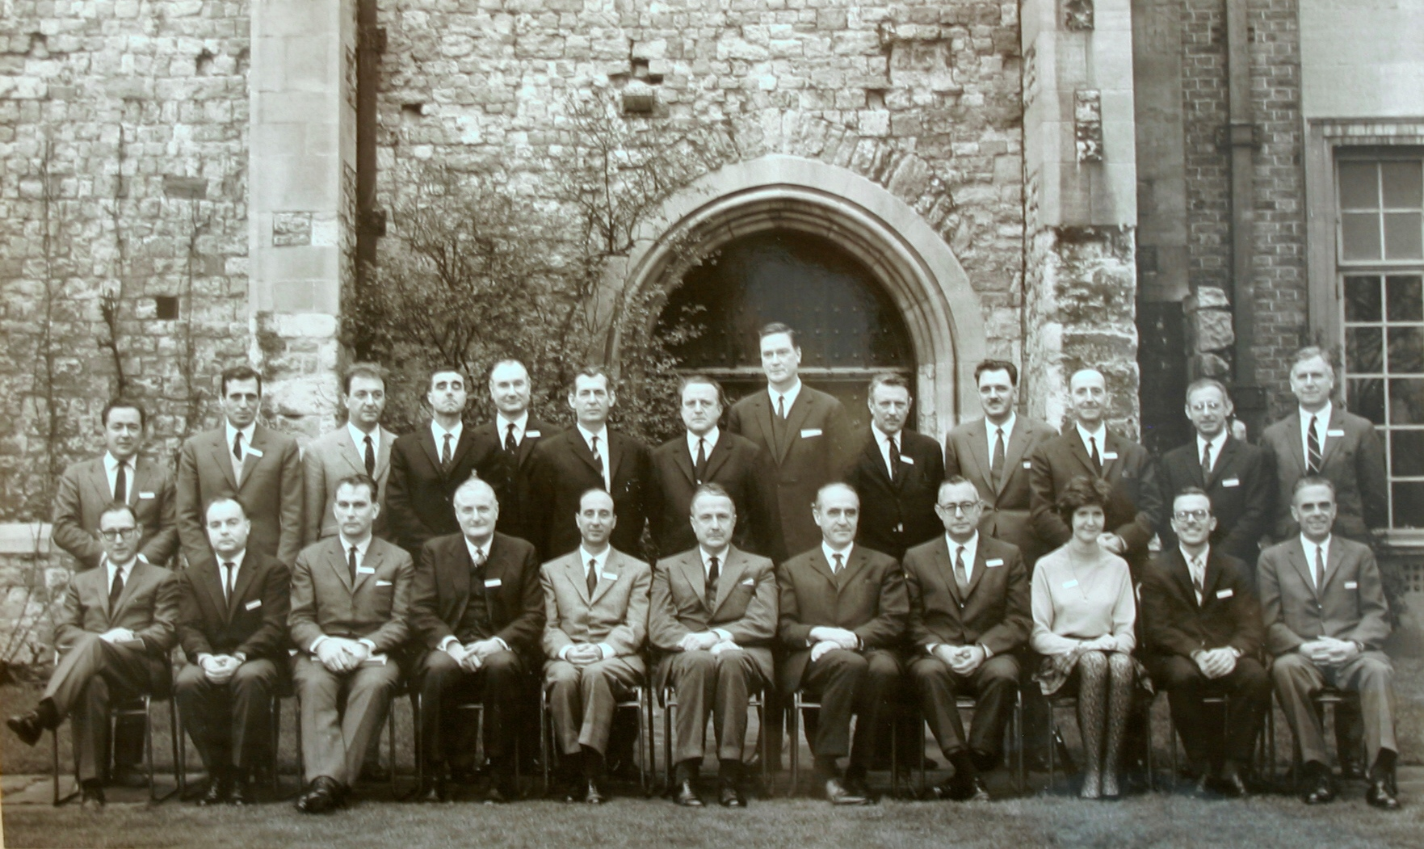
The first BILC conference
BILC Conference 1967, Eltham Palace, London GBR

Slide 12
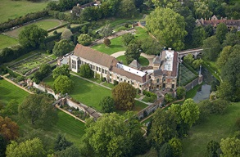
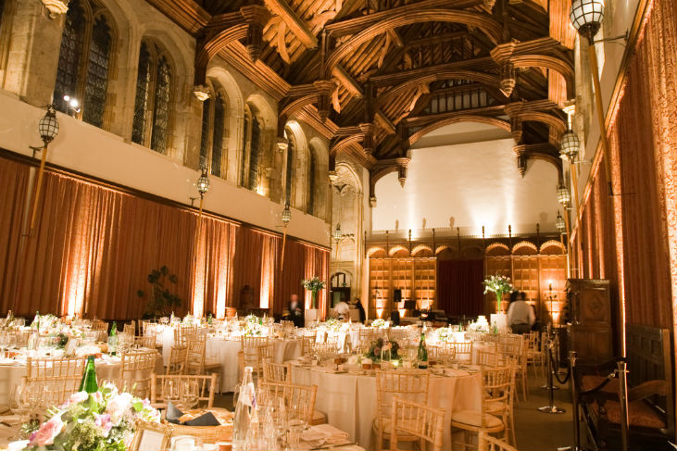
The first conferences
Eltham Palace, London GBR

Slide 13
Time Periods
The Early Years
Assistance
Expansion
New Frontiers
Consoli-dation
1966-1981
1982-1990
1991-1997
1998-2009
2010-onwards
GBR
DEU
USA
CAN-USA
Secretariat

Slide 14
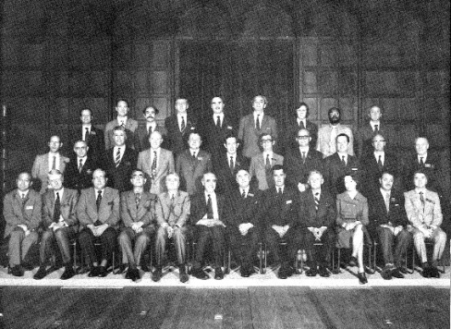
The Early Years (1966-1981)
1967
1968
1969
1970
1973
1971
1972
5
8
8
8
8
8
8
Working Party
Administrative Group
Host
Chair
Editor
Secretary

Slide 15
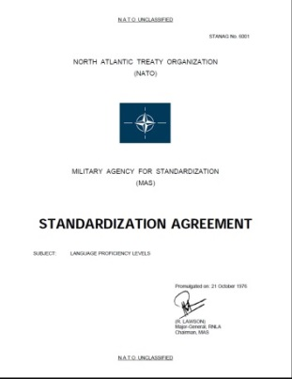
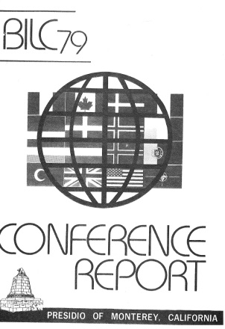
The Early Years (1966-1981)
1974
1975
1976
1977
1980
1978
1979
1981
DEU hosts conference
PRT becomes BILC member
8
8
8
8
9
9
9
9
SHAPE/IMS NATO becomes assoc. BILC member

Slide 16
The Early Years (1966-1981)
1974
1975
1976
1977
1980
1978
1979
1981
DEU hosts conference
PRT becomes BILC member
8
8
8
8
9
9
9
9
SHAPE/IMS NATO becomes assoc. BILC member

Slide 17
The Early Years (1966-1981)
1974
1975
1976
1977
1980
1978
1979
1981
DEU hosts conference
PRT becomes BILC member
8
8
8
8
9
9
9
9
SHAPE/IMS NATO becomes assoc. BILC member
BILC Rules of Procedure
Working Group on Testing

Slide 18
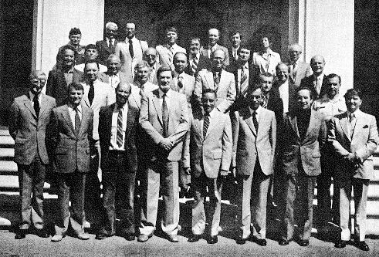
The Early Years (1966-1981)
On average 30-35 participants
Male dominated
Academic nature
National reports
English and French
BILC Conference 1979 Monterey USA

Slide 19
The Early Years (1966-1981)
Major themes
Systems Approach to Language Training
Teacher Training
Proficiency levels
Methodology
Technology
Programme and Curriculum Design
The Learner

Slide 20
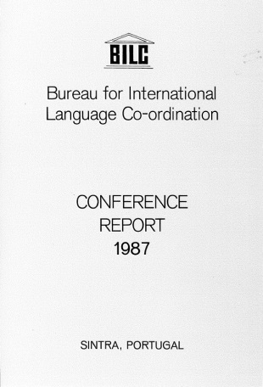
Consolidation (1982-1990)
1982
1983
1984
1988
1986
1987
1985
1989
1990
DNK and GRC join BILC
ESP becomes BILC member
Secretariat
9
10
12
12
13
13
13
13
13
TUR becomes BILC member

Slide 21
Consolidation (1982-1990)
More practice and needs-oriented
More between-conference work by study groups
Special seminars on selected topics in addition to the annual Conference

Slide 22
Consolidation (1982-1990)
Focus on making military language training more cost-effective:
1984: Effective language learning strategies for military requirements
1985: Identifying and Controlling Parameters Governing the Duration of Military Language Training
1986: Strategies for Attaining more Effectiveness and Cost-Efficiency in Military Language Training with emphasis on Educational Technology
1987: Strategies for Cost-Effective Military Language Instruction
1989: International Co-operation in the development of Strategies towards more cost-effective Training and Teaching

Slide 23
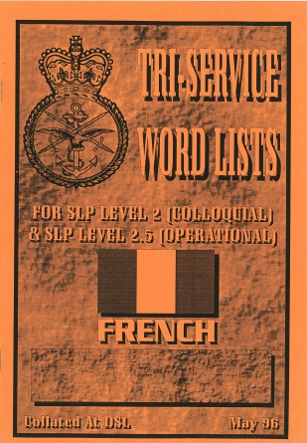
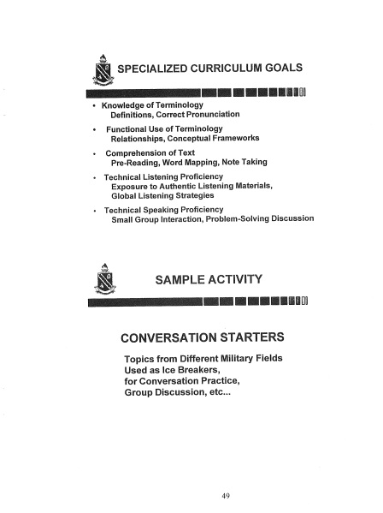
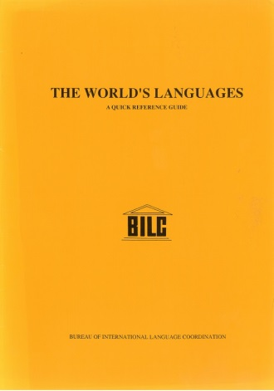
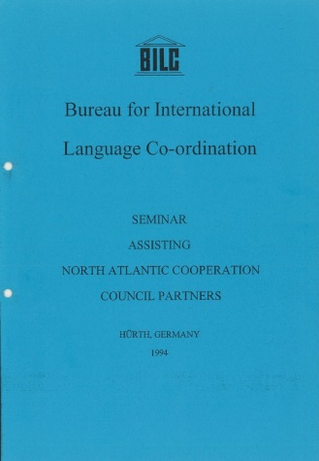
Assistance (1991-1997)
1991
1992
1993
1997
1995
1996
1994
Arms Control Seminar
NOR becomes BILC member
13
13
14
14
14
14
14

Slide 24
Assistance (1991-1997)
Cooperation with PfP
Professional seminars
Increased practical focus
Criticism:
Too much focus on English
Lack of tangible products/results

Slide 25
Expansion (1998-2008)
1998 – USA takes over BILC Secretariat
BILC website
Working Group on Testing and Assessment
Standardization: interpretation of STG 6001 level descriptors
Language Testing Seminars

Slide 26
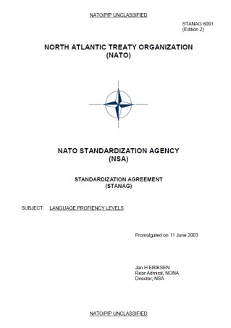
Expansion (1998-2009)
1998
1999
2000
2004
2002
2003
2001
2005
2006
2007
2008
2009
BUL, EST, LTV, LTU, ROU, SVK, SVN BILC members
Secretariat
Secretariat
14
17
17
17
17
17
24
24
24
24
24
26
CZE, HUN, POL BILC members
ALB, HRV
BILC members

Slide 27
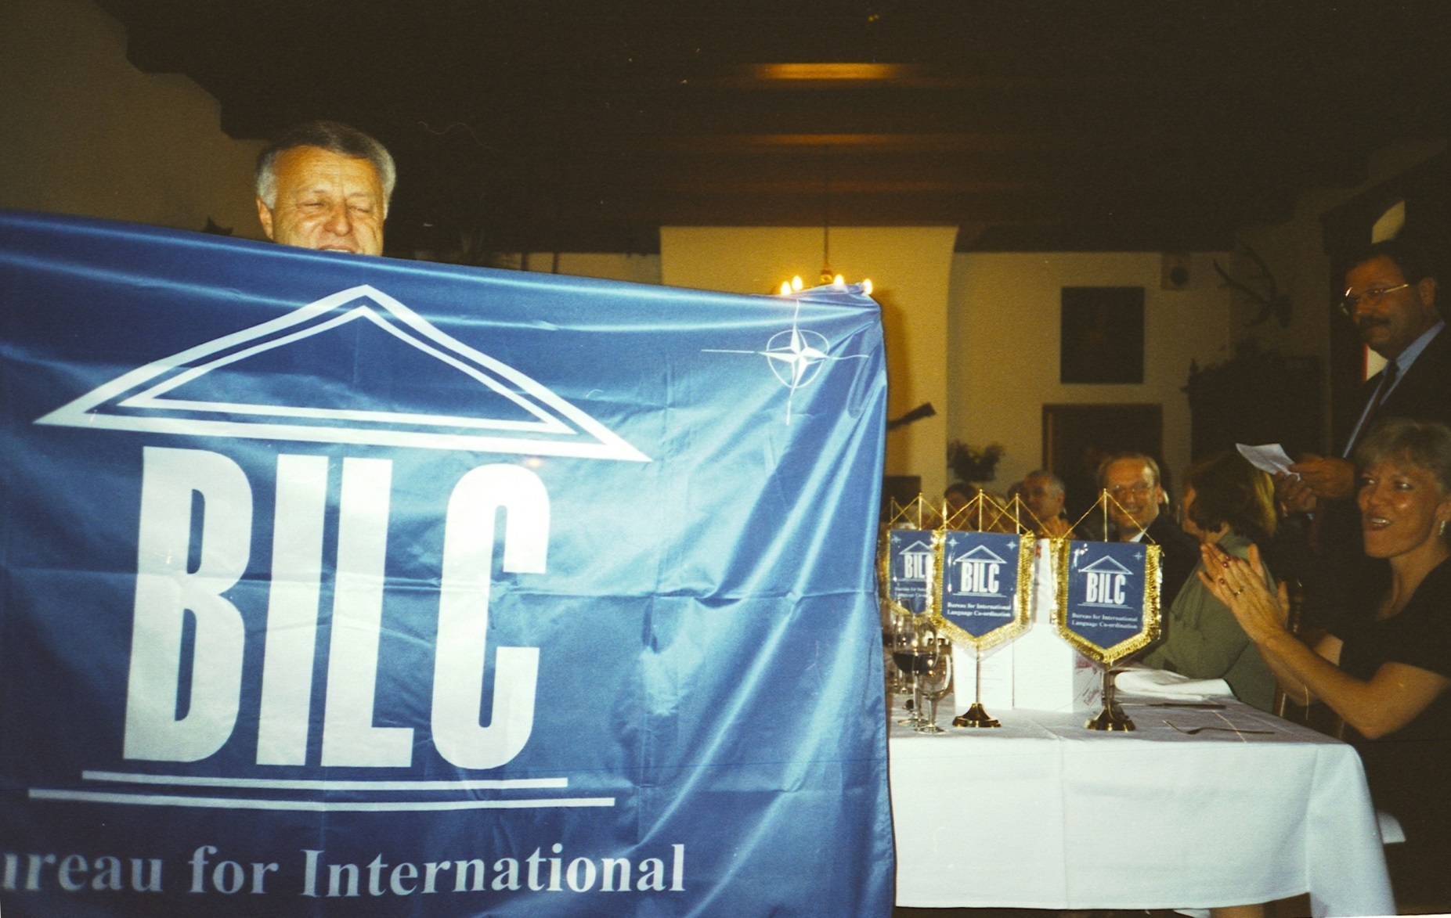
Expansion (1998-2008)

Slide 28
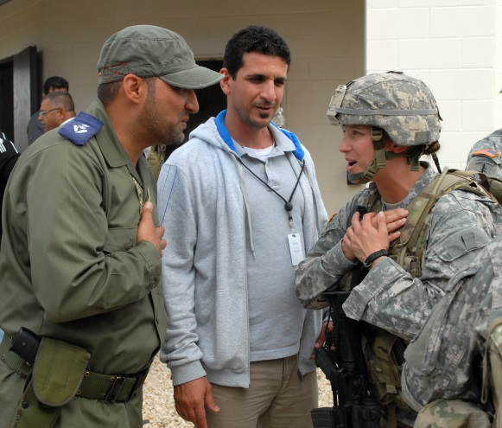
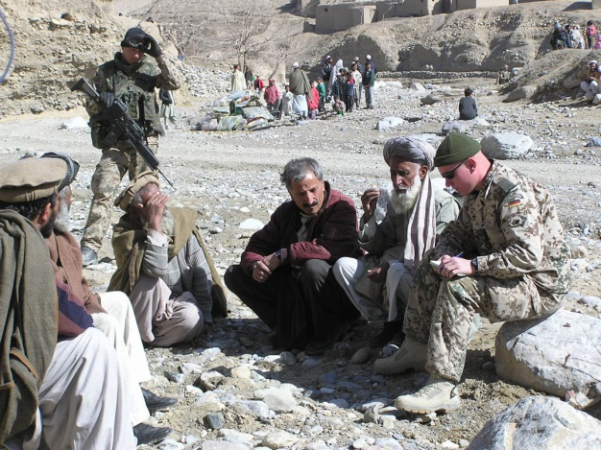
Expansion (1998-2008)
New member nations
STANAG 6001 ed. 2: Expanded descriptors
New language training needs
Local languages, mission oriented
Cultural awareness

Slide 29
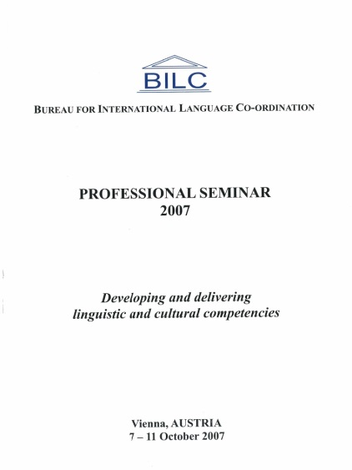
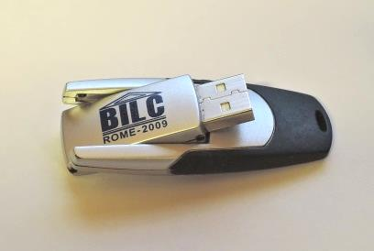
Expansion (1998-2008)
New technology – e-learning, blended learning
BILC reports, from 44 pages in 1969 to 461 in 2007
Conference Presentations
Venues: from military facilities to *****Hotels

Slide 30
New Frontiers (2010-today)
2010
2011
2012
2015
2013
2014
2016
Working Group on Level 4 Proficiency
Secretariat
Secretariat
26
26
26
26
26
26
26
Reassignment as advisory body to HQ SACT
BILC
Terms of Reference -
Mission & Vision

Slide 31
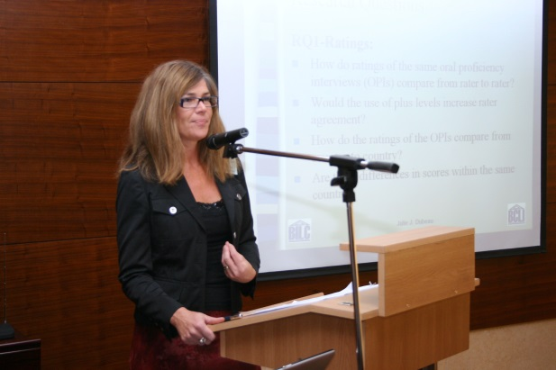
New Frontiers (2009-today)
New activities:
STANAG 6001 Testing Workshops
Language Standards & Assessment Seminars
English Teaching Faculty Development Workshops
BILC Military Glossary for civilian English teachers and translators (2014)
Sharing website (BILC SharP)
2013: Ms. Julie Dubeau first female BILC Chair

Slide 32
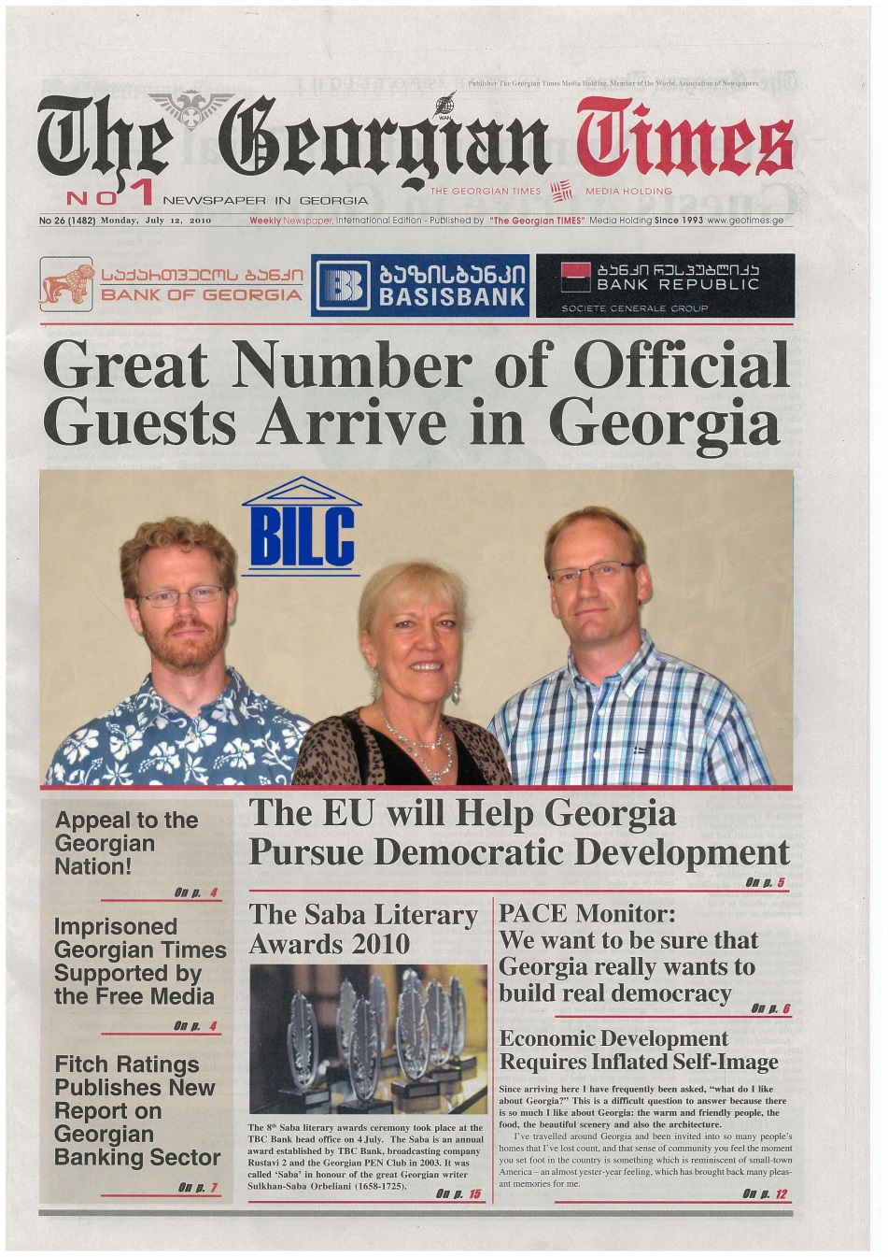
International Acclaim

Slide 33
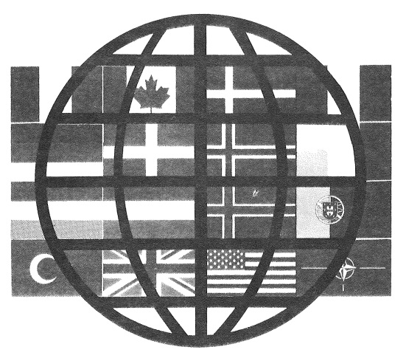
The BILC logo
1967-1974
1979
1980-1997
1998-today

Slide 34
Facts & Figures
Fact | Figure
Total number of delegates that attended a BILC Conference or Professional Seminar | > 4000
Average no. of participants | 51 (Conference) 61 (Prof Seminar)
Largest BILC Report | 561 pages (Seminar 2000, Ljubljana SVN)
Longest term BILC Secretariat | 16 years (both GBR and DEU)
Most frequent host nation | 12 times (GBR)
Largest conference/seminar | 107 participants (Athens GRC, 2008)
Highest female participation | 57% (Seminar 2008, Bucharest ROU)
Most frequent participation | 43 times (Peggy Garza)
Longest association with BILC | 34 years (Dr. Ray Clifford, since 1982)
Longest prep time for BILC photo | 18.5 minutes (Conf 2004, Riga LTV)

Slide 35
The expanding BILC Community
BILC Members and Affiliated Nations
Notes:
35

Slide 36
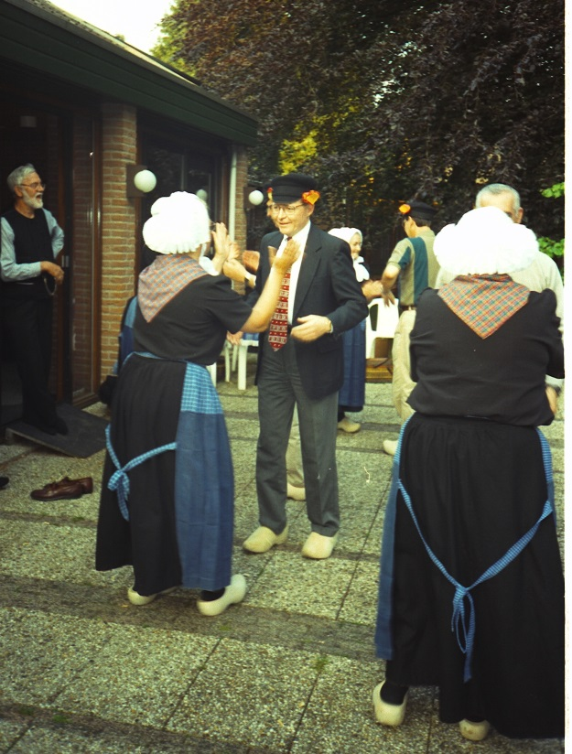
What made BILC a success?
Mix of participants
Military and civilian
Male and female
Mix of work and social activities (“work hard - play hard”)
Hospitality of the host nations
Voluntary nature of the contributions
High level of expertise and professionalism
Willingness to share and exchange
Friendships

Slide 37
What made BILC a success?
Devotion of individuals
BILC Secretariat
Chairs | Secretaries
Col J.J.N. Manson (GBR) | Maj F. A. Johnson (GBR)
LtCol G.S. Goodman (GBR) | George Worrall (GBR)
Dr. Josef Rohrer (DEU) | Dr. Christopher Huellen (DEU)
Herbert Walinsky (DEU) | Hermann Roder (DEU)
Dr. Ray Clifford (USA) | Peggy Garza (USA)
Dr. Richard Monaghan (CAN) | Keith Wert (USA)
Julie Dubeau (CAN) | Julie Dubeau (CAN)
Keith Wert (USA) | Jana Vasilj-Begovic (CAN)
THANK YOU!!

Slide 39
BILC Conference 1976, Quebec CAN

Slide 40
BILC Conference 1976, Quebec CAN

Slide 41
BILC Conference 1976, Quebec CAN

Slide 42
Female Attendance

Slide 43
Facts & Figures
BILC Seminar 2004, Riga LTV

Slide 44
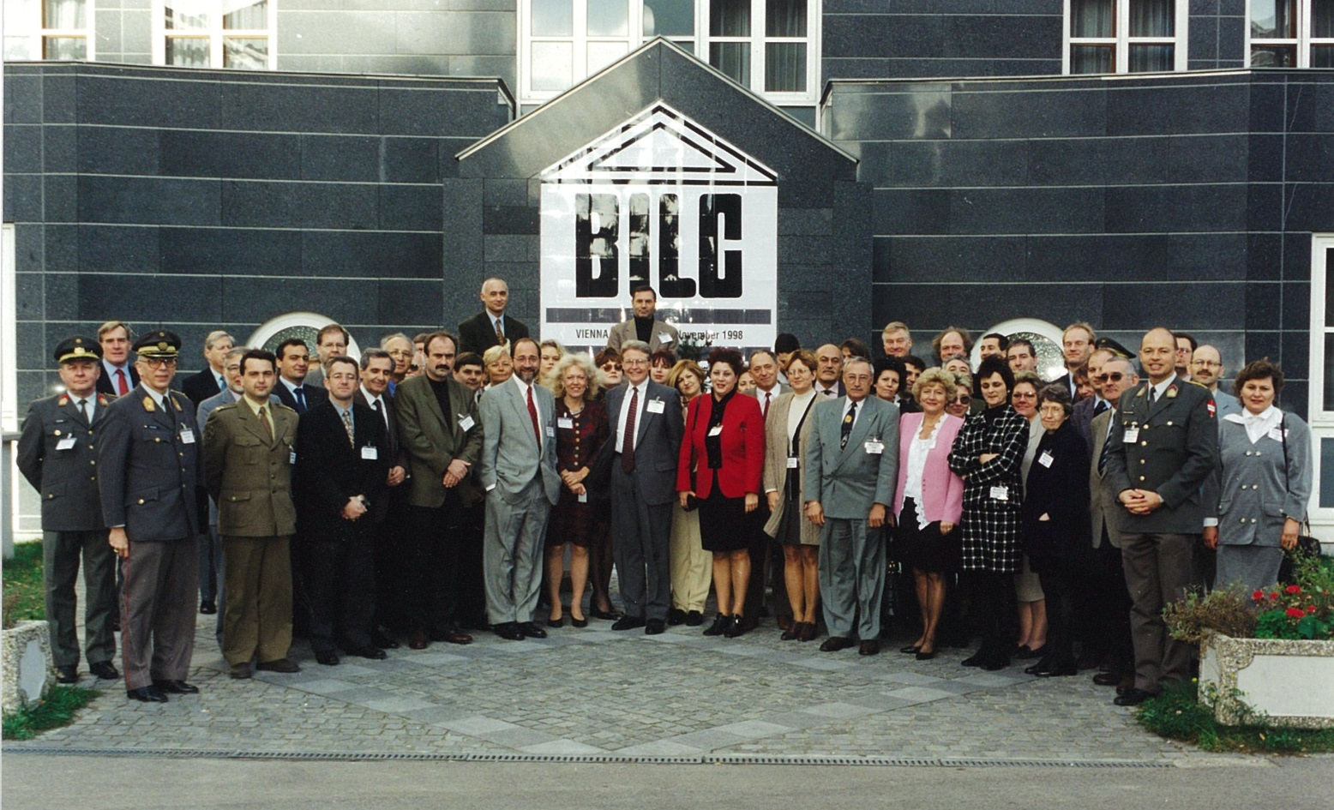
Facts & Figures
Best arranged BILC Group Photo

