Slide 1
BUREAU FOR INTERNATIONAL LANGUAGE COORDINATION SEMINAR 24-28 OCTOBER 2016
HUNGARY, BUDAPEST

Slide 2
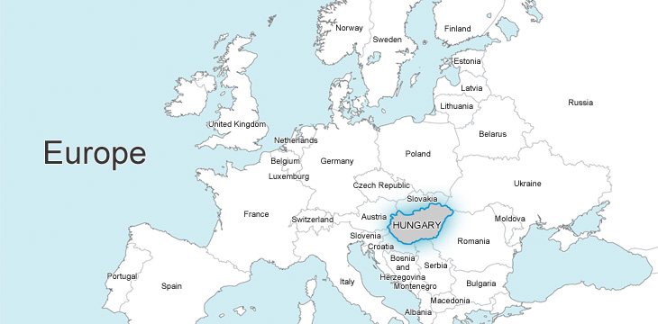
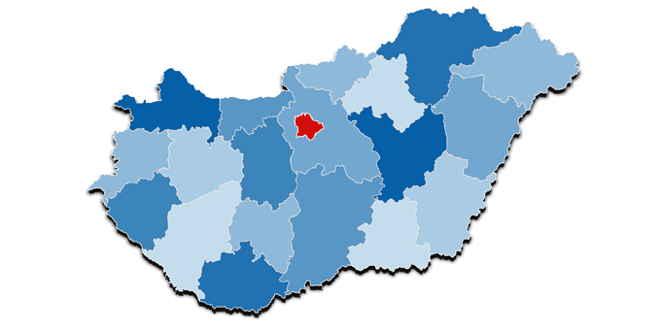
HUNGARY, BUDAPEST

Slide 3
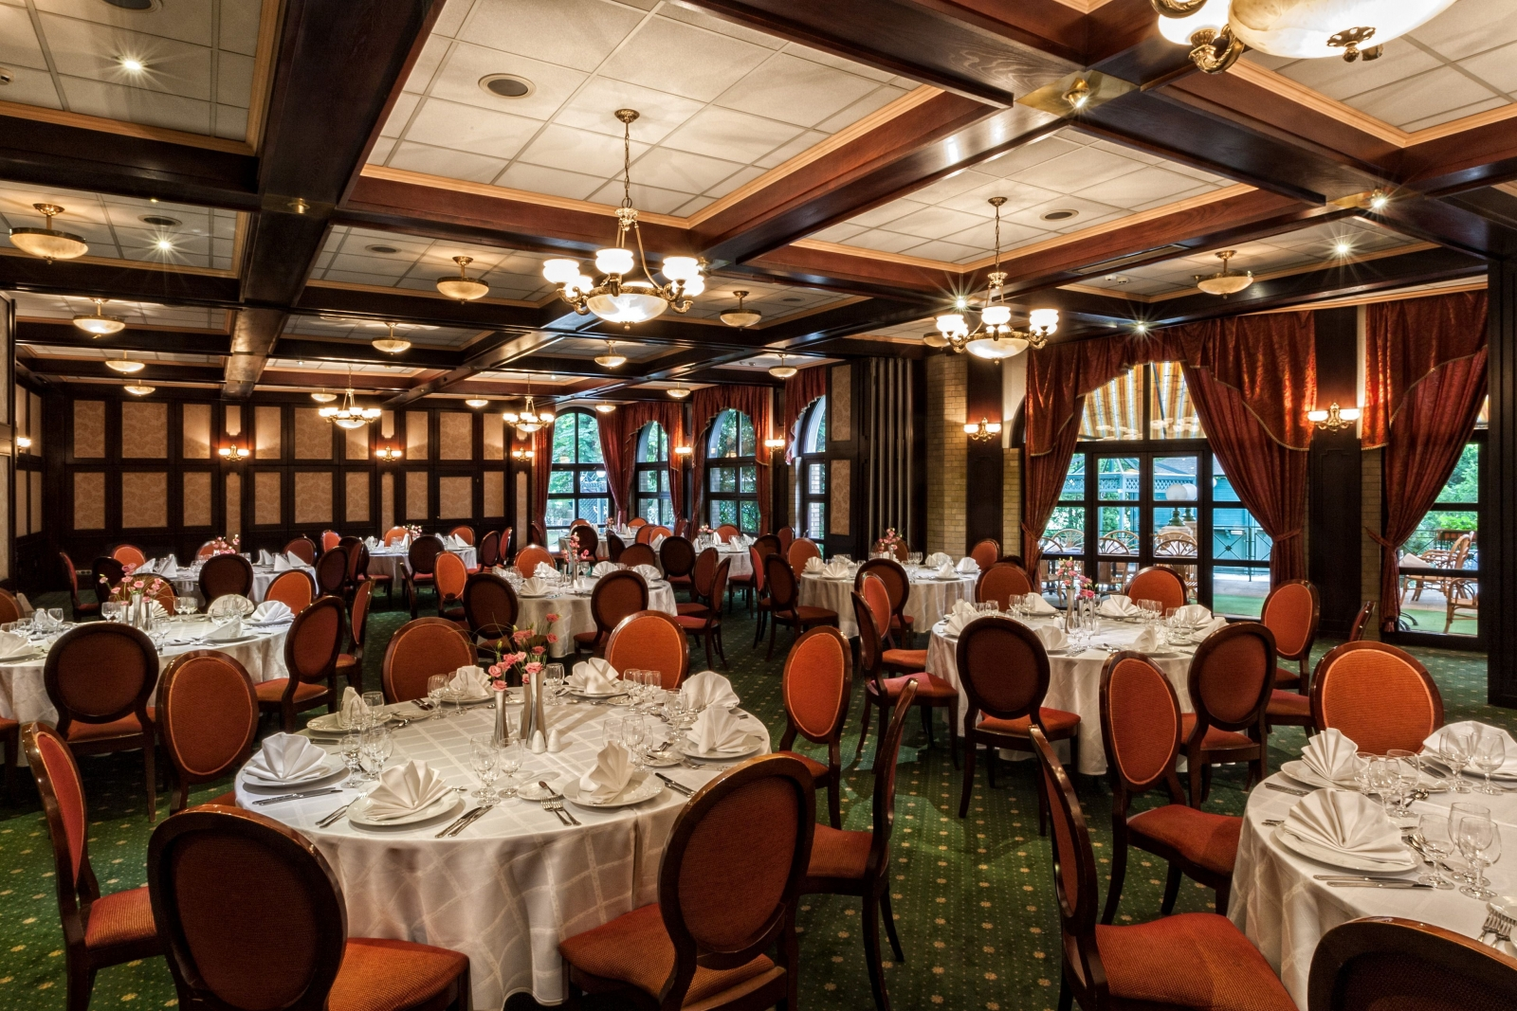
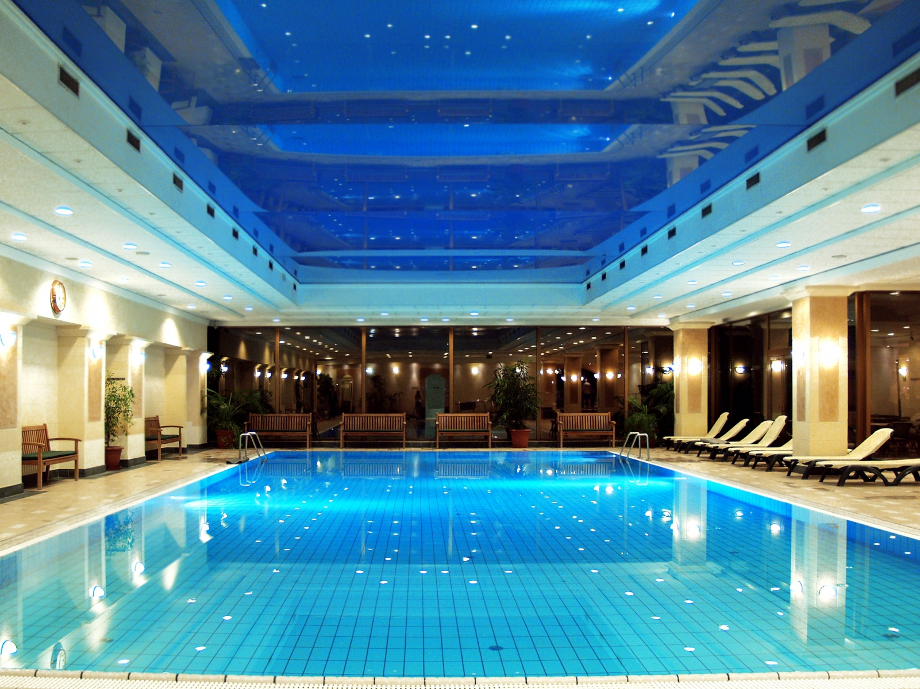
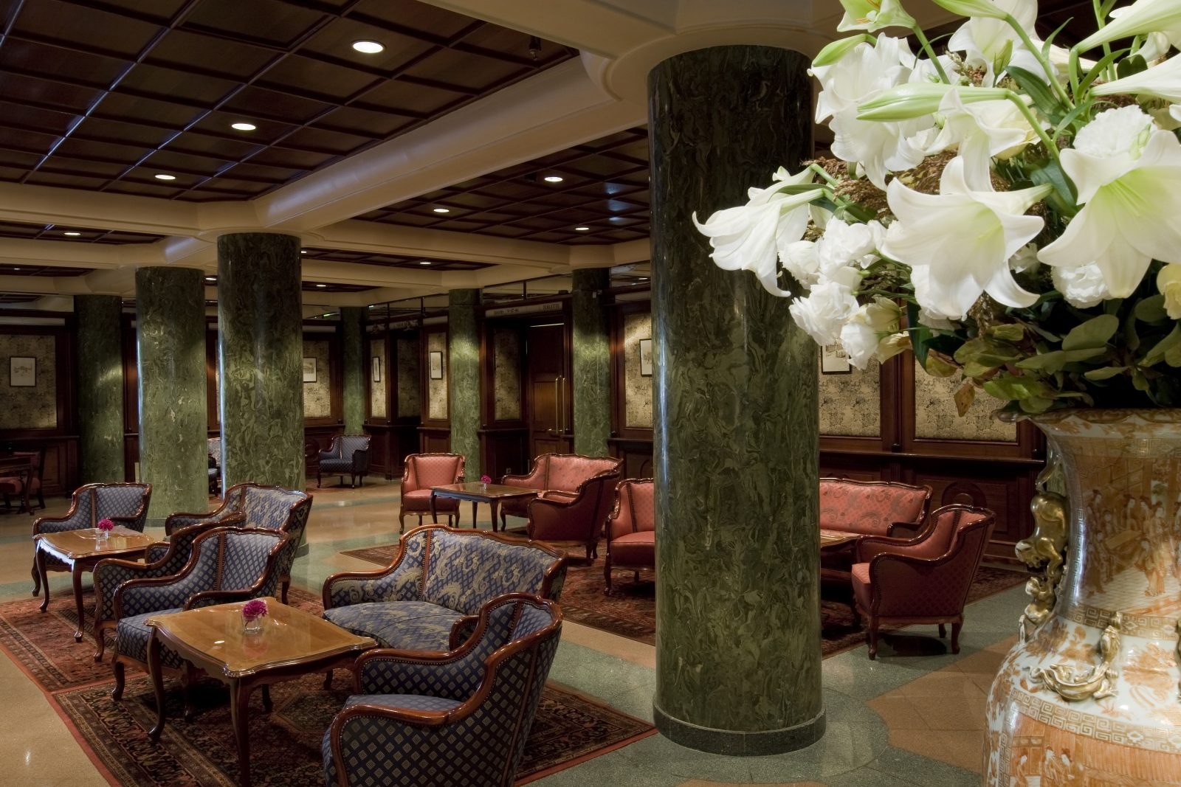
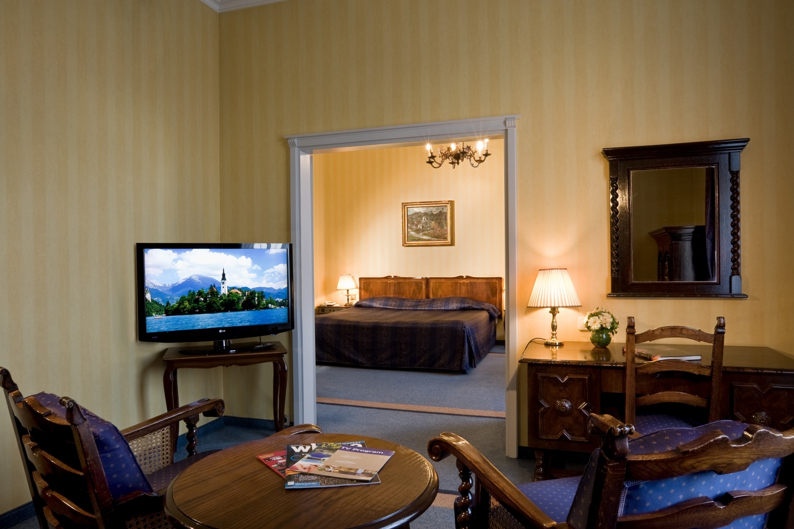
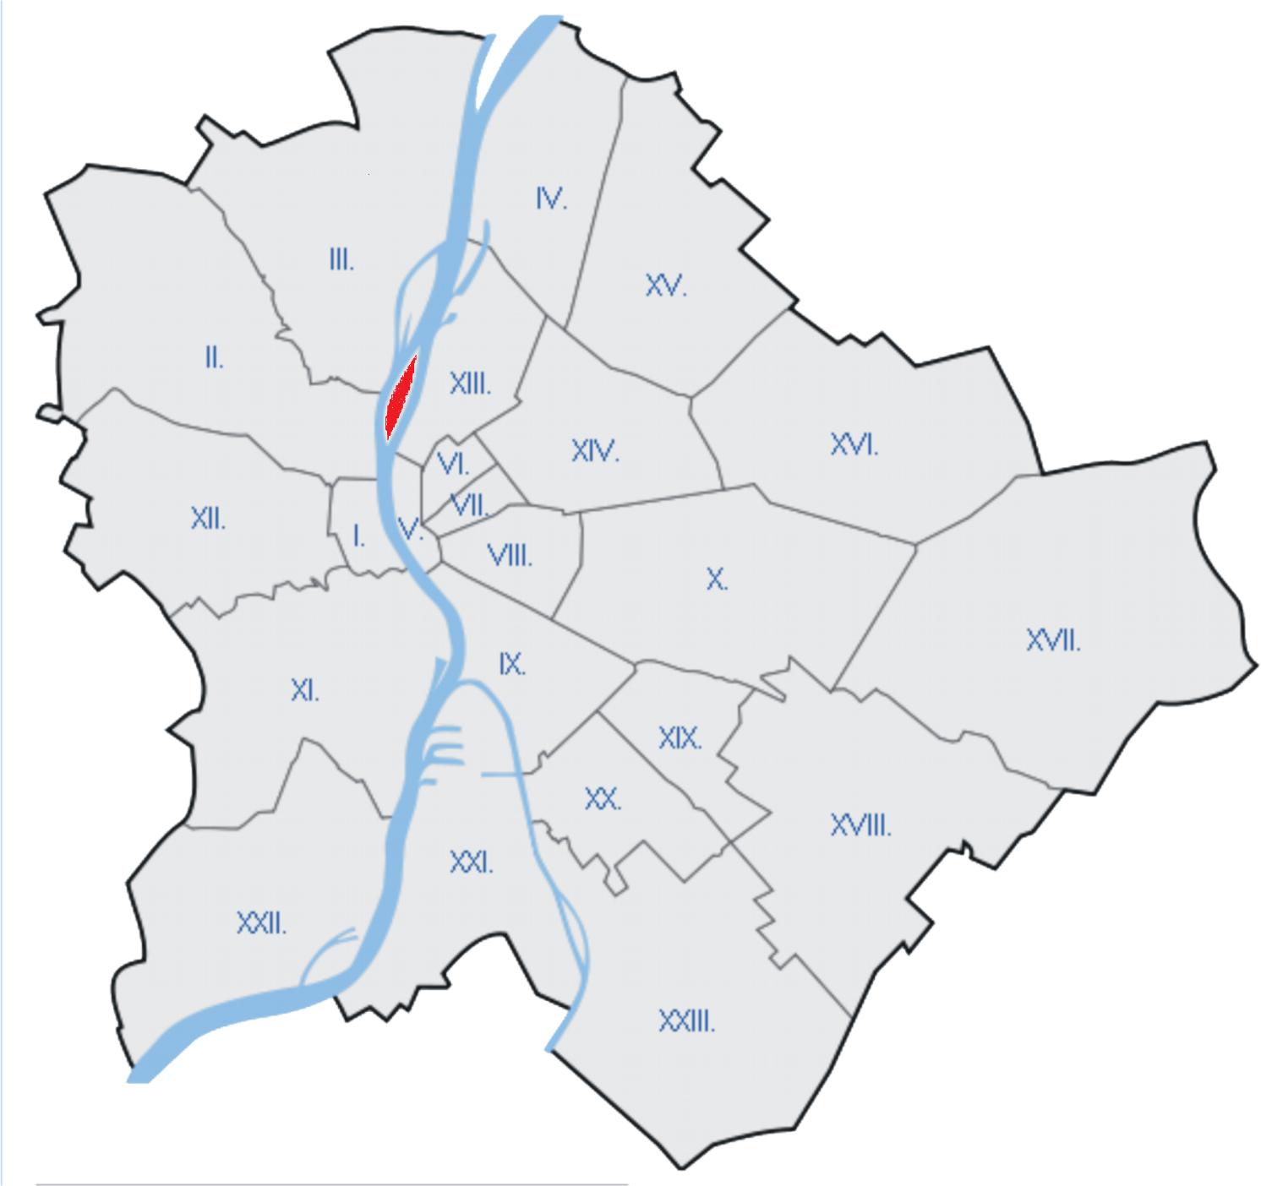
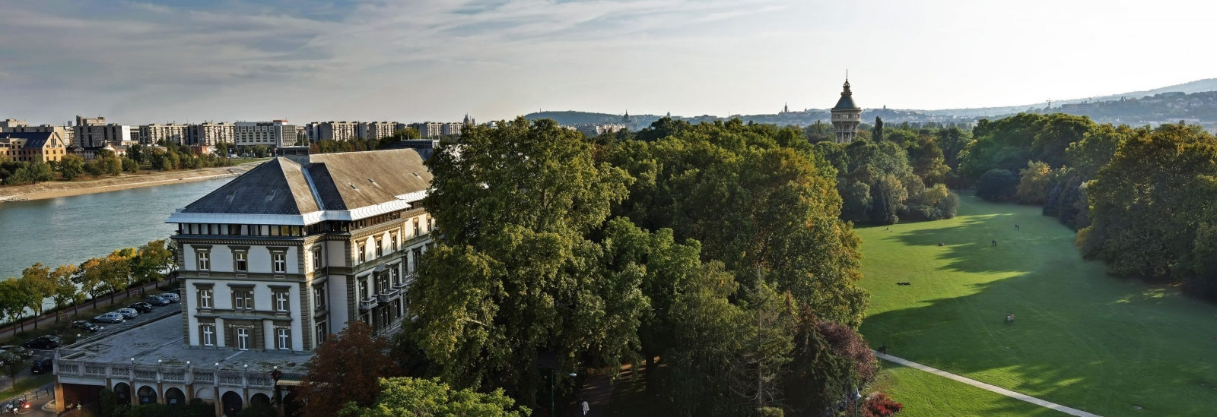
HOTEL – Danubius Hotel Margitsziget

Slide 4
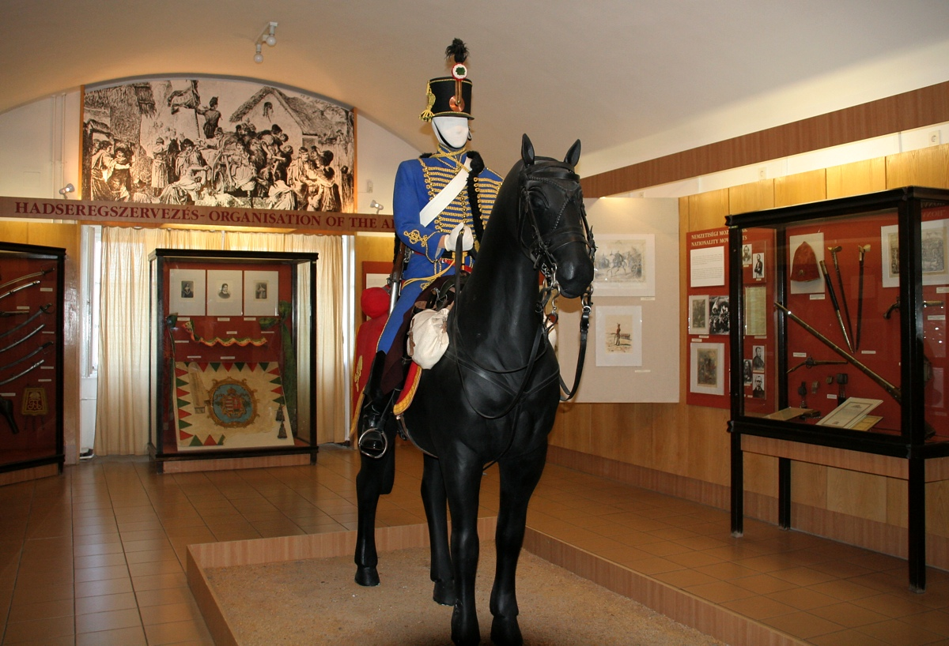
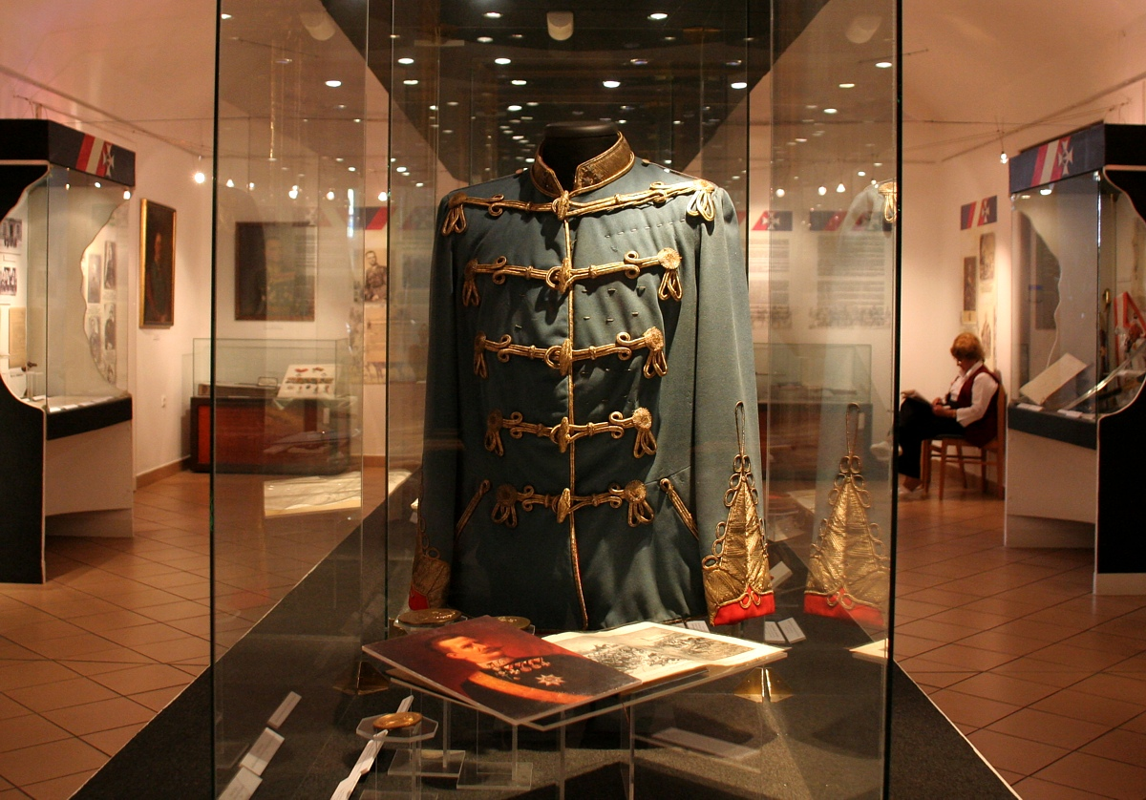
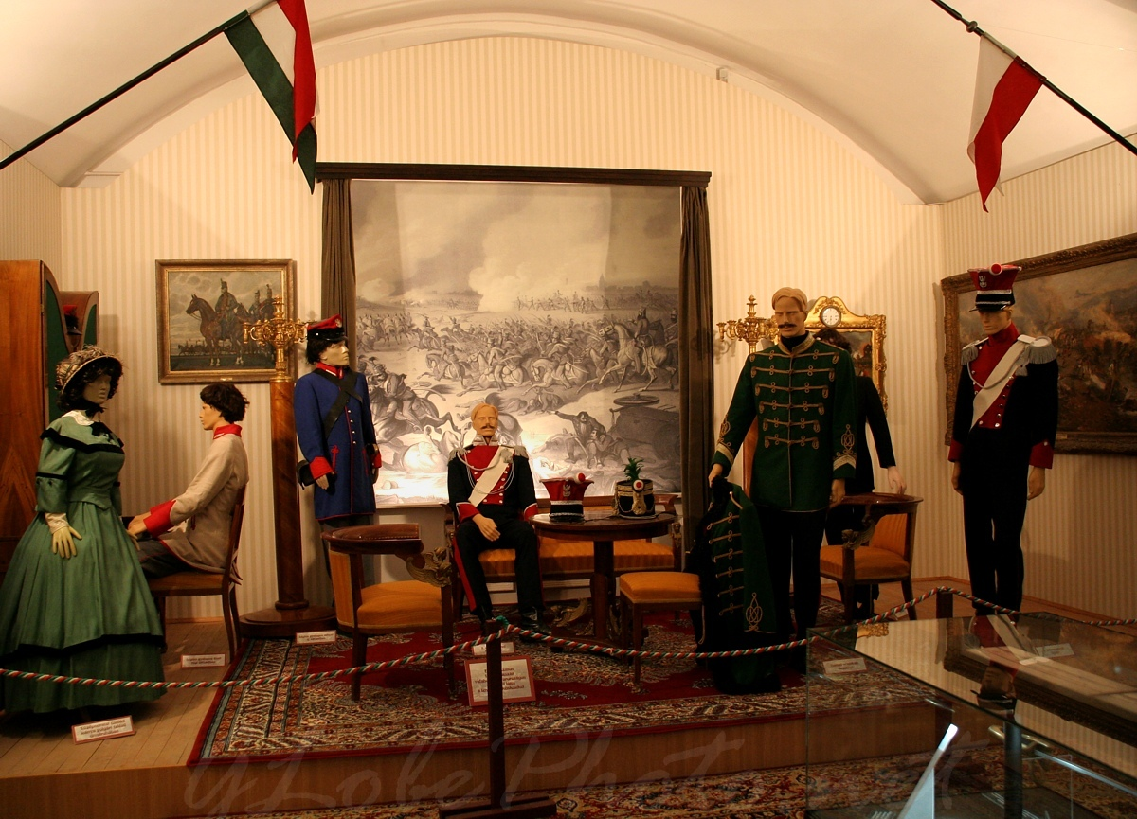
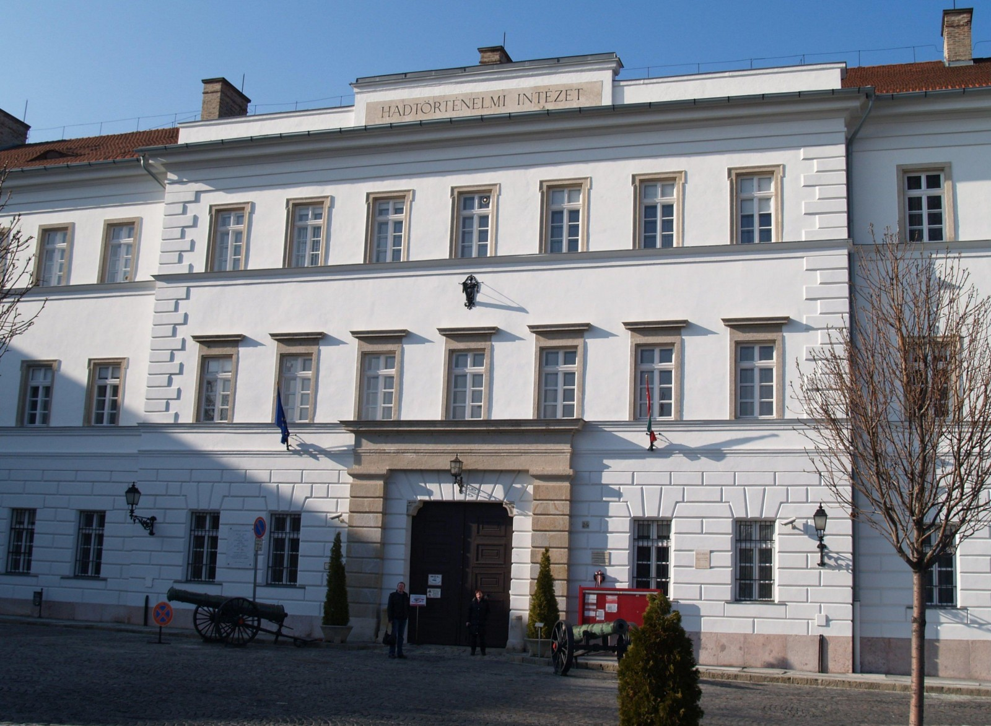
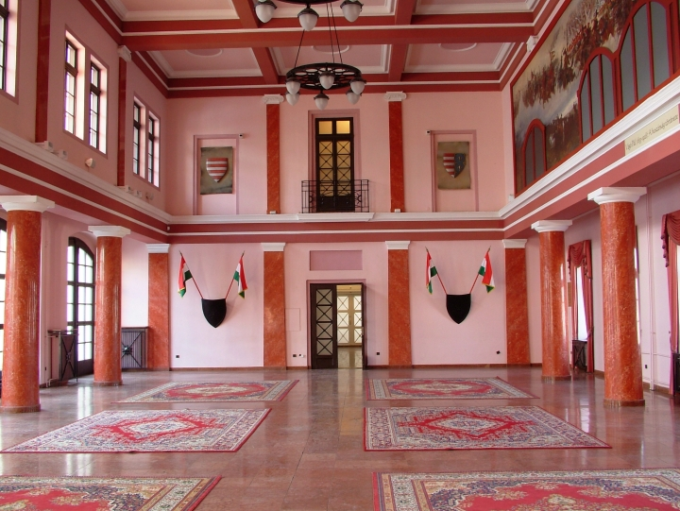
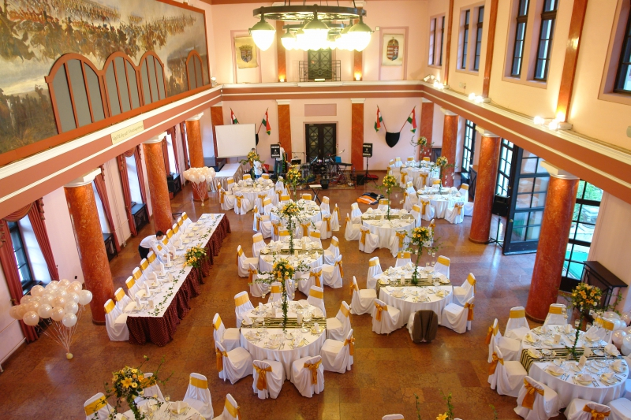
DRAFT PROGRAM
Sunday - Arrival
Ice-breaker
in the
Institute and Museum
of
Military History
Guided tour in the
Institute and Museum
of
Military History

Slide 5
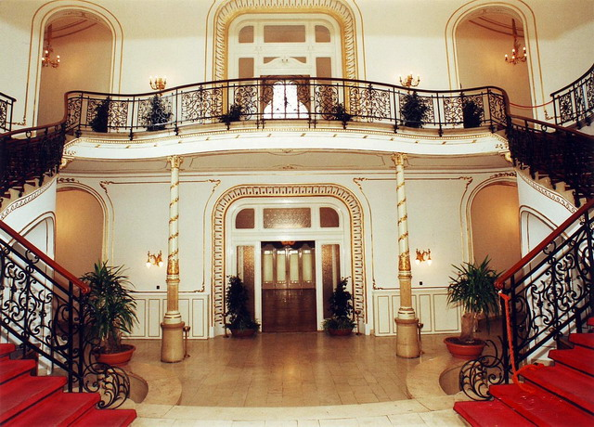
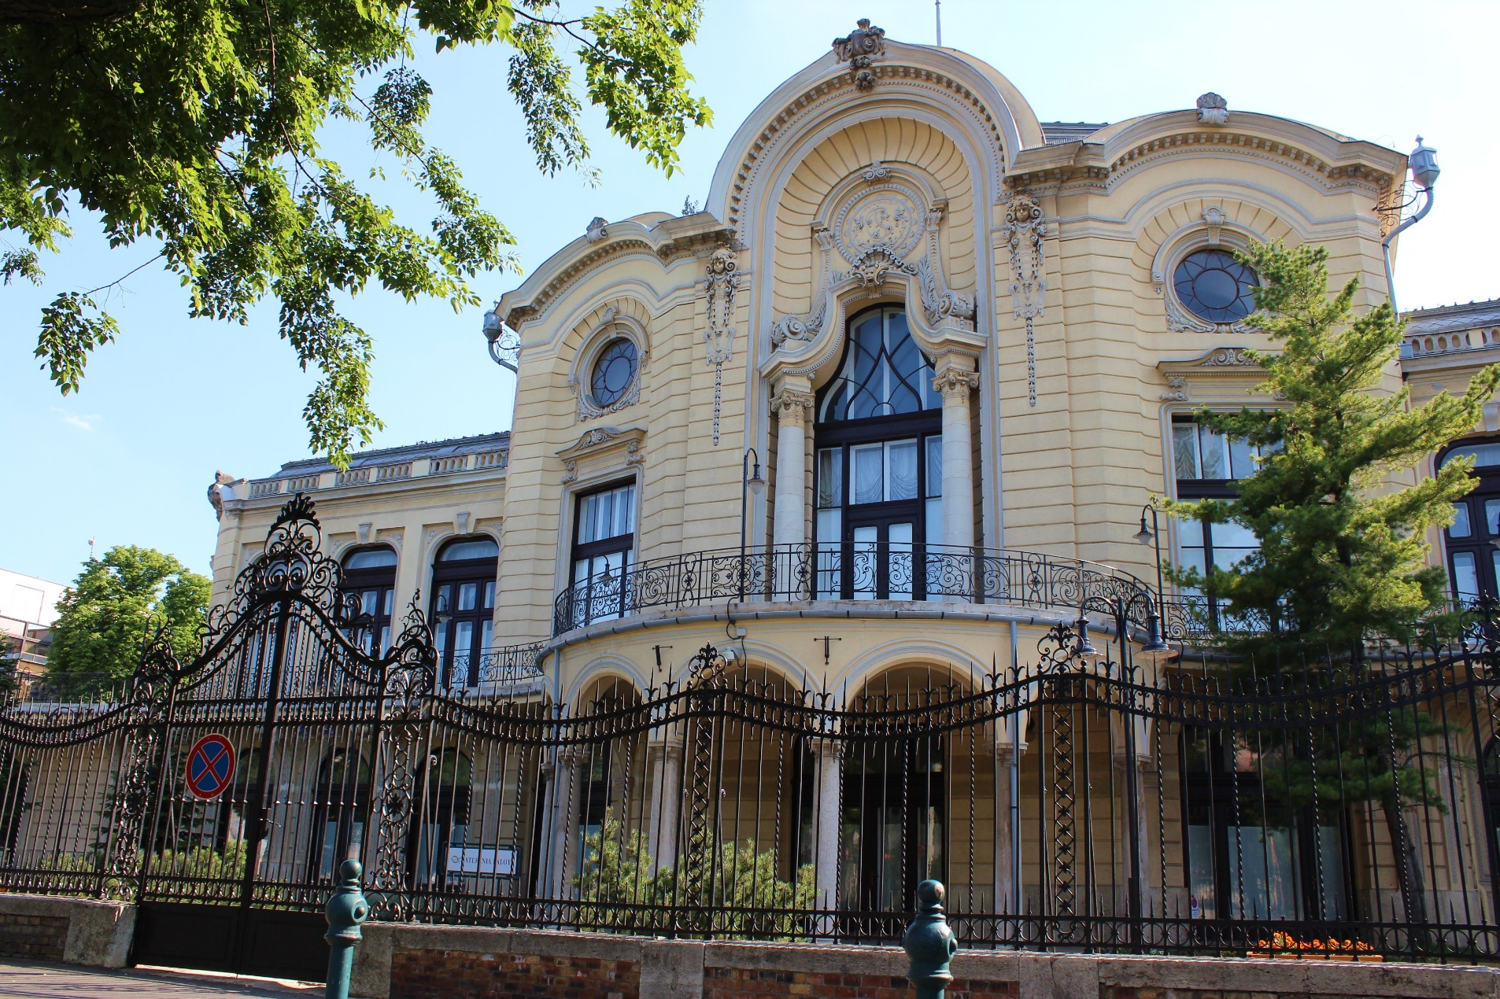
Seminar venue – Stefánia Palace

Slide 6
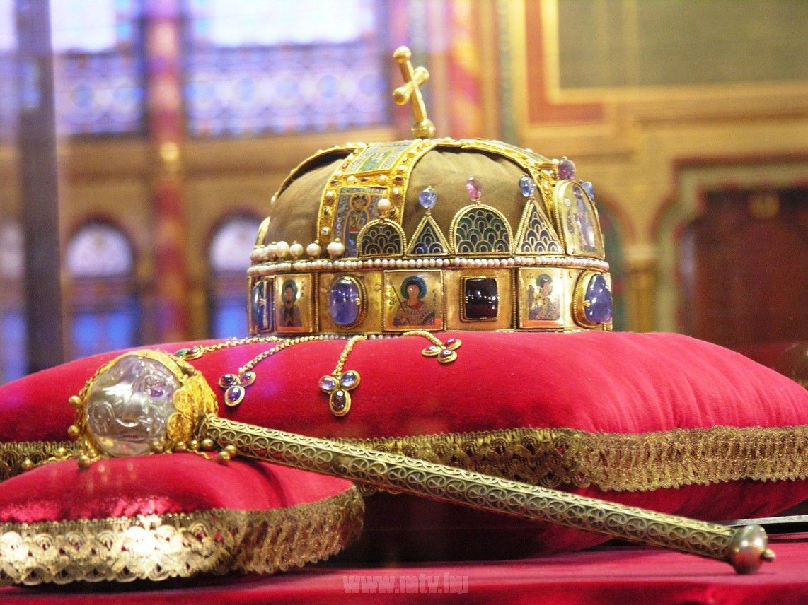
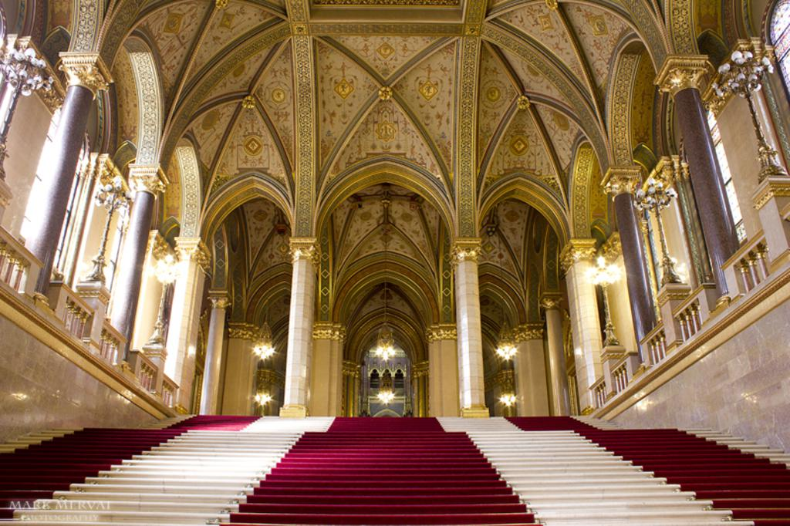
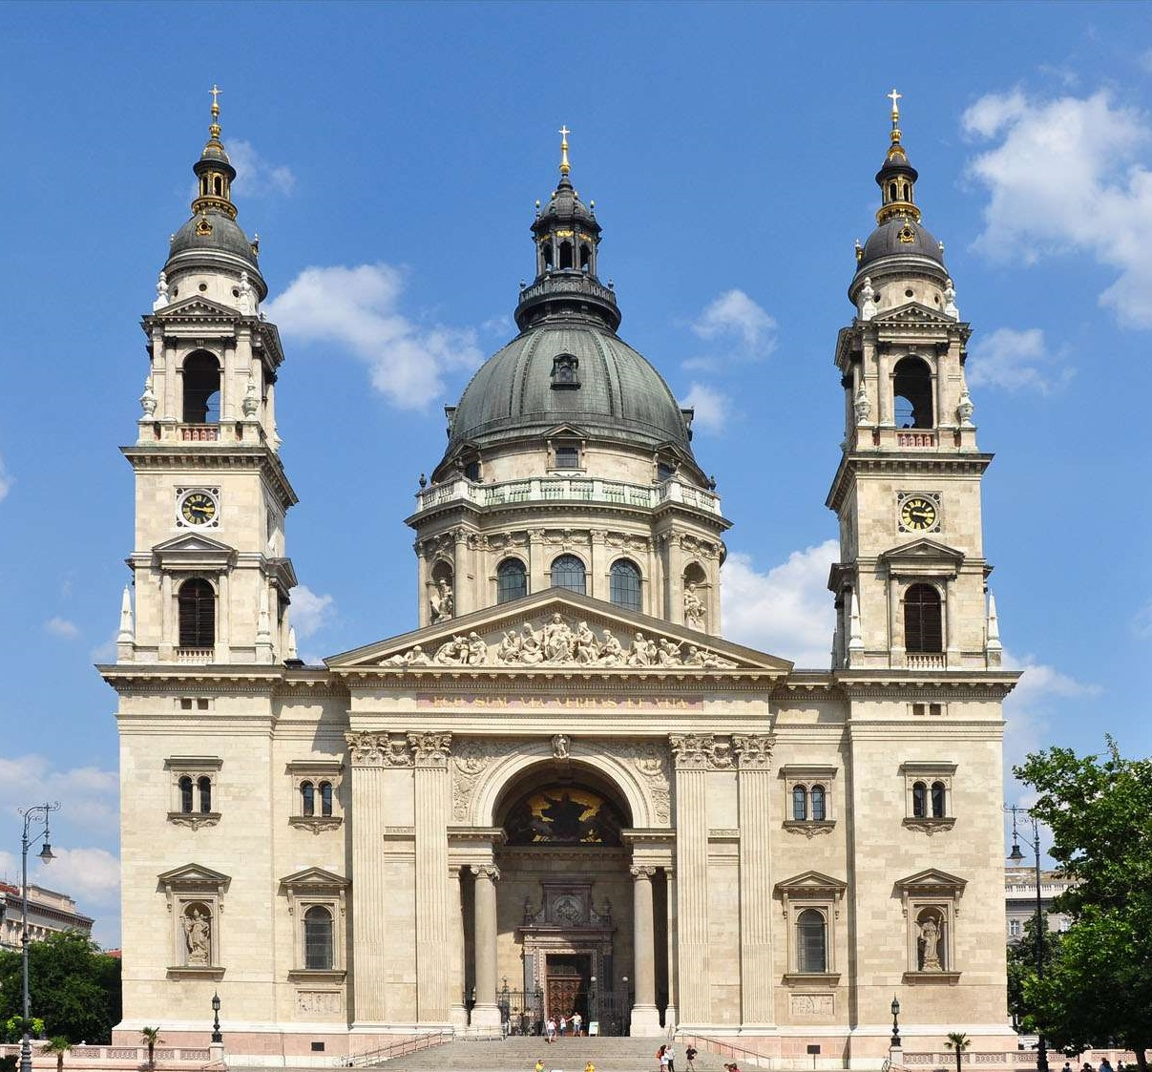
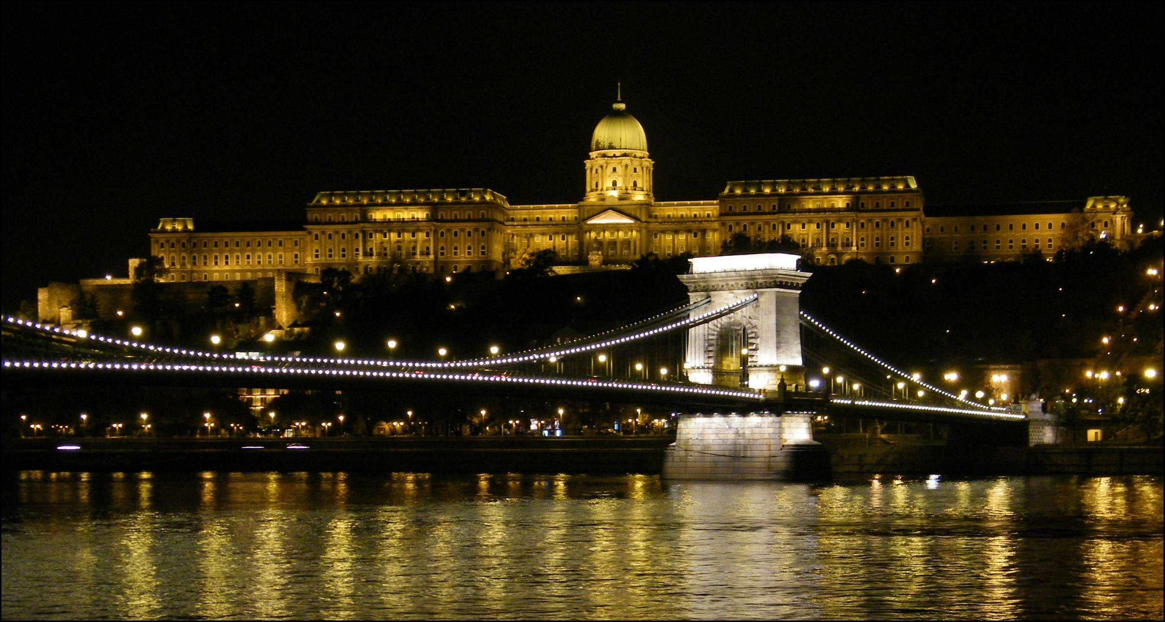
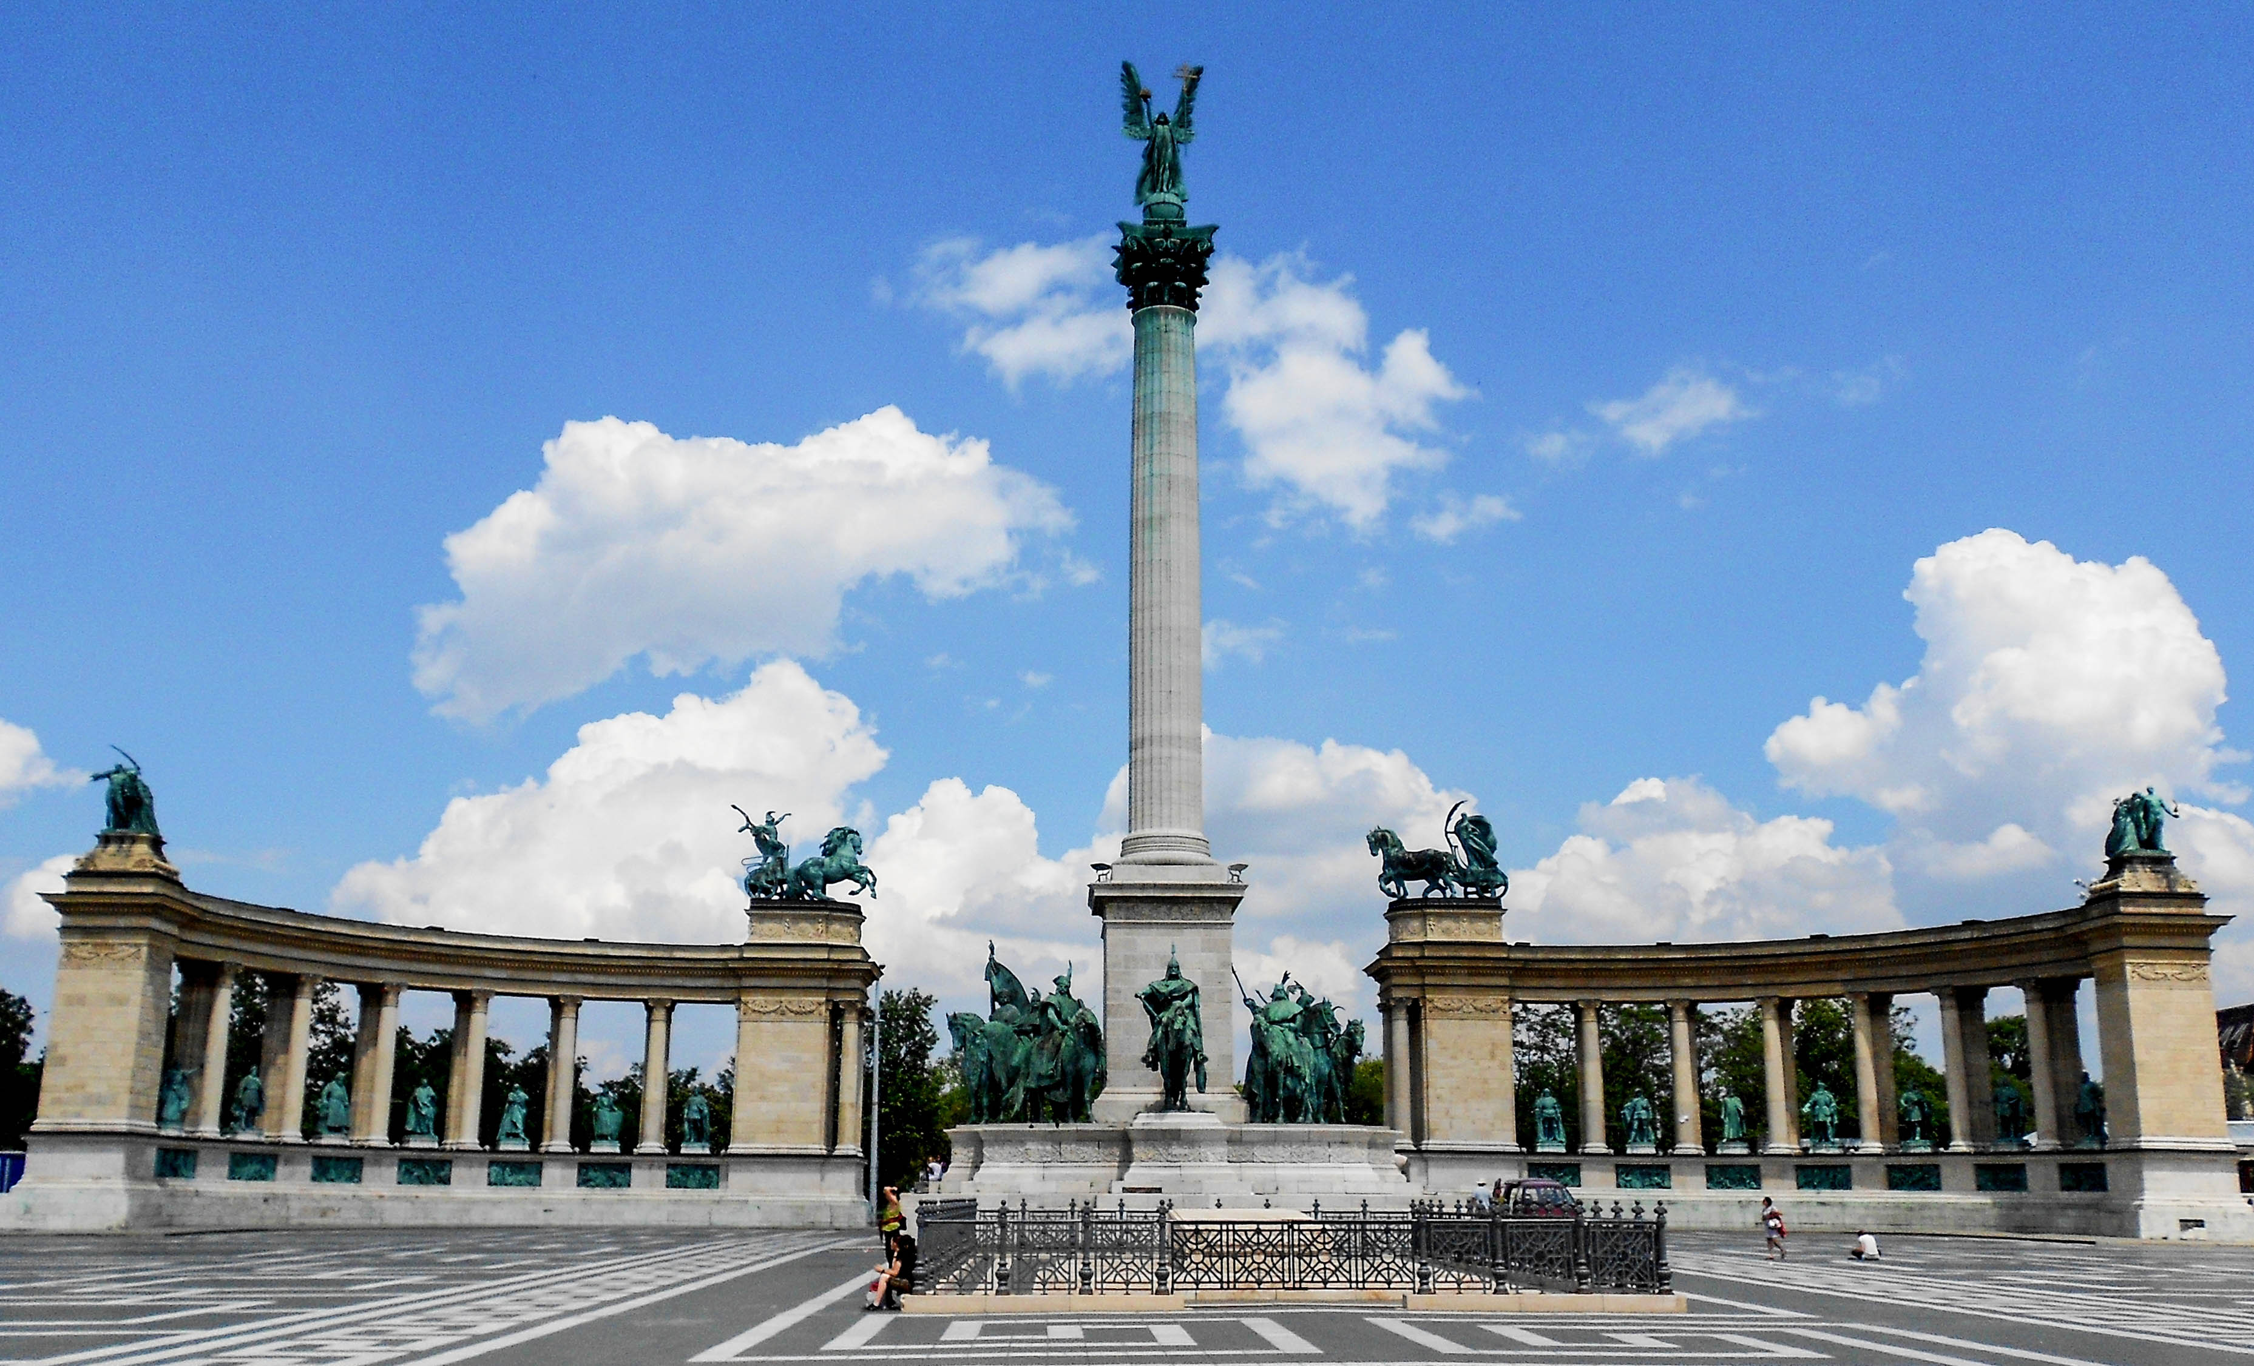
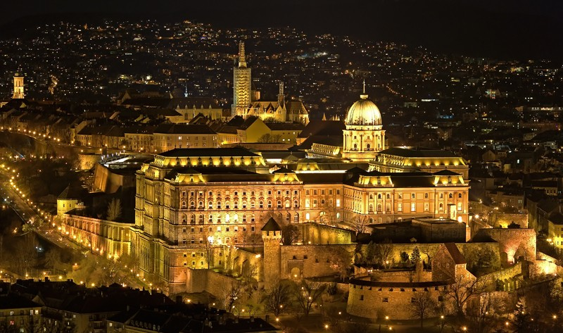
DRAFT PROGRAM
Monday – Sightseeing and Parliament

Slide 7
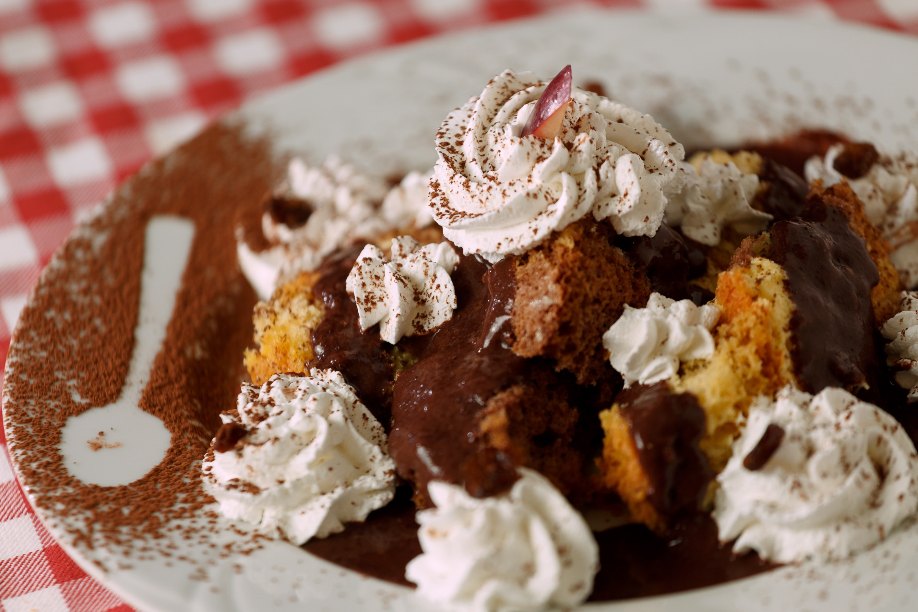
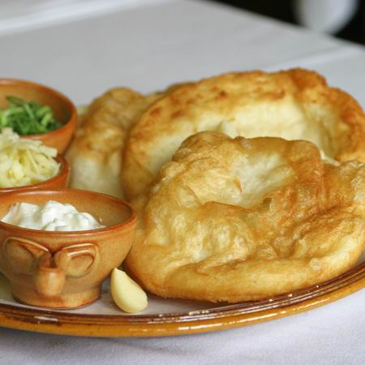
DRAFT PROGRAM
Tuesday– Free evening
Wednesday – Cultural program
Culture shock foreigners will experience
when visiting Hungary:
Pálinka will find you and try to kill you… ☺
and…
Food reigns supreme over anything and everything… ☺

Slide 8
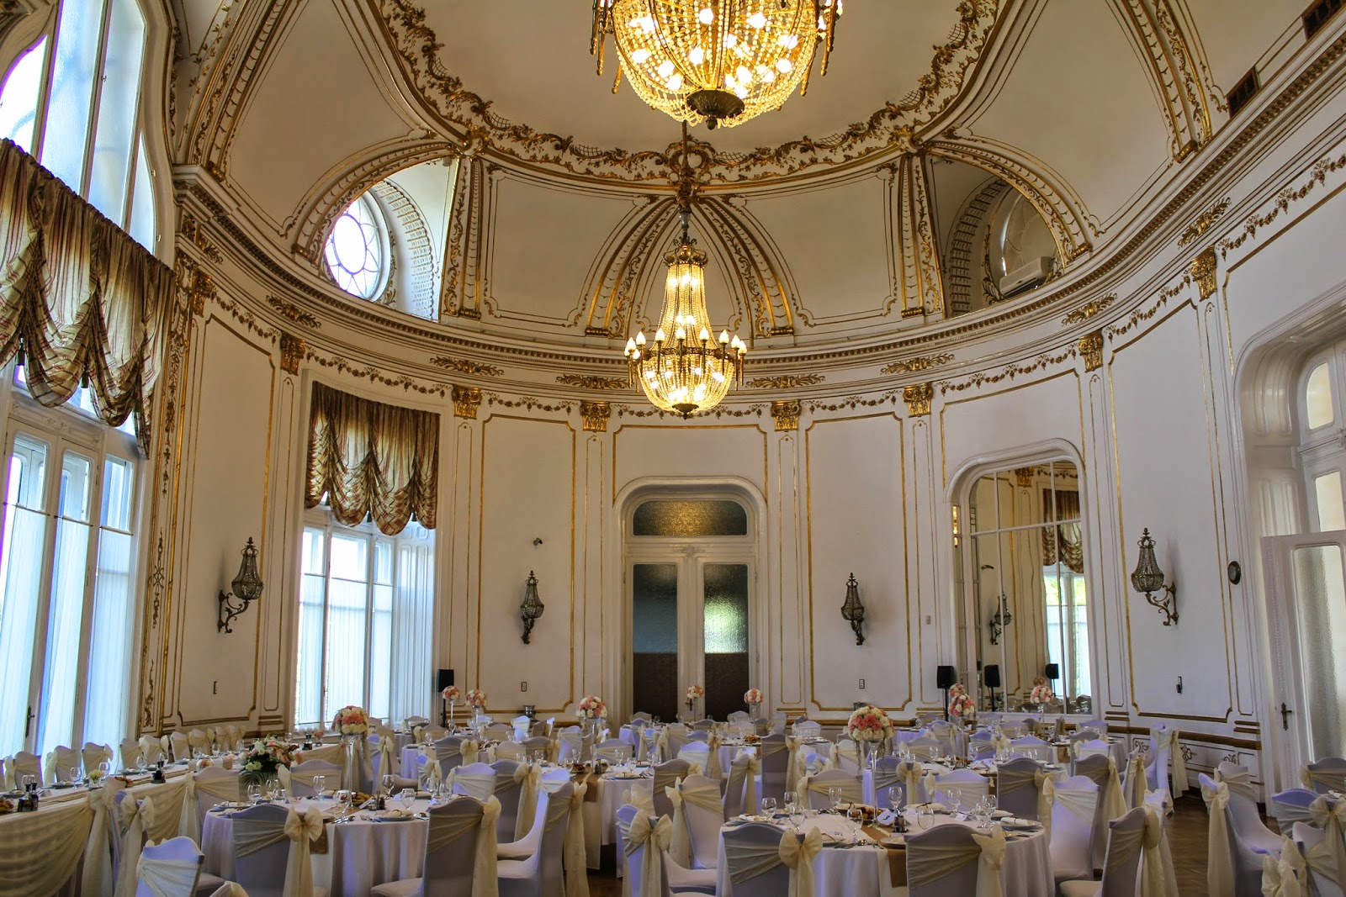
DRAFT PROGRAM
Thursday – Formal dinner
STEFÁNIA PALACE

Slide 9
BUREAU FOR INTERNATIONAL LANGUAGE COORDINATION SEMINAR 2016
Seminar theme
Authenticity in Training and Testing: Making it Real
Sub-themes
Linking training and testing to real-world target language use
Traditional textbooks versus authentic materials
Co-operating/partnering with local universities
Attaining concordance between linguistic objectives and training outcomes
Benefitting from tele-collaboration between training establishments Using social media in training
Teaching and learning as two sides of the same coin
Language maintenance

Slide 10
BUREAU FOR INTERNATIONAL LANGUAGE COORDINATION SEMINAR
Dates and location
24-28 OCTOBER 2016, Hungary, Budapest
Financial details
Accommodation – Premium single room: 120 EUR/night
Accommodation – Premium double room: 135 EUR/night
Seminar fee: 250 EUR/person
Spouse program fee: TBD (minimum 15 persons)
Registration deadline
09 September 2016

Slide 11
Budapest
https://www.youtube.com/watch?v=QfqyPGQgOlY

Slide 12
BUREAU FOR INTERNATIONAL LANGUAGE COORDINATION SEMINAR 24-28 OCTOBER 2016
Your host,
the Ministry of Defence of Hungary
looks forward to welcoming the
BILC family
to Budapest, Hungary!

