Slide 1
Bridging the gap between teaching and testing
Maj AF Ana Carina Lagares Overgaag
Head of the Germanic Languages Department
Spanish Defence School of Languages
Notes:
Good morning ladies and gentelmen, Mr. Chairman, …..
It is a great pleasure for me to be able to talk to you about one of the couses we have at our school.
ANECDOTE
I welcome questions at the end of my presenatation.
NATO servicemen/women need to take a proficiency exam in the English language.
It is easier to learn a language when there is an objective.
Not only learning for the sake of learning.
Our teaching is oriented towards improving L, S, RC, W in order to achieve a better result in the SLP exam

Slide 2
Two month-long English and French intensive courses at our school
Oriented to improve all skills
Enhance knowledge of language
Capabilities
Tackle SLP exam
Course aimed at professional level.
Notes:
The course lasts eight weeks
Oriented to improve all skills
Enhance knowledge of language
Improve Capabilities
Tackle SLP exam – providing students with the tools they need
Course aimed at professional level
We have this course in French also, their teachers are following the same method.

Slide 3
Index
Structure of the course
Selection process and tests
Programme of the course
The WIKI
Final aspects
Notes:
This is the index of my presentation.
Structure of the course
Selection process and tests
Programme of the course
The WIKI (Wikispaces – Internet site for educatyional purposes)
Final aspects

Slide 4
Structure of the course 2 groups of 10 students > grouped according to the SLP selective test
Germanic Language Department
Head of Dpt.
2 philologists
Control WR, extra lessons
Control SP, extra sessions
Outsourced
language academy
3 teachers
2 Testers
OPI Practice
SLP Writing
Notes:
We have three main pillars that are interwoven
The Germanic Language Deptm.
Academic aspects are important, but also the well being of the student.
2 philologists, have their lessons and control performance of students in Wr and Sp
The Language Academy > Outsourced lack of personnel
provides 3 highly experecienced teachers.
1 British, 1 American and 1 Spanish, all highly qualified.
1 teacher is more focused on improving language knoledge using materials from different sources and a coursebook
The other teacher does more SLP oriented activities. (Not tests, but acquiring the abilities, eg debates for expressing opinion- L3 task)
Third teacher does extra reinforcement sessions with groups of 5 students, 4 individual sessions/ Student, corrects HW writing 7 / student.
2 Testers
4 OPI sessions to practice the exam format, they correct the 7 SLP format writing excercises (1/week) and give feedback in the sessions.

Slide 5
Selection process and tests
Initial SLP test for 96 students > only the 20 best ones take the course
Mock exam, in the middle of the course
Final official SLP exam
Notes:
- Out of almost a hundred servicemen and servicewomen, the twenty best ones will take the course.
They need to have at least 9,5 points (counting the plus levels as 0.5) and a level 2 is the minimum level required.
A typical entry level is 2+2+2+2+2 or 3232. Normally, most of our students start with 10 points.
This official SLP test of the four skills is relevant for training purposes.
- The mock exam in the middle of the course to detect possible areas that still need to be improved.
A detailed tuition with each individual is done by the Head of the course.
- Final SLP exam (the two examiners that teach in the course, DON´T examin our students, of course)
Teaching and testing are completely separated.
The test is taken at the end of the course.
Participants improve in 0.5 points, so if they have a 2+ at the beginning of the course, they will reach level 3 at the end of the course.
If they started with a 2, after the course they have a better 2.
Rate of Slp 3333 is about 50-60%.

Slide 6
Programme of the course
Done by the department (200 hours), all skills everyday
1 reinforcement session (5 students) per day, voluntary basis
Individual tuitions (several purposes)
Lunch with teachers
Cultural activities
4 hours of selfstudy in the afternoon/evening
Notes:
The Germanic Languages Department programs every session.
Suggestions of teachers are welcomed and implemented, as well as the student´s proposals.
The programme is continuously updated and improved. We also take into consideration the student´s needs.
Higher attention is paid to Speaking and Writing.
This is not a course to do tests all day, but to improve the skills and abilities needed through activities like debates, role plays etc.
Reinforcement sessions > small groups, tailored according student´s needs
Individual tuition for psychological aspects (shyness, nerves, blank dullness, selfconfidence, orientation), academic ones etc
CHANGE YOUR PERSONALITY FOR ONE MONTH
Crises in the middle of the course
Lunch with teachers, 2 cultural activities and selfstudy

Slide 7
Example
SKILLS
CONTENT
W3
Monday 19 MAY
 | SKILL | CONTENT
09:00 09:55 | V | Finish War and peace p. 82 & 83 + Give Peace a Chance crossword pair work (Innovations Teacher Resource pp.60&61) Teacher’s FOLDER only pg T42
10:00-10:55 | S L | The Military and the Media (Campaign 3 pp. 80, 81) FOLDER pg 46-47
10:55-11:25 |  | PAUSE
11:25 12:20 | R | Assistant editor / Life in / Extract from a film (CAE Practice tests pp.7, 8, 9) FOLDER Pg 48-49
12:25-13:20 | S | “US to Reduce Use of Drones” (Discussion and/or role play) (Breaking News) FOLDER pg 50-51
13:30- 14:30 | REF | (as scheduled)
Review of MODALS
HOMEWORK
GR Innovations Unit 14 Modals Read G3 on pages 163,164 + Modals ex.5 (Innovations WB U4 p.14) FOLDER pg 52
W- Read SLP Manual Unit 5 For & Against Essays, self correct your exercises
Tuesday 20 MAY
The law: Relevant topic
 | SKILL | CONTENT
09:00 09:55 | S G L | Innovations Unit 4 The Law page 24
10:00-10:55 | S G L | Innovations Unit 4 The Law pages 24 & 25
10:55-11:05 |  | PAUSE
11:05 12:00 | S, L | Explore Speaking- Choose a logo (Unlimited Upper Inter. Unit 5 pp.44,46) CD 1 tracks 7-8 + Do role-plays (Arguments and counterarguments) FOLDER pg 53
12:05-13:00 | S,R | It´s quiz time! + Discussion FOLDER pg 54
13:30- 14:30 | REF | (as scheduled)
Role play: OPI task
Discussion: Opinion L3 Task
HOMEWORK
HW3 The use of Unmanned Aerial Vehicles (UAVs) in Afghanistan and Pakistan has given rise to a worldwide heated debate. Some believe they save lives while others believe they too often kill civilians and create even more animosity towards the U.S. and its allies. Write an essay in which you explain what drones are and how they work; (L2) and present the arguments for and against drone warfare.(L3) (300 words) (Task Description + Essay for and against / SLP Manual Unit 5 / Topic War & Peace)
HW: Writing: military topic
Notes:
This is the programme for 2 days.
Skills, content, Review of modals as HW, Relevant topic:the law, Role play, Discussion, Write a doc as HW
As we need to outsource the course, this is the best way of maintaining a high quality regarding the content , another company could win the contract.
Active students participation in class.
Dynamic and communicative lessons.

Slide 8
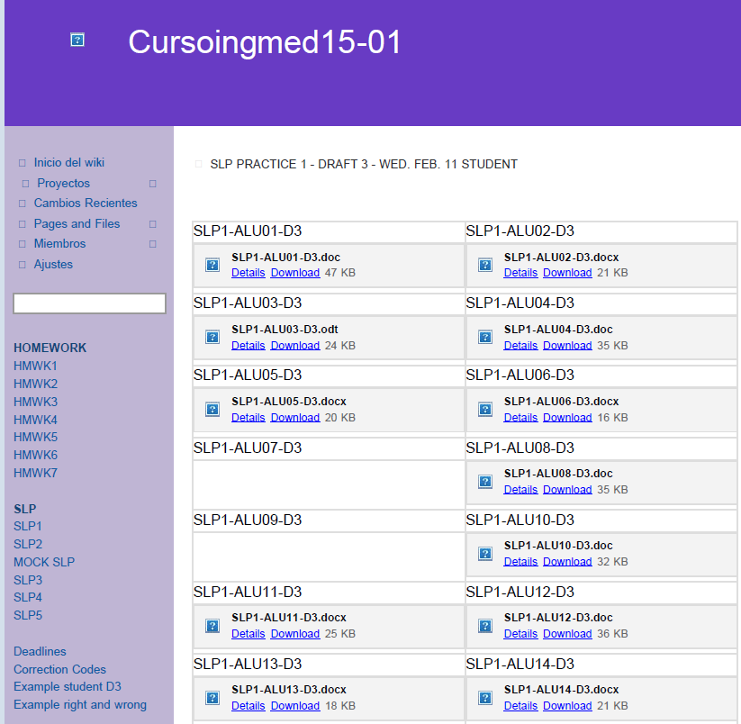
WIKI: a way of centralizing the Writing
Students upload
their documents.
Teachers correct them
and give feedback
Collaborative learning
For free

Slide 9
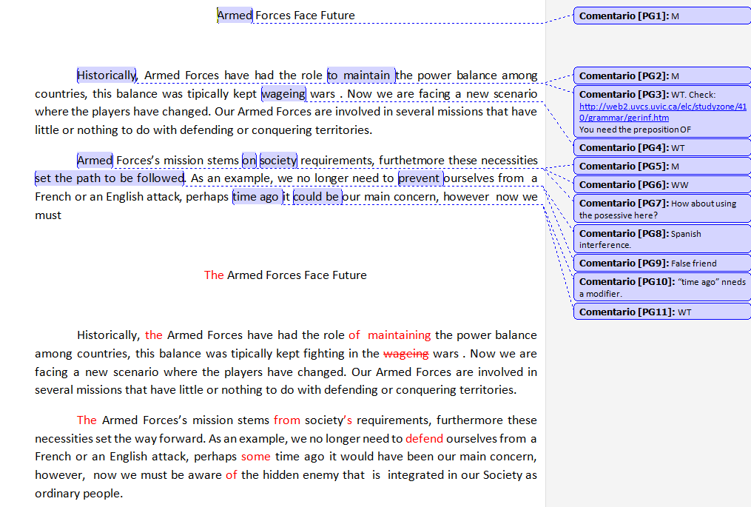
Notes:
4 steps
WO: word order is wrong
Feedback does not necesarrily imply giving marks, but stating what should be improved

Slide 10
Final aspects
Personalized attention
(8 professionals for 20 students)
Continuous feedback
Weekly team assesment meeting
Tools and strategies to succeed in the exam
Only English is spoken
Notes:
Highly motivated
Hard work of students and my team

Slide 11
Thank you
for your attention

