Slide 1
SUPPORTING ESP LEARNING OF THE MILITARY PERSONNEL
Assoc. Prof. Valentina Georgieva, PhD
Rakovski National Defence College Sofia
Tartu, 29th May 2019

Slide 2
Agenda
Background
Hybrid learning: a definition
Face-to-face vs Online teaching benefits
Advantages of hybrid teaching approaches
Hybrid course design: challenges for teachers
Hybrid teaching methods
Conclusion

Slide 3
Background
Teaching General and Specialized English (ESP) to the military in Bulgaria
“Digital Natives, Digital Immigrants” Marc Prensky
The Strategy for Development of the System for English Language Education: “English Language Education is a priority and one of the main tools for fulfillment of the national commitment for contributing to NATO capabilities. The System for English Language Education does not exist in isolation, but is affected by many factors, among which are the new missions and tasks for the Armed Forces […], powerful impact of modern technologies, etc.” (p.2); “distance and continuous education capabilities are underused”
Strategy goals: of the System for English Language Education are also included among others: development and piloting of new forms of teaching that combine blended and distance learning phases; development of the distance learning system; enhancing English courses’ potential with development of new short blended and/or distance courses.

Slide 4
Hybrid learning: a definition
hybrid: a plant or animal that has been produced from two different types of plant or animal, esp. to get better characteristics; or something that is a mixture of two very different things
hybrid learning: combining traditional face-to-face teaching and online teaching into one cohesive experience

Slide 5
Face-to-face vs online
blended learning: 75/25
hybrid learning: 50/50 or
“courses in which a significant portion of the learning activities have been moved online, and time traditionally spent in the classroom is reduced but not eliminated”, i.e. hybrid learning is done mostly online.

Slide 6
Face-to-face vs Online teaching benefits
Face-to-face teaching benefits
Human contact and support
Nonverbal communication
Discussing, assigning tasks
Negotiating expectations and responsibilities
Diagnosing students’ conceptual problems and providing immediate feedback
Brainstorming
Developing student’s debating skills
Developing student’s presentation skills
Online teaching benefits
Flexibility in time management; self-paced learning and practice
Broader participation in discussions
Sustaining group cohesion, collaboration, and support
Reflective, on-task discourse maintaining students’ sense of autonomy
Critical analysis and greater student responsibility
Self-assessment quizzes with feedback
Automatic grading of multiple choice, T/F, fill-in-the-blank tests
Chunking content into modules

Slide 7
Advantages for students
Flexibility
→ students can watch a video or listen to a listening task many times
→students access study materials anywhere anytime
→complete online assignments
→ online assignments are posted to asynchronous discussion forums for online discussion and students comment, advise, argue and get actively engaged in the topic.

Slide 8
Advantages for students Cont’d
Students interact and collaborate
Activity: students prepare a project online, post it to the university platform’s discussion forum for debate and revision, and then present it in the face-to-face class for final discussion and assessment
Personalised learning
Personalised feedback
Advice and support to Sts

Slide 9
Hybrid course design: challenges for teachers
requires more time because a systematic course structure is necessary
not just upgrading the existing traditional face-to-face course with additional online activities
Converting a traditional course: re-examining course objectives, designing online learning activities to meet course’s objectives, and effectively integrating online activities with the face-to-face classes

Slide 10
Hybrid teaching methods
Flipped classroom - students learn new content at home – predominantly online by watching video lectures – and the face-to-face class time is devoted to more creative activities
https://www.khanacademy.org/
https://www.khanacademy.org/humanities/grammar/parts-of-speech-the-verb/verb-aspect-and-modal-verbs/v/perfect-progressive-aspect-the-parts-of-speech-grammar
https://www.englishcentral.com/
https://www.englishcentral.com/video/22679
https://learningenglish.voanews.com
https://learningenglish.voanews.com/a/hamlin-garland-return-of-a-private/4307341.html
http://www.freeieltscourse.com/
https://www.youtube.com/watch?time_continue=19&v=iOQG6SpxaRQ
Debates
Discussions and group chats
Peer review

Slide 11
Self-evaluation as a hybrid method
Self-evaluation through quizzes
https://www.englishclub.com/
https://www.englishclub.com/speaking/weather-vocabulary-quiz.htm
Self-evaluation of the listening skill
www.tubequizard.com
http://www.tubequizard.com/quiz.php?id=149
Self-evaluation of the writing skill
https://writeandimprove.com/
https://writeandimprove.com/workbooks#/wi-workbooks/bdc648bc-b760-4bac-98bc-161a95deff5e/tasks/585be9d7-55b7-4bab-9832-ba017429e470
Inquiry based research: students ask their own question(s) on a primary source of information
Critical incident questionnaire: helps teachers see their teaching practice through students’ eyes.

Slide 12
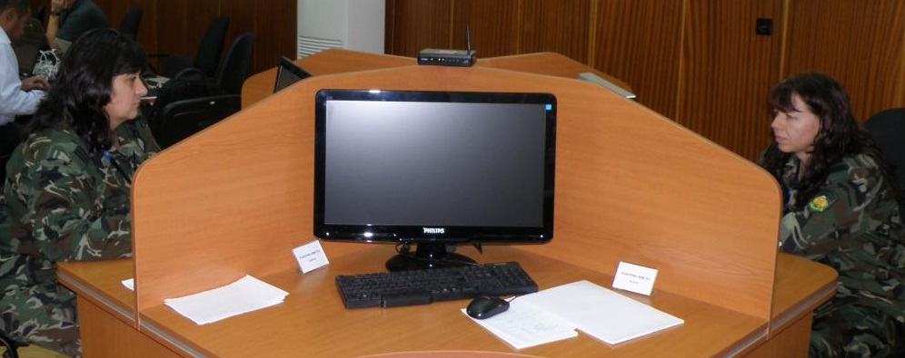
Conclusion
Hybrid ESP model which integrates traditional and online teaching approaches and combines innovative technology with effective personalized teaching is the answer for the military specialists who need English for performing their tasks in an international environment

Slide 13
Thank you for your attention!

