Slide 1
Transforming DLIFLC through Faculty Development
Detlev Kesten & Betty Lou Leaver DLIFLC, USA

Slide 2
WHO WE ARE

Slide 3
Linguistic Readiness
Notes:
(VIDEO file: 20150622_PPS1.wmv)
Theme: DLIFLC effectively and efficiently produces high quality language capability for the Department of Defense through rigorous academic and military training.
Message: Transformation at DLIFLC is in part intended to centralize DoD language training to remove redundancy and exploit expertise and efficiencies.
Video description: The Defense Language Institute Foreign Language Center, the Department of Defense’s premier language training provider, is the largest, most efficient and effective, foreign language educational institution in the nation. An organization founded in the shadow of World War II, today the Institute continues to adapt to meet the requirements for our nation’s security.
The Institute currently teaches twenty-three languages at the Presidio of Monterey, while another sixty-five languages are offered through its branch in Washington D.C. At any given time there are approximately 4,000 students attending the Institute from the Department of Defense, other U.S. government agencies as well as a small number of military students from allied nations. To ensure the best possible training for future language professionals, students are taught by highly educated instructors, 95% of whom are native speakers of the languages they teach.

Slide 4
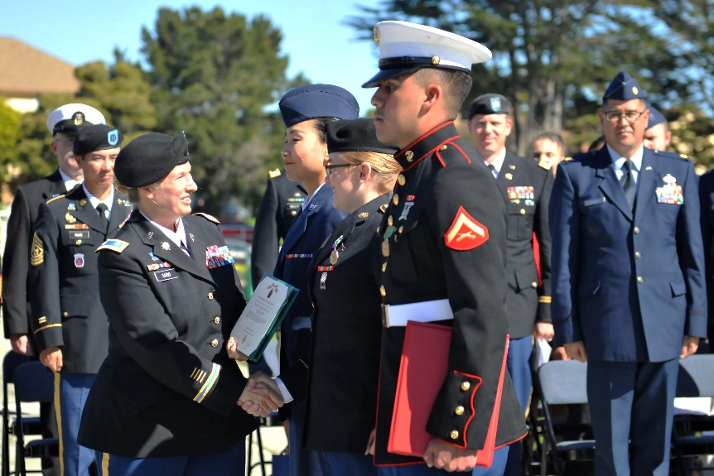
Undergraduate Student Profile
~ 2,500 multi-service
66% - under age 25
99% - high school graduates
17% - college graduates
8% - officers
71% male population
29% female population
84% - students will support intelligence missions
Schedule: 5 days/week, 6+ hrs
per day, 2-3 hrs homework
39%
13,439 AA degrees awarded
since 2002
Notes:
Updated as of Mar 29, 2017

Slide 5
DLIFLC Languages
Category I
Spanish
French
Category II
Indonesian
Category III
Persian Farsi
Russian
Urdu
Hebrew
Tagalog
Category IV
Modern Standard Arabic
Arabic - Egyptian
Arabic – Sudanese
Arabic - Levantine
Arabic - Iraqi
Chinese Mandarin
Korean
Japanese
Pashto
94% of Students taking CAT III & IV Languages
Course Lengths
CAT I & II – 36 Weeks
CAT III – 48 Weeks
CAT IV – 64 Weeks
Notes:
Spanish and French have been extended by 10 weeks in FY16.
Began teaching Egyptian Arabic end of July 2014.
Sudanese first course started in Aug. 2015.
In 2014 we closed: Italian and Thai department. Dari ended July 2015.
In Jan 2016, announced the closure of: Portuguese, German, Serbian/Croatian, Hindi and Turkish.

Slide 6
After DLIFLC
Notes:
(VIDEO file: 20151127_After_DLI.wmv)

Slide 7
Non-Resident Learning Resources for Students

Slide 8
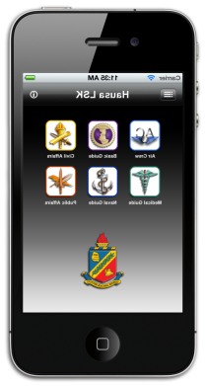
Language Survival Kit (LSK)
To provide governmental and NGOs with point-of-need basic language skills
93 LSKs
10 topic areas: Air Crew, Basic Language, Civil Affairs, Cordon/Search/Raid, Force Protection, Medical, Military Police, Navy, Public Affairs and Weapons
Notes:
LSK: Albanian, Algerian, Amharic, Azeri, Baluchi, Bengali, Bosnian, Bulgarian, Burmese, Cantonese, Cebuano, Chavacano, Colombian, Czech, Croatian, Dari, Egyptian, Emirati, French, Gan, Georgian, Gujarati, Haitian, Hassaniya,
Hausa, Hebrew, Hindi, Igbo, Ilocano, Indonesian (Bahasa), Iraqi, Italian, Japanese, Javanese, Jordanian, Kashmiri, Kazakh, Khmer, Korean (North), Kosovar (Albanian), Kurmanji, Kyrgyz, Lebanese, Libyan, Lingala, Malay, Mandarin,
Modern Standard Arabic (MSA), Mongolian, Moroccan, Nepali, Palestinian, Pashto (Afghanistan), Pashto (Pakistan), Persian-Farsi, Polish, Portuguese (Angola), Portuguese (Brazil), Portuguese (European), Punjabi (Pakistan),
Romanian, Russian, Saudi, Serbian, Sindhi, Somali, Sorani, Spanish (Mexico), Spanish (Colombia), Spanish (Venezuela),Sudanese, Swahili, Syrian, Tagalog, Tajik, Tamashek, Tamil, Tausug, Telugu, Thai, Tigrinya, Tunisian, Turkish,
Turkmen, Uighur, Urdu, Uzbek, Vietnamese, Wu, Yakan, Yemeni, Yoruba

Slide 9
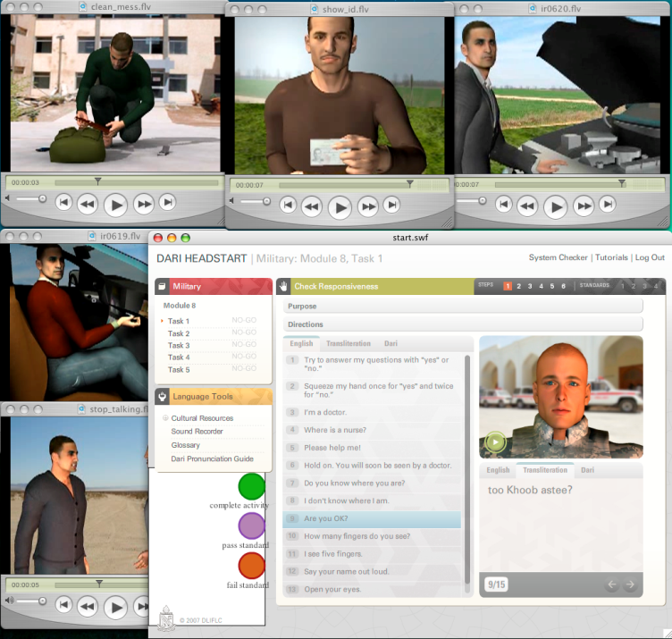
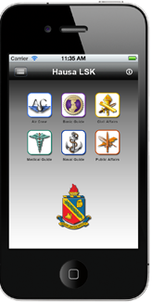
Online Resources
- Rapport – 6-8 hrs. language & culture training – 27 languages
- HeadStart2 - 80-100 hrs. training - 39 languages
- Language Survival Kits - 93 languages
Sustainment materials
- Cultural Orientation - 95
- Countries in Perspective - 75
- GLOSS - 41 languages
- ODA - (diagnostic) -18 languages
Mobile Apps
- iTunes
- Google Play
Majority of products are open to the public
Notes:
Updated - Dec. 7, 2016
Online learning: HeadStart2 and Rapport (100hr and 6hr training)

Slide 10
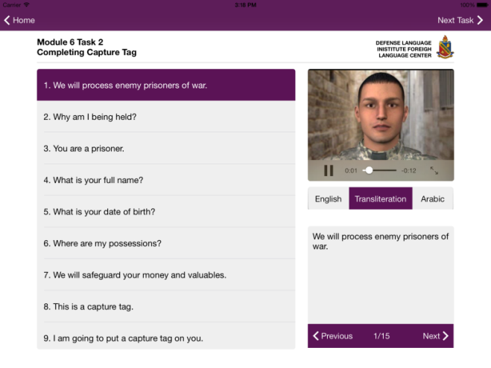
There’s an App for That
LSK mobile applications for mobile devices available in:
iTunes – 15 languages
Google Play – 8 languages
Notes:
Headstart2 - iTunes: Arabic MSA, Baluchi, Cebuano, Chinese, Dari, Egyptian, European, Portuguese, Farsi, French, German, Hausa, Iraqi, Korean, Kurmanji, Levantine, Moroccan, Pashto, Punjabi, Russian, Somali, Spanish, Swahili, Tausug, Turkmen, Uzbek
Hedstart2: - Google Play: Baluchi, Egyptian
LSK - iTunes: Dari, Pashto, Afghanistan, Mandarin, Cantonese, Portuguese, Amharic, Colombian, Swahili, French, Somali, Farsi, Baluchi, Urdu, Yemeni, Russian
LSK - Google Play: Dari (5), French (6), Pashto (5), Cantonese (1), Cebuano (6), Korean (6), Somali (6), Korean (consolidated)

Slide 11
Transformative Approaches to Learning & Teaching: Transforming DLIFLC

Slide 12
The Roots of Transformation
Educational Philosophy | Transmission | Transaction | Transformation
Theory | Mastery Learning (Bloom) | Experiential Learning (Dewey, Freire) | Humanistic Learning (Rogers)
Goal | To know | To do | To be
Cognition | Memorization | Constructivism Critical Consciousness | Self-efficacy
Concepts | Reproduction | Schema Theory Zone of Proximal Development (ZPD) | Counseling/Mentoring Autonomous Learning
Notes:
Constructivism is basically a theory -- based on observation and scientific study -- about how people learn. It says that people construct their own understanding and knowledge of the world, through experiencing things and reflecting on those experiences.; Piaget – schema; Vygotsky – ZPD;
Critical consciousness focuses on achieving an in-depth understanding of the world, allowing for the perception and exposure of social and political contradictions. Critical consciousness also includes taking action against the oppressive elements in one's life that are illuminated by that understanding.
Postman suggests creating a class where students themselves are entirely in control of the syllabus, class activities, and grading. Critical pedagogy also refers to inquiry methods of learning (Postman).
reflective teaching practice is a continuous process and involves learner thoughtfully considering one's own experience in applying knowledge to practice while being taught by professionals. It helps the individual's to develop their own personality.

Slide 13
Transforming…
 | Methods | Students | Curricula
From | Transactive modes (e.g., communicative approaches) Memory intensive Summative testing Appropriate products | Textbook oriented Teacher dependent Recipient & actor Learning ”to do” Culturally “schizophrenic” | Task-based Content-based Textbook-based Uniform/standardized Objective-guided
To | Transformative modes Contextually extensive Formative testing Achieving objectives | Tasks & projects Learning “to become” Culturally “eccentric” | Self-directed study/interest Learning contracts Super-authentic materials Objective dependent
How | Learner-centered Diagnostically oriented Student-directed Learner-led Prochievement tests Teacher advisor/mentor | Self-directed study Learning contracts Research & experience Autonomy Self-knowledge Learning strategies | Adaptive syllabi/negotiated Open architecture Self-directed design Selection of materials: teacher & objective guided Technology-enhanced

Slide 14
The Action of Transformation
To become
a fluent language user
a bicultural individual
Student
Let go of preconceived ideas of L2 learning & teaching
Take risk & responsibility; release dependency
Acquire metacognitive strategies
Instructor
Learn to lead from behind (listen, analyze, suggest, prompt
Reframe, empathize, be congruent, be positive (non-judging)
Allow student to take charge and to learn

Slide 15
Advanced Language Academy (ALA)
ALA for Senior Leaders: Aug 10-21, 2015
ALA for Chairs*
Phase I: 11/2 – 11/27, 2015 & 1/11 – 1/29, 2016
Phase II: 11/30 – 12/4, 2015 & 2/22 – 2/26, 2016
Phase III: 6/6 – 6/7, 2016
ALA for Teachers*
Phase I: 4/25/16 ( starting in all UGE schools)
Phase II : 7/18/16 (24 hr; UGE Trainers)
ALA for Academic Specialists and Trainers
Phase I: 3/28 – 4/22 & 4/25- 5/20/16
Phase II: 6/8/16 – 6/10/16
ALA for Military Associate Deans & CMLIS
Phase I: 4/10- 4/17, 2017
Phase II: 4/18 – 4/21, 2017

Slide 16
ALA for Faculty
Phase 1 Online 6 hours | Transformative Pedagogy (educational philosophy), Open Architecture, “Everything Hidden Is Revealed,” Differentiated Instruction, Diagnostic Teaching (Principles & Assessment Tools), Content-Based Instruction, Project-Based Instruction, Scenario-Based Instruction, Principles and Components of Strategy-Based Instruction, Learning Strategies at Lower/Higher Levels of Proficiency, Learner Autonomy, Learning Contracts, Self-Assessment
Phase 2 In-person (F2F) 24 hours | Post-method era (paradigm shift), Teaching for 2+, Learner Development for 2+, Diagnostic Teaching, Differentiated Instruction, Project-Based Instruction, Strategy-Based Instruction, Content-Based Instruction, Scenario-Based Instruction, Learner Autonomy, The Teacher as Leader
Post-ALA | Varies by school; mentoring by chair and team leader; quality assurance by Faculty Development Division, teacher swaps; rewarding transformative teaching )Provost Showcase), dozens of specific topic workshops available & able to be developed/adapted

Slide 17
References
Anon. 2017. “Transformative Pedagogy.” Education for a Sustainable World website. Downloaded March 12. https://ufbutv.com/e-learning/transformative-pedagogy/
Cohen, Laurence Robert. Summer 1997. "I Ain't So Smart and You Ain't So Dumb: Personal Reassessment in Transformative Learning.“ New Directions for Adult and Continuing Education. N 74.
Freire, Paolo. 2000 (reprint from 1970). The Pedagogy of the Oppressed. Bloomsbury Academic.
Ginsburg, Herbert. 1987. Piaget’s Theory of Intellectual Development. Pearson.
Keneman, Margaret. Fall 2016. “Empowering the Foreign Language Learner through Critical Literacies Development.” Journal of Language and Literacy Education. V12 N2.
Kozulin, Alex et al. 2003. Vygotsky’s Educational Theory in Cultural Context. Cambridge University Press.

Slide 18
References
Mezirow, J. 1997. Transformative Learning: Theory to Practice. New Directions for Adult and Continuing Education, 74, 5–12.
Mezirow, J. 2000. Learning as Transformation: Critical Perspectives on a Theory in Progress. San Francisco: Jossey Bass.
Parkes, R. J. 2000. “The Crisis in Pedagogy.” In M. O'Loughlin (Ed.). Philosophy of Education in the New Millenium: Conference Proceedings, Vol. 2 (pp.73-87). University of Sydney (Australia).
Postman, Neil. 1971. Teaching as a Subversive Activity. Delta Publishing.
Rogers, Carl. 1991 (reprint from 1968). On Becoming a Person. Mariner Books
Ukpokodu, Omiunota. 2009. “The Practice of Transformative Pedagogy.” Journal on Excellence in College Teaching, v20 n2 p43-67.

Slide 19
QUESTIONS?

