Slide 1
BILC SEMINAR 2024-10-16
DEALING WITH DYSLEXIA
IN TEACHING AND TESTING
Mariamma Martin
Stephen Haughey

Slide 2
Agenda
Introduction
Misconceptions and clarifications
Dyslexia as a strength
Challenges relating to the military
Practical strategies for the military
Tools & methods used in the SWE AF
Fostering a supportive environment

Slide 3
Misconceptions
and Clarifications
Functional impact - does not equate to a lack of intelligence or ability
Wide spectrum - manifests differently in individuals, and it’s not just about reversing letters or having reading difficulties

Slide 4
Dyslexia as a Strength
Neurodiversity
creative problem-solving
strategic thinking
attention to detail
Famous military dyslexics
Dwight Eisenhower
George Patton
George Washington

Slide 5
Challenges Relating
to the Military
Interpreting maps
Following written orders
Using technology
Reading reports
Writing reports

Slide 6
Practical Strategies For the Military
Adaptive training
Assistive technology
Written communication
Importance of leadership in creating an inclusive environment
Workplace adjustments

Slide 7
Tools Used in the SWE AF
for Teaching and Testing
TorTalk
Stava Rex

Slide 8
TorTalk
Speech synthesizer
A work tool that you can use when you want to listen to a text
Reads text live, meaning that nothing is pre-recorded
Can be used only for open information
Can read web pages, PDF files, e-books, scanned text
Has an OCR function
Possible to choose reading speed, voice and language
Has an off-line function, which makes it possible to listen while traveling or working from home

Slide 9
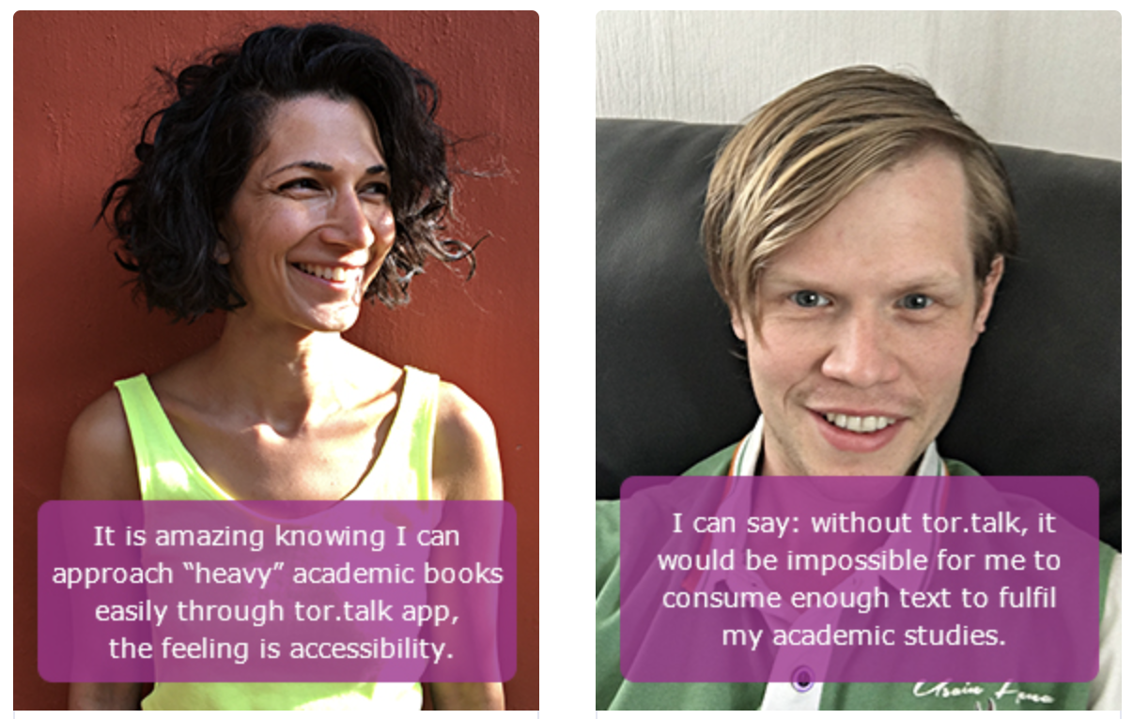
TorTalk Feedback

Slide 10
Stava Rex
Spelling and grammar checker
Add-on to Word, more advanced than what is already built in
Program that corrects Swedish spelling and grammatical errors
Provides support for writing difficulties
Can be used as an add-on to Microsoft Office or as a stand-alone program together with other programs
Can correct serious errors and helps to distinguish between easily confused words

Slide 11
Fostering a Supportive Environment
Confidentiality and respect
Promoting teamwork
Framing dyslexia in terms of practicality and inclusivity, with an eye to benefitting military organisations

