Slide 1
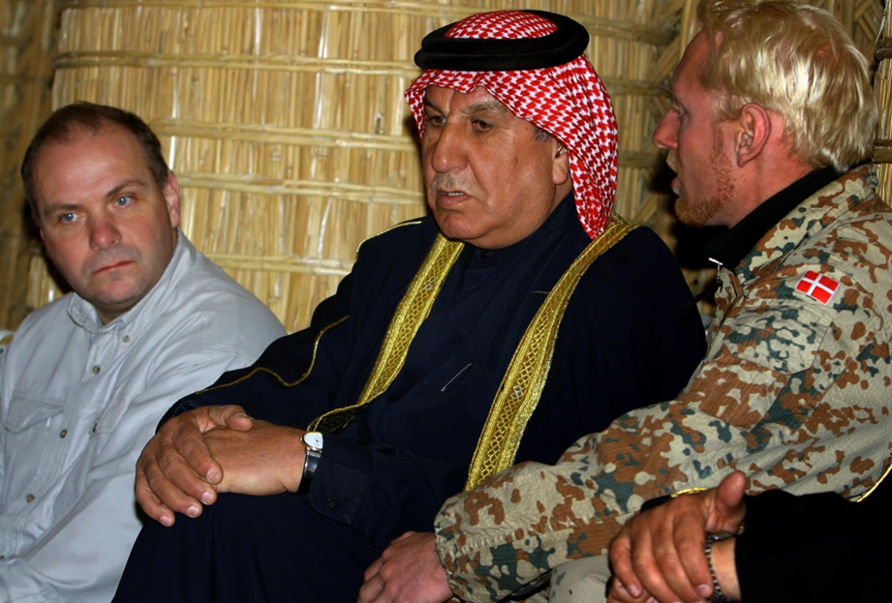
FROM CLASS ROOM PROFICIENCY TO PERFORMANCE IN THE FIELD
Training Officer Linguists for Training Missions in Iraq, Ukraine, and Afghanistan
Kristian Kolding
Senior Lecturer - MA, captain
Head of Language Training (LOTE)

Slide 2
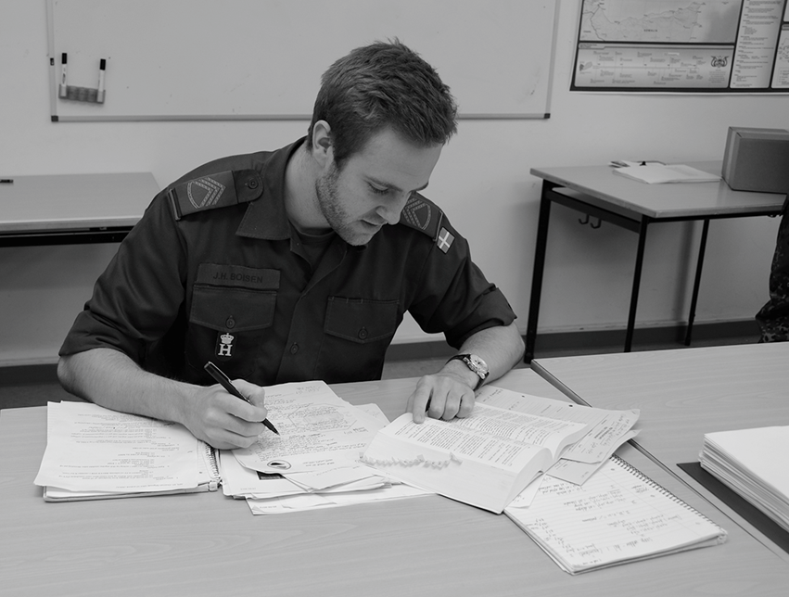
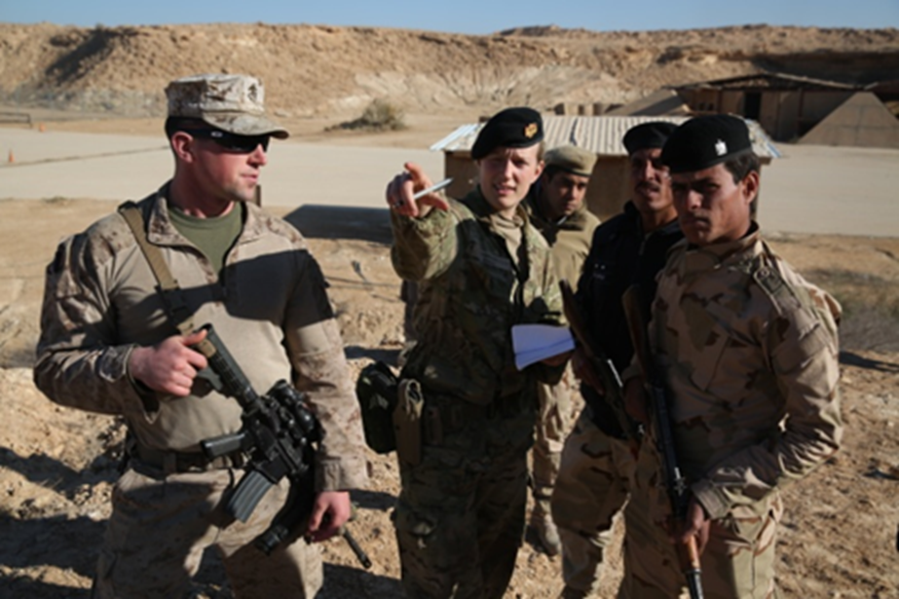
FROM PROFICIENCY TO PERFORMANCE

Slide 3
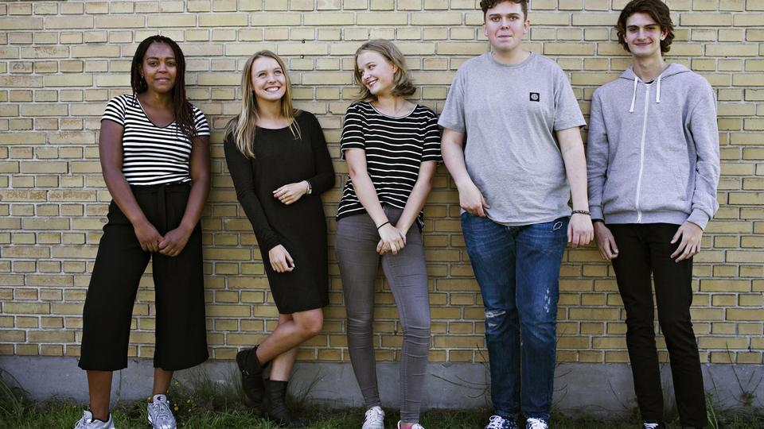
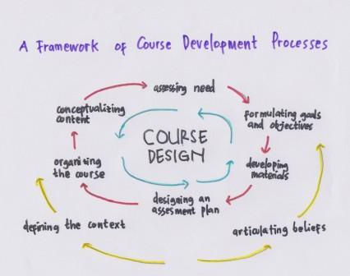
SCOPE 1 - CONTEXTS
Recruitment & selection
Iraq - OIR
Afgh. - RSM
Ukraine - UNIFIER
Programme- and curriculum design
Training missions

Slide 4
SCOPE 2 – EXPERIENCE, FEEDBACK & EVALUATION
Review of syllabus/ curriculum (?)
Data – qualitative feedback
Returning linguists – experience

Slide 5
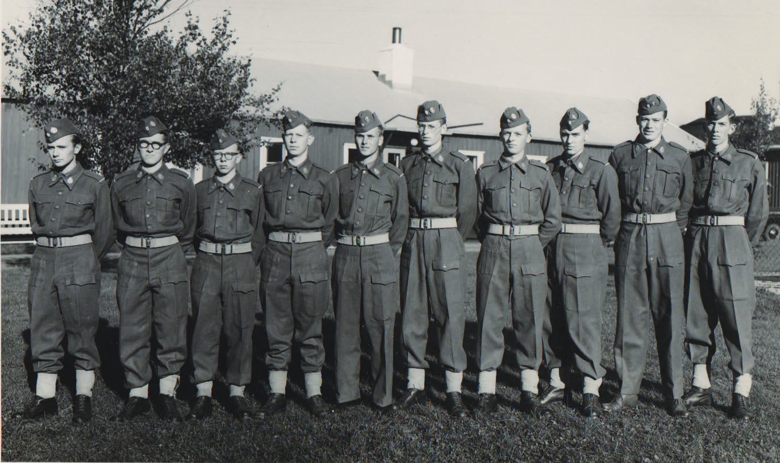
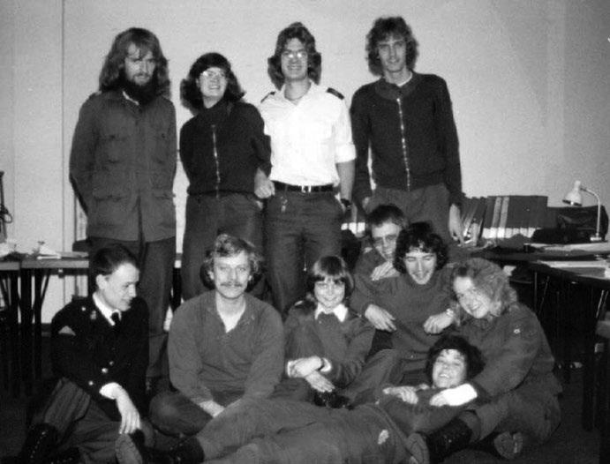
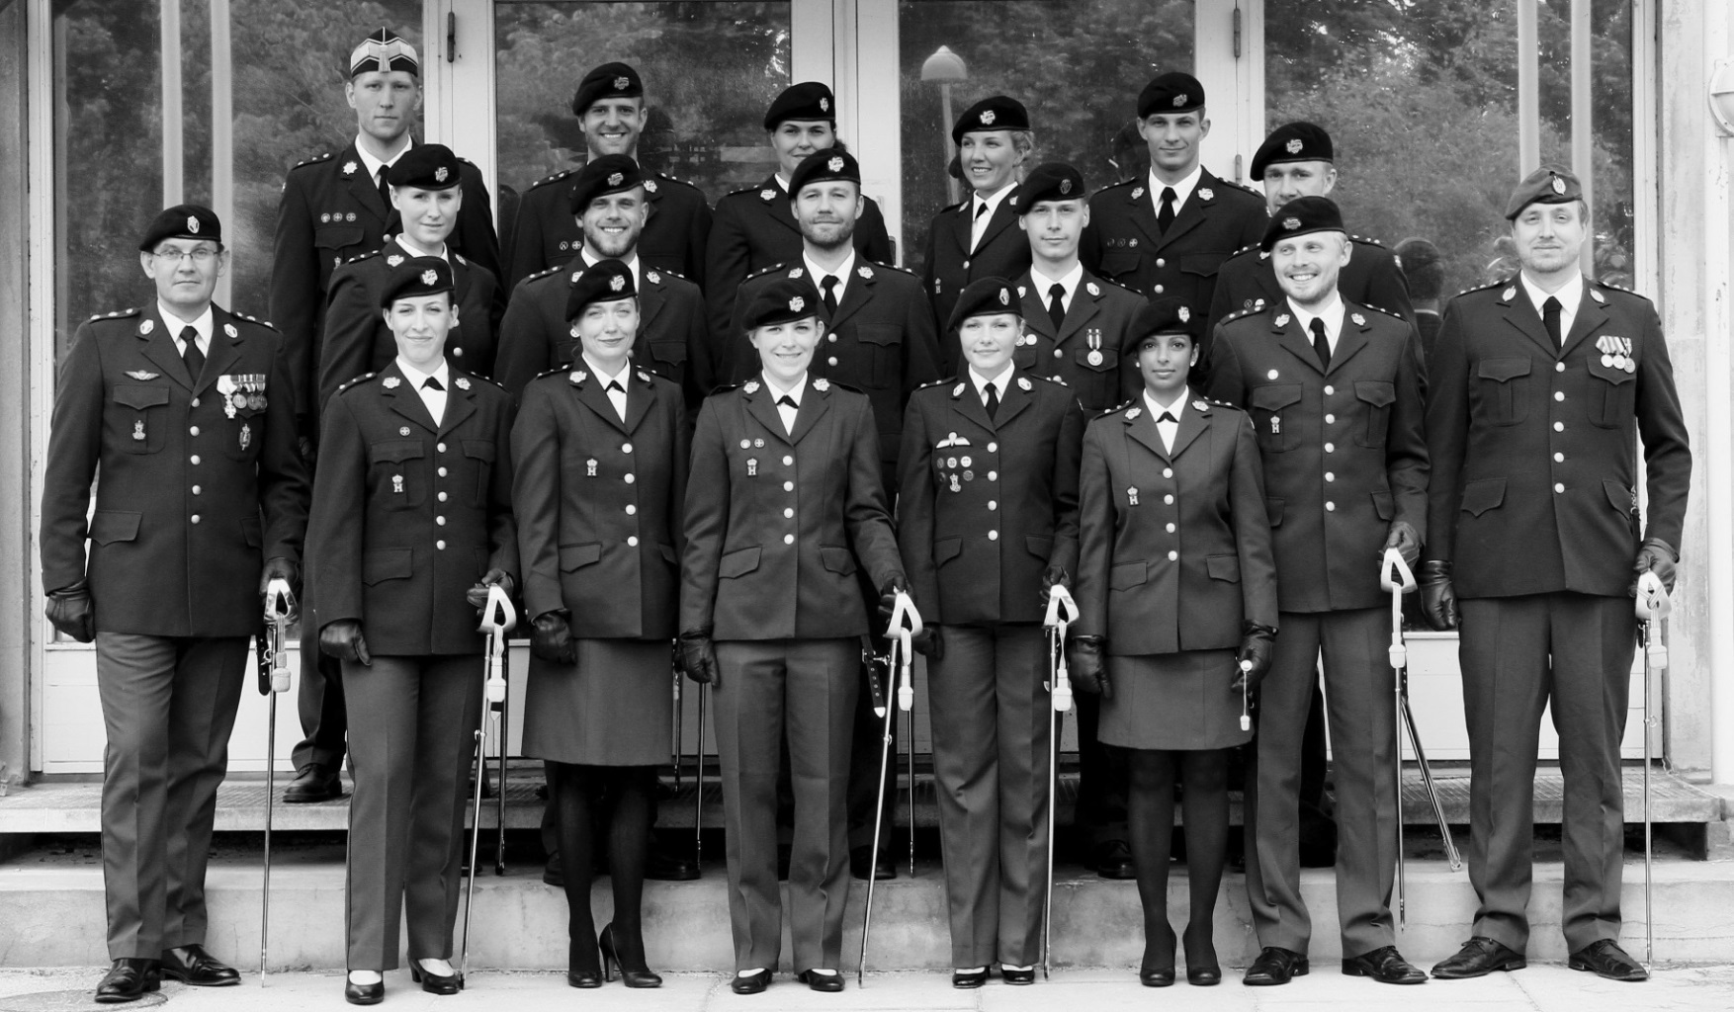
RDDLA 1957 - 2019
Languages:
Russian 1957
Polish 1986-1993
Arabic from 1995
Pashto 2007-2013
Dari 2012
English from 2015
English testing from 1995
1957
Special training and research:
Intelligence, until 2003
Interrogation techniques, until 2006
Interpretation techniques from 2005
Treaty Inspections, since 1992
Culture as a military enabler 2007-2018
1981
2013

Slide 6
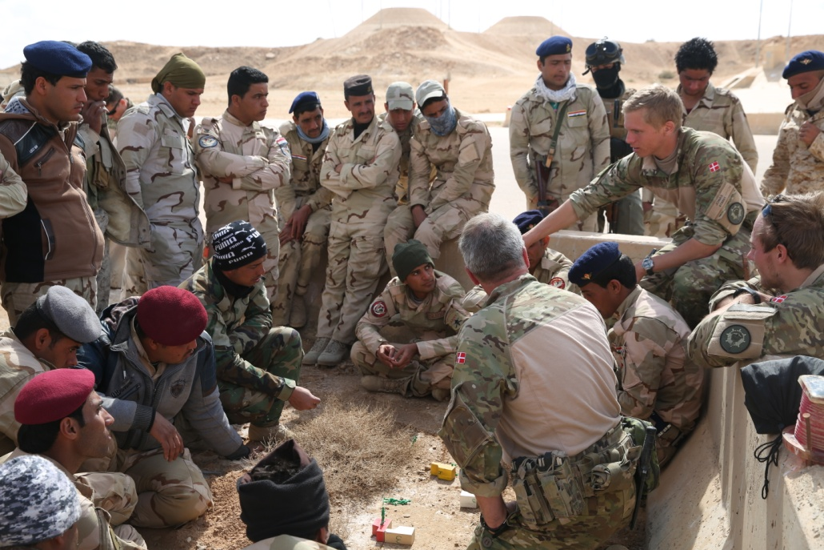
MISSION
English language training of Army, Navy and Air Force officers
STANAG testing in English & French
Run Royal Danish Defence Officer Linguist Programme
SUPPORT to NATIONAL / INTERNATIONAL OPERATIONS

Slide 7
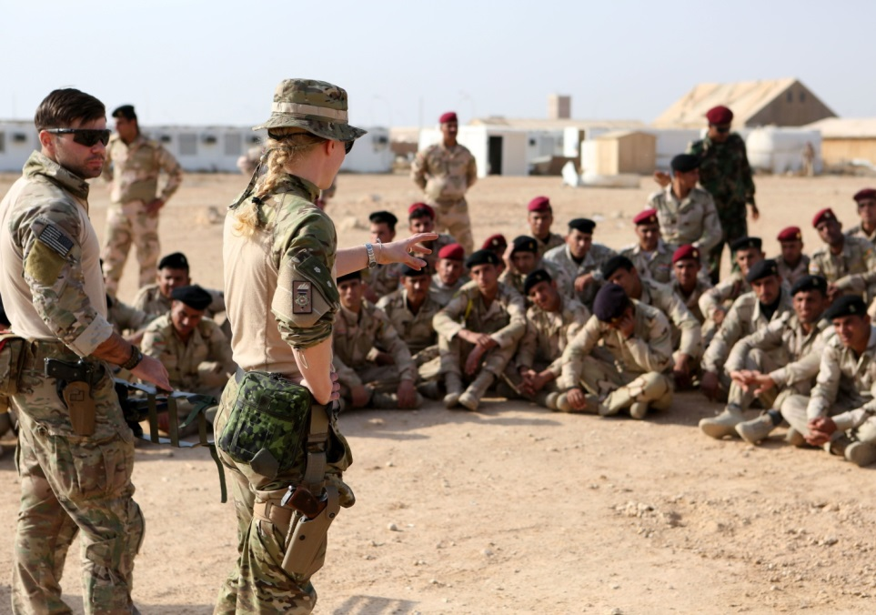
OFFICER LINGUISTS - RECRUITMENT AND TRAINING
Recruitment & selection:
Dedicated, ambitious, self-disciplined, motivated, team working language talents.
Rigorous testing for intelligence, language aptitude, fitness, psychological profile etc.
4 months basic training at Army Sergeant School
20 months at RDDLA:
Language training: 1.400 hrs.
Politics, history, religion, culture: 300 hrs.
Military training, PT: 500 hrs.
Homework: 1.500 hrs. (At least!)
Deployment mandatory

Slide 8
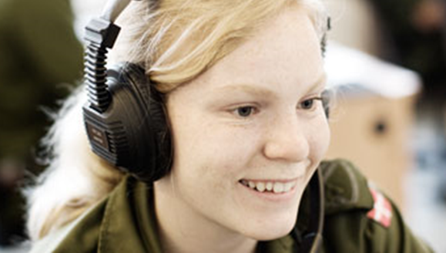
CURRICULUM GUIDING PRINCIPLES
General proficiency before (military) performance
STANAG 6001 guided curriculum aiming at SLP 3332
…but no testing…
“Tests” and exams
“Prochievement” exams/tests early on
…at later stages only performance exams/tests
Role plays and authentic tasks
Teaching
Student centered
Commuicative
Content based/CLIL
Performance based authentic tasks

Slide 9
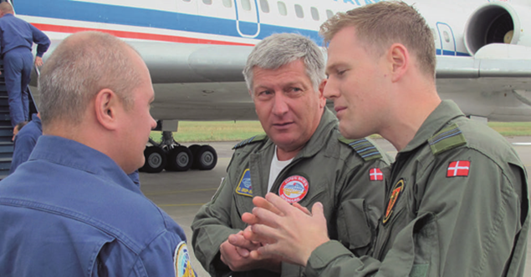
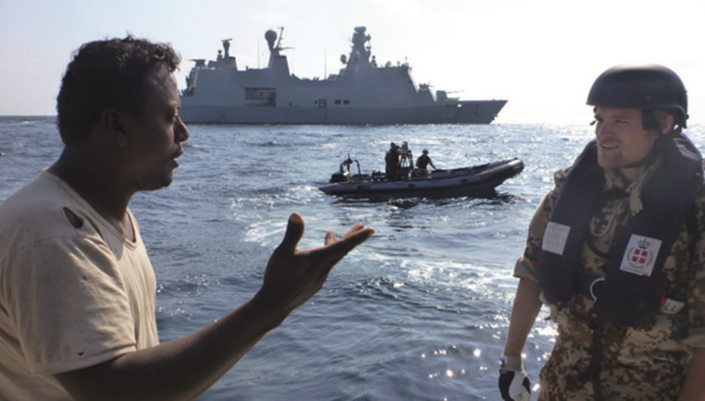
TRANSLATING PROFICIENCY TO PERFORMANCE
What is level 3 in…
Translation?
Interpretation?
Intercultural competence?
Social situational awareness?
What more than target language proficiency?
English
Interpretation techniques
(Written) Danish language skills
Military knowledge / officer skills
Social skills
All-round Knowledge
“Bildung”

Slide 10
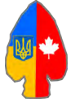
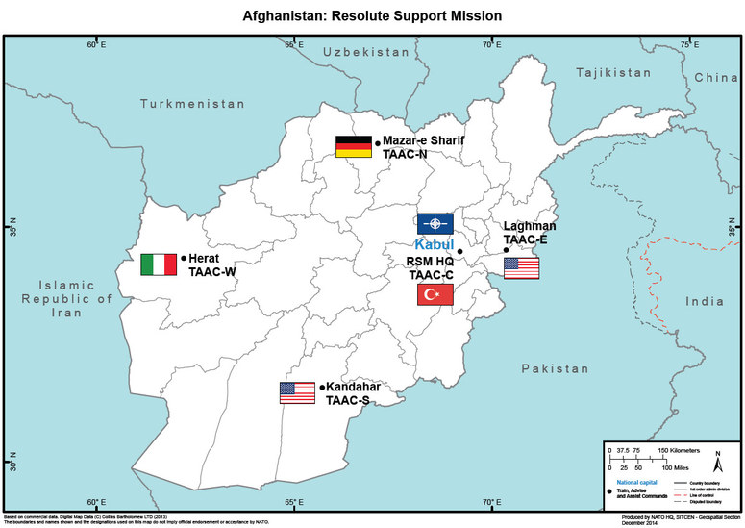
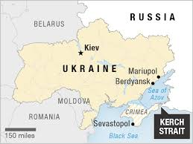
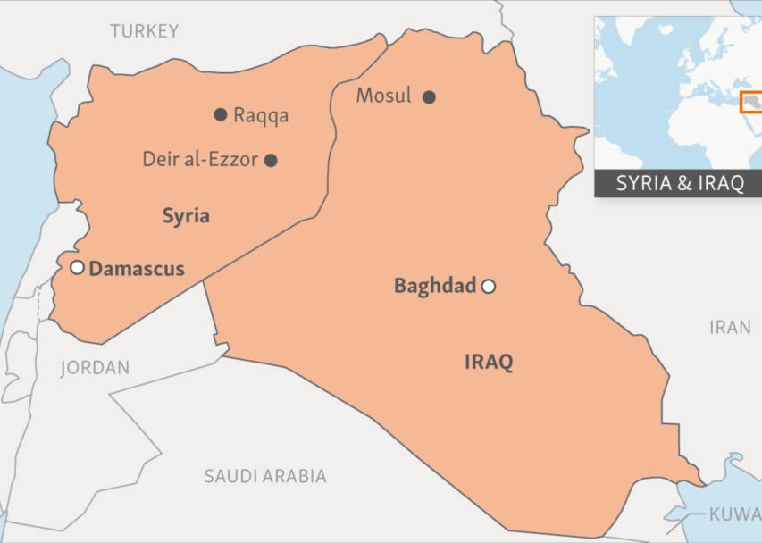
TRAINING MISSIONS
Common job descriptions and tasks
Interpretation & translation
Military and social
Different levels and areas
Mentoring – train the trainer
Management of other interpreters/language assets
Linguists in mission
Officer / CULAD / specialist
Civilian-military / contracted from contributing nations
Locally hired

Slide 11
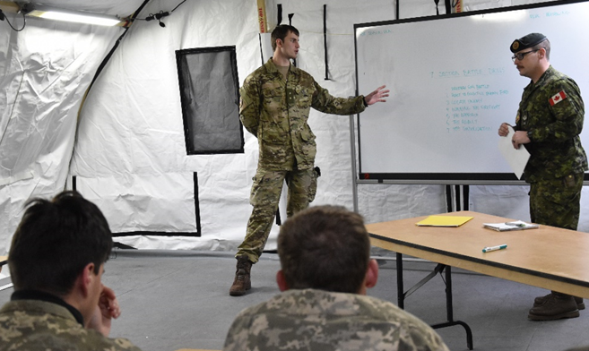
EXPERIENCES AND FEEDBACK
Methodology and data (?)
Key takeaways
Variety of tasks
Fixer, mediator, duty-phone, coordination, (informal) liaison, cultural conflict negotiator, good vibes facilitator, English expert
Informal everyday language
Social chit-chat, courtesies & cursing, SOME/non-standard language, listening difficulties due to speaker variation
Mission specific knowledge and vocab. in target language
Organisation, history, geography, names, training-specific terminology
Culture
(military) culture of allies just as important as target language culture.
[Training does work]
General proficiency, interpretation, military terminology etc.
s

Slide 12
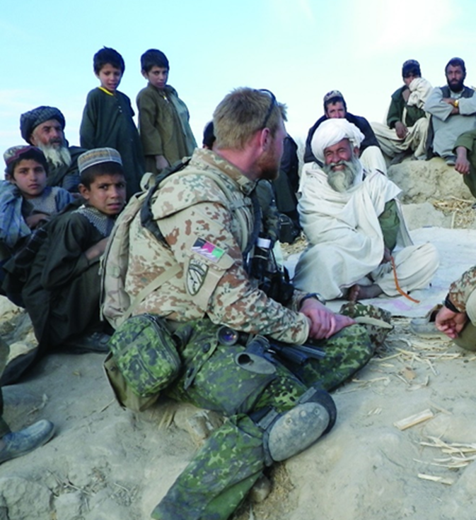
ANALYSIS OF DATA
Linguistic competence
Language variation
Specialised vocab.
High frequent grammar
Sociolinguistic competence
Social relations in mission
Authority and appropriateness
Discourse competence
Mission specific genres
Strategic competence
☺
All the other
Interpersonel competence
Cultural comptence
Military/leadership
Context awareness & knowledge of mission

Slide 13
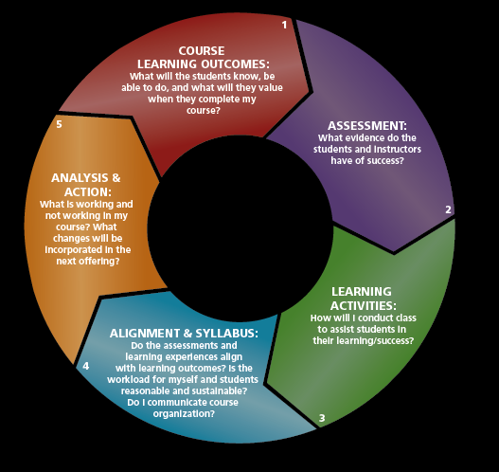
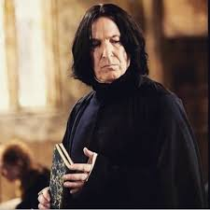
IMPLEMENTING CHANGE -THEORY VS REALITY
Resources
- Staff, time and money
Existing context
Existing course
Institutional tradition
Logistical constrictions
Grumpy inflexible teachers
Case by case approach
Low-hanging-fruits
Teacher involvement
Support from returning linguists

Slide 14
IMPLEMENTING CHANGE - CASES
Interpreting training lessons
Instruction and imperatives
Specialised vocabulary and concepts
Interference from environment
Importance of preparation
Discourse in social situations
Courtesies
Cursing and vulgarities
History, culture, religion
Handling “curveballs”

Slide 15
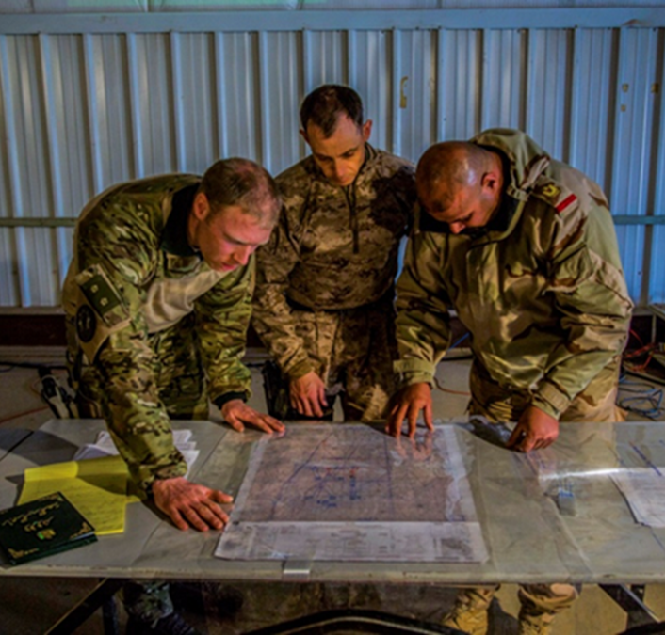
TO SUM UP…
Training vs. reality
You can never prepare for it all
Proficiency and Performance
General proficiency goes a long way
Teach the students to handle obscure tasks, crazy inputs and curveballs
Mission specific tasks and activities → Performance
Tasks of a military linguist
Variety
More than language

Slide 16
QUOTE
“We don’t rise to the level of our expectations, we fall to the level of our training.”
-Archilochus

