Slide 1
ENGLISH TEACHING
FACULTY
DEVELOPMENT
WORKSHOP
ACT.547
Notes:
GOOD MORNING / AFTERNOON LADIES AND GENTLEMEN. THE PURPOSE OF THIS PRESENTATION IS TO INTRODUCE YOU TO THE…

Slide 2
BREAKING NEWS
Notes:
WELL… IT SEEMS THAT WE HAVE BREAKING NEWS!!!

Slide 3
Notes:
AND… YES! THE BILC POST HAS JUST ANNOUNCED THAT THE FACULTY DEVELOPMENT WORKSHOP GANG HAS NAILED THE TASK OF DEVELOPING A BRAND NEW WORKSHOP.

Slide 4
Notes:
LET’S LOOK AT THIS ARTICLE A LITTLE CLOSER

Slide 5
English Teaching Faculty Development Workshop
The BILC community identified a need for professional development for teaching faculty
Two-week interactive workshops for experienced English language teachers
Aimed at enhancing theoretical knowledge and practical skills of teaching English
Notes:
“THE BILC COMMUNITY IDENTIFIED A NEED FOR PROFESSIONAL ...”
THE SUGGESTION WAS TO DEVELOP...
“TWO-WEEK INTERACTIVE WORKSHOPS... , ... SKILLS OF TEACHING ENGLISH”

Slide 6
Instructional Design
ADDIE
Analysis
Design
Development
Implementation
Evaluation
Alignment
and
Continuous
Feedback
Notes:
TO SET THINGS IN MOTION WE FOLLOWED THESE STEPS…
LET’S TAKE A CLOSER LOOK ON HOW THINGS WERE DONE…

Slide 7
English Teaching Faculty Development Workshop
Needs Analysis
Phase 1-Questionnaires and focus groups
Phase 2-BILC Study Group
Conclusions
Professional development is needed
All topics rated as beneficial
Establish a Curriculum Development Working Group
Notes:
IN PHASE ONE , PLTCE CONDUCTED SURVEYS IN FOUR NATIONS THROUGH QUESTIONNAIRES AND FOCUS GROUP MEETINGS WITH ENGLISH LANGUAGE TEACHERS TO SUBSTANTIATE THE NEED FOR SHORT COURSES OR WORKSHOPS FOR TEACHING PROFESSIONALS THE CHARACTERISTICS OF THE POTENTIAL TARGET AUDIENCE, THE SCOPE, TIME AND RESOURCES NEEDED TO ACCOMPLISH THE PROJECT
PHASE TWO WAS CARRIED OUT IN BRUGES DURING THE BILC CONFERENCE. MR. KEITH WERT AND MS. PEGGY GARZA LED A STUDY GROUP ON THIS SUBJECT. THE CONCLUSIONS OF BOTH PHASE ONE AND TWO WERE CLEAR… “PROFESSIONAL DEVELOPMENT ...,... DEVELOPMENT WORKING GROUP”

Slide 8
Notes:
SO PLTCE DECIDED TO GATHER A WORKING GROUP TO FULFIL THIS NEED AND DEVELOP A WORKSHOP TO SUPPORT THE LANGUAGE SCHOOLS’ EFFORTS TO MEET NATO REQUIREMENTS AND PROVIDE LANGUAGES TEACHERS FACULTY DEVELOPMENT OPPORTUNITIES.
AND THE WORKING GROUP WAS…

Slide 9
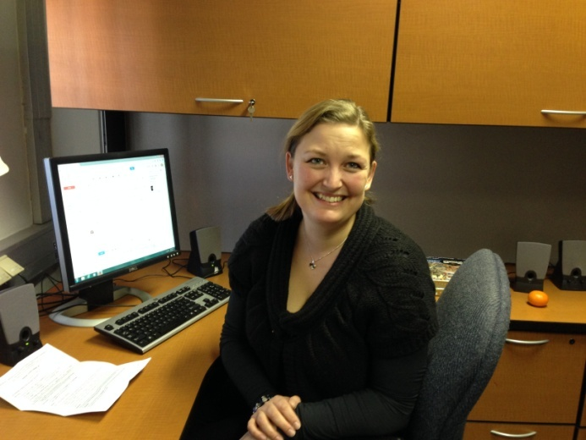
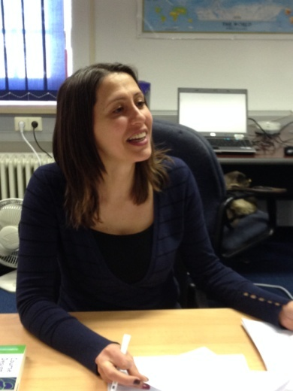
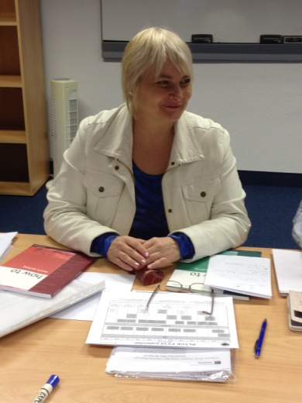
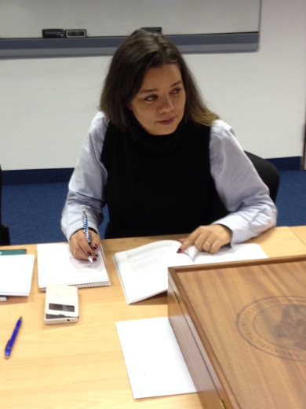
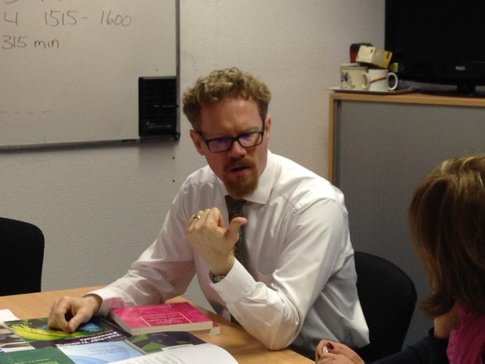
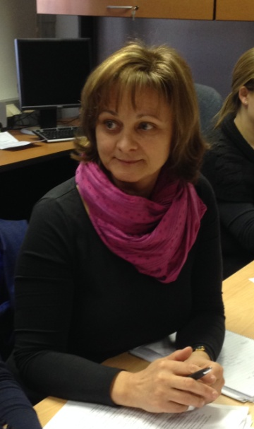
Curriculum Development
Working Group
Ms. Christine Worm
Denmark
Ms. Valentina Eneva
Bulgaria
Dr. Gabriella Kiss
Hungary
Ms. Peggy Garza
USA
LT Estela Parreira
Portugal
Mr. Roger Embree
USA
Ms. Dubravka Zupanec
Slovenia
Notes:
INTRODUCE EVERYONE BY NAME AND COUNTRY

Slide 10
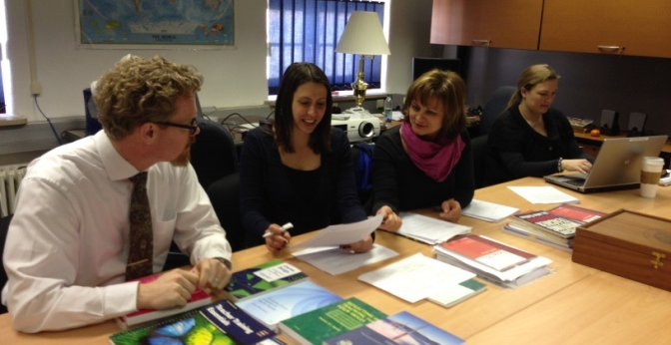
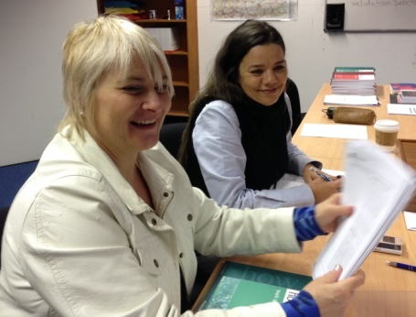
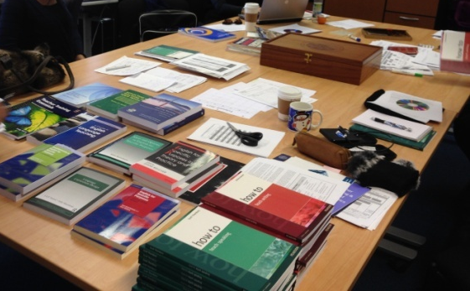
English Teaching Faculty
Development Workshop
Design
WG accomplishments- Meeting #1
Produced learning outcomes
Produced outline
Determined instructional methods
Drafted teaching notes
Selected textbooks
Notes:
THEY MET LATE NOVEMBER AND… “BOY”… WAS THE AGENDA DEMANDING. BUT THEY WORKED HARD, AND I MEAN, REALLY HARD., THEIR ACCOMPLISHMENTS IN THE FIRST MEETING ARE NOTEWORTHY.
THEY… “Produced learning outcomes… , … Selected textbooks”

Slide 11
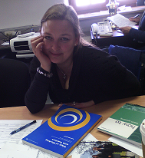
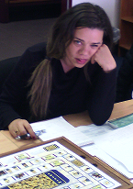
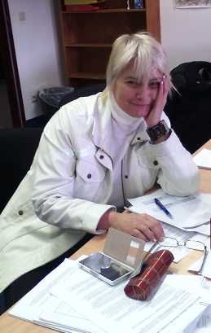
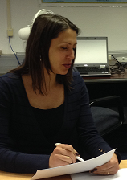
English Teaching Faculty
Development Workshop
Homework
Power Point Presentations
Activities
Worksheets
Handouts
Games
Notes:
BUT LIFE IS NOT EASY AND… THEY HAD HOMEWORK TO DO… AT HOME! BACK TO THEIR COUNTRIES THEY DEVELOPED… “Power Point Presentations... , ... Games”

Slide 12
English Teaching Faculty
Development Workshop
Development
WG accomplishments- Meeting #2
Reviewed and fine-tuned
Daily teaching points
Activities
Worksheets
Handouts
Determined facilitator roles
Notes:
IN MEETING TWO… WELL THIS IS WHAT THEY WORKED ON… “Reviewed and fine-tuned… , …. Determined facilitator roles”. WE SHOULD ALSO MENTION MS. JEANNIE WEDDLE AND THANK HER. SHE PUTS ALL TOGETHER IN FOLDERS AND...
BY NOW, YOU MIGHT THINK: ALL READY, RIGHT? WELL... “NOP”, NOT QUITE, ALMOST THOUGH.
IN MARCH... WELL IN MARCH...

Slide 13
Notes:
THE IMPLEMENTATION STAGE.

Slide 14
English Teaching Faculty
Development Workshop
Implementation
10 – 19 March (validation)
Facilitators- BGR, DNK, SVN, USA
Twelve participants
AUT
AZE
BGR
ROU
SVN
UKR x 2
GEO x 2
JOR
MNG x 2
Notes:
FROM 10 TO 19 MARCH 4 FACILITATORS: MS VALENTINA FROM BULGARIA, MS CHRISTINE FROM DENMARK, MS DUBRAVKA FROM SLOVENIA AND MS PEGGY FROM THE USA FACILITATED THE WORKSHOP WHICH ALSO SERVED THE PURPOSE OF VALIDATION. TWELVE PARTICIPANTS FROM NINE NATIONS ATTENDED THE WORKSHOP.

Slide 15
Notes:
BUT… WHAT WAS THE WORKSHOP ABOUT? WE KNOW THE TOPIC… BUT WHAT WAS FACILITATED? HOW, WHEN, WHAT…? OK! IN THIS CASE CURIOSITY WILL NOT KILL THE CAT…

Slide 16
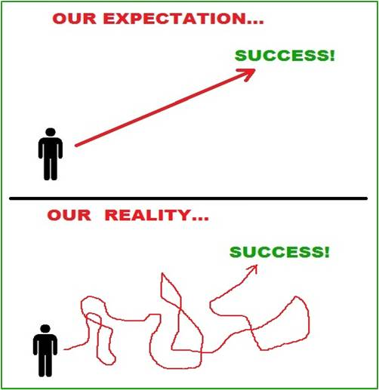
English Teaching Faculty
Development Workshop
What this is:
Military flavor and context
Practice oriented
What this is not:
A course in military terminology
Introductory teacher training
Purely theory and concepts
Notes:
THIS WORKSHOP IS… “Military flavor … , … oriented” . THIS WORKSHOP IS NOT… “A course in military terminology…”.
OF COURSE OUR EXPECTATIONS WERE… BUT REALITY WAS SLIGHTLY DIFFERENT.

Slide 17
English Teaching Faculty
Development Workshop
Topics
STANAG 6001
Military contexts
Military Students
Notes:
AS YOU HAVE SEEN THE TOPIC WAS/IS “TEACHING SPEAKING AND WRITING FOR MILITARY PURPOSES”, AND OF COURSE STANAG 6001

Slide 18
English Teaching Faculty
Development Workshop
Workshop Features
Schedule: 0830-1600
Materials.: A handbook with worksheets and appendixes. (STANAG 6001, Edition 5, Glossary of instructional terms, References and electronic references )
Two textbooks :
How to Teach Speaking by Scott Thornbury
How to Teach Writing by Jeremy Harmer
Format: quite varied to foster maximum interaction
plenary input sessions and discussions
individual work followed by sharing with partners
pair work and small group work.
Notes:
NOW LET’S LOOK AT THE WORKSHOP FEATURES… TIGHT SCHEDULE, AH?

Slide 19
English Teaching Faculty
Development Workshop
Workshop Features
Microteaching: two videotaped microteaching sessions each week, accompanied by peer feedback
Review: Some games were used to review concepts and terms (Board game, Puzzle, “The Hangman”)
Homework: The participants were
given reflection questions/topics
asked to write in their journals

Slide 20
English Teaching Faculty
Development Workshop
Workshop Content
Some examples:
Challenges of teaching speaking to military
students
Cooperative Learning
Activities that promote speaking in a military
context
Practical activity: video recorded microteaching
Speaking vs. writing for military students
Process writing and the writing process
Best practices in conducting writing activities
for military students
Notes:
JUST TO AROUSE YOUR CURIOSITY… HERE ARE SOME EXAMPLES OF THE CONTENT OF THE WORKSHOP

Slide 21
English Teaching Faculty
Development Workshop
Evaluation
Collect input from facilitators and participants
Questionnaires
Errata sheets
Focus groups
Journals
Notes:
VALIDATION ACCOMPLISHED BY COLLECTING INPUT FROM BOTH FACILITATORS AND PARTICIPANTS. THEIR FEEDBACK AND CRITIQUE IS WHAT HELPS US MAKE ADJUSTMENTS AND IMPROVE. THANK YOU.

Slide 22
English Teaching Faculty
Development Workshop
Evaluation
Facilitators
Daily meetings
Notes:
VALIDATION ACCOMPLISHED BY COLLECTING INPUT FROM BOTH FACILITATORS AND PARTICIPANTS. THEIR FEEDBACK AND CRITIQUE IS WHAT HELPS US MAKE ADJUSTMENTS AND IMPROVE. THANK YOU.

Slide 23
English Teaching Faculty
Development Workshop
Workshop Feedback
The workshop strengths were:
Microteaching
Reflection and journal writing
Excellent textbooks
BILC Military English Glossary
Good balance of concepts and practical work
Cooperative learning
Modeling of sound methods of teaching
speaking and writing
Mix of facilitators from different BILC nations
Notes:
THE STRENGTHS HIGHLIGHTED WERE…

Slide 24
Notes:
ALL GOOD THINGS MUST COME TO AN END… AND THIS IS NO EXCEPTION.
THE WORKSHOP WAS GREAT. THE FEEDBACK FROM FACILITATORS AND PARTICIPANTS WAS VERY POSITIVE…

Slide 25
Notes:
SO… ALL NATIONS THAT PLAYED A ROLE IN THIS PROCESS OF DESIGNING, DEVELOPING, FACILITATING AND VALIDATING... DOESN’T IT LOOK GREAT? AS YOU CAN SEE THE TOPIC FOR THIS WORKSHOP IS “TEACHING SPEAKING AND WRITING FOR MILITARY PURPOSES”. HOWEVER, JUST TO BE AS CLEAR AS WE CAN…

Slide 26
Notes:
SO… COME AND TAKE PART IN OUR NEXT WORKSHOPS!!!!! WE ARE WAITING FOR YOU!!!
THANK YOU!

