Slide 4
Engaging Stakeholders How to avoid a perpetual motion mess in a pointless dialogue of the deaf
Emilie Alice Cleret
Head of the English Department
Higher Military Education
Paris, France

Slide 5
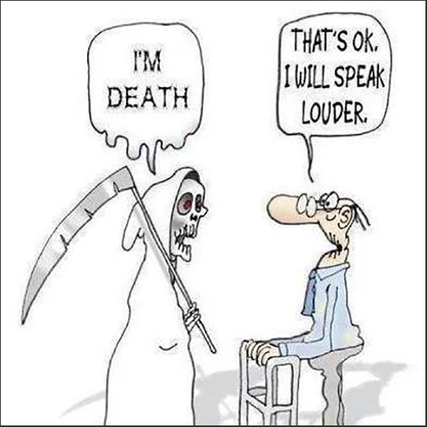

Slide 6
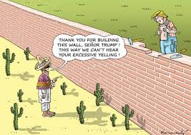

Slide 7
Mission
Principes pédagogiques
Compétences / Outils d’évaluation
Learning Goals
Learning Objectives
Learning Outcomes
Language
What learners produce
thanks to
Critical thinking
Instruction
Instruction
Analysis
Discussion
Transfer of content
Analysis /
Case Study
Professional
Creativity
Discussion
Measurable
Observable
EXAMS

Slide 8
The Military
Teachers
Serving
 | Professional | Language
Learning Goals
Learning Objectives
Learning Outcomes
Exams/Tests
Express Needs
Identified by the military
Must NOT be solely linguistic
(they don’t want language experts)
Teaching staff’s mission:
Needs analysis to design relevant language course with consistent activities
Head of Department
Need to convince commanding staff and students
Constantly need to convince that the learning objectives are the most relevant to achieve the learning goals
Teachers
Guidelines for the teachers
Students
Boundary difficult to pass

Slide 9
French Programme
in the French War College
Foreign officers
in France for a specific training course
learning French is an obvious need
English Programme
in the French War College
French officers only
in their national War College
in their own capital city
no immediate need to learn English
Notes:
9

Slide 10
STUDENTS’ PERCEPTION OF AN ENGLISH COURSE
OBJECTIVE CRITERIA
NO | YES
HAS NEVER SERVED IN AN ENGLISH-SPEAKING ENVIRONMENT | HAS SERVED IN AN ENGLISH-SPEAKING ENVIRONMENT
+ | +++ If the course is well designed | I LOVE ENGLISH | YES | SUBJECTIVE CRITERIA
--- | + Has experienced the need | I HATE ENGLISH | NO

Slide 11
The Military
Teachers
Serving
 | Professional | Language
Learning Goals | Identified by the military Must NOT be solely linguistic (they don’t want language experts) Need to convince commanding staff and students | Teaching staff’s mission: Needs analysis to design relevant language course with consistent activities
Learning Objectives | Constantly need to convince that the learning obejctives are the most relevant to achieve learning goals | guidelines for the teachers
Learning Outcomes
Exams/Tests
Express Needs
Head of Department
Teachers
Professional skills acquired
Command of language in a specific professional environment
Students
?
PLS 4
PLS 3
TOEIC
Boundary difficult to pass

Slide 12
MISTAKES – SOLUTIONS - EXAMPLES
KILL THE PIPE DREAM OF THE PERFECT SYLLABUS
DON’T PLAY MILITARY, YOU ARE NOT QUALIFIED
SPARE THEM THE LANGUAGE NERD BANTER
DON’T KILL THE MOOD WITH YOUR PASSION FOR THE LEARNING PROCESS
DON’T BEG FOR THEIR ATTENTION
NO VICTORY LAURELS TO REST UPON – KEEP GOING
NEVER CONFRONT, PREPARE, PUSH BACK AND NEVER GIVE UP

Slide 14
QUESTIONS?

