Slide 1
English Language Teacher Training
at the
Defence Academy of the UK
Colette Fyfe
Senior Lecturer
English Language Wing
Professional Skills for Defence and Security

Slide 2
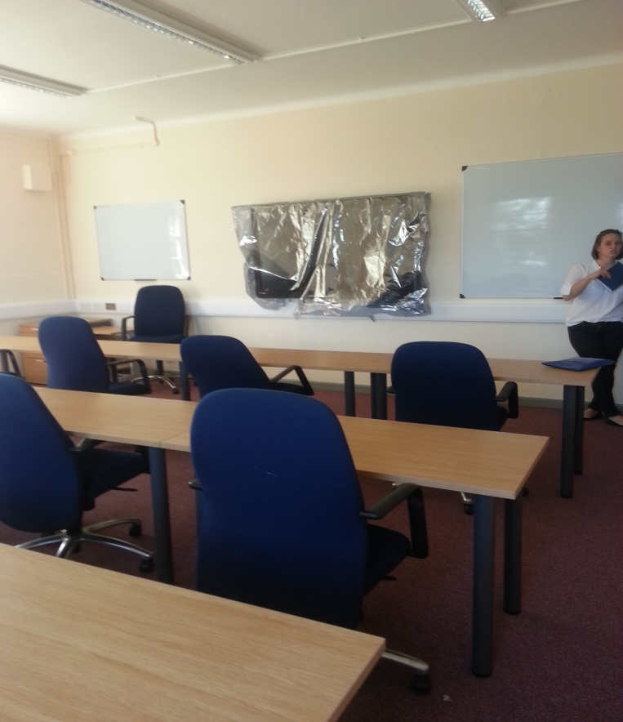
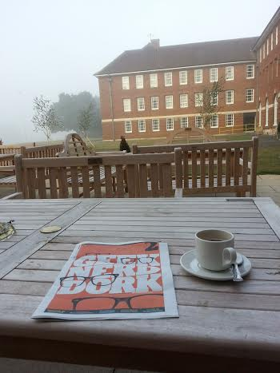
English Courses at Shrivenham
Pre-Sandhurst
British Military English
Technical Language Training
Pre-Staff Course Training
Pre-RCDS Training
SLP Assessments

Slide 3
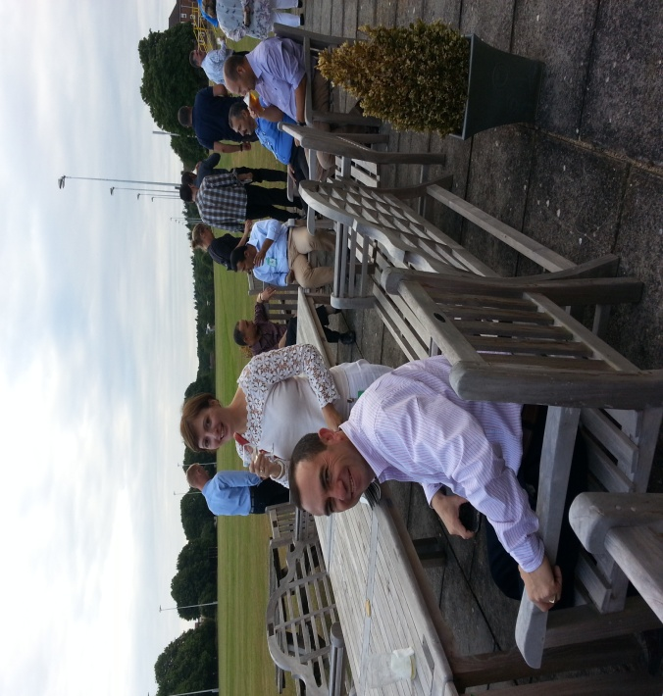
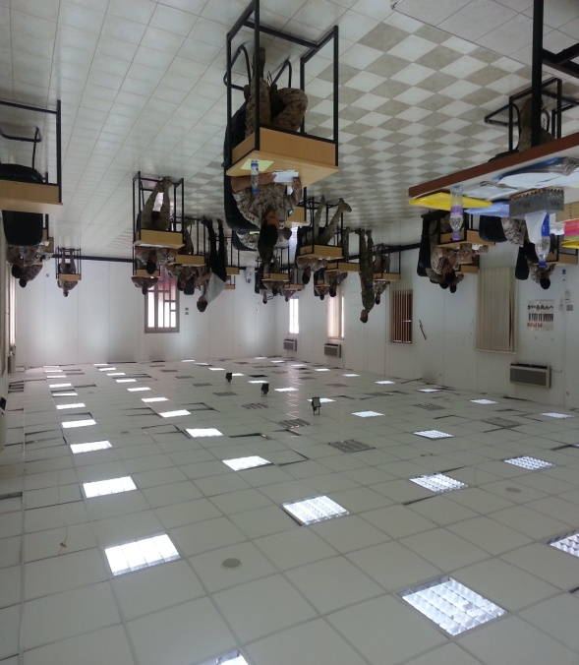
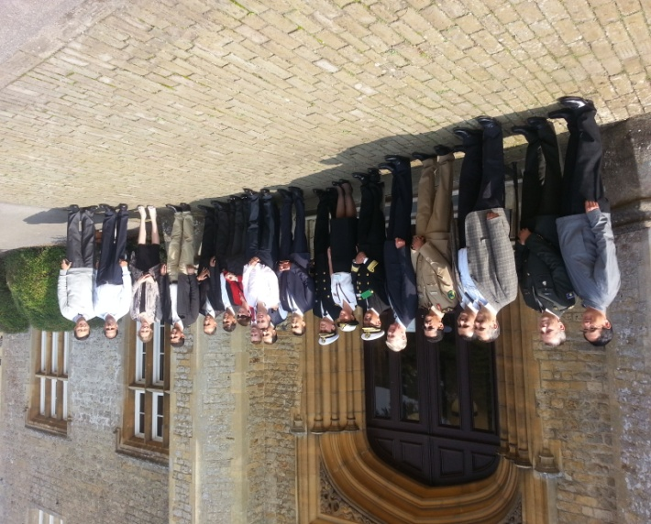
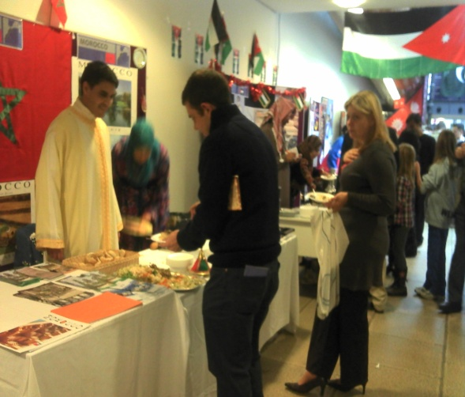
Our Students
Albania, Bosnia, Colombia, Kosovo, Latvia, Georgia, Azerbaijan, Libya, Morocco,
Mauritania, Sudan, Ethiopia,
Egypt, UAE, Kuwait, Saudi Arabia, Indonesia, Malaysia, Afghanistan, Czech Republic, Kyrgyzstan, Kazakhstan, Uganda, Brazil, Chile, Mexico, Poland, Armenia, Thailand, China, Japan, Oman, Jordan, Yemen, Montenegro, Finland, Tajikistan, Ukraine, Macedonia, Iraq, Estonia

Slide 4
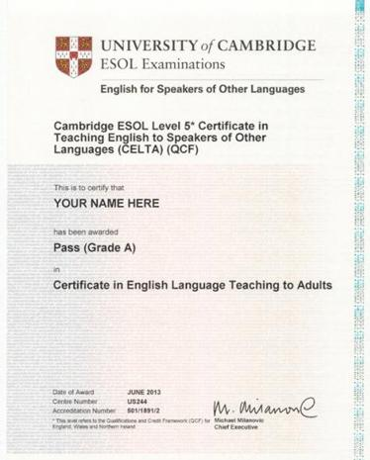
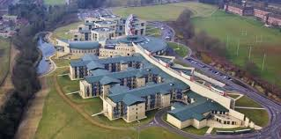

Slide 5
CELTA – THE HONEST TRUTH
British military personnel and international
colleagues train together
4-week intensive course
Written assignments x 4
Teaching Practice x 6 hours
Language Analysis
Methodologies for teaching the skills and
systems of English
Testing and Assessing

Slide 6
Why bother? I’ve Already Got a Teaching Qualification and Quite Enough Work to Do, Thanks Very Much.
Share practice
Experience life on a British military base which is the
home of the UK MOD’s staff education and training
courses
Teach and socialise with many different nationalities
Achieve a globally-recognised British English teaching
qualification

Slide 7
Thank you for listening!
Please come and talk to me if you would like to know more.
Enjoy the rest of the BILC Conference

