Slide 1
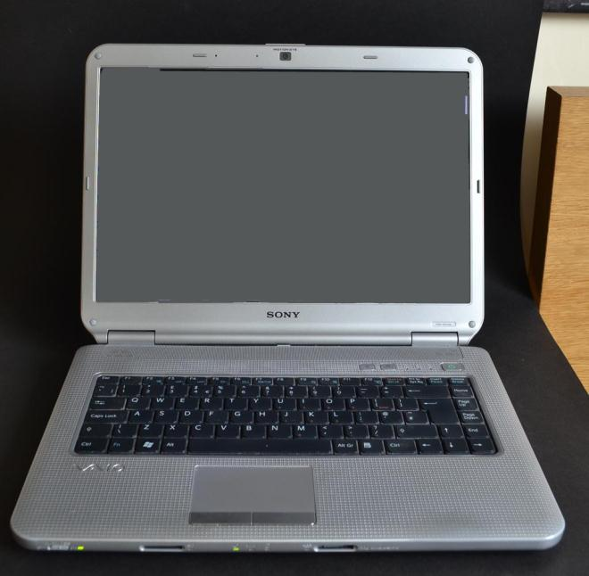
Enhanced LOTE Learning through the use of DFSL Moodle-Based Platform
Notes:
For those of you I haven’t met yet, my name is Anna Ivanova and I am representing A DFSL at this conference

Slide 2
DFSL Mission
Develop and conduct training and assessment of selected ADO personnel in specified LOTE
Enable ADO personnel to conduct joint, combined and/or interagency operations and other Defence business in support of the Australian National Interest
Notes:
Quick overview of the school: we teach foreign languages to ADF personnel

Slide 3
Languages Taught
In House |  | Outsourced
Indonesian (and Javanese) Malay Chinese (Mandarin) Korean Pacific Languages -Tok Pisin Fijian SI Pijin Tetum | Thai Vietnamese Arabic Farsi Dari Pashtu French Portuguese | Japanese Spanish Filipino Turkish Urdu Khmer Any unique requirement
Notes:
e use a Standing Offer Panel for low throughput or unique languages.
Just recently our School went through 2 major changes

Slide 4
Major change N1 - Curriculum Redesign
Curriculum reconfigured from general proficiency to CBT
Addressing the language needs of the work place from tactical to operational and strategic levels
Notes:
Curriculum was redesigned and redeveloped to closely align our courses outputs with ADF operational needs.
Those who attended BILC seminar in Germany last year might remember my presentation on our biggest project – 46 w SE course design and development. This very intensive course designed to prepare selected individuals for overseas postings into embassies (future DAs and ADAs) and foreign staff colleges. I am happy to report that our first pilot – Indon SE is going smoothly and we are getting very positive feedback from our students. Started SE development in Chinese this year.

Slide 5
Major change N2 – Organisational Restructure
CO
SSM
XO
Indo-Malay
Regional
Non Regional
Ops
Executive
Development
Indonesian
Javanese
Malay
MCS
Chinese
Korean
Pacific Langs
Tetum
Thai
Vietnamese
Arabic
Persian
French
Pashto
Portuguese
Assessment
Blended Learning
Course Design
Faculty Devt
63 x FTE
16 x ADF
2 x International
4 x Reserve
Notes:
3 Deliv wings and we now have designated teams in the course design, FD, assessment and BL areas.
In re to the Course Design area our experience is that now that we don’t need to outsource the design of our courses and are using our in house SMEs we find it’s a much more efficient and effective way to achieve our intended outcomes. [A lot of effort went into the redesign of TI and OE courses and we designed our SE last year]
My presentation today will be about our work in the BL space.

Slide 6
The use of Moodle at DFSL 1
DFSL website is hosted by ADELE (Australian Defence Education Learning Environment) platform
We have 28 Moodle instances on this website at the moment
Cover our pre-course needs, on course online materials and post course support to our graduates
Staff PD area & BILC SharP
Notes:
Ok, so how is Moodle used to enhance LOTE leaning at DFSL?
Originally Moodle was used as a repository of on-course resources but now that people are getting used to the idea of Moodle, getting trained, their confidence goes up – they start exploring other options.

Slide 7
The use of Moodle at DFSL 2
Pre-course:
Language Awareness module
Language Learning Strategies module
Notes:
LA module covers basic grammar terminology that our students will need on their courses. 2 options online – functional and traditional grammar.
LLS – module covers the info on different learning styles and specific strategies to support the acquisition of vocabulary, grammar, speaking, listening, reading, writing, interpreting and translation and pronunciation skills
Before – delivered F2F, this year we trialled offering them as a pre-course online package

Slide 8
The use of Moodle at DFSL 3
On course:
Learner Guides (LGs)
Audio, video files, ppts supporting LGs
Quizzes (multiple choice, drag and drop, etc)
Games (Hangman, Snakes and Ladders, Sudoku, etc)
Weblinks, e.g.: Quizlet, Memrise, Youtube, etc
Assessments
Course Info & Timetables
News forum
Notes:
Links to Memrise, Quizlet – electronic flashcard websites both reinforcing new daily vocab our students acquire in class
News forum used by instructors, e.g.: there is a movie on French Navy on SBS channel tonight
SE - cartoons with cultural info Follow-up sessions in class
+ links to other online resources stretching students knowledge

Slide 9
The use of Moodle at DFSL 4
Post-course:
Skills Maintenance Packages
2. Useful links

Slide 10
Other uses of Moodle in DFSL
Development Wing area:
Newly Employed Staff Training (NEST)
Staff Training to Enhance
Professionalism (STEP)
3. Internal and External PDs

Slide 11
Our plans
Track students progress on Moodle across courses and use this info in our Training Revision Board (TRBs) meetings
Online Rater Training
Online Q/P testing
Trial Google Apps
Begin to explore the use of simulation in
LOTE teaching
6. If approved, content curate BILC SharP
Notes:
We are due to trial GoogleApps that might change the way we do things as well
Our BL staff are getting trained in the use of VBS3 (Virtual Battle Space) ver 3 and FaceShift
Google apps – Moodle will remain our LMS

Slide 12
Our issues
Bandwidth
Hardware
Late adopters
Time!
Notes:
Priority in IT space to increase it

Slide 13
Why Blended learning?
The strength of our institution is a F2F component but we find that online activities:
Help to make learning more engaging
Can be accessed 24/7 anywhere
Save us a lot of training time
Can be an effective learning
and assessment tool
5. Complete repository of course resources
Notes:
Which

Slide 14
Questions??

