Slide 1
2018 BILC professional seminar, Croatia

Slide 2
1. What is the Croatian name for Croatia?
Mađarska
Hrvatska
Danska

Slide 3
2.Which of the following is the capital of Croatia?
Split
Rijeka
Zagreb

Slide 4
3. How many countries does Croatia have a continental border with?
5
7
6

Slide 5
4. The Croatian currency, ‘KUNA’, was named after an animal. Which one?
bear
tuna
marten

Slide 6
5. 5. Which clothing item, known as ‘KRAVATA’, became famous all over the world thanks to the Croatian soldiers who wore it in the Napoleonic wars?
a belt
a tie
a hat

Slide 7
6. Which of the following is a region in Croatia?
Slavonia
Slovenia
Slovakia

Slide 8
7. 101 Hollywood cartoon dogs bear a name of a region in Croatia, which one?
Istria
Dalmatia
Lika

Slide 9
9. 8. What is the order of colors in the Croatian flag?
red, white, blue
blue, red, white
white, blue, red

Slide 10
9. How many red and white checkers are there in the Croatian coat-of-arms?
15
20
25

Slide 11
10. What is the Croatian word for ‘THANK YOU’?
nazdravlje
također
hvala

Slide 12
Date: 01 – 04 October 2018
Venue: Croatian Defense Academy (CDA), Zagreb
Conference fee: EUR 180.00
Accommodation: Antunović Hotel (EUR 80.00 – 100.00)

Slide 14
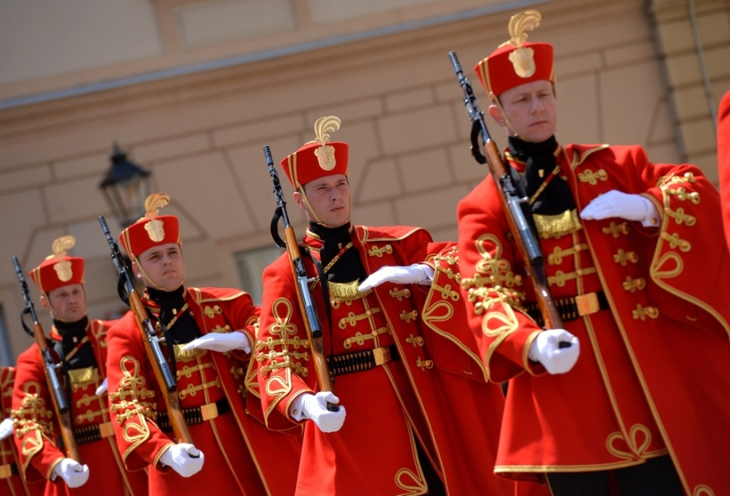

Slide 15
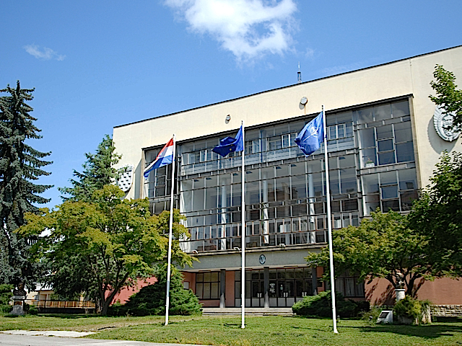

Slide 16
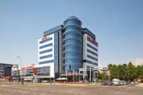

Slide 17
LANGUAGE LEARNING AND THE ADULT MIND: ENHANCING MOTIVATION AND EFFICIENCY IN THE MILITARY CONTEXT
Subtopics:
1. Increasing language learning efficacy in the classroom
Maintaining motivation in FL teaching/learning
Promoting efficacy through in-house teacher professional development
Bridging the gap between 1+/2 and 2+/3 in writing and speaking

Slide 18
2. Purposeful learning environment as a motivational factor
Language teachers as course designers
Authenticity of material in a language classroom and its effect on motivation
Motivational techniques in promoting higher-level thinking skills
3. Strenghtening responsibility for one's own learning
The importance of self-efficacy in learning performance
Fostering the learner-centered perspective and autonomous learning
Teaching learning strategies and its impact on the learning process

Slide 19
4. Tester's contribution to learners' motivation and learning efficacy
Learner-oriented test preparation
Bridging the gap between teaching/learning and testing
Teachers' standardization in productive skills assessment

Slide 21
Dobro došli u Zagreb, Hrvatsku!!!
Welcome to Zagreb, Croatia!!!

