Slide 1
From MOOC to SPOC Maritime English through blended learning
How to design and implement a gamified blended-learning course with distance learning and in-class practice, a Learning Management System, learning videos and associated quizzes.
The NEPTUNE naval English e-learning program.
EA 3875

Slide 2
THE PROBLEM
20 hours of class to teach SMCP + VHF
Standardized language + heavy lexical load
In the past:
In-class teaching (waste of valuable teacher time)
Book-based
No speaking exam (no time, too hard)

Slide 3
THE Solution: Flipped classroom
Need to free up class time
Remove material that students can learn without teacher
Give them time to learn it before coming to class
Help them learn
Create learning media (videos)
Create associated quizzes + gamify
Increase amount of practice

Slide 4
THE PLAN
Plan ahead of schedule
Flip the classroom
MOOC → Use MOODLE (LMS) → SPOC
Create well-designed media
Short, one-theme, visual
Create engaging e-learning content
Track student activity (to maintain engagement)
Maximize practice time

Slide 5
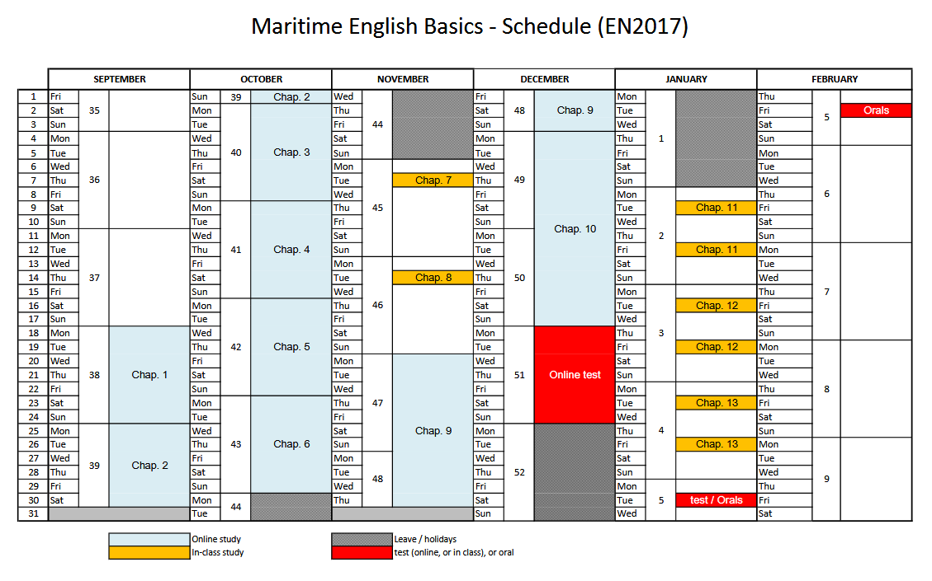

Slide 6
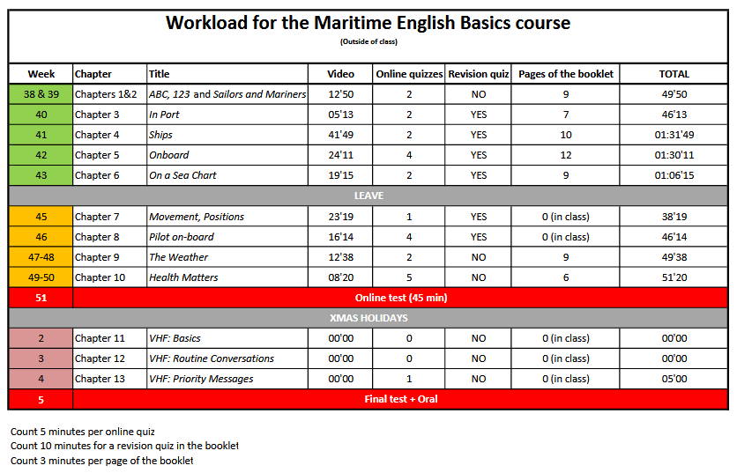

Slide 7
160 pages
13 thematic chapters
Very visual
QRcodes

Slide 8
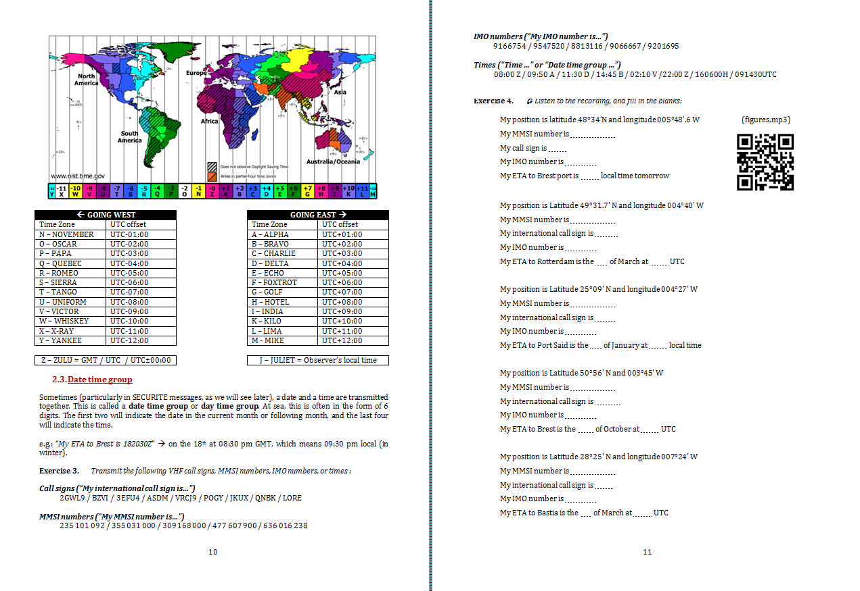

Slide 9
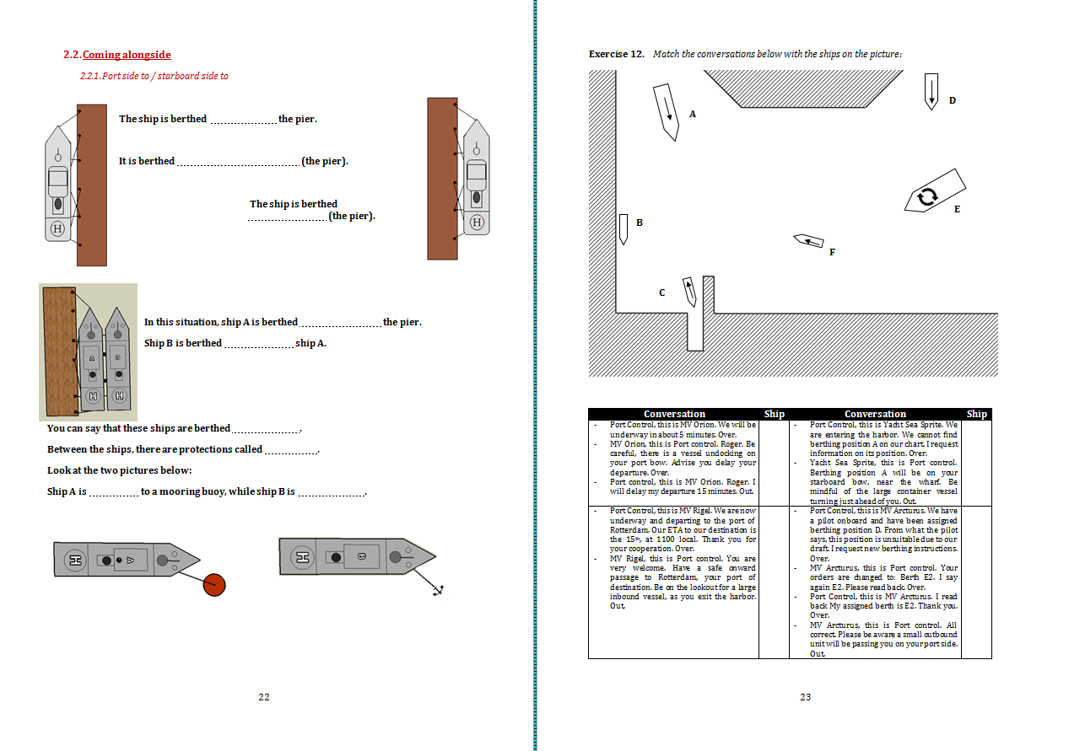

Slide 10
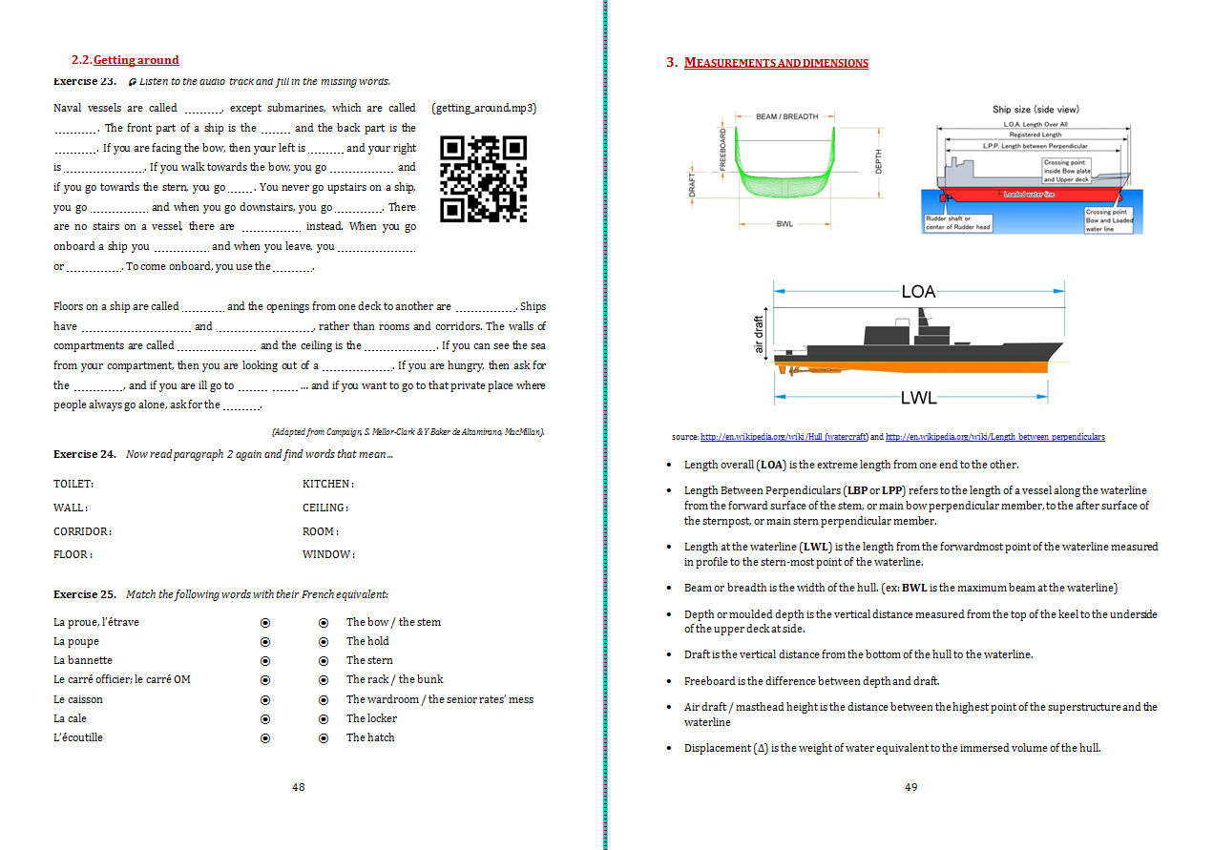

Slide 11
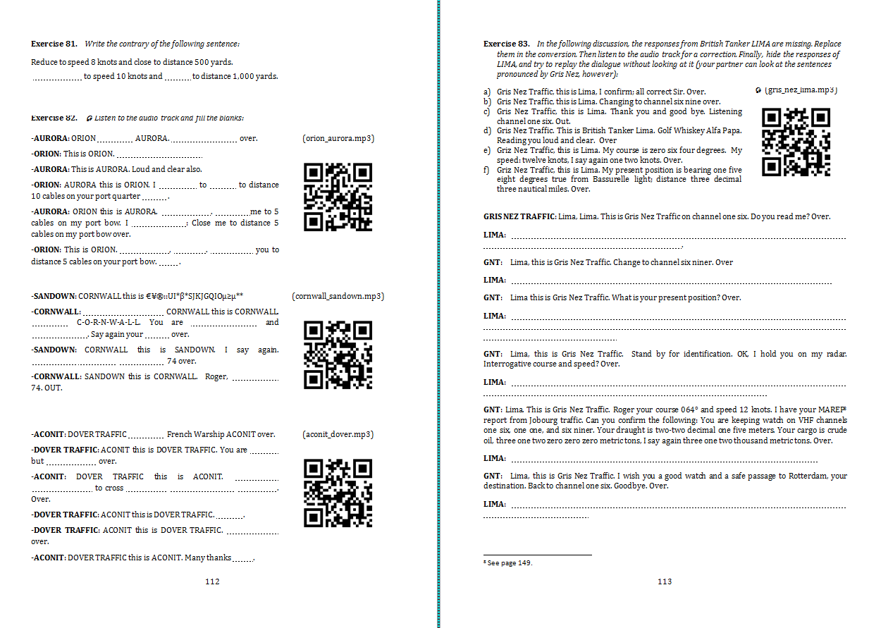

Slide 13
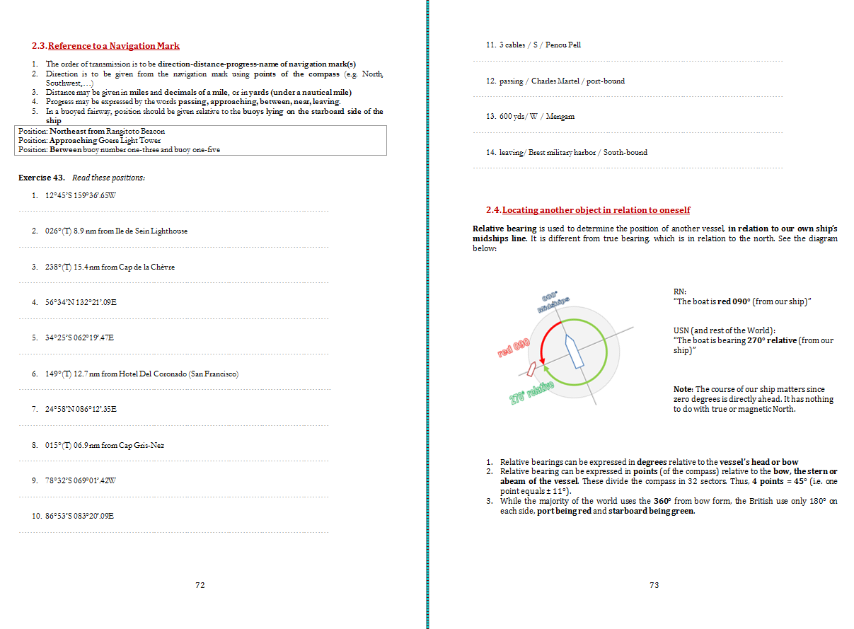

Slide 14
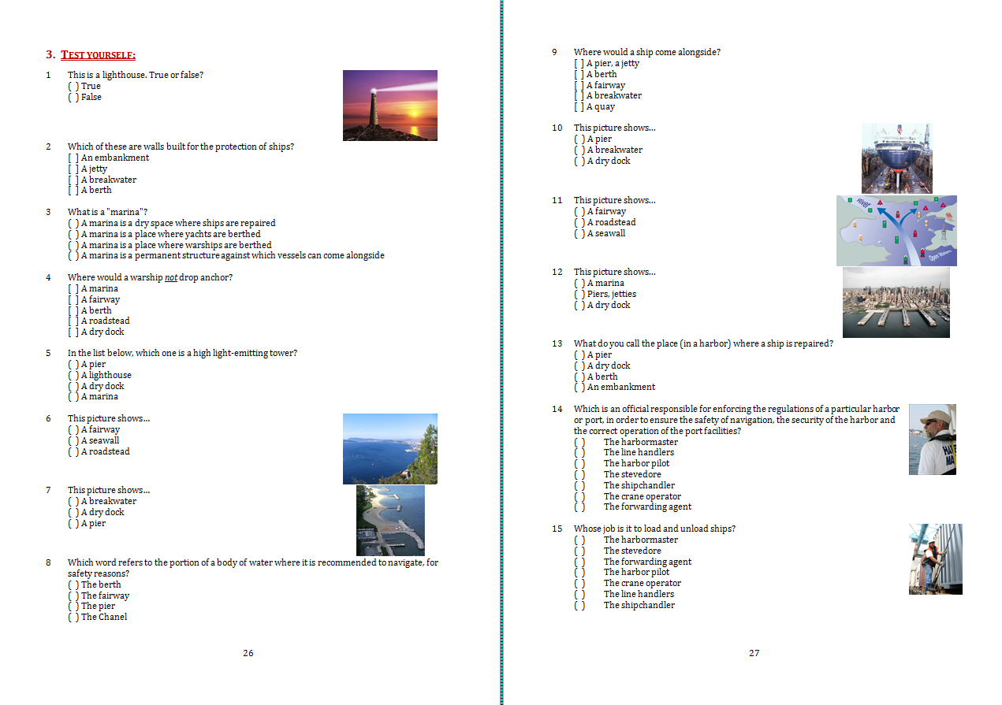

Slide 15
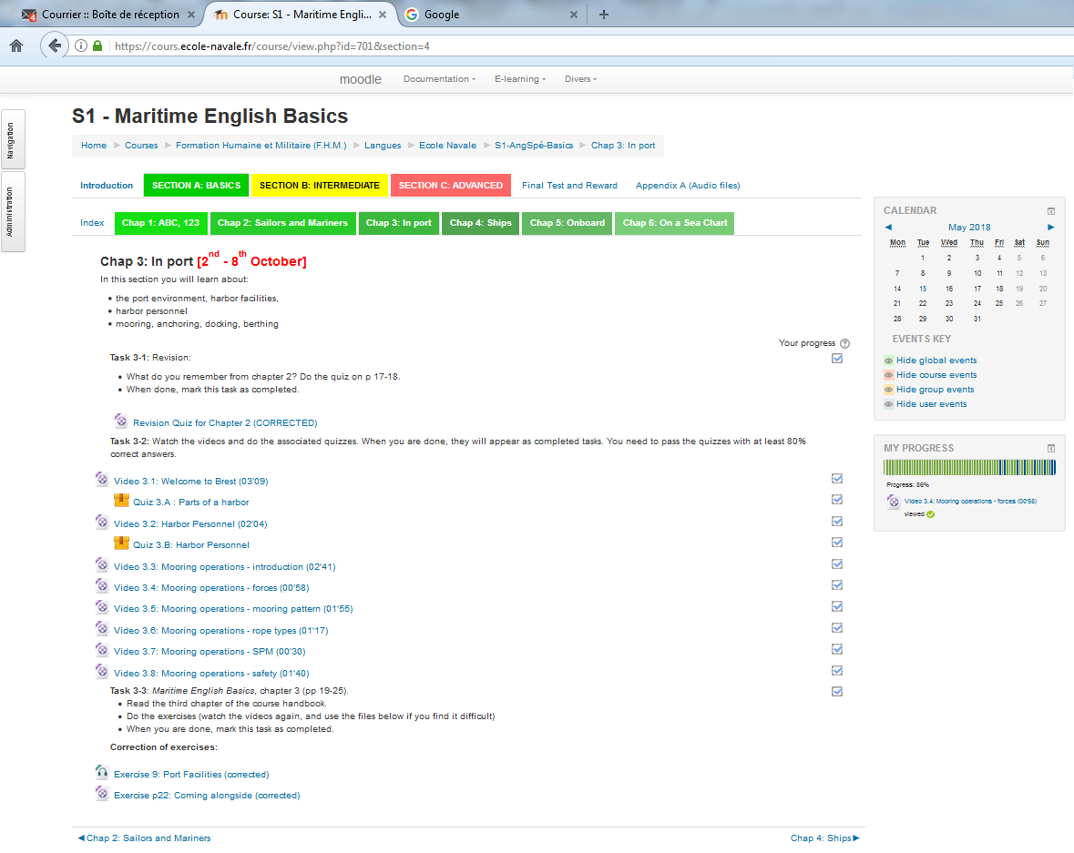

Slide 17
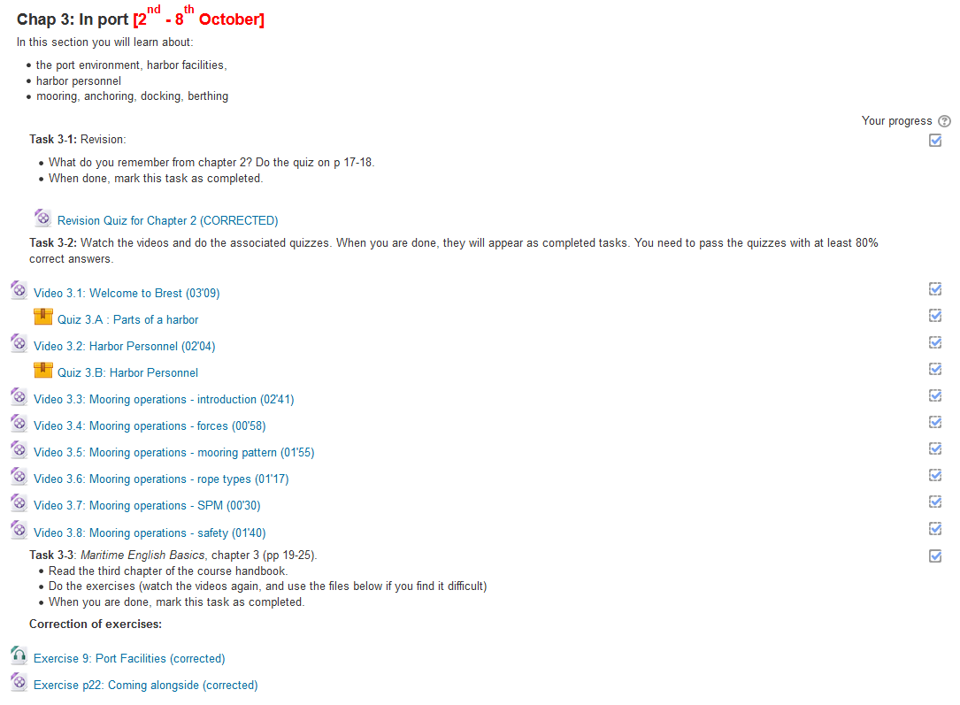

Slide 18
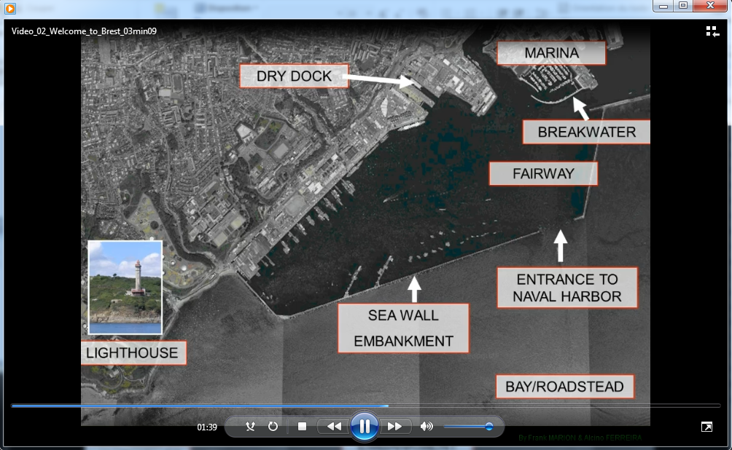

Slide 19
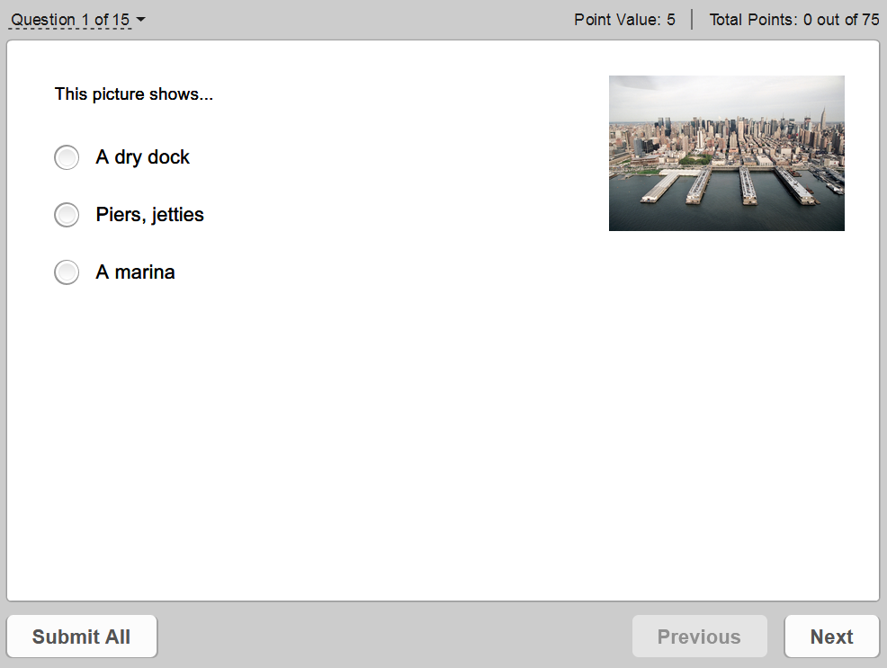
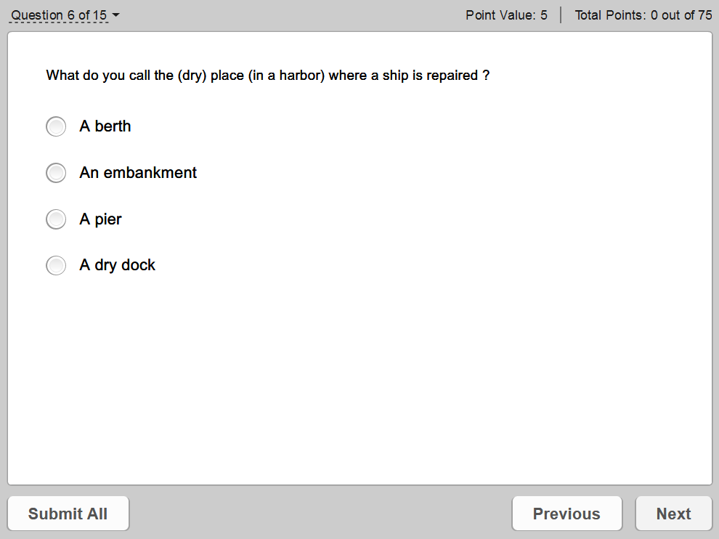
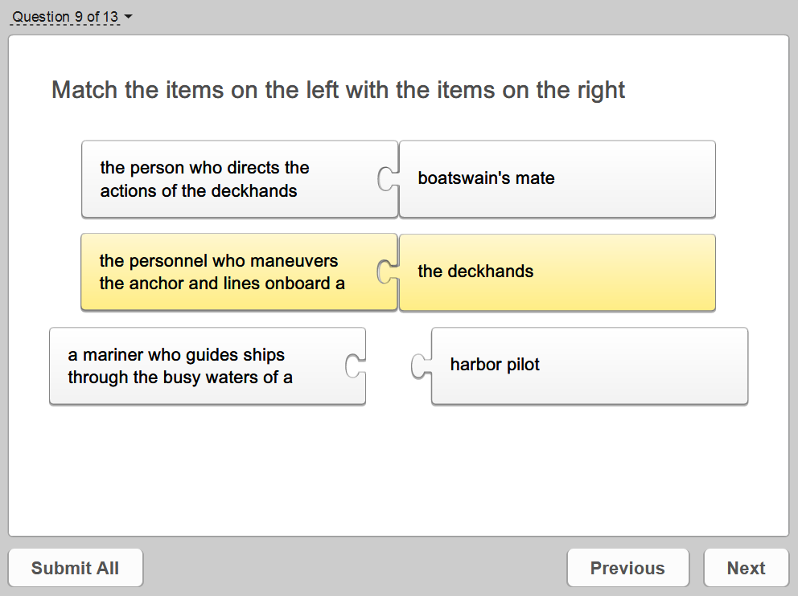
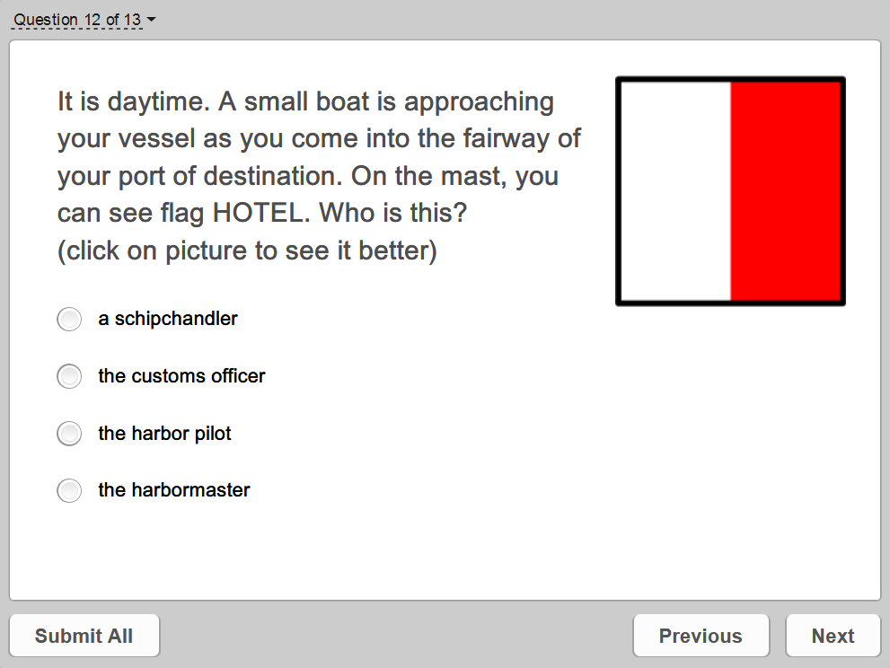

Slide 21
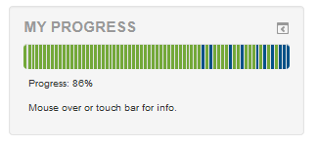
For completion of the course (watched all required videos and passed every required quiz with 80% correct answers or better)
For never being behind schedule during the first 6 weeks of the course (all assigned tasks completed by deadline)
For scoring 95% correct or better in every quiz

Slide 22
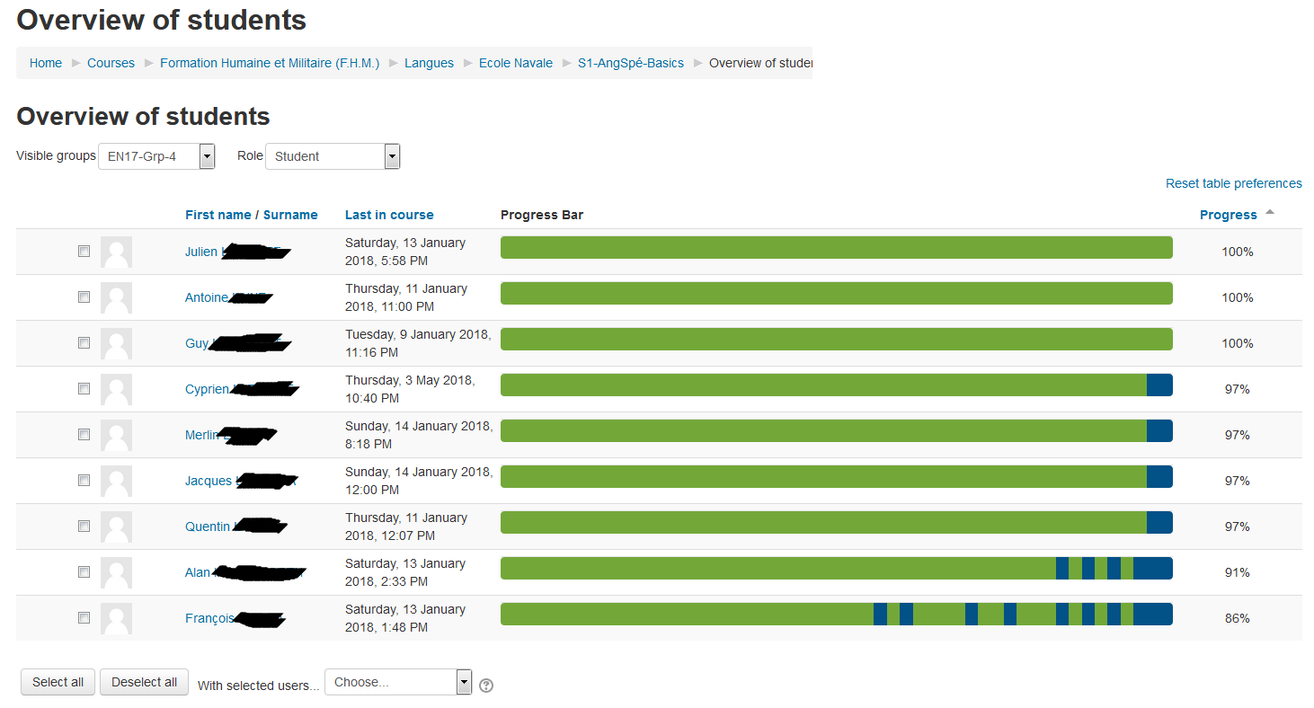

Slide 23
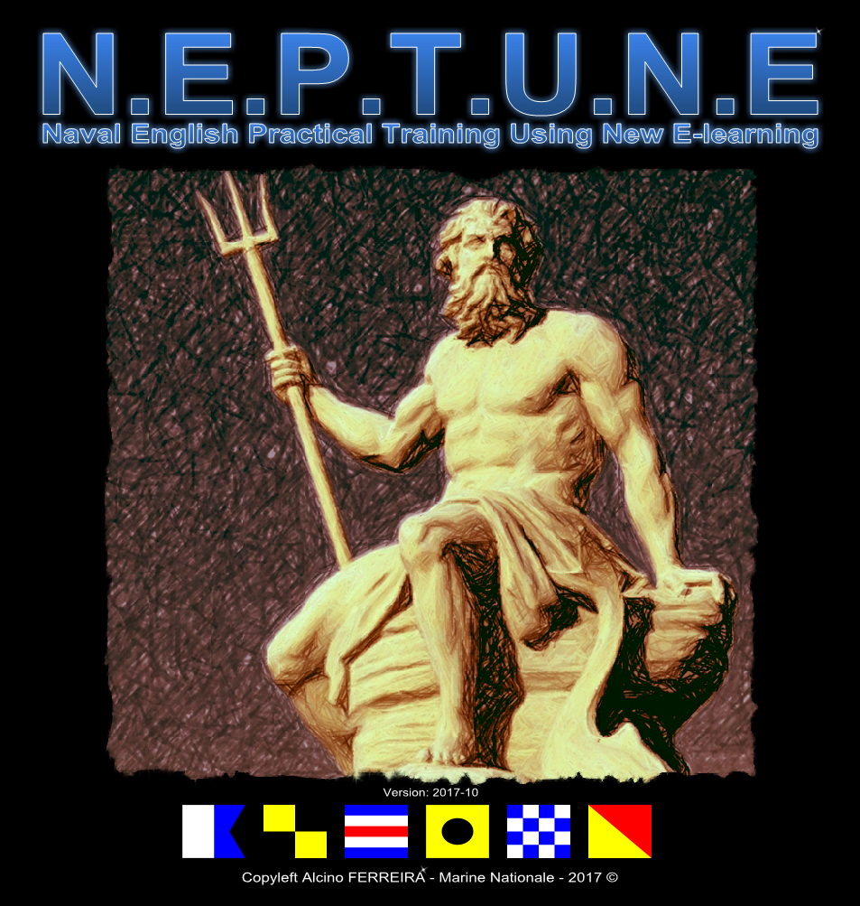

Slide 24
ADVANTAGES / CONSTRAINTS
- creating media takes time
- Takes some computer literacy
- no tutoring = failure
+ 6-fold increase of practice time
+ oral exam now possible and a success for 95% of students
+ fun factor (they love it and we love it) → engagement++

Slide 25
THANK YOU for not sleeping through this ☺
E-mail: alcino.ferreira@ecole-navale.fr
Web (for NEPTUNE): alcino-ferreira.com
Twitter: @alcino_ferreira

