Slide 1
Gamification
Christine Kelly
CE.Kelly@mindef.nl

Slide 2
Introduction
About me
TCD
Royal Military School
Regular Courses / Mission Preparation

Slide 3
Purpose of this workshop
To share ideas on how to use (elements of) gamification in lessons

Slide 4
Contents
Definition
Why I use games in lessons
Mentimeter
Quizizz
Operational Scene Description (example)
Dominoes (example)
60 seconds

Slide 5
Definition
The scientific definition of gamification is the process of applying game elements to non-game contexts (Zimmerling, Höllig, Sandner, & Welpe., 2019; Schöbel et al., 2020; Ding, Er, & Orey, 2018; Domínguez et al., 2013).
Often used exclusively to describe the use of digital game elements. For practical reasons, I will discuss both digital and analogue games.

Slide 6
Context
RNLA: English in NCO-training
Understand a platoon order (level 3), Issue a squad order (level 2)
Learn Military Jargon
Within the Language Department games are used for all ranks and language courses

Slide 7
Why I use games during lessons (examples)
Brain break / Energizer
Recap (previous) lesson
Formative assessment
To boost engagement
Build and apply vocabulary

Slide 8
Mentimeter
Engagement
MC + open-ended questions
Tools to share thoughts/ideas
Deemed safe (by NLDA)

Slide 9
Quizizz
Go to joinmyquiz.com
You have to sign up, but you can use a nonexistent e-mail address

Slide 10
Quizizz
Why I use Quizizz:
To activate students (after a break)
To practice with relevant terminology
Students have a chance to correct their mistakes
Answers can be discussed afterwards
Different question types

Slide 11
Quizizz
Disadvantages:
Students need to sign up
Publicly visible in free version
Security not guaranteed

Slide 12
Analogue Example: Operational Scene Description
You will work in pairs.
One of you receives a picture of an operational scene; do not show this picture to your buddy! Describe everything you see in your picture as accurately as you can, including as much military terminology as you can.
The other person draws everything described to them.
After +/- 15 minutes all original pictures will be shown on the screen and the person drawing has to recognize which picture is theirs.

Slide 15
Analogue Idea: Dominoes
Groups of 3-4
Connect the pieces into one large ‘snake’ by matching…
Picture – term
Abbreviation – meaning
Civilian term – military alternative
Dutch term – English term

Slide 16
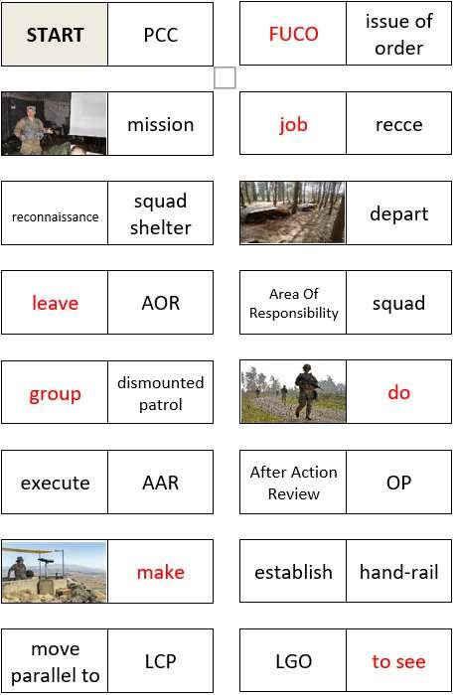
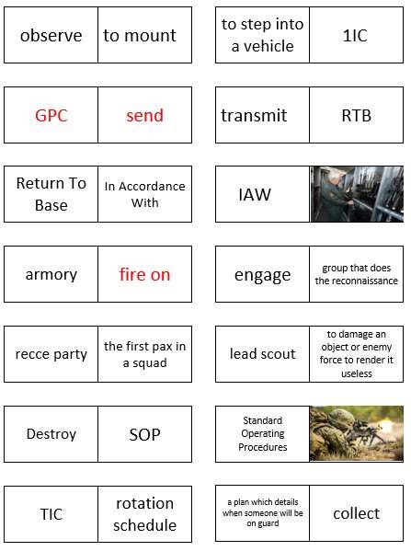
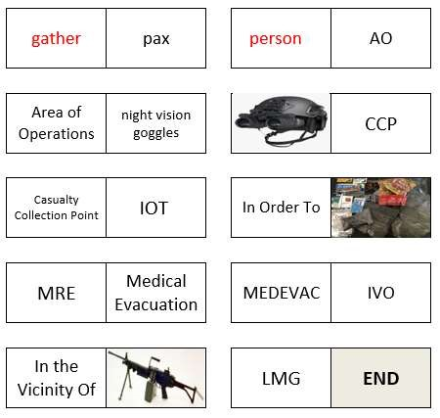
Analogue Idea: Dominoes
255

Slide 17
Analogue Idea: Dominoes

Slide 18
Analogue Idea: Dominoes
3 levels: - Make a glossary
Write sentences; highlight new words
Write a CONOPS paragraph; highlight new words
You will discuss your work after 10 minutes

Slide 19
Analogue Idea: 60 Seconds Quiz
Divide the group into multiple teams
Each team selects one person to describe the words on the card. The rest of the team tries to guess the words on the card. Try to guess as many words as possible in 60 seconds

Slide 20
Rules
Once all words on the cards have been found, you can get a new card
No [Dutch] allowed!
Do not say (parts of) the words on the card
No hand gestures / non-verbal communication
If there are abbreviations on the card, it is not necessary to give the full term

Slide 21
Examples
60 SECONDS | tracked vehicle to abort roll call armed Initial Commander’s Back Brief (ICBB) | Military English

Slide 22
Discussion
Form groups of +/- 4 people and share how you use games in lessons and/or how you could use games in your lessons.
Share your thoughts in the poll on the next screen.

