Slide 1
BILC Conference 2018
First Experiences with Mobile Devices
in Language Training
Dr Sabine Baltes-Ellermann
Deputy Head of Section
“Concepts, Teaching Materials and Tests”
Dr Dugald Sturges
Head of English Language Instruction, Hürth
Lisbon, 22 May 2018

Slide 2
The Project Team‘s Perspective
2
Notes:
2

Slide 3
The Project Team‘s Perspective
Background: From Laptops to Tablets
German Armed Forces:
from 2020: comprehensive supply with mobile devices for training purposes
piloting phase (now running): selected training institutions are supplied with laptops, smartboards and peripheral equipment, connected to the local educational network
Bundessprachenamt: not part of the initial project phase, but benefitted from surplus equipment (95 laptops)
BUT: little interest on the part of the students and the teachers
→ 3 key problems
3
Notes:
3

Slide 4
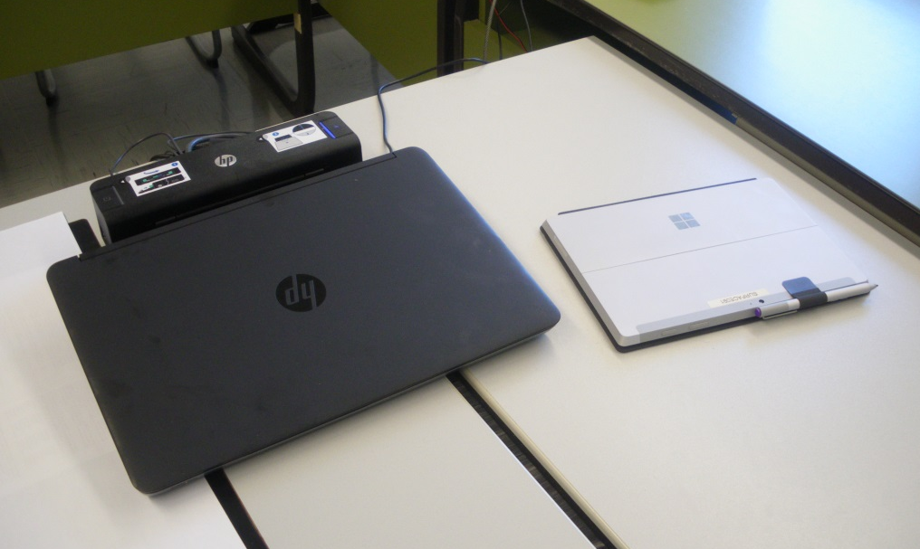
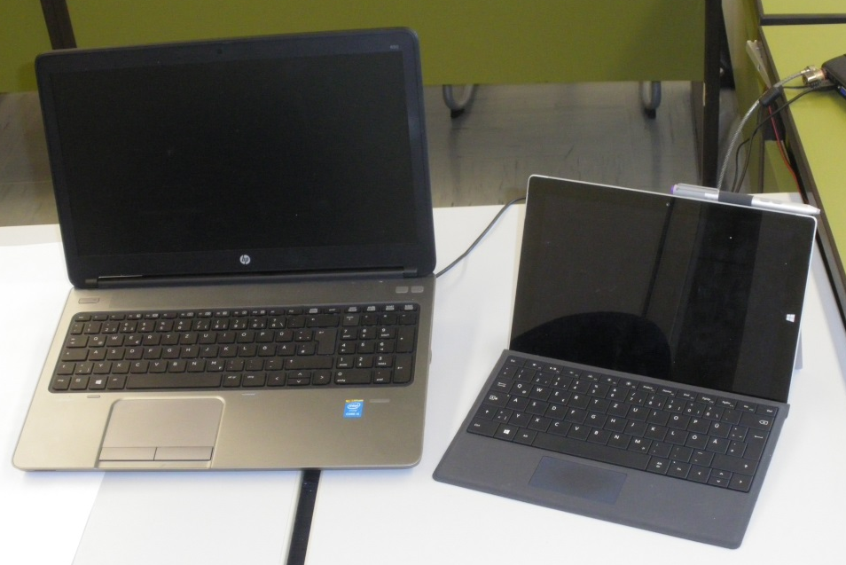
The Project Team‘s Perspective
Background: From Laptops to Tablets
Problem 1: Laptops and supporting equipment take up much space in the classroom.
→ Tablet computers are more convenient.
4
Notes:
4

Slide 5
The Project Team‘s Perspective
Background: From Laptops to Tablets
Problem 2: Laptops are to be connected to the local educational network via docking stations in classrooms.
Bundessprachenamt has a fully functioning WiFi connection
5
Notes:
5

Slide 6
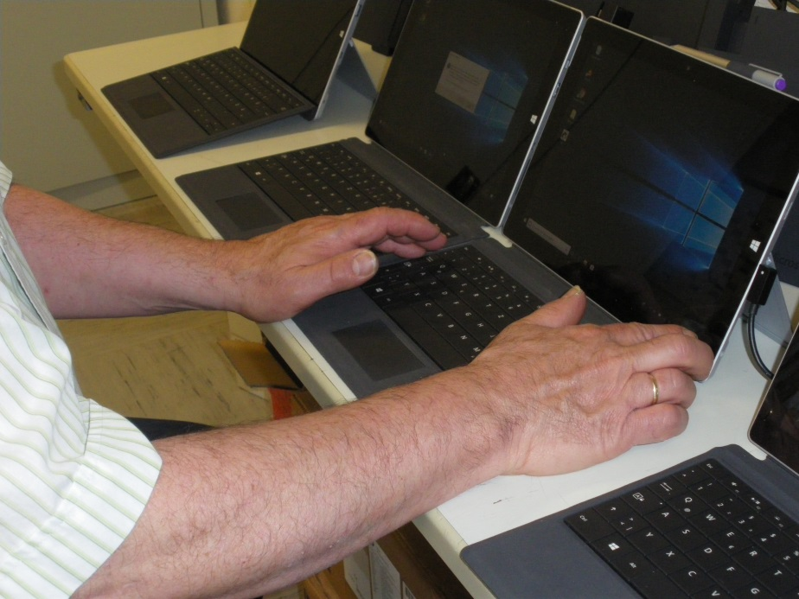
The Project Team‘s Perspective
Background: From Laptops to Tablets
Problem 3: Availability does not guarantee use.
→ support from the Project Team
6
Notes:
6

Slide 7
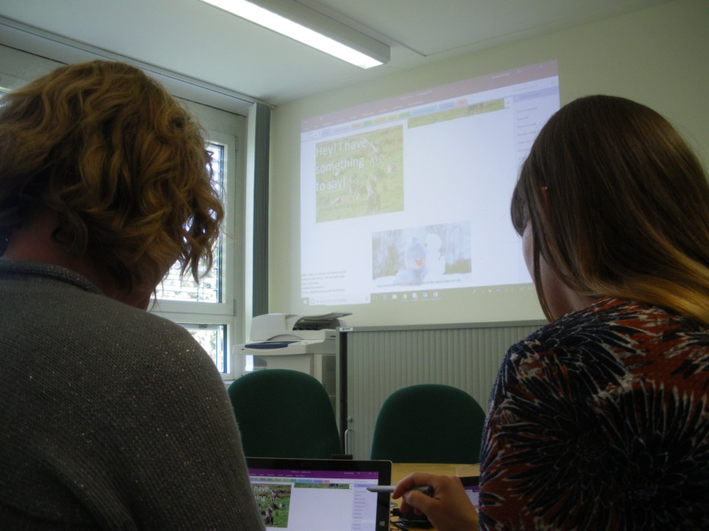
The Project Team‘s Perspective
Getting the Ball Rolling
crucial factor: winning over the teachers
individual tutoring
assistance during teaching time,
trouble shoot technical problems
→ More and more teachers have joined the group (we are actually running short on devices now …)
7
Notes:
7

Slide 8
The Project Team‘s Perspective
Class Briefings
making the students familiar with the devices
advising how to use them for further language study
demonstrating how to exploit
the possibilities of collaborative use
8
Notes:
8

Slide 9
The Project Team‘s Perspective
Feedback
asking students and teachers for feedback
handing out feedback questionnaires
[picture]
(well, slighty more sophisticated than this …)
9
Notes:
9

Slide 10
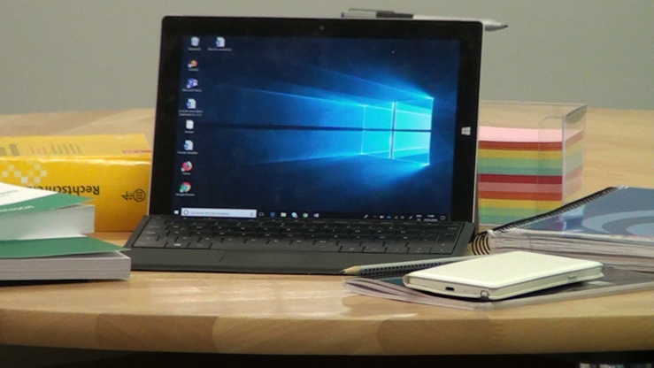
The Project Team‘s Perspective
Key insights
It is not sufficient just to provide a mobile device; rather, it is vital
to make both teachers and students see its potential for language learning and
to have someone on stand-by for whenever problems arise.
The project team’s support and guidance have been vital for the ongoing success of the project.
10
Notes:
10

Slide 11
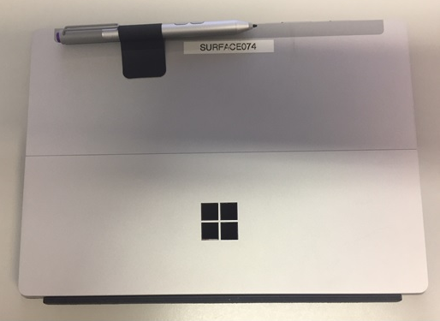
The Instructor’s Perspective
11
Notes:
11

Slide 12
Or…
The Fine Art of “Surfacing”

Slide 13
Introducing new technologies in the classroom
Invigorating? – Or taken for granted?
A technological TOOL – To that extent do new tools change training?
What can I (the instructor) now do better? Differently?
What do the learners expect to be able to do?
What do the learners expect me to be able to do?

Slide 14
Experiences in a variety of class types
Mobile devices have been issued to various types of language classes
German as a Foreign Language
Foreign Language SLP (including English)
English for Specific Purposes
In principle, mobile devices are used the same way in all languages.
Higher degree of topically specific content in LSP courses

Slide 15
Diversity of student affinity to new technology
Some students require more intensive training in the use of the devices, depending on age, country of origin, “tech savvy” etc.
Lack of experience with technology qua technology
Lack of experience with more independent, individualized learning.
Reluctance to give up familiar learning tools (Vokabelheft!)
Other students (especially digital natives) take the presence of mobile devices for granted
High expectations regarding technical platform
Desire to use own devices

Slide 16
Student Expectations and Acceptance
Comparison of post-course course evaluation questionnaires of the same course type and similar student populations in 2017 (without issued mobile devices) and 2018 (with issued mobile devices)
“Use of modern technologies in language instruction” improved, however,
Overall course evaluation remained about the same.
New technology is appreciated and seen as a useful improvement but is not a deciding factor in overall course approval

Slide 17
Potential and Challenges
Potential:
Making the classroom a Paperless Workplace!
Challenges:
Many students still prefer using paper and pen
Redoubling material – many students want printouts in addition to online material
Retention of material learned?
Technical problems can be showstoppers
Students’ desire to use their own devices rather than school issue

Slide 18
Potential and Challenges
Potential:
Students can upload their work and teachers can correct it at any time.
More flexible distribution of workload for learners and instructors
Students can more easily revise corrected work for re-submission.
Challenges:
Students who prefer paper may and often do hand in printed or handwritten homework.
SLP Exams are paper-based, therefore students must gain some practice doing paper-based work before being tested.

Slide 19
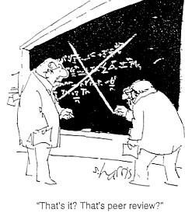
Potential and Challenges
Potential:
Students can cooperatively compose and edit texts
Possibilities for peer correction
Collaboration on collecting arguments for discussions and debates.
Challenge:
In-class discipline is required in the collaboration zone.
Guidelines need to be established – who is authorized to do what?
Risk of uneven workload within groups

Slide 20
Potential and Challenges
Potential:
The www is always available to everyone!
No need to reserve a dedicated “computer classroom“ (no booking or other conflicts)
“Let me Google that…“ The opportunity to spontaneously check facts or gather arguments for discussions
In-class research for presentations, debates, etc.
A wealth of general and specialist lexical material immediately available.
The ability to work with real/authentic material:
SLP: Internet sites in the target language; ESP: Technical documentation, etc.

Slide 21
Potential and Challenges
Challenges:
Danger of plagiarism – Insufficient understanding of what constitutes original thinking/composition (eg. e-hausaufgaben.de).
The temptation to use online translators like Google Translator or Linguee – without awareness of the weaknesses of these tools
The “Linguee trap”: False contexts / False friends/ may be perpetuated by students quoting sources from their own language zones (eg. “Germanisms” from English language sites with .de, .ch or .at addresses)
Qualitative difference of sources – both linguistically and topically
Dominance of advertising on many free sources
Less retention of new vocabulary and structures

Slide 22
Solution Strategies
While all issues regarding use of internet sources mentioned existed before, with the introduction of mobile devices they have become more critical
Digital learning must be reconciled with paper based testing - Dictionary skills, writing skills etc.
Need to educate students to critical use of internet-based material, both in terms of content and in terms of language
Redefining classroom discipline:
- “Where are they (i.e. the students) right now?”
- “Device fixation”
- “Raising hands” (students can access the projector…)
In short: Many possibilities and pitfalls which require rethinking the classroom.

Slide 23
Troubleshooting (aka Stage Management)
Software updates must be regularly conducted before class. Otherwise function in class might be impaired.
Allow for mouse and touchscreen affinities
Plan time to write by hand – for purposes of retention and to maintain writing habits for exams.
Charge batteries
… but just in case, make sure there are enough electrical outlets, spare batteries and extension cords available.
The teacher as roadie and instrument tech: The instructor should be familiar enough with the devices used to be able to assist students in case of the most common problems
Because the show must go on!

Slide 24
Results of the First Phase
In summing up, the introduction of mobile devices has proven so far to be a useful tool for teaching and for increasing student productivity.
It can be applied in all instructional phases: warm-up, in-class work, homework/ revision and in presenting results.
To make the most of the potential of this technology, both students and teachers need to be sufficiently prepared for its pitfalls as well as its possibilities.
This requires a lot of classroom rethinking on the part of instructors and imparting a new in-class netiquette to the students.

Slide 25
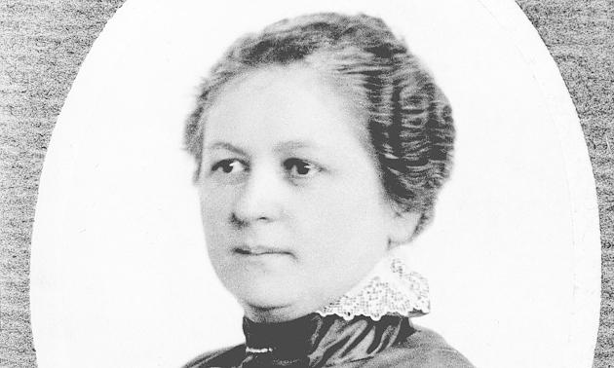
A Brief Historical Note
In 1908, Melitta Bentz (1873-1950) invented the coffee filter: The state of the art in making good coffee for over half a century.

Slide 26
A Brief Historical Note
1969: Otto Bengtson invented an automatic coffee machine with integrated coffee mill. Large quantities of good coffee could now be made quickly and cheaply.
1985: Arthur Schmied’s fully automatic, high pressure coffee maker went into production. Espresso, cappuccino, latte macchiato could now be produced by pressing a button.
The result of all this progress: Good coffee is faster, more diverse and more convenient to produce. But it is still coffee.

Slide 27
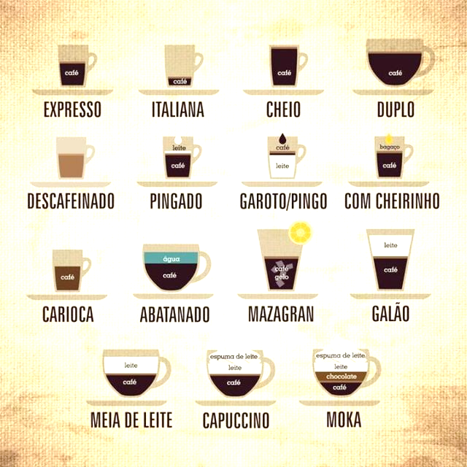
And in the end, coffee is still made with beans and water.
Just as language skills are still taught by people in order to enable people to communicate with other people.
Muito obrigado pela vossa atenção.

