Slide 1
50 Years of BILC
BILC’s Professional Development Program
by
Peggy Garza

Slide 2
BILC Testing Seminars
Language Testing Seminar (LTS)
Advanced Language Testing Seminar (ALTS)
Language Standards and Assessment Seminar (LSAS)

Slide 3
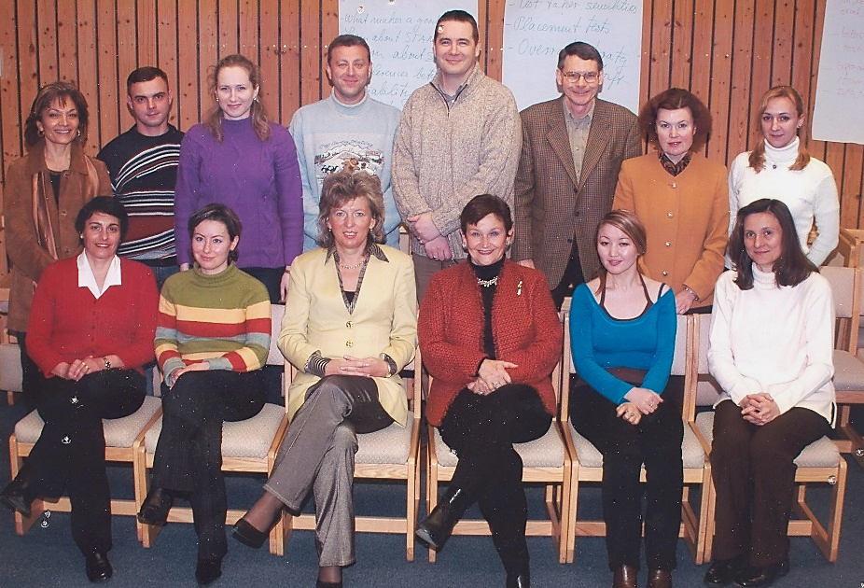
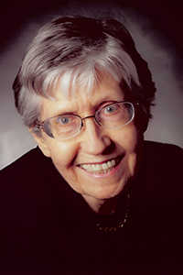
Language Testing Seminar (LTS)
Notes:
Background: A BILC initiative aimed at promoting a common interpretation of STANAG 6001 and consistency in language proficiency testing
Began in 2000

Slide 4
Language Testing Seminar (LTS)
Duration: 2 weeks
Content:
Familiarization with STANAG 6001
Concepts in testing
Practice developing proficiency test items in all four skills
Focus on Level 2

Slide 5
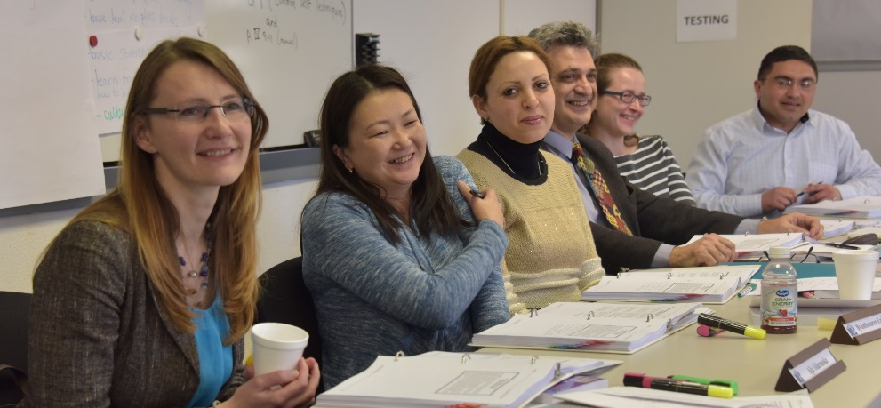
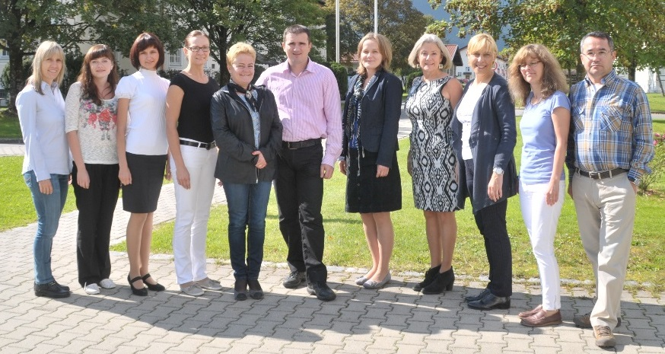
Language Testing Seminar (LTS)
Participants
Almost 500 participants from 53 nations/NATO offices
Facilitators
40 facilitators from 20 nations

Slide 6
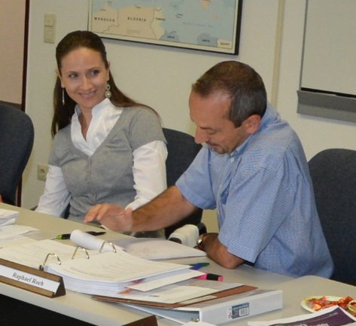
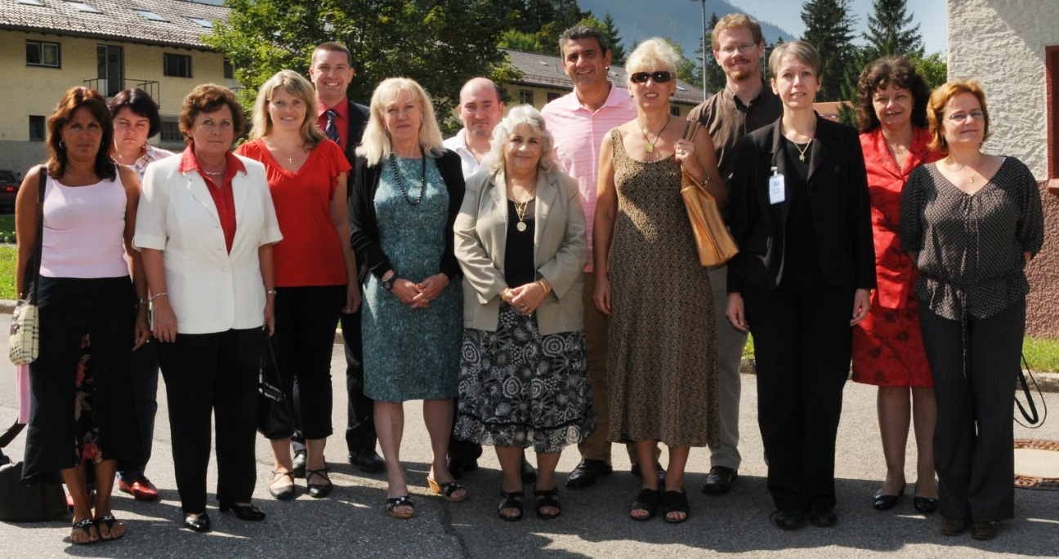
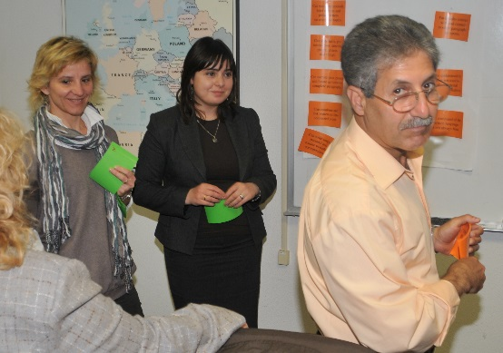
Advanced Language Testing Seminar (ALTS)
Notes:
Background: Target audience is LTS graduates who continue to work on STANAG 6001 testing
STANAG 6001 standardization sessions
Focus on Level 3 for practical exercises
Opportunity to exchange best practices
Began in 2009

Slide 7
Advanced Language Testing Seminar (ALTS)
Duration: 3 weeks
Content:
Module 1: Receptive Skills: Listening and Reading (one week)
Module 2: Productive Skills: Speaking and Writing (one week)
Module 3: Test Validation (3 days)
Module 4: Managerial Issues (2 days)
Focus on Level 3

Slide 8
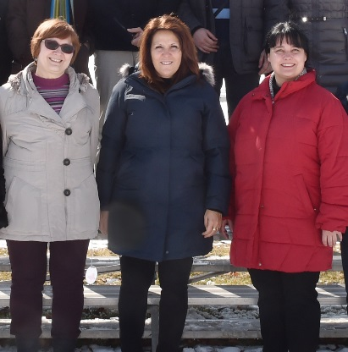
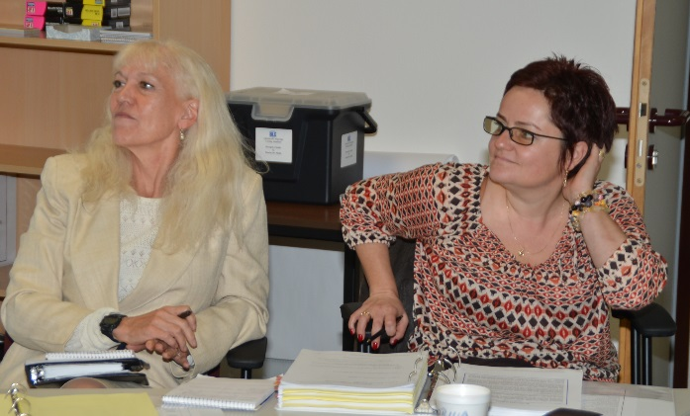
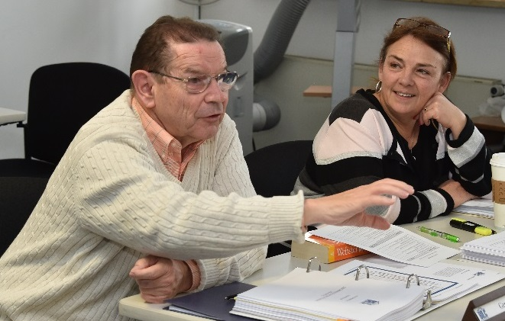
Advanced Language Testing Seminar (ALTS)
Participants
Almost 100 participants from 31 nations/NATO offices
Facilitators
14 facilitators from 9 nations

Slide 9
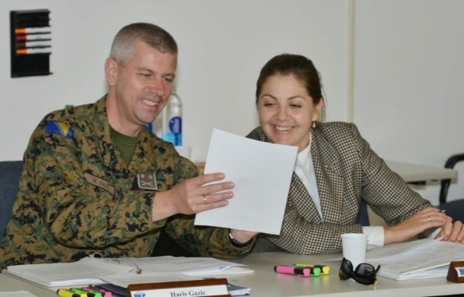
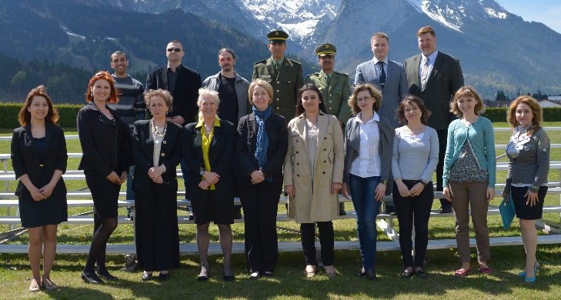
Language Standards and Assessment Seminar (LSAS)
Notes:
Background: language testing seminars were aimed at NATO test developers.
Language teachers and program managers also needed to be familiar with STANAG 6001 and assessment literacy
Began in 2013

Slide 10
Language Standards and Assessment Seminar (LSAS)
Duration: 2 weeks
Content:
Familiarization with STANAG 6001
Concepts in testing and assessment
Aligning instruction to NATO standards
For language teachers and program managers

Slide 11
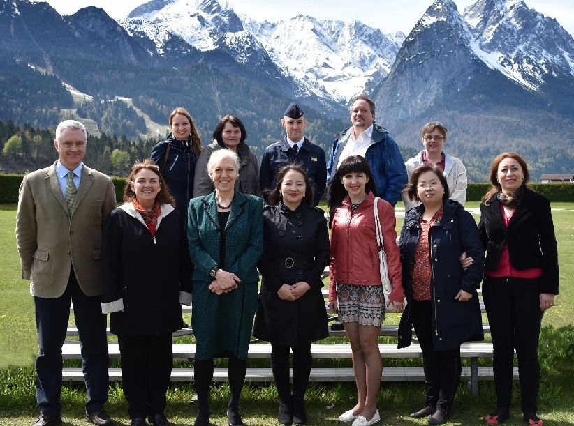
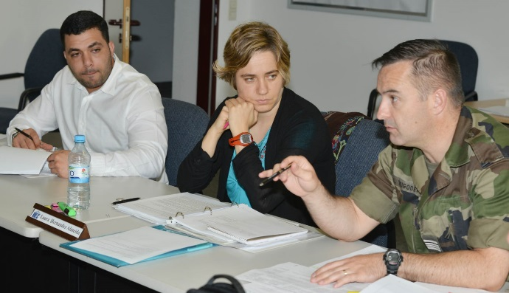
Language Standards and Assessment Seminar (LSAS)
Participants
Almost 75 participants from 28 nations/NATO offices
Facilitators
8 facilitators from 8 nations

Slide 12
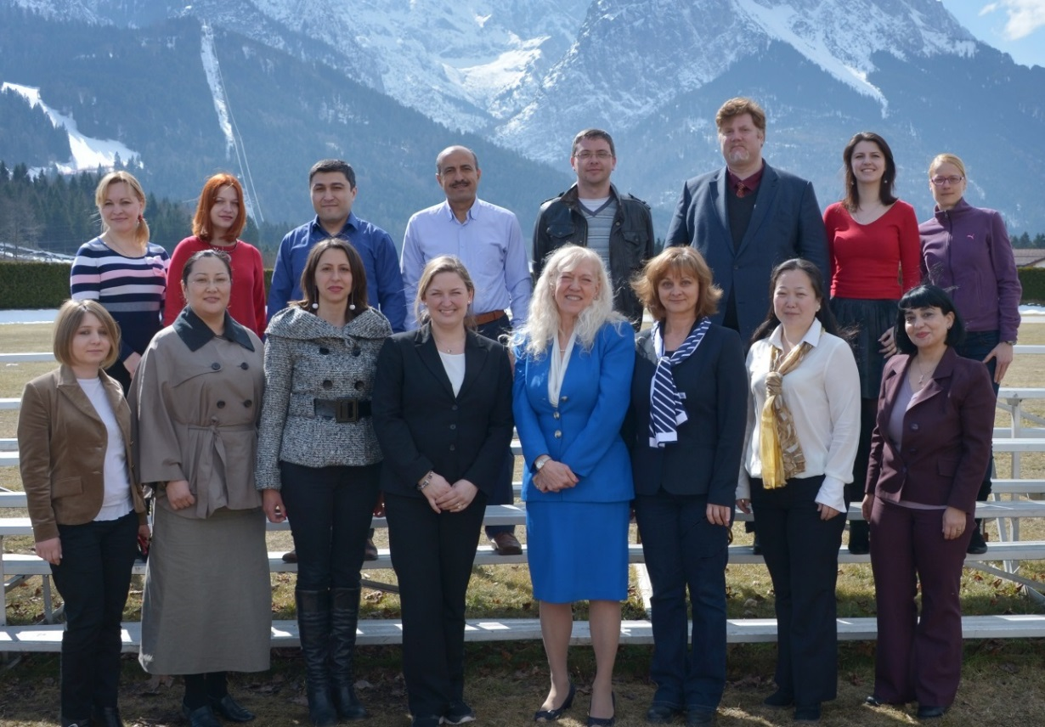
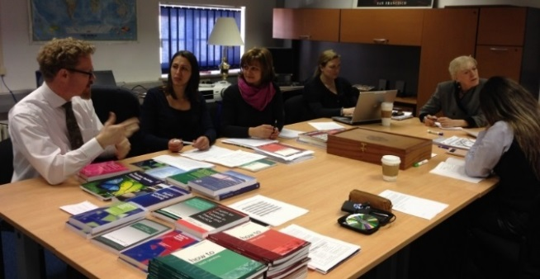
English Teaching Faculty Development Workshop
Notes:
Background: The BILC community identified a need for professional development for teaching faculty
A BILC working group designed and developed a workshop that presents current language teaching methodologies and practices for military contexts aimed at furthering interoperability for language, with a focus on teaching speaking and writing to military students.
Began in 2015

Slide 13
English Teaching Faculty Development Workshop
Duration: 2 weeks
Content:
Week 1: Teaching Speaking for Military Purposes
Week 2: Teaching Writing for Military Purposes
STANAG 6001
Military contexts
Military students
Principles and practice in
communicative language teaching

Slide 14
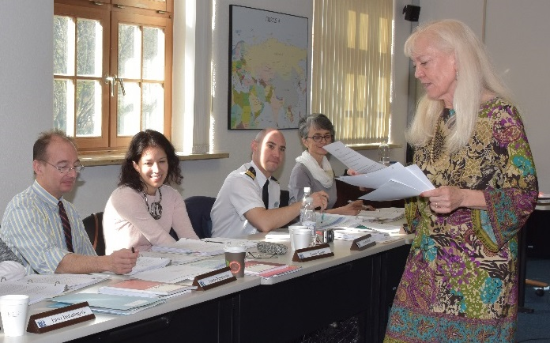
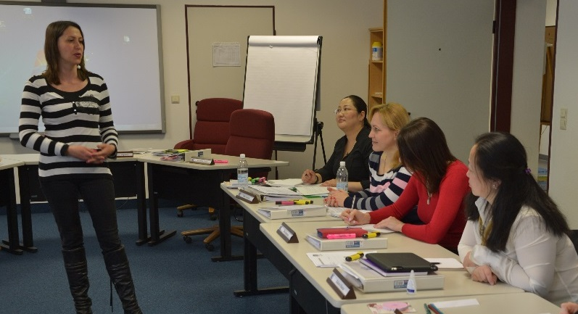
English Teaching Faculty Development Workshop
Participants
Almost 50 participants from 21 nations/NATO offices
Facilitators
7 facilitators from 7 nations

Slide 15
BILC’s Professional Development Program began 16 years ago with the Language Testing Seminar

Slide 16
Participants Have Come From
Albania | Greece | Poland
Algeria | Hungary | Portugal
Armenia | Italy | Romania
Austria | JFC Naples | Russia
Azerbaijan | Jordan | Serbia
Belarus | Kazakhstan | SHAPE
Belgium | KFOR | Slovakia
Bosnia-Herzegovina | Kyrgyz Republic | Slovenia
Bulgaria | Latvia | Spain
Canada | Lithuania | Sweden
Croatia | Macedonia | Switzerland
Czech Republic | Mauritania | Tunisia
Denmark | Moldova | Turkey
Egypt | Mongolia | Turkmenistan
Estonia | Montenegro | Ukraine
Finland | NATO AWACS | United Arab Emirates
France | Netherlands | United Kingdom
Georgia | Norway | United States of America
Germany | Pakistan | Uzbekistan

Slide 17
Nations Providing Facilitators
Austria | France | Portugal
Bosnia-Herzegovina | Germany | Romania
Bulgaria | Hungary | Serbia
Canada | Italy | Slovakia
Croatia | Lithuania | Slovenia
Czech Republic | Moldova | Spain
Denmark | Netherlands | United Kingdom
Estonia | Poland | United States of America

Slide 18
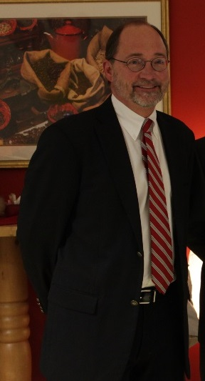
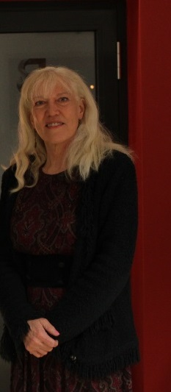
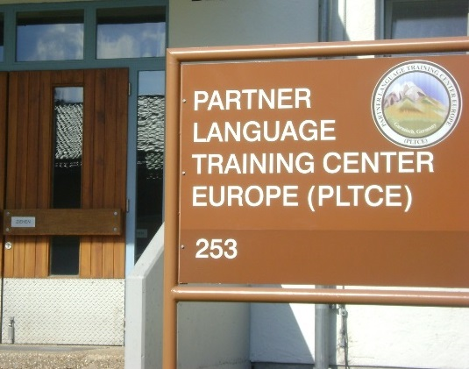

Slide 19
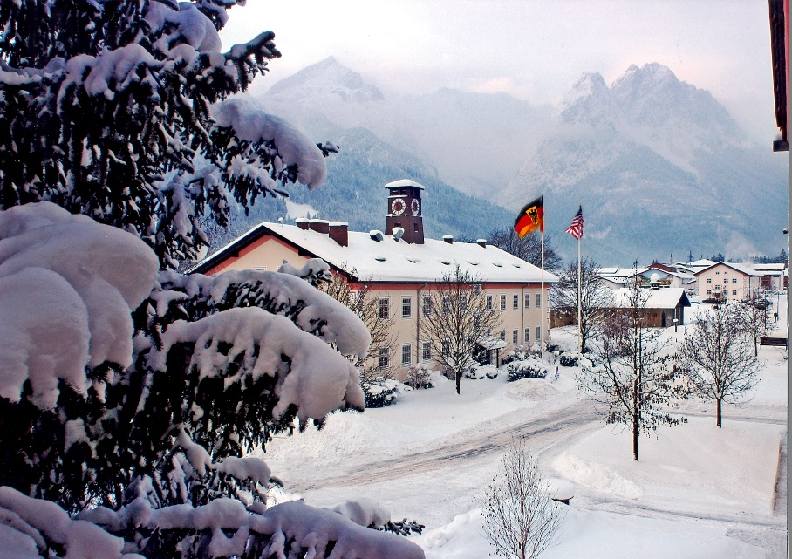
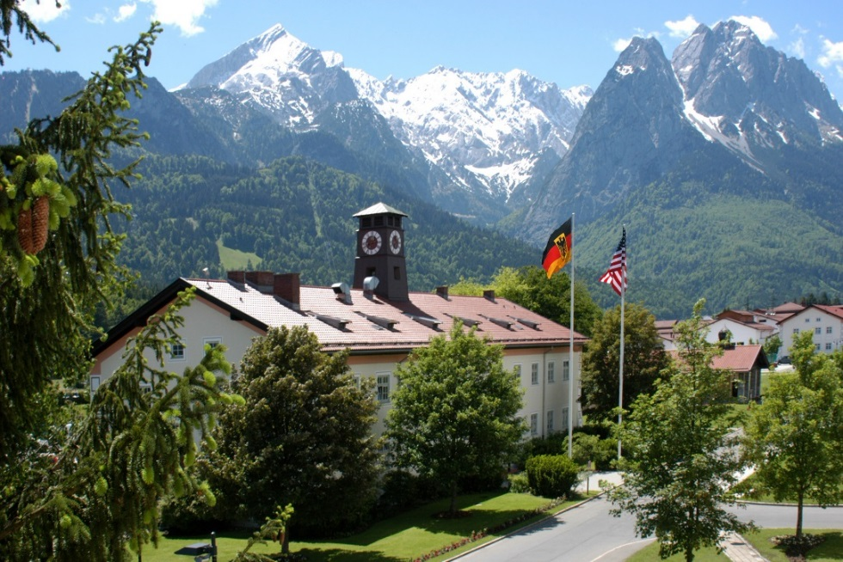

Slide 20
Language Testing Seminar Memories

Slide 21
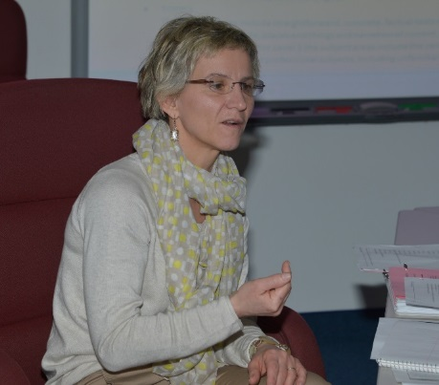

Slide 22
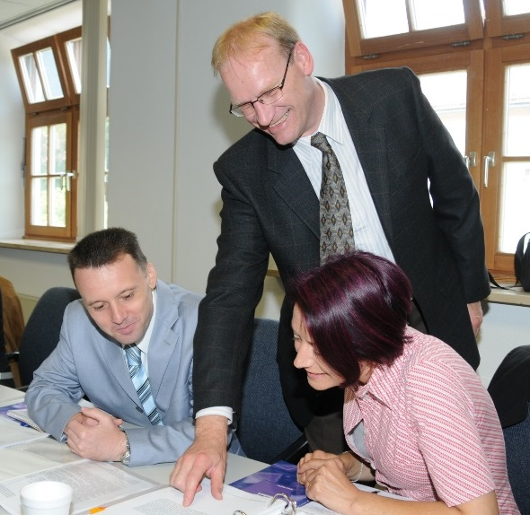
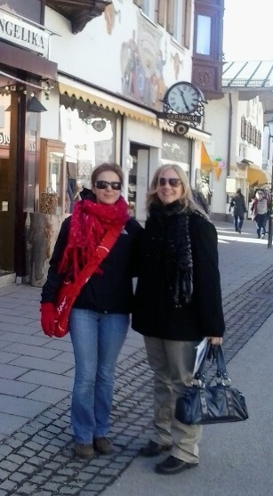

Slide 23
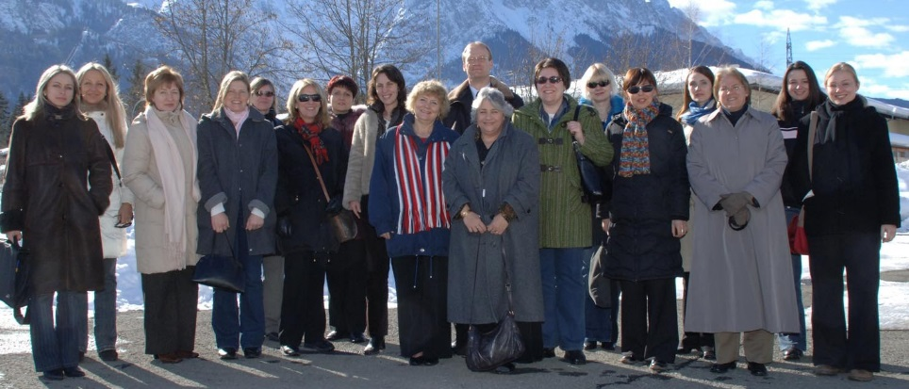

Slide 24
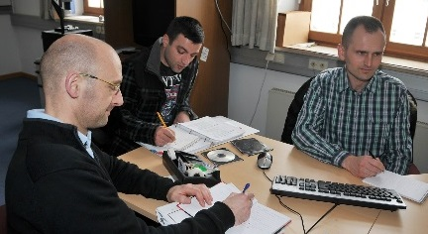

Slide 25
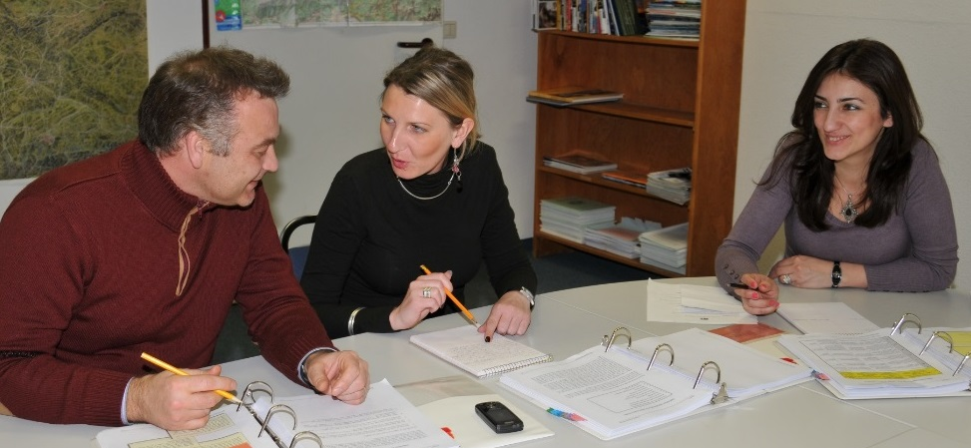
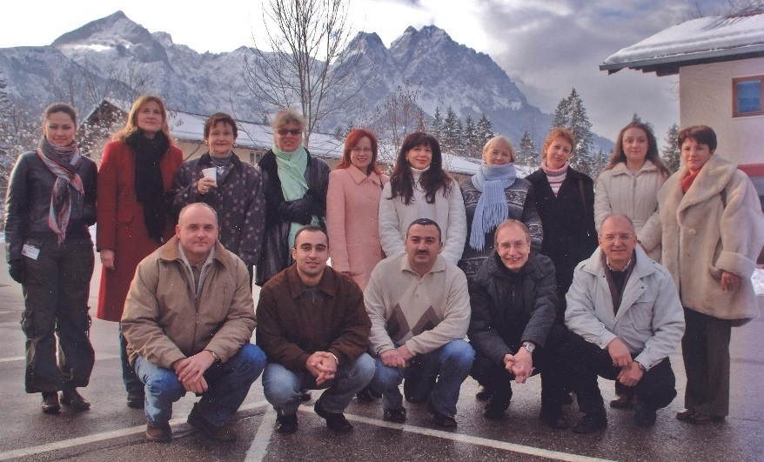

Slide 26
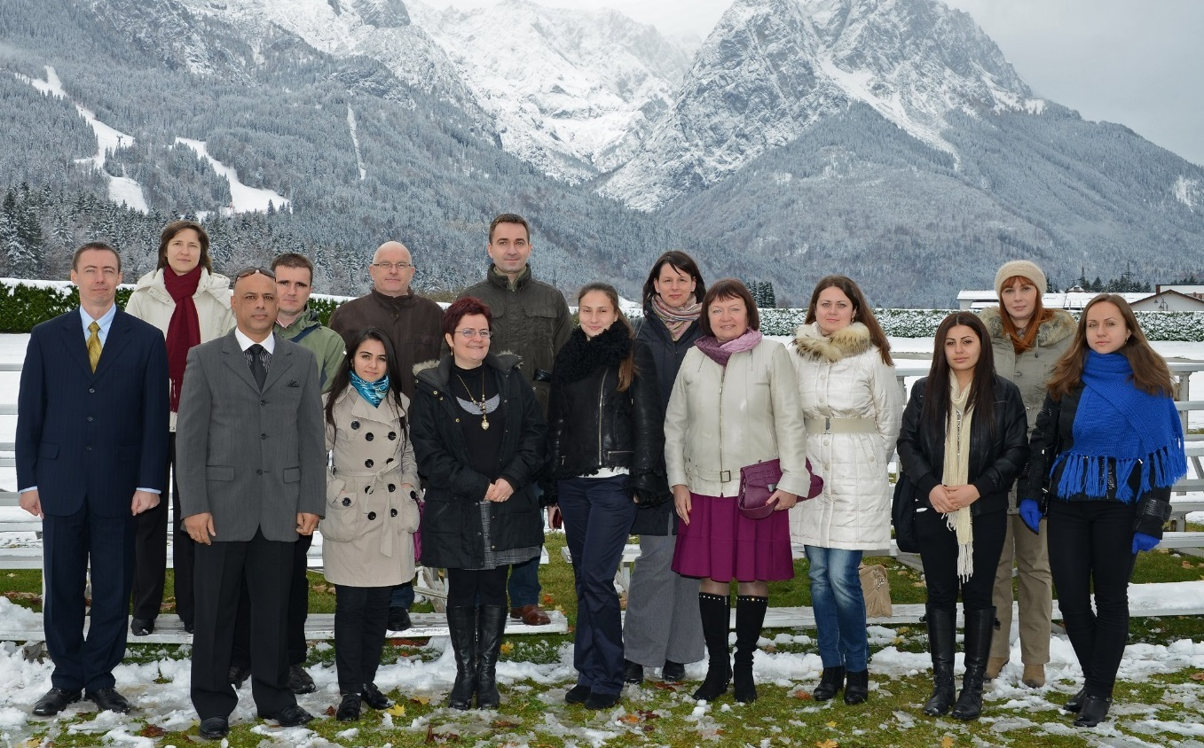

Slide 27
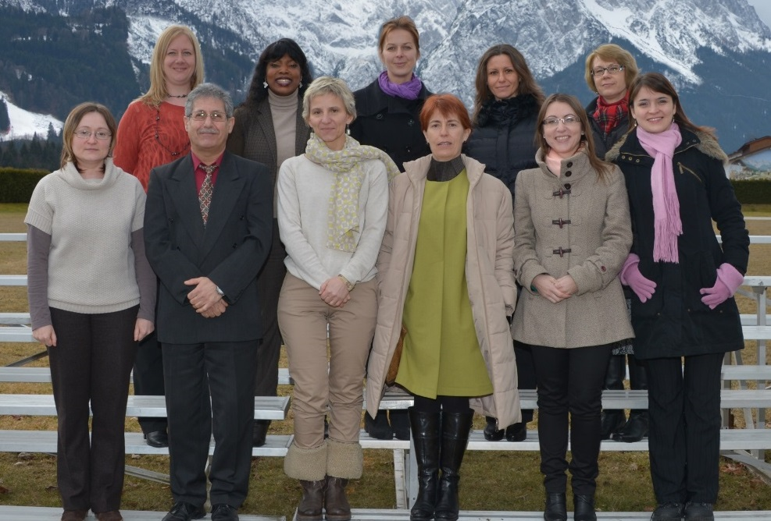
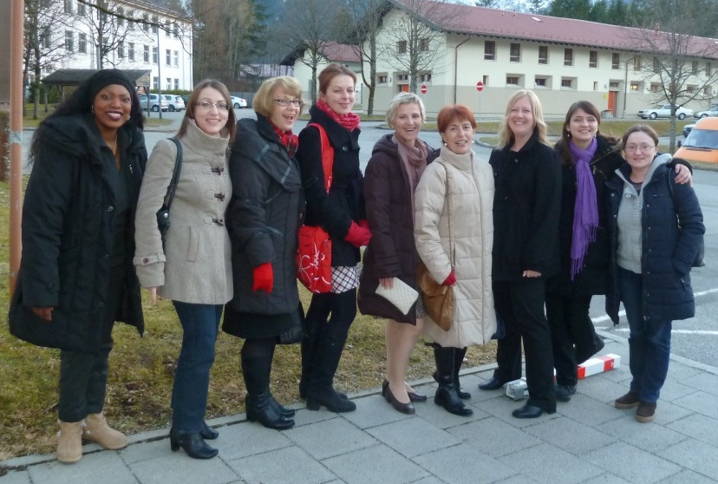

Slide 28
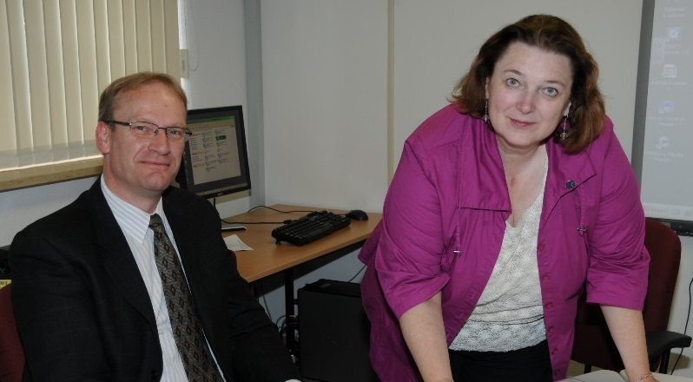
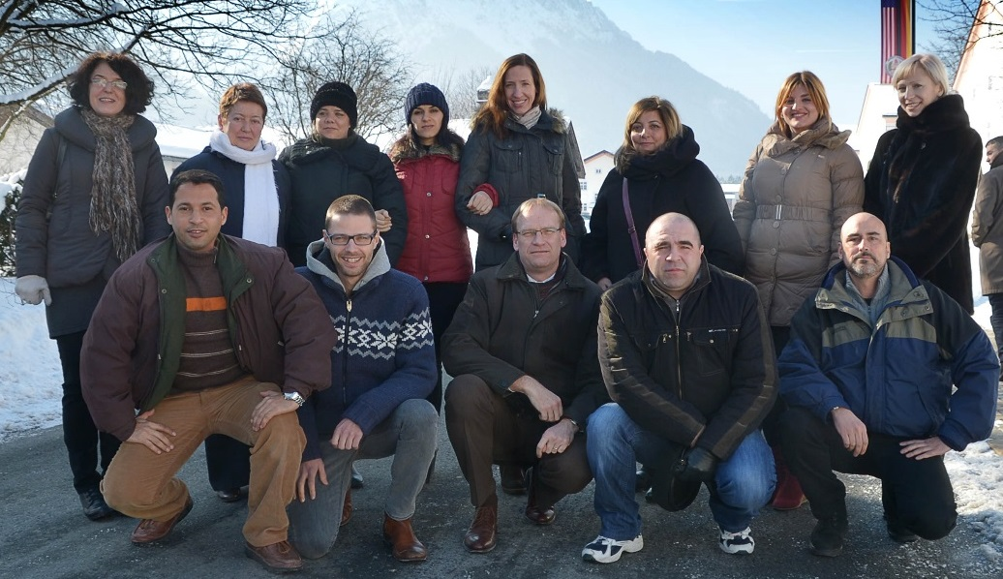

Slide 29
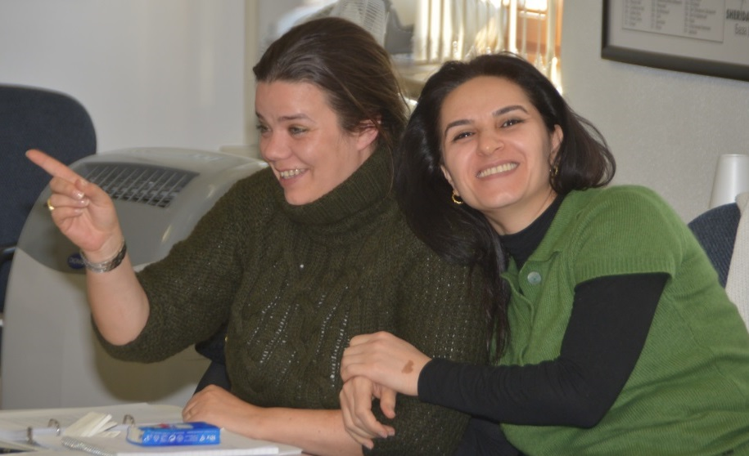

Slide 30
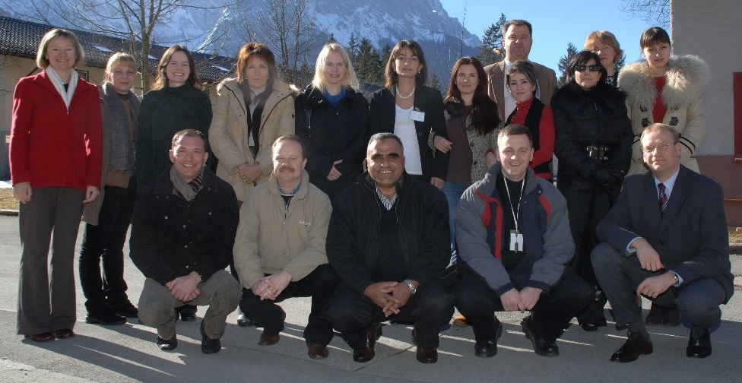

Slide 31
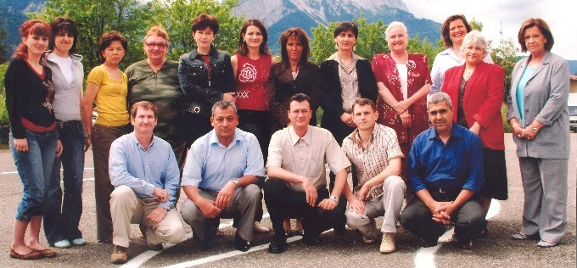
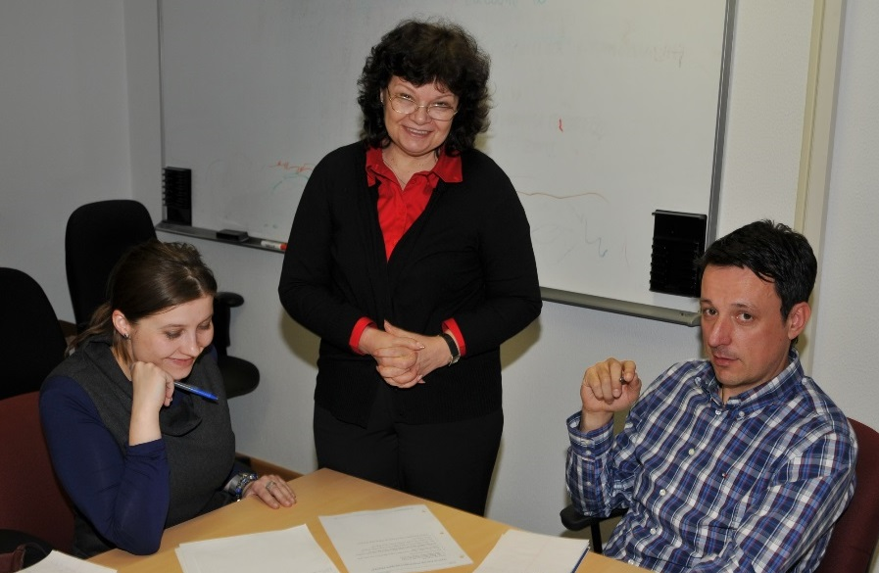

Slide 32
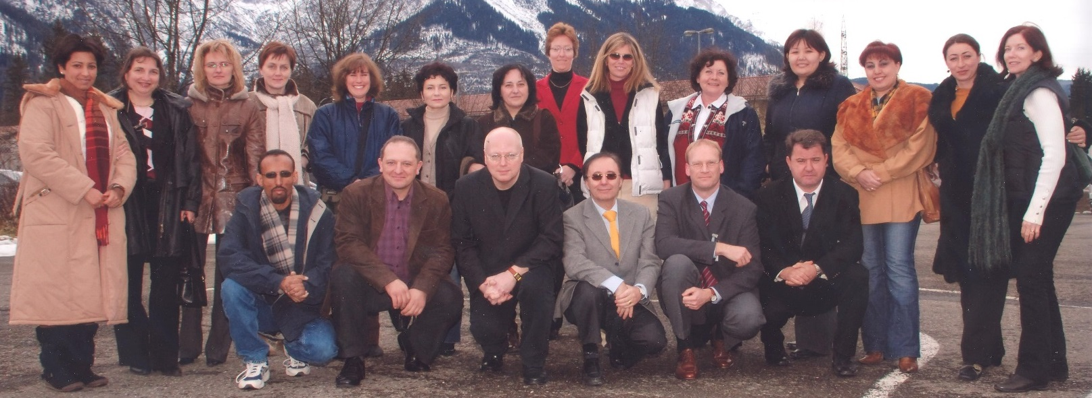

Slide 33
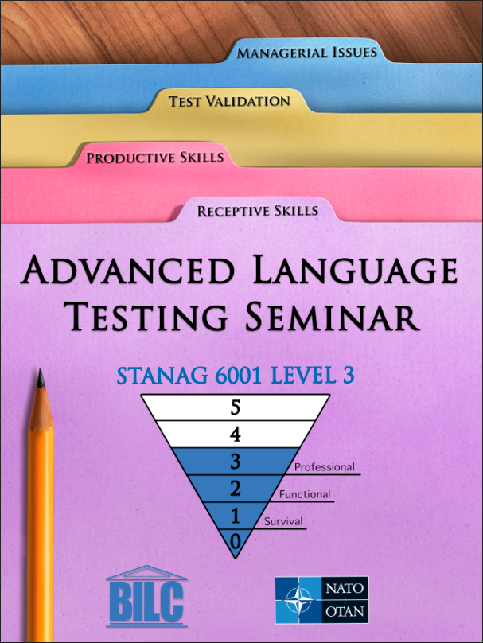
Advanced Language Testing Seminar
Memories

Slide 36
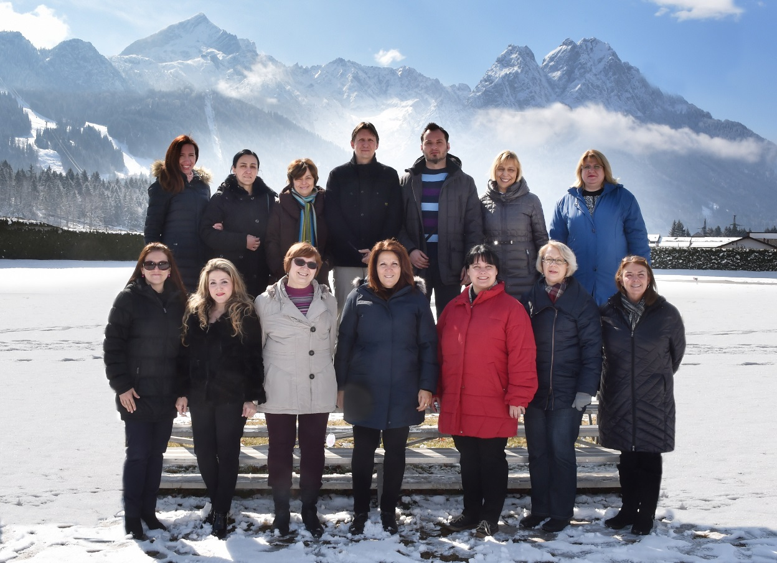

Slide 38
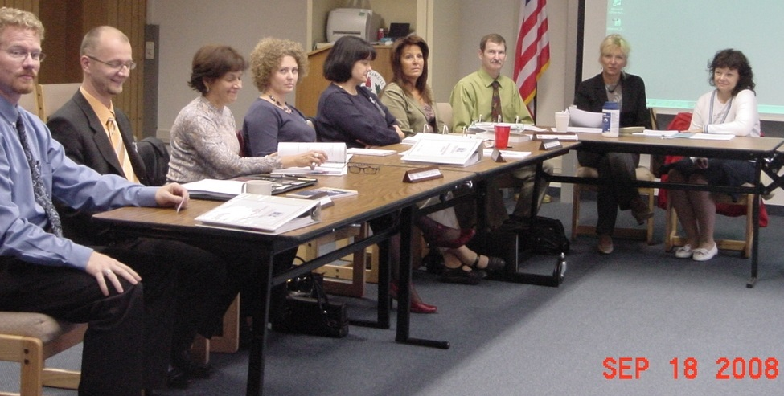

Slide 39
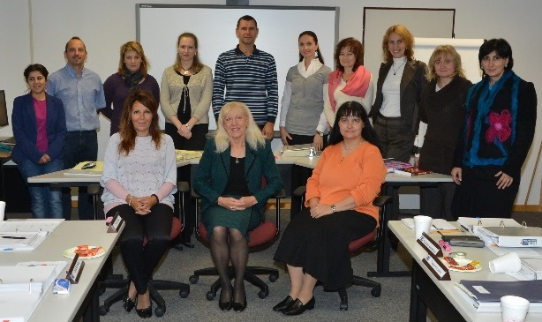
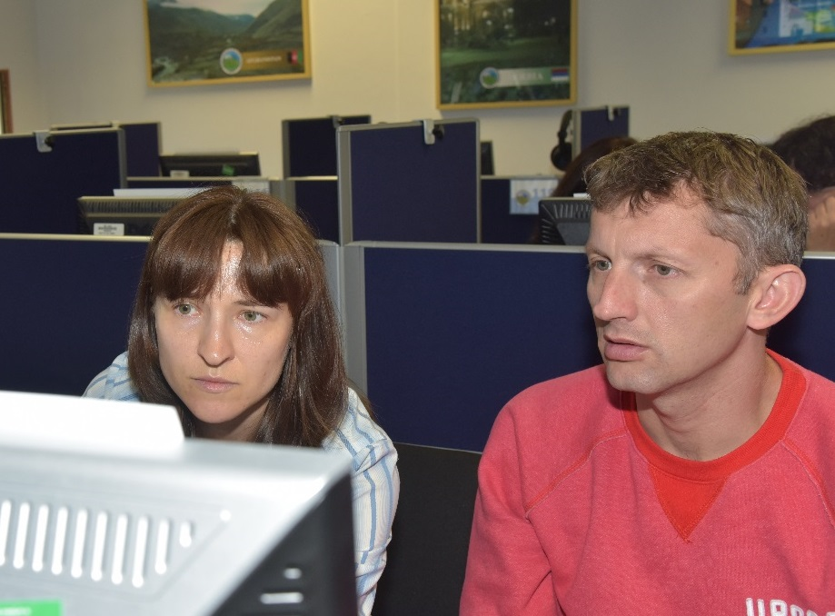

Slide 40
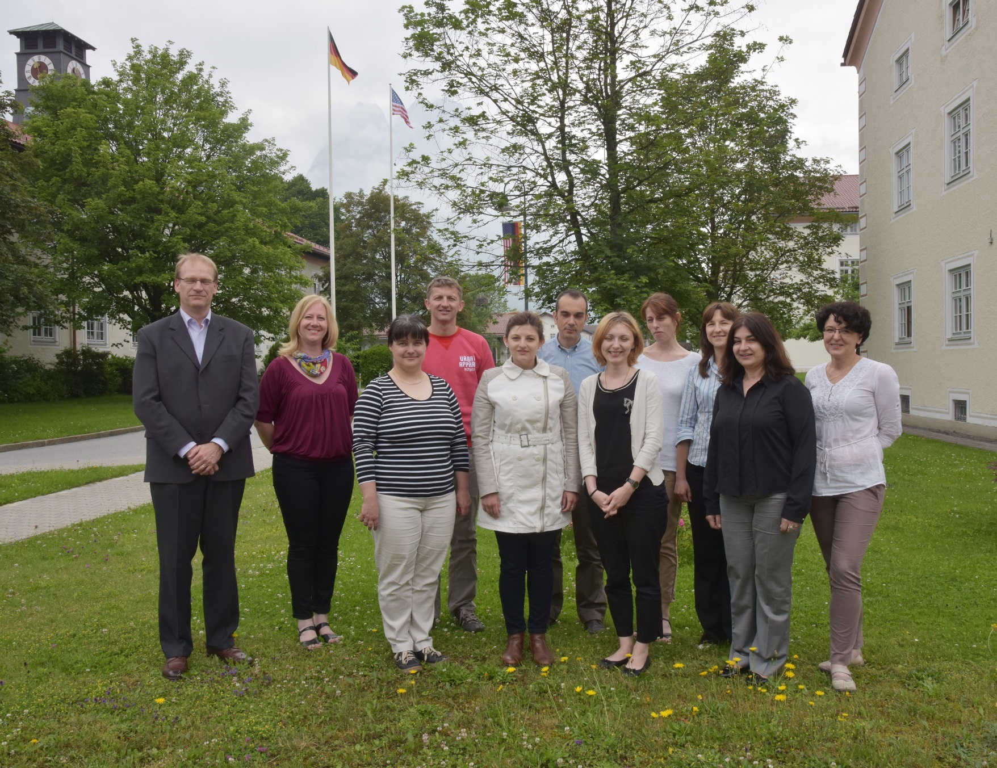

Slide 41
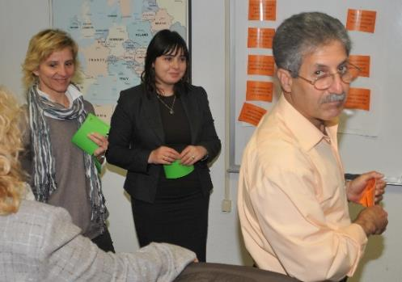
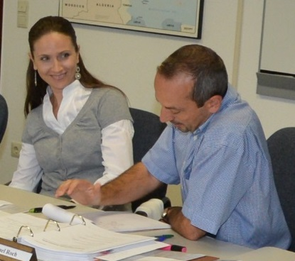

Slide 42
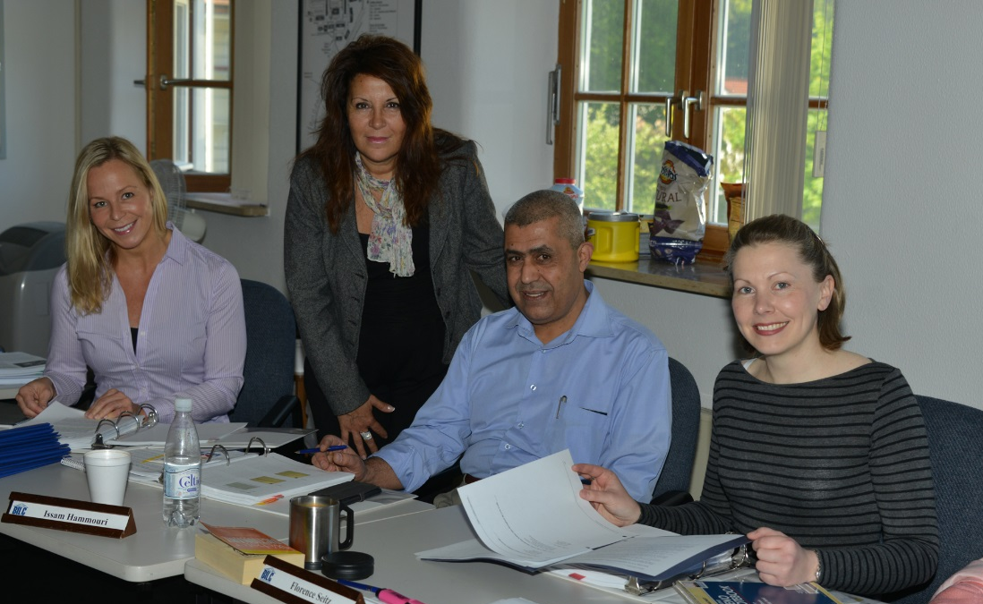

Slide 43
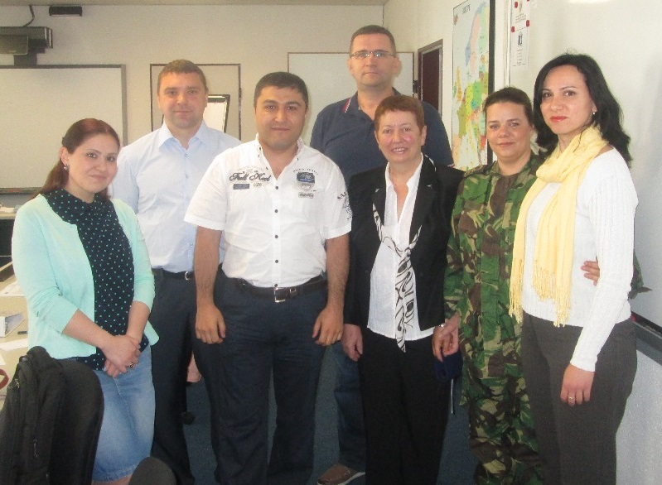

Slide 46
Language Standards and Assessment Memories

Slide 56
English Teaching Faculty Development Workshop Memories

