Slide 1
CYCLICAL EVALUATION & THE ISD PROCESS
Judith Geerke Chief, Advanced English Curriculum DLIELC

Slide 2
American Language Course
How the courses within the levels and within the ALC are interrelated and sequenced.

Slide 3
Organization of DLIELC Instruction
GENERAL ENGLISH 34 books
SPECIALIZED ENGLISH
24 courses derived from 60+ modules
ADVANCED ENGLISH
4 courses employing AE modules plus professional and academic COTS texts
INSTRUCTOR DEVELOPMENT
5 courses employing ID modules and COTS texts

Slide 4
ALC General English Curriculum
Progressively sequenced series – 6 levels with 6 books each
Assessment
Book Quiz measures learning
ECL measures proficiency
A program with great flexibility
Regrouping capability
Right-sizing student to book
Accelerated instruction possible
Downward recycling available
Enables maximizing class size
Ease of instructor substitution
GENERAL ENGLISH
34 sequential books; advancement gatekeeper is ECL qualification

Slide 5
Specialized English Curriculum*
Nine weeks of instruction
Twenty-four SET codes
More than sixty modules

Slide 6
SET’s English for Specific Purposes
Sixty (60) ESP modules are available to teach 24 courses.

Slide 7
SET Codes
25 Composite Curriculum
30 Aircrew / Fixed-Wing
35 Aircrew / Rotary-Wing
38 Weapons Control
39 Air Traffic Control
41 Army Leadership
42 Army Operational
50 Electronics
51 Radar
60 General Maintenance
61 Aircraft Maintenance
61A Aviation Maintenance - Rotary Wing
63 Supply
73 Tech Instructor
80 Medical
90 Explosive Ordnance
96 Navy
96A Underwater Demolition
96C Diving
98 Academics
99 Public Affairs
OPSAV Oral Proficiency Skills for Aviators
Serving 1200+ FOT Military Articles & Services List (MASL) codes

Slide 8
Set Modules
M026, General Mechanics
M101, Orientation to Specialized English
M102, Technical Reading
M104, Reading Strategies
M105, Listening Strategies
M106, US Military Culture & Training Environment
M107, American Culture for International Military Students
M109, Transition to Follow-On Training
M301, English Language Skills for Aviation
M302, English Language Skills for Communication
M303, English Language Skills for Navigation
M351, English for Rotary-Wing Aviation
M352, English for Basic Nav/Comm
M353, English for Rotary-Wing Nav/Comm
M401, Army English Fundamentals 1
M402, Army English Fundamentals 2
M411, English for Army Leadership 1
M412, English for Army Leadership 2
M421, English for Army Professionals 1
M422, English for Army Professionals 2
M423, English for Army Professionals 3
M424, English for Army Professionals 4
M501, Fundamentals of Electronics
M502, Topics in Basic Electronics
M503, DC Circuits

Slide 9
Set Modules
M511, Radar Principles
M512, Radar Equipment
M601, Introduction to Maintenance
M602, Mechanical Principles
M603, Mechanical Components
M611, English for Aircraft Maintenance
M612, English for Aircraft Maintenance
M613, English for Aircraft Maintenance
M614, English for Aircraft Maintenance
M615, English for Aircraft Maintenance
M616, English for Aircraft Maintenance
M617, English for Rotary-Wing Maintenance*
M631, Logistics Systems
M632, Retail Level Supply
M633, Supply Items
M801, Medical Language Course
M901, Explosive Ordnance Reconnaissance
M902, Explosive Ordnance Disposal
M903, Munitions Safety & Security
M904, Conventional Munitions
M944, Leadership
M952, NBC Operations
M961, Naval Administration
M962, Naval Ships
M963, Surface Ship Operations
M964, English Language Skills for Diving
M966, AMEC Navy Topics
M981, Academic Reading
M983, Academic Writing Skills
M984, Military Speaking Skills
M985, Military Discussion Skills
OPSAV, Oral Proficiency Skills for Aviators

Slide 10
Curriculum sequence example: Code 96, Navy
M101, Orientation to Specialized English
SET Core
M107, American Culture for International Military Students
M106, US Military Culture & Training Environment
M102, Technical Reading
M984, Military Speaking Skills
M961, Naval Administration
M962, Naval Ships
M963, Surface Ship Operations
M109, Transition to Follow-on Training

Slide 11
Language functions
Check listener’s understanding
Confirm your understanding
Ask for repetition
Seek/give clarification/verification
Correct a misunderstanding
Request/give instructions
Buy time/fill silence
Interrupt
Get a conversation back on track
Summarize/recap key points
Ask for opinions/offer an opinion
Express agreement/disagreement
Ask for rationale/justification
Explore solutions
Accept/reject a plan
Ask for/provide feedback
Take/keep the floor
Express doubt/uncertainty/lack of understanding
Paraphrase/restate
Offer a suggestion
Identify & assess problems
Assign task/delegate
Cover contingencies
Prioritize
Make/accept/deny a request
Ask/give/deny permission
Change the topic
Give reassurance
Conclude a discussion/conversation

Slide 12
Advanced English Curriculum*
English for Academic Purposes (EAP)
English for Instructional Purposes (EIP)

Slide 13
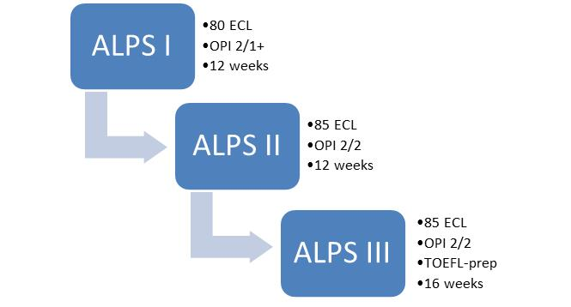
Advanced Language Proficiency Seminars

Slide 14
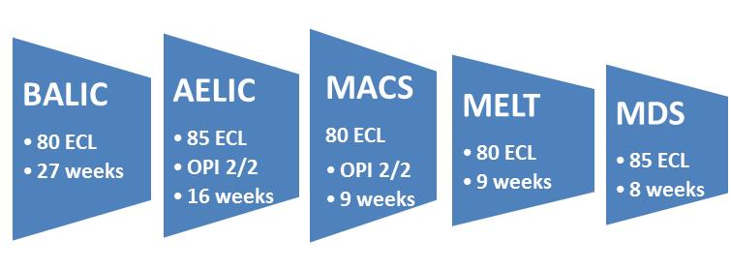
Instructor and Professional Development
Basic American Language Instructor Course - BALIC
Advanced English Language Instructor Course - AELIC
Methodology and Culture Seminar - MACS
Managing English Language Training - MELT
Materials Development Seminar - MDS

Slide 15
AELIC: A spiral curriculum Merging two goals in 16 weeks
A spiral curriculum involves deciding items to cover, and then covering them regularly over time at increasing levels of detail.
Radial spokes indicate material to be learned
The spiraling line represents language strategies introduced and practiced over time with increasing levels of detail and competence.
Notes:
The language acquisition goal of AELIC is to help trainees develop useful strategies in the language skill that will enable them to produce English as competent ESL/EFL professionals. Each integrated skills lesson (there are 16) is based on a topic in the field of Education. The learning activities focus on identifying and utilizing rhetorical patterns, increasing English language fluency and accuracy, and analyzing content for meaning and validity. Each lesson includes intensive and extensive reading, review and practice of grammatical accuracy, individual presentations and group discussions, vocabulary development through a variety of strategies, and writing for specific, professional purposes. The radial spokes represent the materials to be learned (topic: Teaching English as a 2nd Language); the spiral line represents the strategies introduced and treated in each lesson and practiced over time with increasing levels of detail and competence.

Slide 16
Instructional Systems Design (ISD)
Inner Circle Outer Circle

Slide 17
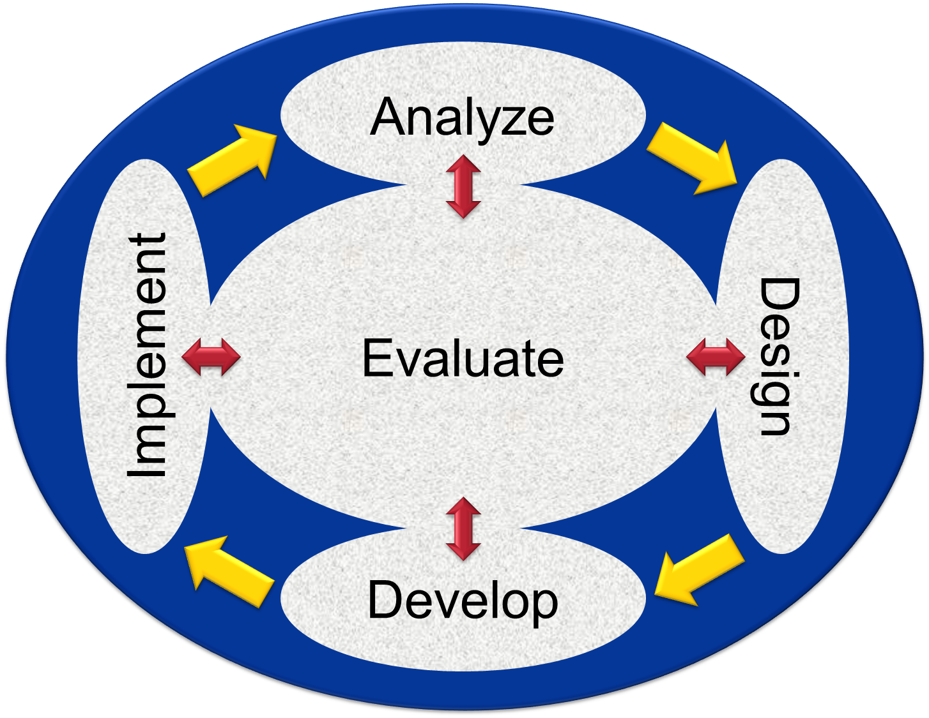
Instructional Systems Design
Management
Delivery
Support
Administration

Slide 18
ISD Process – The Inner Circle
Course developer efforts occur in the steps of the ISD’s inner circle.
A dynamic relationship exists among the inner circle’s five elements.

Slide 19
Milestone steps require coordination with graphics contractors, test and measurement flight, editorial section (pub prep), and logistics flight for printing, sales & warehousing, instructional flight for teaching. Project plans and reports require approval from chief of ECF, EIF, and 332TRG to permit start and continued progress with the plan.
Work Plan: New Project Milestones
MS 1 | Planning
MS 2 | Development
MS 3 | Pub Prep & Print
MS 4 | Validation
MS 5 | Post-Validation Revision
MS 6 | Post-Validation Pub Prep & Print
MS 7 | Operation Use

Slide 20
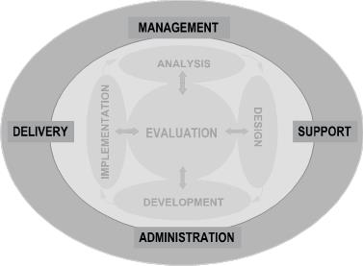
ISD Process – The Outer Circle
637TRG CC Command
TTF – ITU for CBT delivery
332TRS ESF
TLF – printing (GPO), ware- housing, sales, classroom delivery
637ISS
637TSS
332TRS CC (CRB)
What aspects of DLIELC as an “institution” can you attribute to each of the ISD’s outer circle elements?

Slide 21
Management
Delivery
Support
Administration

Slide 22
ISD Process and Course Review
Cyclical review – 6-year cycle
Continuous improvement recommendations
End-of-Course surveys (EOCS) from students
EOCS items specific to course materials (new!)
Responses from nonresident instructors
Responses from DLIELC instructors deployed overseas
Interviews/surveys with resident instructors
Interviews/surveys with supervisors
Review of current trends in methodology
Examination of skills/vocab identified by SET

Slide 23
Questions ?

