Slide 1
Language and culture in uniform: From language needs analyses to classroom instruction
Associate Professor Elizabeth Thomson
Charles Sturt University
NSW, Australia
BILC 7 May, 2015

Slide 2
Abstract
This paper will introduce the edited collection,
Language in Uniform
Language Analysis and Training for Defence and Policing Purposes
which features recent, ground-breaking work in the Language for Specific Purposes fields of defence and policing. It will describe recent work by members of BILC and other defence language professionals as well as professionals working in policing contexts.
In addition, the paper will describe a recent Australian report,
Battling with Words
A study of language, diversity and social inclusion in the Australian Department of Defence.
on the nature of Defence culture taken from a sociolinguistics perspective which was commissioned by the Department of Defence to address the issues of diversify and social inclusion within the organisation.

Slide 3
Language in Uniform Language analysis and Training for Defence and Policing Purposes
Edited by Helen de Silva Joyce and Elizabeth A. Thomson
ISBN 978 1 4438 7055 9
Published by Cambridge Scholars www.cambridgescholars.com

Slide 4
book sections – from language needs analyses to classroom instruction…
Part 1: Discourse and Needs Analysis
Part 2: Curriculum Development
Part 3: Assessment

Slide 5
TABLE OF CONTENTS
Part 1: Discourse and Needs Analysis
Chapter One ................................................................................................. 2
Interpreting the Speaking Performance Requirements of Forward Air
Controllers
Mary Jo Di Biase and Francesco Gratton
Chapter Two .............................................................................................. 18
Language at the Pointy End: Understanding the Additional Language
Needs of the Australian Defence Force
Elizabeth A. Thomson
Chapter Three ............................................................................................ 41
An Overview of Law Enforcement English
Ileana Maria Chersan
Chapter Four .............................................................................................. 62
Analysing the Genres of Military Operational Engagement for Curriculum
Design
Helen de Silva Joyce and Elizabeth A. Thomson

Slide 6
Interpreting the Speaking Performance Requirements of Forward Air Controllers
This chapter by Mary Jo Di Biase and Francesco Gratton offers a description of needs analysis for the highly specific English language requirement of calling in air support in a conflict zone. This was in response to the need to improve the language capabilities of Italian Forward Air Controllers through the development of a task-based, performance test in English for Specific Purposes (ESP), based on a specific Military Operational English (MOE) course. Using Google Earth to reflect authentic scenarios, an innovative testing approach was developed and validated for assessing specific speaking skills, to comply with NATO proficiency requirements.

Slide 7
Part 2: Curriculum Development
Chapter Five .............................................................................................. 84
Developing an English Curriculum for the Indonesian National Police: A Case Study
Jaclyn Gishbaugher
Chapter Six .............................................................................................. 105
Challenges in Converting Training Needs Analysis (TNA) Findings
into a Comprehensive Language for Defence Purposes (LDP) Course
Sue Casey
Chapter Seven .......................................................................................... 132
Professional Development in a Counter-Terrorism Policing Context:
A Program of Research Literacies for Writing Reports
Terry Royce
Chapter Eight ........................................................................................... 150
Techniques for Teaching Advanced Learners of Military English
through Content-based Language Courses
Annette Nolan
Chapter Nine ............................................................................................ 178
Professional Development and Curriculum Change: Perils and Pitfalls
Helen de Silva Joyce, Beth Foster and Elizabeth A. Thomson

Slide 8
Techniques for Teaching Advanced Learners of Military English through content-based Language Courses
This chapter by Annette Nolan discusses the challenges of facilitating the development of advanced learners of English. Annette’s paper focuses on meaningful interaction, which relates to the military students’ professional language needs and the immediate context of their learning in university programs. She describes how she used reading comprehension and the genre of presentation to develop a repertoire of questioning strategies for application in the defence workplace.

Slide 9
Part 3: Assessment
Chapter Ten ............................................................................................. 198
Defining and Assessing STANAG 6001 Level 4 Language Proficiency
Jana Vasilj-Begovic, Gerard Seinhorst, Martha Herzog, Mary Jo Di Biase,
Dugald Sturges, Annette Nolan, Ulla Gudnason, Peggy Garza,
Emilija Nesheva and Michael Adubato
Chapter Eleven ........................................................................................ 223
Marching Out of Step: The Uneasy Links between Task-based Language
Competencies for Military Purposes and a General Proficiency Scale
Catherine Elder, John Pill, Kellie Frost and Catherine Bow
Chapter Twelve ....................................................................................... 241
Profiling Second Language Reading Ability in a Military Context:
Processes to Enhance Validity and Reliability
Fiona Daniels and Kate Weir

Slide 10
Defining and Assessing STANAG 6001 Level 4 Language Proficiency
Probably the chapter of most interest to the BILC audience is the collaborative chapter by Jana Vasilj-Begovic, Gerard Seinhorst, Martha Herzog, Mary Jo Di Biase, Dugald Sturges, Annette Nolan, Ulla Gudnason, Peggy Garza, Emilija Nesheva and Michael Adubato. This chapter examines the interpretation of the Expert level of the NATO Standardisation Agreement (STANAG 6001), typically considered beyond the language requirements of NATO positions that require English. This chapter reviews the descriptors, the learner profile and the knowledge and skills required at the Expert level and considers the implications of these for testing. The chapter points to the difficulties of testing for general proficiency at advanced levels, while attempting to avoid context or profession specific content.

Slide 11
Profiling Second Language Reading Ability in a Military context: Processes to Enhance Validity and Reliability
Another chapter on assessment by Kate Weir and Fiona Daniels from the University of Westminster describes the development and evaluation of six tests, at three Standard Language Profile levels, designed to assess the reading ability of civilian and military personnel posted to a military headquarters. The authors identify and discuss three factors that affect the validity and reliability of the tests designed to profile second language reading ability–text selection, the question format and the test takers. They offer insights into the usefulness of various methods of analysing test items and text readability for designing reading tests.

Slide 12
The Australian contributions…
Chapter 4, Analysing the Genres of Military Operational Engagement for Curriculum Design by Helen de Silva Joyce and myself investigates the features of the language of joint military planning, something of shared interest to the BILC community. Discourse analysis was employed to analyse the spoken and written texts used in operational tasks in deployment contexts. The discourse analysis identified the kinds of language used in military planning, noting a range of written and spoken genres that manage the guidance, compliance and surveillance of military activities. The process revealed the roles that military language users play in joint, multilingual planning exercises and the lexico-grammatical features of the language of planning.
And finally, the other chapters on initiatives in Australia are those about Defence specific language curricula design which has been an ongoing project at the Defence Force School of Languages since 2009. These chapters are:
Chapter 2: Language at the Pointy End: Understanding the Additional Language Needs of the Australian Defence Force.
Chapter 6: Challenges in Converting Training Needs Analysis Findings into a Comprehensive Language for Defence Purposes Course.
Chapter 9: Professional Development and Curriculum Change: Perils and Pitfalls
Chapter 11: Marching Out of Step: The Uneasy Links between Task-based Language Competencies for Military Purposes and a general Proficiency Scale

Slide 13
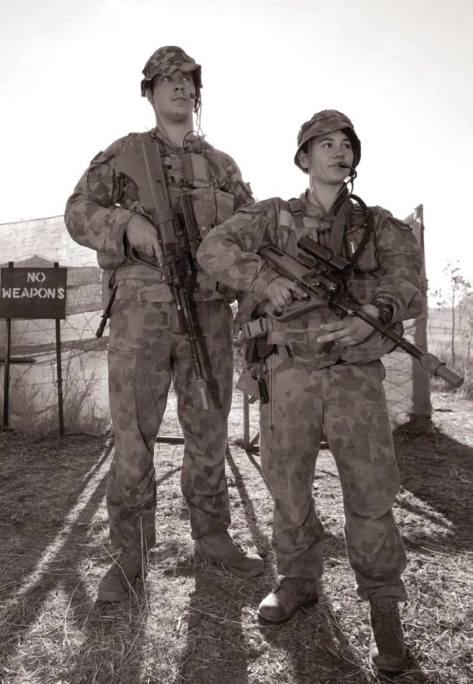
Understanding military contexts:
Another kind of needs analysis?

Slide 14
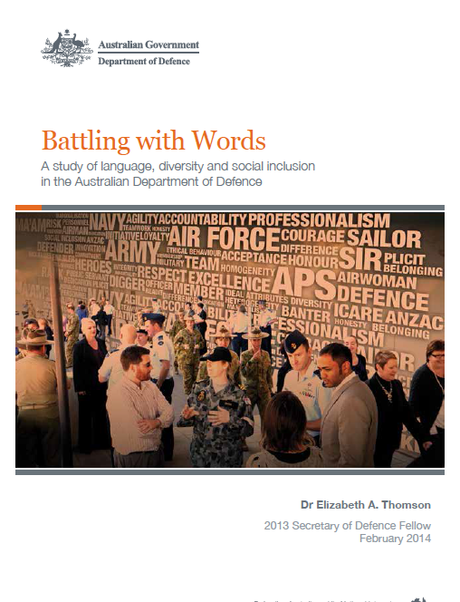
http://www.defence.gov.au/adc/publications/Commanders_Papers.html
ISBN 978 0 987 4959 6 9

Slide 15
contents
a lack of diversity; a lack of social inclusion
Chapter 1: Diversity and social inclusion
Chapter 2: Frameworks and methodologies
Chapter 3: Four Cultures, one department
Chapter 4: Values and icons to rally around
Chapter 5: Everyday talk and inclusion
Chapter 6: Towards social inclusion: policy changes; intercultural training; countering unconscious bias in doctrine and defence media.

Slide 16
A socio-linguistic study … what can it tell us?
It can demonstrate how
cultural behaviours are visible in language choice: eg. Consider how rank changes how you speak;
language differences define sub-cultures within cultures, or functions and roles within cultures etc: eg. consider the specific language of the Navy compared to that of Air Force or Army;
Different Services rally personnel differently: eg Air Force around technical specialisation; Army around duty and sacrifice for the team;
Teams are bonded through language, shared values that are modeled by significant people: eg acts of bravery and courage by particular kinds of past heroes;
How and what might need attention in order to bring about lasting cultural change: eg the percentage of women in the Services.

Slide 17
How might this study by relevant to other military cultures?
Across the world, military cultures use the same linguistic strategies
to build their profession of arms;
to build functional military teams;
to construct the military ethos and values;
Many military cultures are faced with the same modern day challenges which require cultural change;
All military activity operates in cross cultural contexts where interculturality matters;
All military activity is a language activity and all military organisations train personnel in language and culture.

Slide 18
I commend this study to you in the hope that it may provide some useful insights into the military context and thus to the content of your language and culture instructional content.
http://www.defence.gov.au/adc/publications/Commanders_Papers.html
ISBN 978 0 987 4959 6 9

Slide 19
Thank you
Questions?

