Slide 1
New Technologies Creating a New Linguistic Function
Jérôme COLLIN
Enseignement Militaire Supérieur
Directeur du Département Langue française

Slide 2
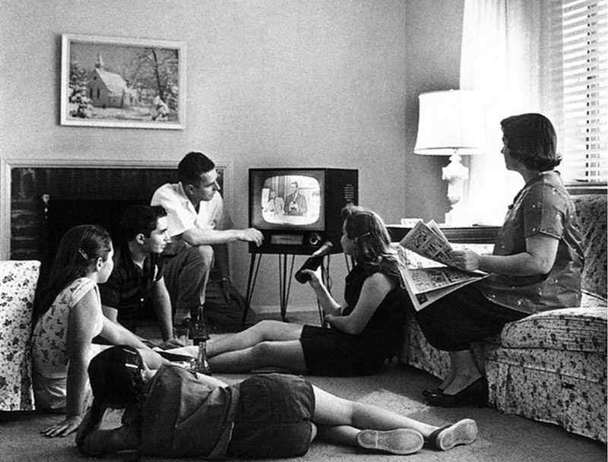
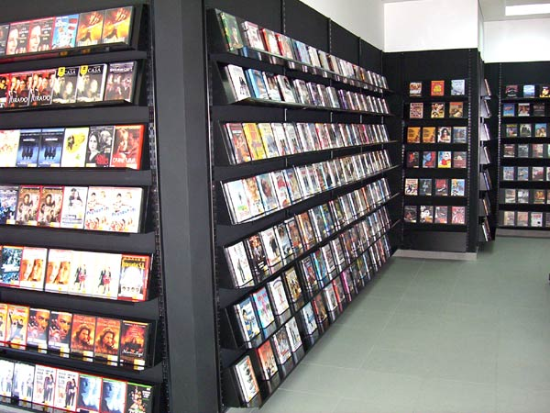

Slide 3
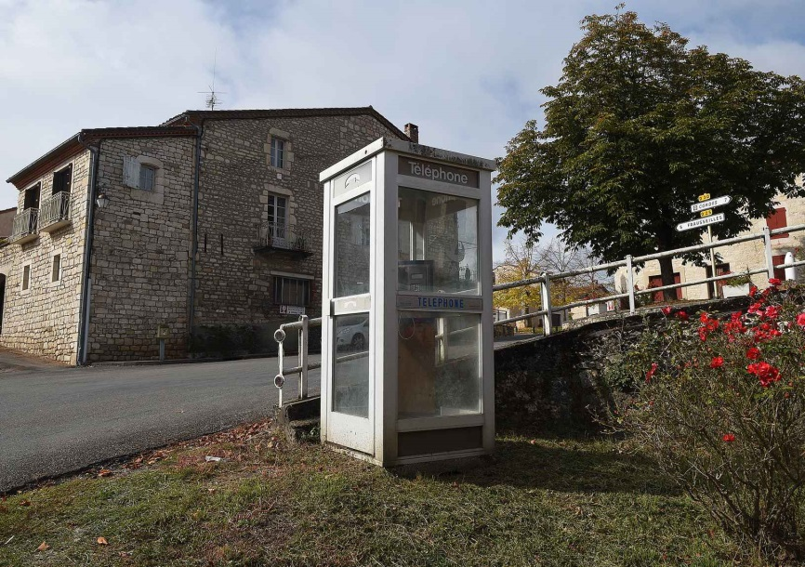
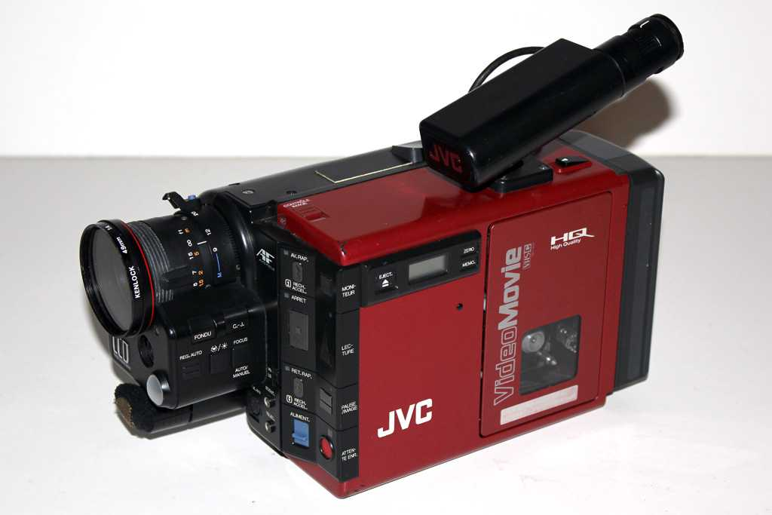
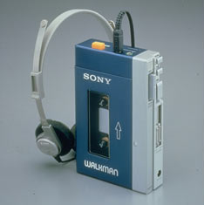
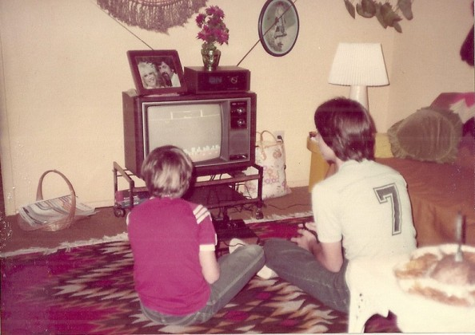
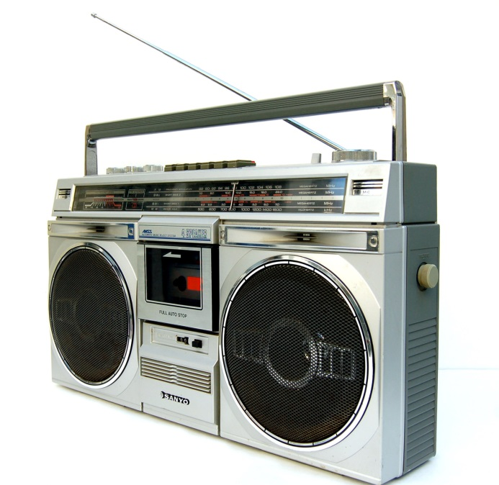

Slide 4
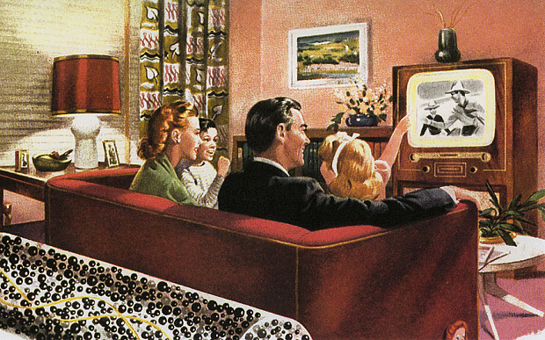
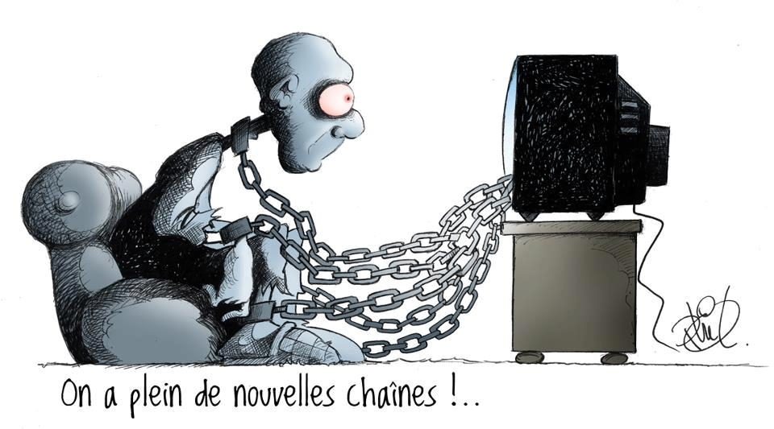

Slide 5
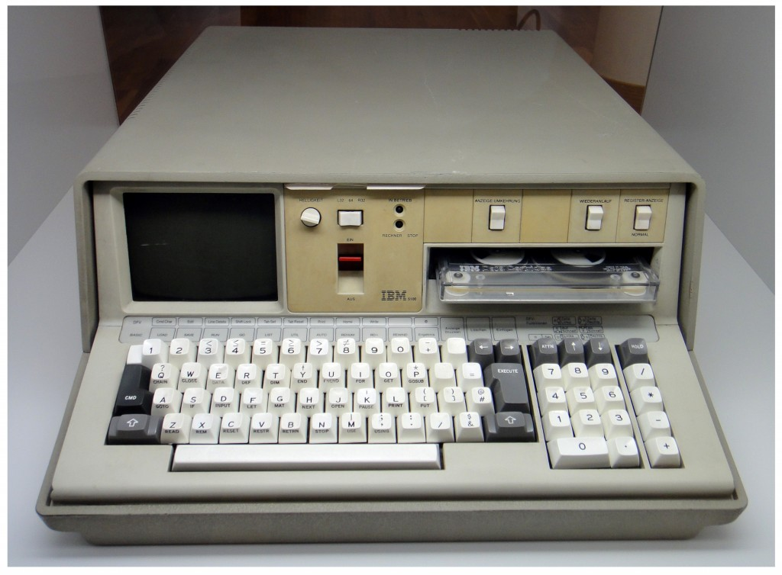

Slide 6
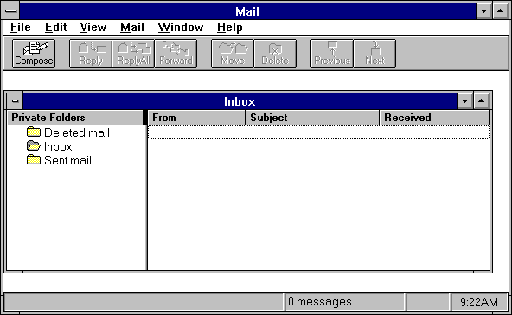
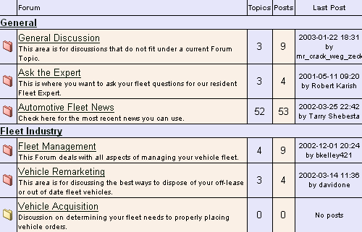
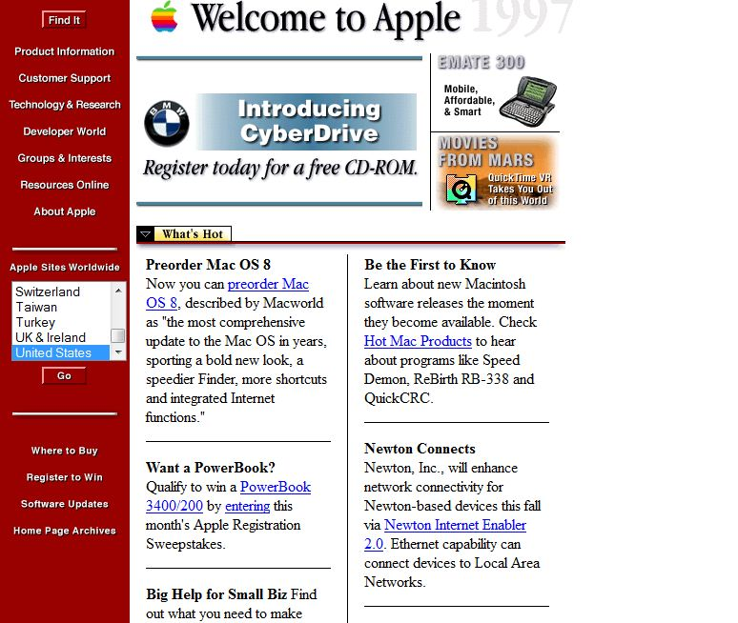

Slide 8
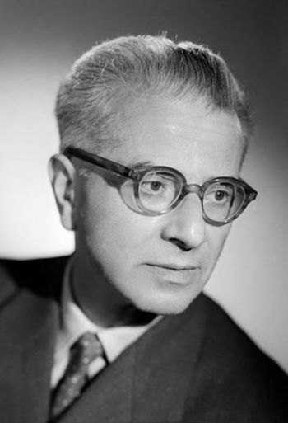
Emile Benveniste (1902 – 1976)

Slide 9
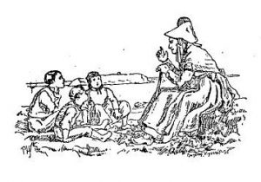
“I/me,” “you,” “we/us”
“yesterday,” “tomorrow,” “here,” “there”
he, she, they
the day before, the next day, in this spot
Napoléon, July 14th, Venice in the 18th century
“Today I’m visiting Sacré-Coeur.” “Yesterday you went to the Louvre.” “Tomorrow we’ll be in Versailles.”
On November 22, 1812, while his army was in retreat, Napoléon reached the Berezina River, whose bridges had been blocked by Tchichagov’s men.

Slide 10
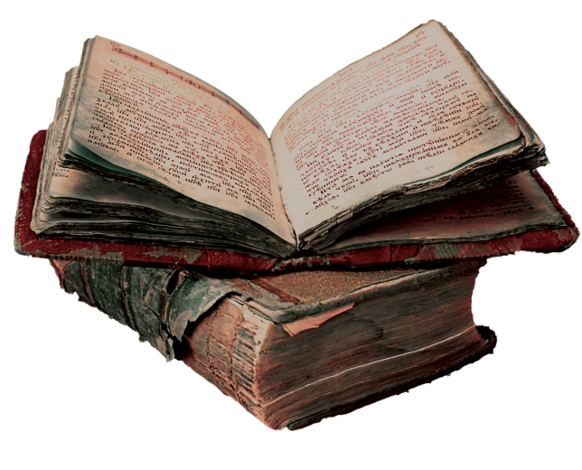
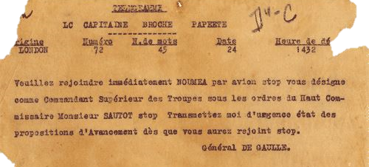

Slide 11
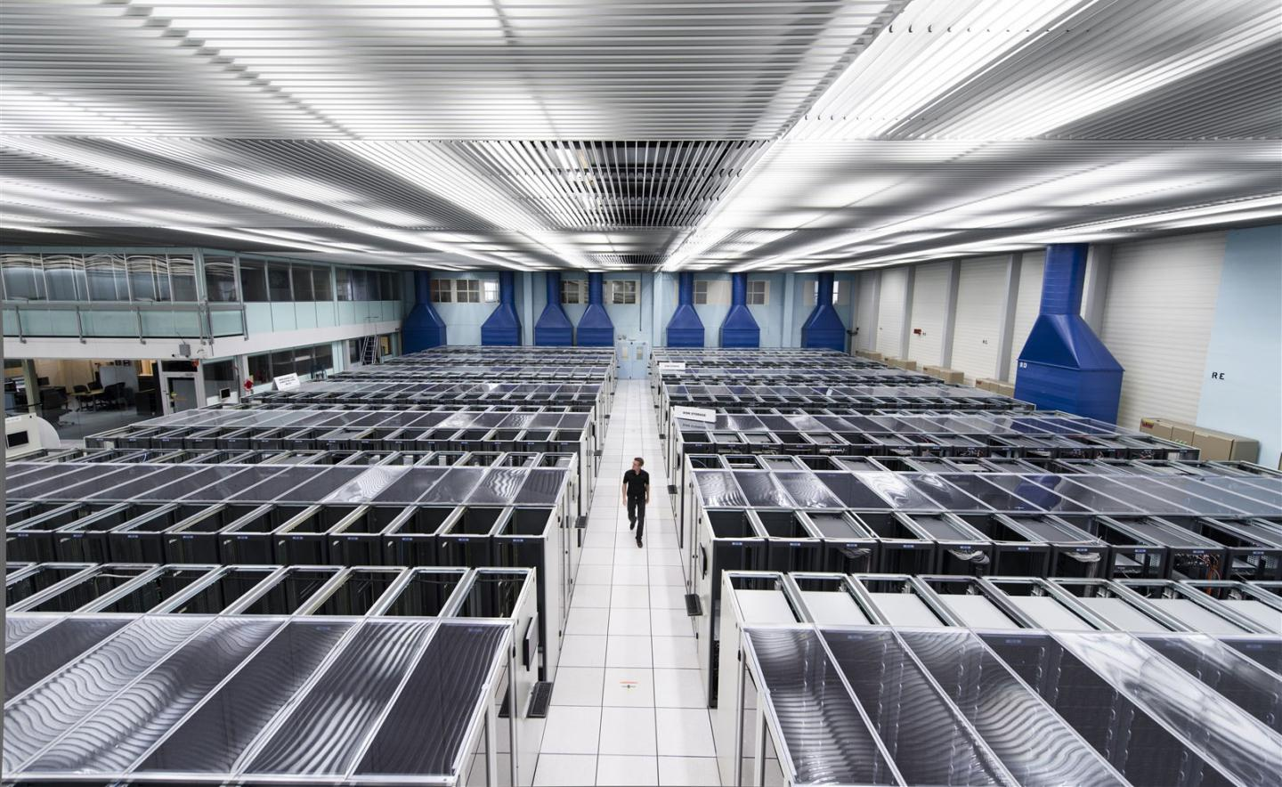

Slide 12
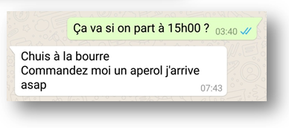

Slide 13
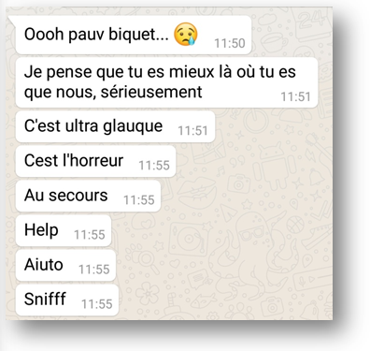

Slide 14
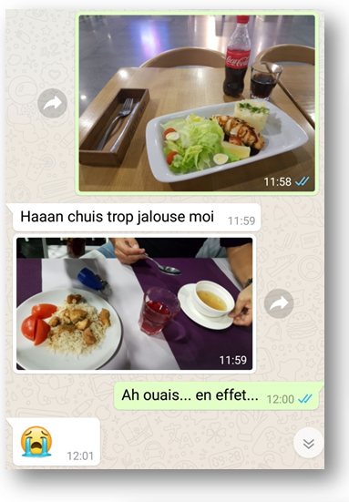

Slide 15
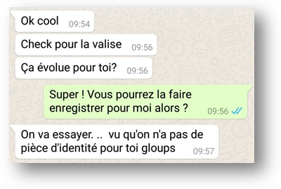

Slide 16
Oral code | familiar expressions; pet names | je suis à la bourre; biquet
 | hyperbole | Ultra-glauque; l’horreur (“What a horror!”)
 | loans from foreign languages | asap, help, aiuto, ok, cool, check
 | duplication of subject (in object form) | je / moi
 | breaks from standard syntax | sérieusement
 | absence of punctuation | . ; , Cest; ultra glauque
 | phonetic transcription of oral deformations | Chuis, pauv, ça (for “cela” – “that, it”)
 | interjections | cool, Super
 | onomatopoeias | Sniff, Haaan, gloups
Written code | intonation punctuation | ? ! …
 | visual symbols | emojis, smileys
 | supporting visual elements | photos

Slide 17
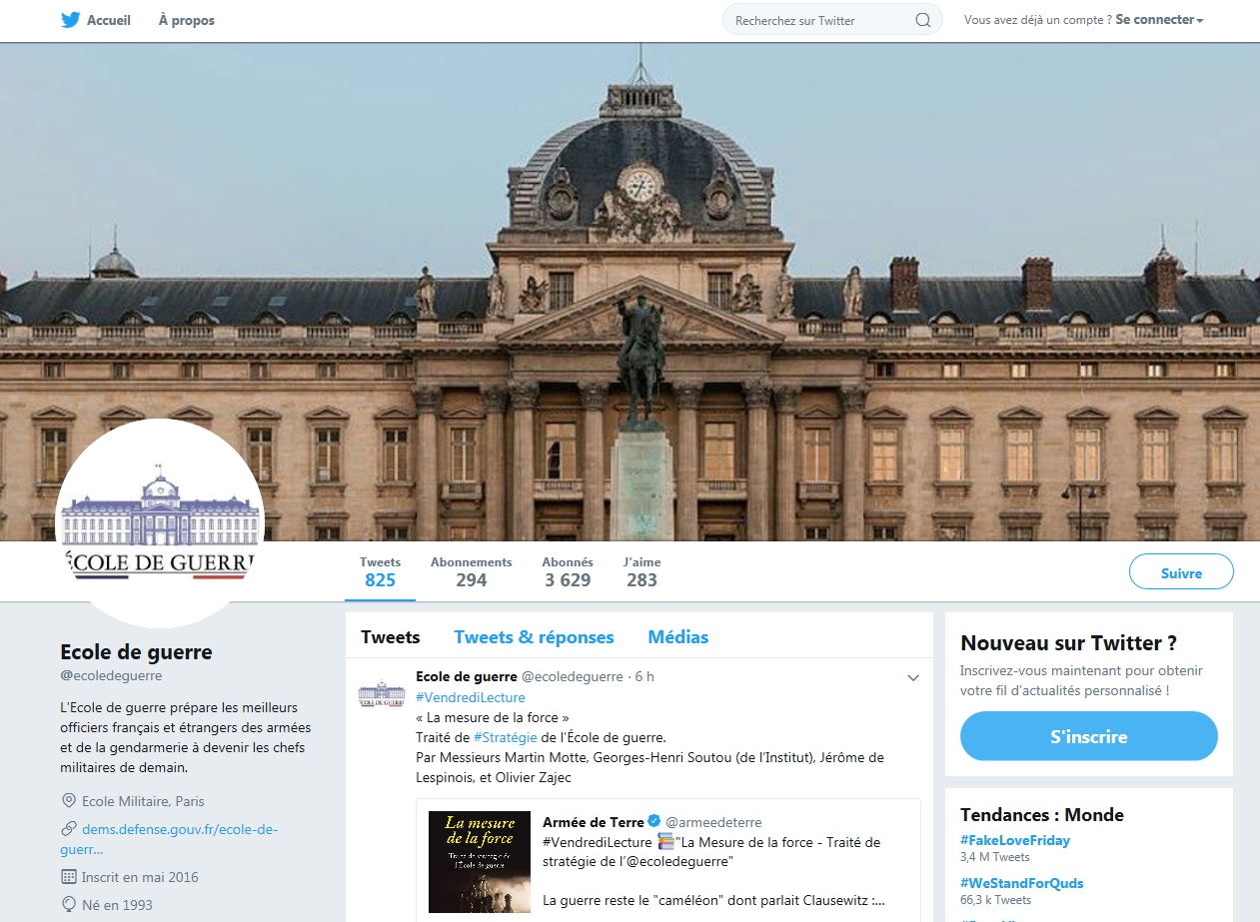
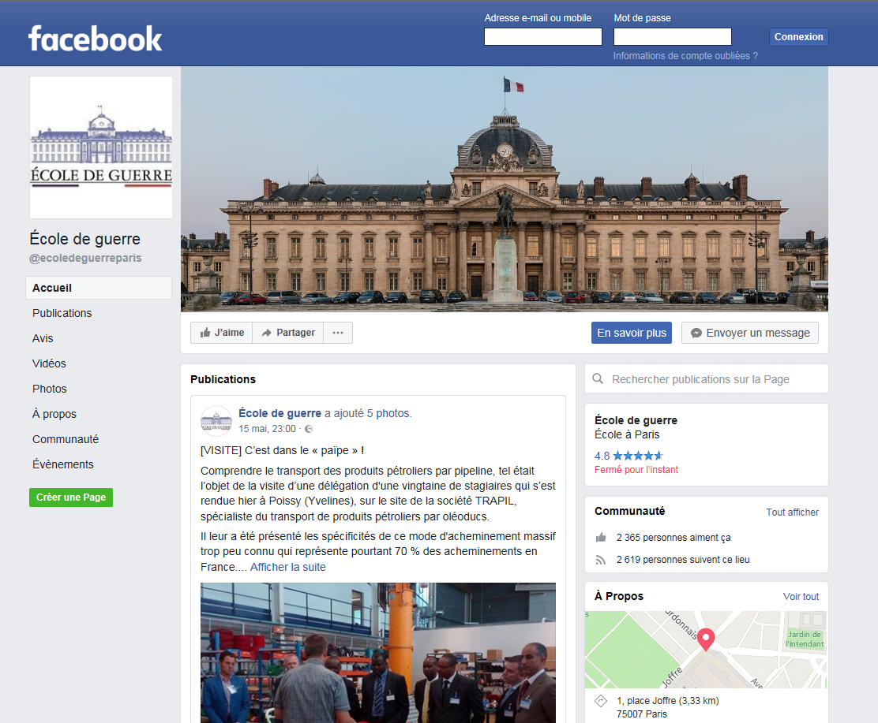

Slide 18
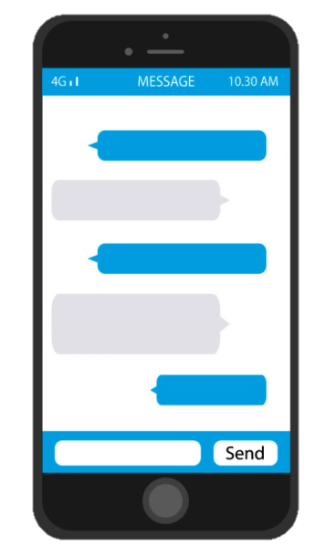
Immediate Written Communication
Completely new language-function
New language
A style of its own
Needs to be described, analyzed, formalized
Difficult to construct a body of representative data
Fundamental role in worldwide communication
Requires good written-expression skills
Efficient strategies for teaching it and evaluating its use

