Slide 1
Measuring progresS in the english language Courses
Maj. AF Ana Carina Lagares Overgaag
Head of the Germanic Languages Department
Spanish Defence School of Languages

Slide 2
Index
ENGLISH COURSES
Objectives
Description
Special aspects
MEASURING PROGRESS
Student´s profile
Requisites
Entrance level vs. final level
CONCLUSIONS
Notes:
At first I will speak about one of the English courses we teach.
Objectives seem to be different, depending on who you are: the teacher´s approach vs the student´s perspective.
Course description
Special aspects aimed at improving results

Slide 3
ENGLISH COURSE Objectives
Our goal:
“ Aimed at improving and strengthening
the four skills in the English language”
10 points minimum
Student´s goal:
3 3 3 3

Slide 5
ENGLISH COURSE Description
- Two-month course , 3 courses/year
- 200 hours in class
- 120 hours selfstudy/homework
- Maximum of 20 students divided in 2 groups of ten
- Individual sessions
- Reinforcement-sessions in groups of 5
- Special tutorial sessions (linguistic and non linguistic to address specific needs)
Notes:
Intensive course
200 hours in class that focus more on improving speaking and writing, without forgeting the othetr skills
Homework : mostly writing
Linguistic needs: improve fluency, special pronunciation matters etc
Non linguistic: nervous in oral tests, shyness, etc

Slide 6
ENGLISH COURSE Special aspects
Personalized attention
Continuous feedback
Weekly team assessment meeting
Tools and strategies to succeed on the SLP test
Only English is spoken
Notes:
Exchange of information is paramount. We have increased the exchange of information.
Meetings
Impressions > confirm if it is a certainty > tackle the problem. Also personal problems.

Slide 7
MEASURING PROGRESS
Initial SLP test for 96 students
one week before the course starts
Only 20 students take the course:
Army - 9 best ones
Navy - 4
Air Force - 4
Common Services (medical branch, lawyers etc) - 3

Slide 8
MEASURING PROGRESS
Requirements to join the course:
- 9 points minimum (e.g. 2 2 3 2)
- 11.5 points maximum (e.g. 3 3 3 2+)
- Minimum of grade 2 in all skills
Initial average SLP points last 3 years: 10.16 (e.g.3 2 3 2)
Final SLP test at the end of the course

Slide 9
RESULTS: AVERAGE SLP POINTS
Notes:
Things go wrong sometimes….people that had good luck on entrance test/ 3 very low level students Common Services , Army didn´t improve
Since 2015 the entrance level is decreasing…

Slide 10
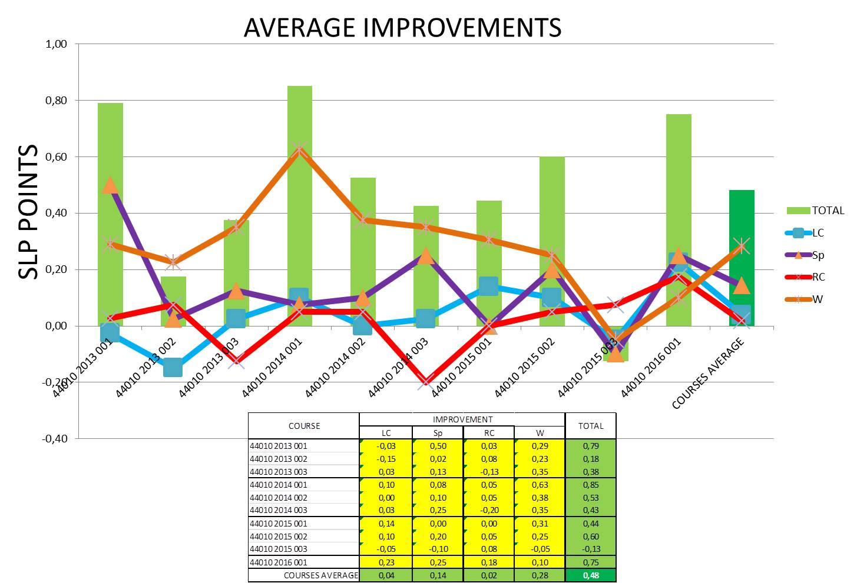
COURSE AVERAGE IMPROVEMENT BY SKILLS
L
Notes:
What stands out more is writing: we have detected that it is not a problem that comes from the English but from students educational background and lack of ability or practice in mothertongue.
RC and LC
Improvement in speaking
The lower entrance level we have, the more they can improve

Slide 11
CONCLUSIONS
+ 0.48 + 0.5
ENTRANCE POINTS | TYPICAL ENTRANCE LEVEL | FINAL LEVEL ACHIEVED
9 | 2 2 3 2 | 2 2 3 2+
10 | 3 2 3 2 | 3 2+ 3 2 3 2 3 2+
11 | 3 2+ 3 2+ | 3 3 3 2+ 3 3 3 3
11.5 | 3 3 3 2+ | 3 3 3 3

Slide 13
THANK YOU FOR YOUR ATTENTION

Slide 14
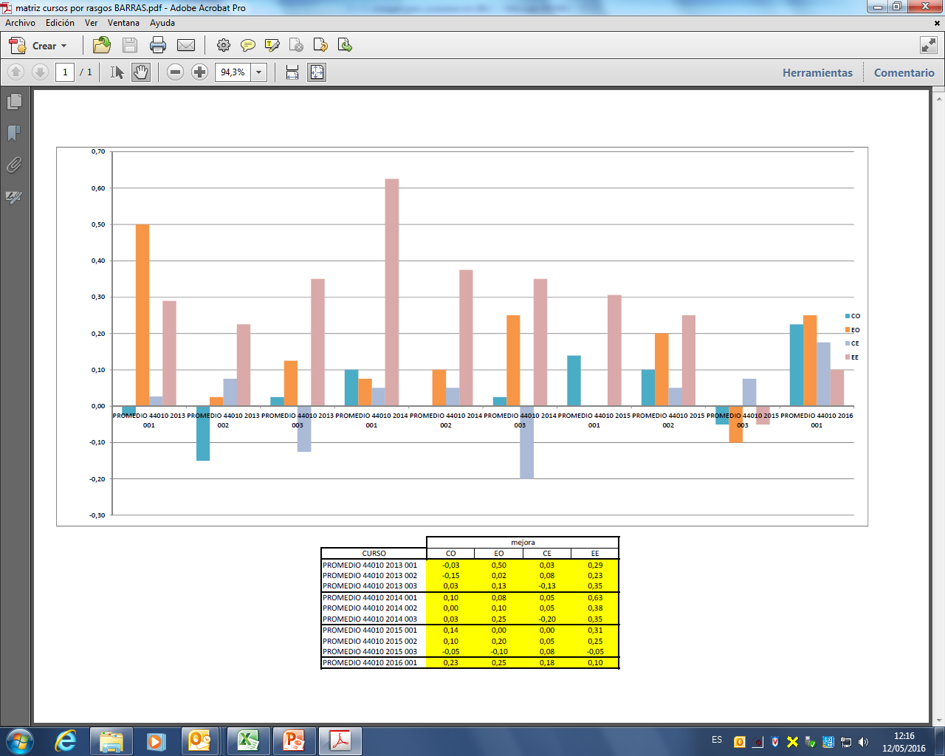
IMPROVEMENT PER SKILLS II

