Slide 1
STANAG 6001
Georgian Defence Forces
SAKARTVELO
საქართველო
TARTU ESTONIA
27- 30 May 2019
Head of the Testing and Assessment Group
Nato Jiadze reserve officer
njiadze@mod.gov.ge
Training and Military Education Command Defence forces MoD Georgia

Slide 2
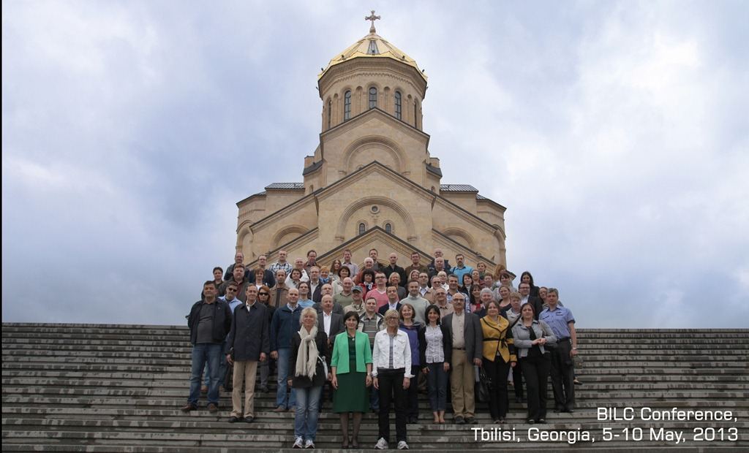
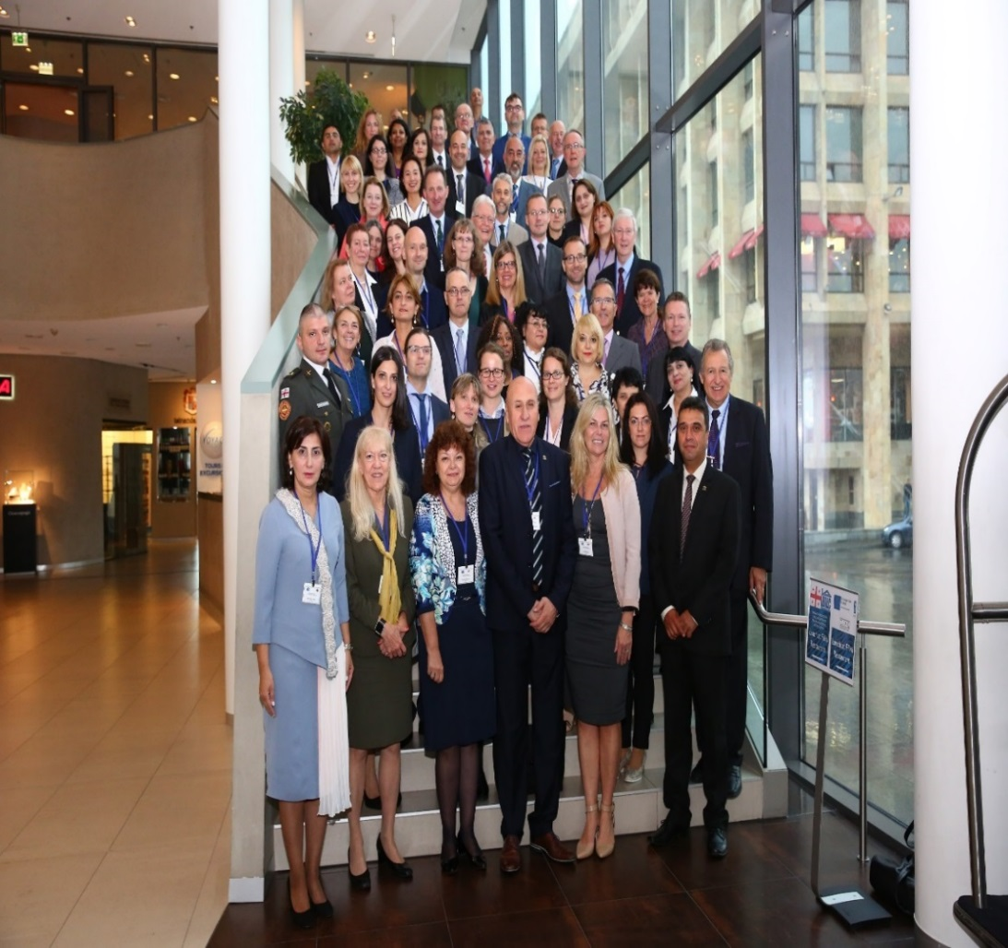
BILC EVENTS IN GEORGIA
1-5 October 2017 TbILISI GEORGIA

Slide 3
CONTENT
Background
Mission
STANAG 6001
Conclusion
Training and Military Education Command Defence Forces MoD Georgia

Slide 4
STRUCTURE
Defence Forces
Training and Military Education Command
Testing and Assessment Group
Training and Military Education Command Defence Forces MoD Georgia

Slide 5
BACKGROUND
English Language Testing and Assessment Group established in 2009
Consists of five trained main specialists + the head
Develop tests and assess candidates in Listening, Speaking, Reading and Writing at levels 1, 2, and 3 according to STANAG 6001 criteria
Keep data base
Statistical analysis
Training and Military Education Command Defence Forces MoD Georgia

Slide 6
TARGET AUDIENCE
Military personnel for deploying Resolute support Mission (RSM)
Military personnel to rank promotion
International positions abroad
Civilian/ Military personnel to prepare to study in foreign
Universities / military schools
Graduates of Bachelors Programme of National Defence Academy (NDA)
Graduates of English language courses of the Language Training
School of NDA
Applicants for the positions of teachers and translators
Training and Military Education Command Defence Forces MoD Georgia

Slide 7
APPROVED DOCUMENTS
STANAG handbook for candidates. Displayed on MoD Website www.mod.gov.ge
STANAG specifications for levels 1&2 and 2&3
Rules for test proctors
Candidate rules for examinations
Training and Military Education Command Defence Forces MoD Georgia

Slide 8
TEST ADMINISTRATION
ALCPT for screening before taking STANAG 6001
for 2&3 for teachers 80 up
ALCPT pre-screening ECL (for IMET candidates)
Listening Twice (based on test specifications)
Testing source (Internet based authentic materials)
Multiple choice questions -15 items for each level
Training and Military Education Command Defence Forces MoD Georgia

Slide 9
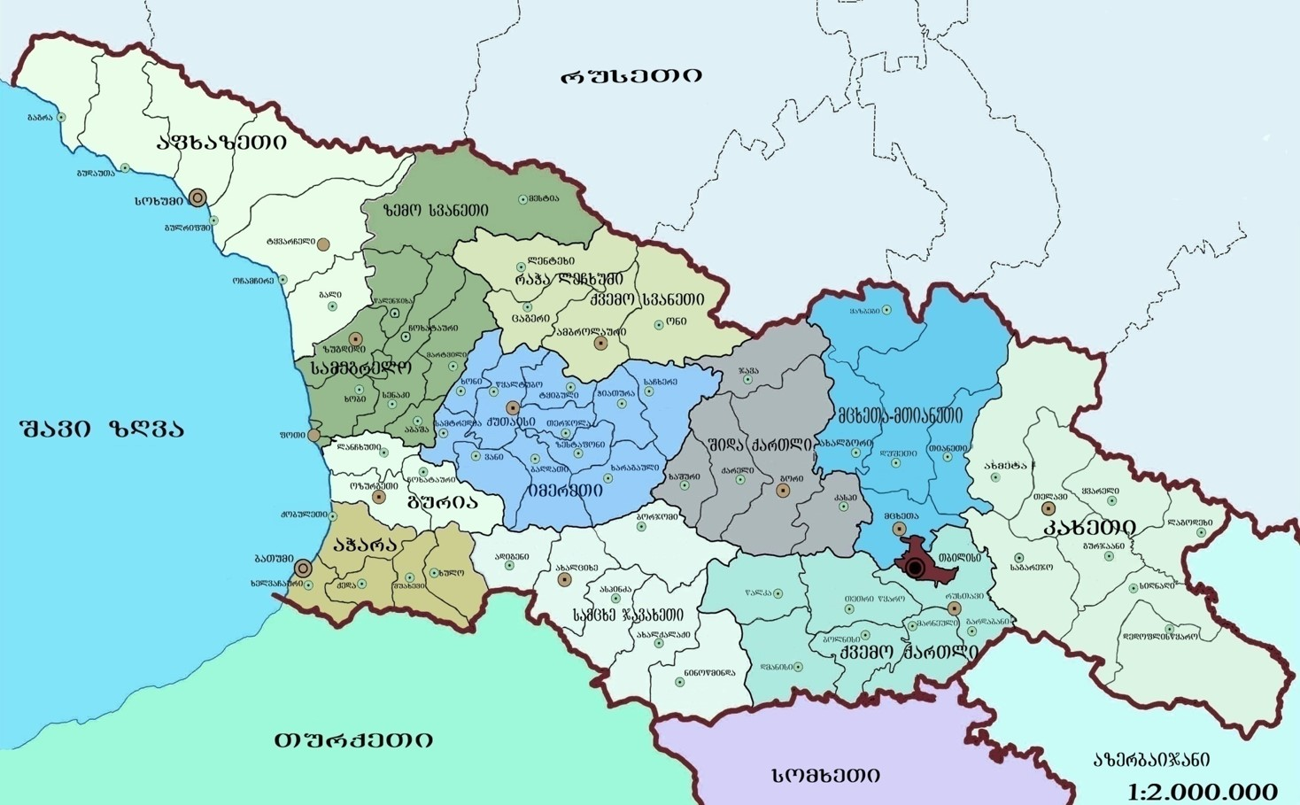
Testing Region (Map of Georgia)
samTo momzadebis skola
erovnuli Tavdacvis akademia
saCxere
“krwanisi”
quTaisi
gori
axalcixe
javSansatanko centri
gardabani

Slide 10
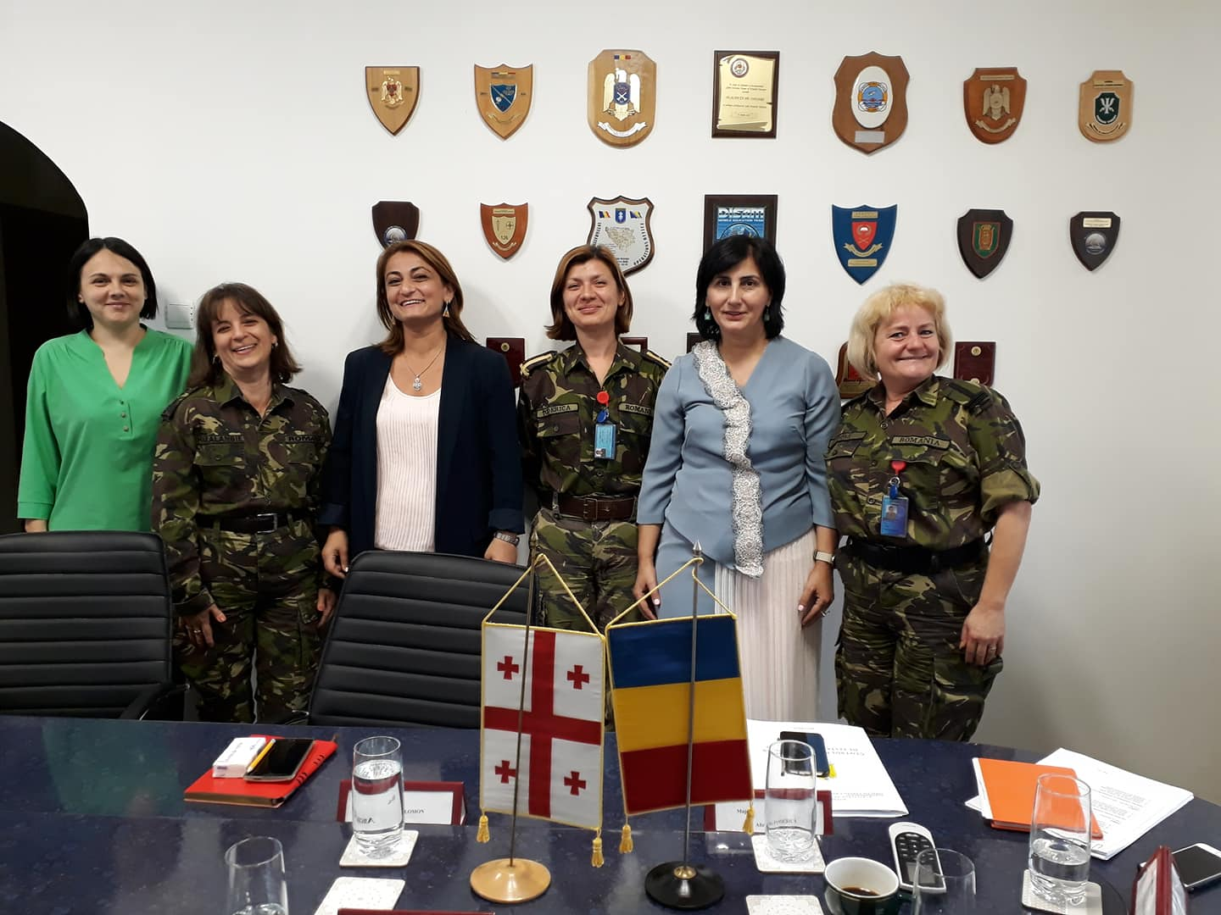
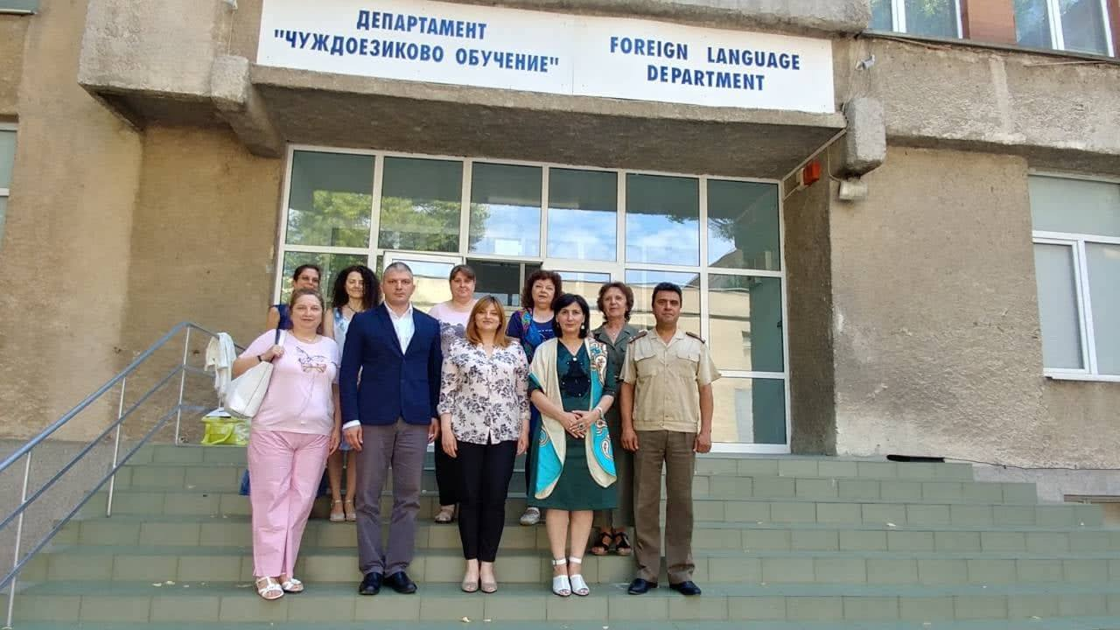
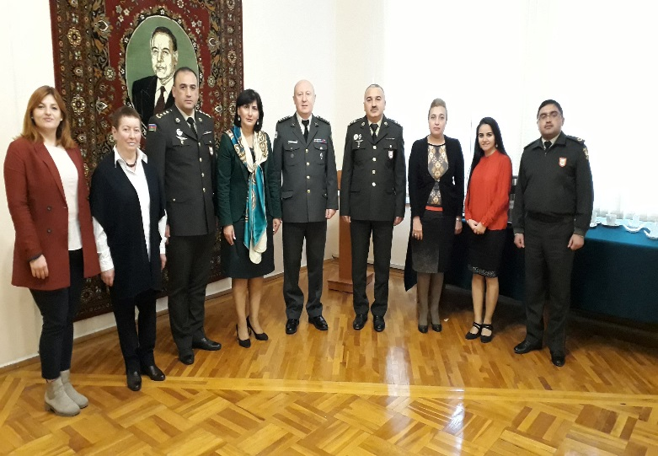
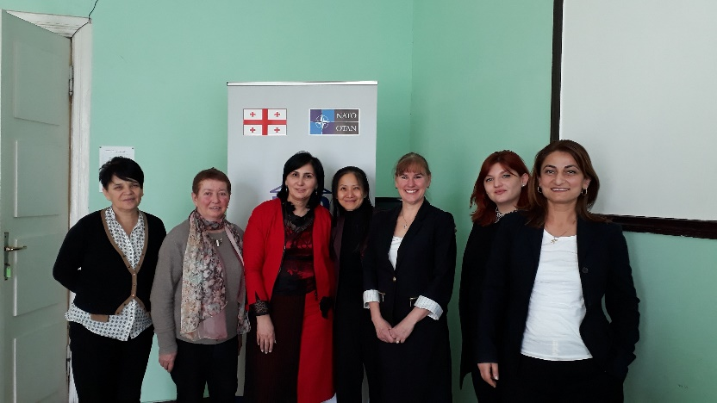
Bilateral cooperation 2018
Training and Military Education Command Defence Forces MoD Georgia

Slide 11
BILC Benchmark Advisory Test
(BAT 2)
level 2&3 – 18 -19 March 2019
National test results - 22 April
BAT 2 - 14 -17 May 2019
Training and Military Education Command Defence Forces MoD Georgia

Slide 12
Way Ahead
Develop Computer Assisted Test (CAT) system
Continue bilateral cooperation with Partner countries (piloting &moderation)
Training team at advanced Level
Training and Military Education Command Defence Forces MoD Georgia

