Slide 1
JORDAN ARMED FORCES LANGUAGE INSTITUTE (JAFLI)
JAFLI Chief Testing Officer
LT.COL FAISAL ALDABOUBI

Slide 2
BRIEFING
AGENDA
JAFLI
INTRODUCTION
FIELDS
HISTORY
FACILITIES
BENIFITS
CHALLENGES

Slide 3
WHAT IS JAFLI
JAFLI is considered one of the most prestigious educational centers in the region that teaches various international languages.

Slide 4
JAFLI FACTS
(10) Languages taught simultaneously
Interactive teaching methods
Up-to-date syllabi and curricula
Practical training aids

Slide 5
Courses held at JAFLI 1. English language wing
COURSE | DURATION (WEEKS) | ALC BKs | ALCPT ENTRY SCORE
BASIC ( LEVEL 1 ) | 23 | 11 - 24 | 69 and below
INTERMEDIATE ( LEVEL 2 ) | 16 | 16 - 24 | 70-80
ADVANCED ( LEVEL 3 ) | 12 | 19 -24 | 80-90

Slide 6
2. Foreign languages wing
Main courses held at JAFLI focus on general basic language learning targeting the 9 foreign languages besides Arabic language program for non-natives
Teaching Parameters:
Basic Language Courses held bi-annually
Duration / 23 weeks
Native speakers available for some languages ( Mutual exchange language programs, and cooperation with Military Attaches )
Frequent participation in Hebrew Language course from Algeria / Pakistan / Turkey/Sudan
Arabic Language Program includes a basic BALC and a refresher courses RALC, targeting the NATO community and our partners in coordination with Military Attaches.

Slide 7
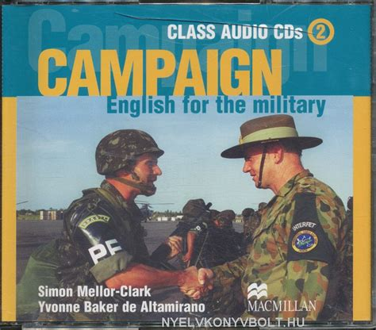
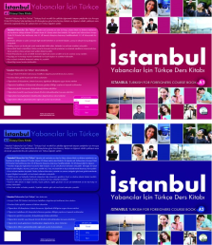
CURRICULA

Slide 8
Does technology provides us with shortcuts to language learning success?
Thomas Edison once said, “Books will soon be obsolete in the public schools.”

Slide 9
What is technology in language teaching field?
Useful tool for the classroom teaching
Tool to support
Enhance learning experience
Can facilitate second language instruction
Provides students interactive learning experiences
Converting a Face-to-Face Course to an Online Course

Slide 10
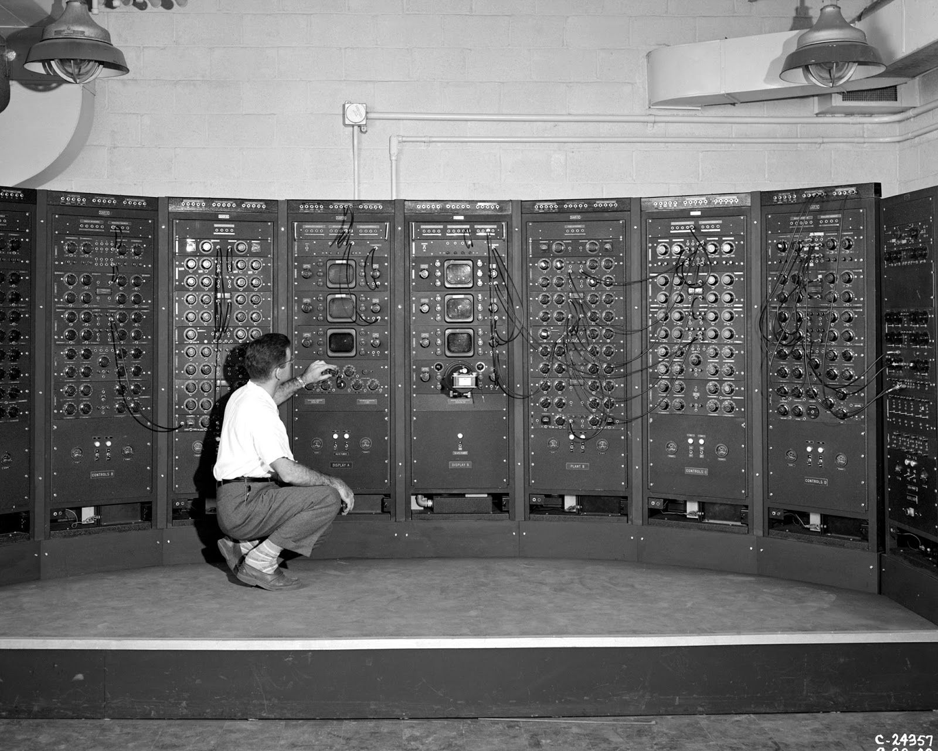
HISTORY
1960 – 1970: Tape recorders, laboratories.
1980: CALL (Computer Assisted Language Learning) learners respond to stimuli on the computer screen.
1990: TELL (Technology Enhanced Language Learning) possibilities offered by Internet and communications.
2000: ICT (Information & Communications Technology) use of Internet and web tools

Slide 11
Second generation of web-based communities such as social-networking sites, which aim to facilitate collaboration and sharing between users.
It does not refer to an update to any technical specifications, but to changes in the ways software developers and end-users use the web.
It also includes a social element where users generate and distribute content, often with freedom to share and re-use.

Slide 12
Whose choice to use supportive materials in language training S.G.T.T ?
The Head of the instructional institution can adopt the strict policy that urges teachers to use supportive materials based on 2nd generation of technology tools (S.G.T.T).
It can be an initiative by professional teachers to use S.G.T.T

Slide 13
Technology facilities we can use
Interactive Smart Boards
Computers / Laptops
Language labs
Overhead Projectors
Digital Cameras
Social software

Slide 14
What can internet provide us in language teaching?
Cyber class : Virtual classes and Blogs
Web based sites as learning material YouTube
Social networks (collaborative learning)
Software applications as supportive learning tools

Slide 15
Why technology is beneficial?
Motivate to learn .Digital Citizenship. Pedagogy
Presentation More efficient .Digital Image. Presentation
Share information up-date .Collaboration. Productivity
Cover topics in more detail. Research. Tools
Engages interactive learning. Content
Allows for self-correction .Critical Thinking
Communication (learning with others)
Provides various authentic material(audio, video, text) Interactive
Cultural awareness ( provides good scoop on targeted culture)

Slide 16
WHAT FOR?
Class Blog:
Tutor blog:
provide learners with news or comments, extra reading practice or homework, summary of a class for students absent, study tips.
All learners post comments on certain topics, on class work or any issue the teacher thinks interesting or relevant to learners.
Student blog:
BLOGS:
Learners can be asked to set up and maintain their own blog and post once or twice a week or post comments on others.

Slide 17
BLOGS:
Provide real world tool to practice written English.
provide a real audience for student writing .
Why?
Contact learners from other parts of the world.
Meaningful & purposeful activity.

Slide 18
Why blogs reasons
Literacy: Read information easier than a book
Engaged Audience: Shared interest
Interactive: Pics, Videos
Multi Learner Types:
Promotes ESL Participation:
Electronic Agenda: Check assignments
Distance Learning: You can work from home if not focusing in class, nothing to miss if absent
Learner Communities: Get over shyness
Technology in the Classroom:
Environment friendly

Slide 19
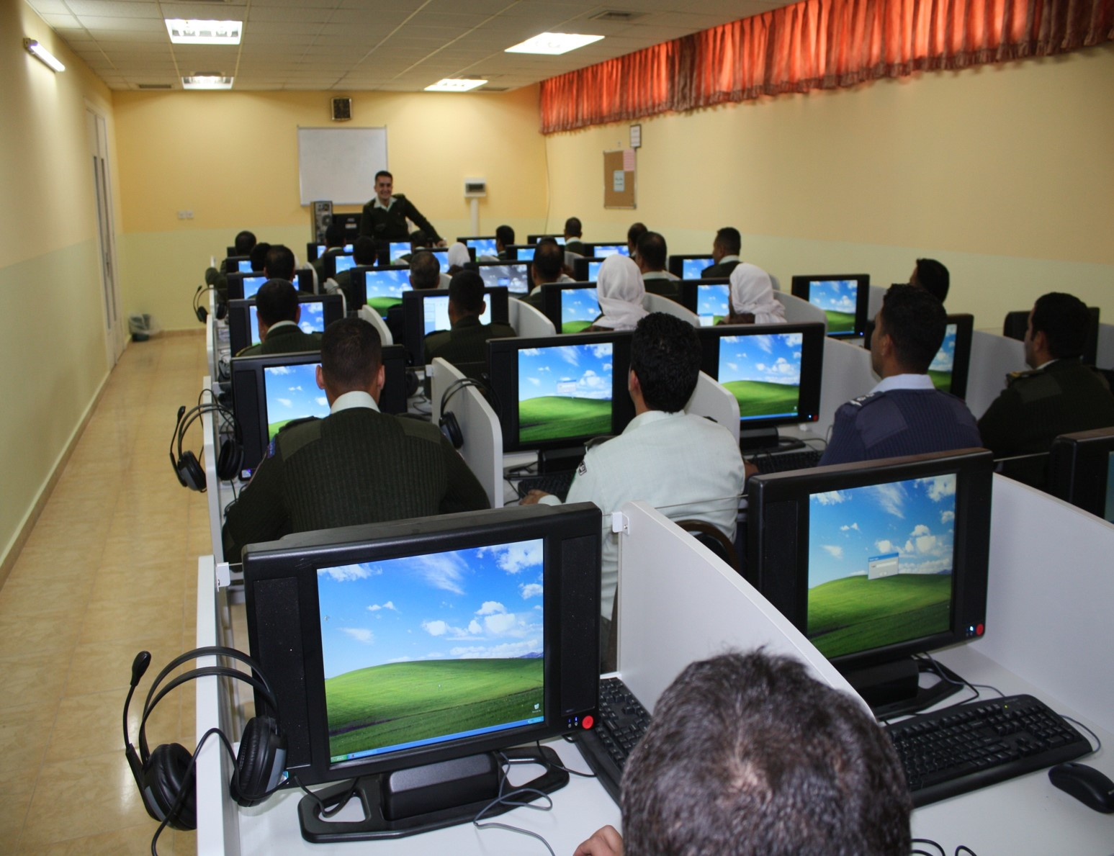
Teaching the lesson
Incorporate technology: PowerPoint, Digital camera, Digital images from Internet and Google images
Teach new vocabulary using words and pictures’ flash cards

Slide 20
Challenges
Use of students’ private, social spaces
3
1
3
3
3
Obsession/addiction
2
Time to plan
Time to evaluate
3
Authenticity/authority of web content
Time to develop
Time to be involved

Slide 21
Which pedagogy teachers to focus on for learning?
Teachers have to choose:
teaching materials that comply with students language level.
Various Authentic materials which balance the four skills.
Schools must use technology that empowers teachers.
Communication platforms like Twitter, Facebook, or Tumblr enable dynamic communication with students.
School systems need to aggressively track what works for their teachers and put all other unworkable technologies aside.
Technologies must change from technology-as-teacher to technology-as-partner in the learning process.)

Slide 22
Conclusion
Technology must be used only when it enhances the language learning experience.
Can be truly useful tool for a classroom teacher.
Students learn with technologies, not from, then the nature of student learning will change.
It is exciting
It is a challenge

Slide 23
USEFUL SITES
Why ?????
Free
Usability
Compatibility

Slide 25
16

