Slide 1
BILC ANNUAL CONFERENCE 2019 Tartu, Estonia
PORTUGUESE
ARMED FORCES
Lt Commander Marta Gabriel| 30 May 2018
Notes:
Good afternoon distinguish audience!
I’m Lt Commander Marta Gabriel. And I’m currently posted at the Portuguese Armed Forces Defense Staff. I’m the Coordinator of the National Testing Team, in addition to being the Gender Advisor to the Chief of Defense.
First of all I would like to thank the BILC Secretariat and our Hosts for such a fruitful conference! Thank you for this opportunity for sharing a bit more of what and how we have been doing back home regarding STANAG Testing.

Slide 2
Tester’s Tailored Training –
Challenges and Opportunities in meeting the interoperability requirements
Notes:
This is what I have proposed to talk about.
This time I would rather focus on the tester than the test taker.

Slide 3
Agenda
Facts and figures
Challenges
Opportunities and Initiatives
Notes:
So, these are the points I would like to share with you.

Slide 4
Facts and figures
Where | Who
Armed Forces Defence Staff HQ Language Lab | 1 officer 2 civ
NAVY English Language Department | 5 officers 3 NCO
ARMY Army Language Center | 4 officers 9 civ
AIR FORCE Air Force Language Center | 3 officers 1 NCO
April 2019
Notes:
To some of you, this information is probably not new, but since the focus is the tester I would like to focus on the people that are involved in testing teams in the Defense Staff and the 3 Services, and to give you an idea of how we are organized.

Slide 5
Facts and figures
A tester is….
A developer
An administrator
An interlocutor
A rater
In Some considerations on STANAG 6001 Tester Training, Gerard Seinhorst (2017)
Notes:
In an ideal world the different roles a tester can play would be played by different people…
I am pretty sure that this not only our the case, I would risk saying, with all countries’ testing teams.
I would be very happy if we would be able to at least have different people in the two main teams of teachers and testers.

Slide 6
Facts and figures
Notes:
Despite the challenges, we have been able to develop and implement measures that are helping us to be aligned, standardized…

Slide 7
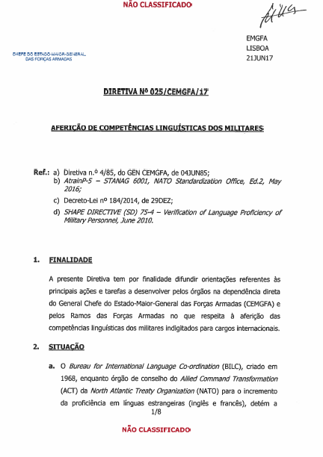
Facts and figures
Alignment/Standardization
Notes:
In order to comply with STANAG 6001 and to promote alignment and standardization, we have developed and implemented doctrine, namely the Directive #25/2017 “Language Proficiency Testing for Military Personnel”, and common procedures.

Slide 8
Facts and figures
According to the Directive and other national doctrine and regulation…
Select and appoint their military personnel;
Pre-test them and assess if they need any training;
Conduct any necessary training sessions, focusing on the skills they need to improve;
Send them to the Defense Staff Language Lab to be tested
Test the appointees and inform about the results, so the nominations by the Chief of Defense can be effective;
Issue the proficiency certificates whenever required.
Notes:
According to the Directive and other national doctrine and regulation:
The three services are responsible for:
Selecting and appointing their military personnel;
pre-testing them and assessing if they need any training;
Conducting any necessary training sessions, focusing on the skills they need to improve;
Sending them to Defense Staff Language Lab to be tested.
The Defense Staff Language Lab is responsible for:
Testing the appointees and inform about the results, so the nomination by the Chiefe of Defense can be effective;
Issuing the proficiency certificates whenever required.
SOME TIMES, more than we would love to, some of these appointees don’t have the necessary proficiency according to the JD and are sent back to their services, so they would decide what to do.

Slide 9
Challenges
Meantime in the land of the Testing Teams….
22 out of 28 of the testers are, in fact, full time teachers - little time to dedicate to testing
40% are in a 6-year contract. Retention is hard or even impossible!
Training of specialized personnel - not a priority, yet!
Interpretation of STANAG 6001 descriptors/levels (new members)
Limited time frame between the appointment of the teste takers and the date of deployment
Notes:
Meantime in the land of the Testing Teams….

Slide 10
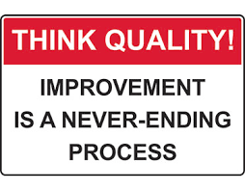
Challenges
“The criticality of accurate measurement of language competence for military job requirements has imposed a strong emphasis on standardization of the STANAG 6001 testing.”
In BILC Best Practices in STANAG 6001 Testing (2019)
Notes:
In addition to all these challenges and perhaps because of them…

Slide 11
Opportunities and Initiatives
Visibility at the strategic level
S.O. #7 – To increment the Armed Forces’ contribution to the external action of the National Defence, by promoting credibility and assurance that Portugal is a co-producer of international security.
Notes:
But then, how have we face these challenges, and what have we done to address them?
One of the opportunities that may help mitigate some of the challenges is to give visibility at the strategic level, by promoting some initiatives to be included in the Strategic Directive

Slide 12
Opportunities and Initiatives
Visibility at the strategic level
Measure # 1 – Promotion of standardization of doctrine, procedures, and best practices in testing iaw STANAG 6001, through:
1.1. Access to regular training for the testing team members;
1.2. Development of dedicated workshops on testing;
1.3. Implementation of regular meetings with HR teams in order to optimize the processes of selection of appointees.

Slide 13
Opportunities and Initiatives
Allocation of resources – Training at PLTCE
2016-2019
4 members of the testing teams (LTS, ALTS, LSAS and Faculty Workshop)
2019 - LTS
June - 1 member of the testing teams
July – 1 member of the testing teams (?)

Slide 14
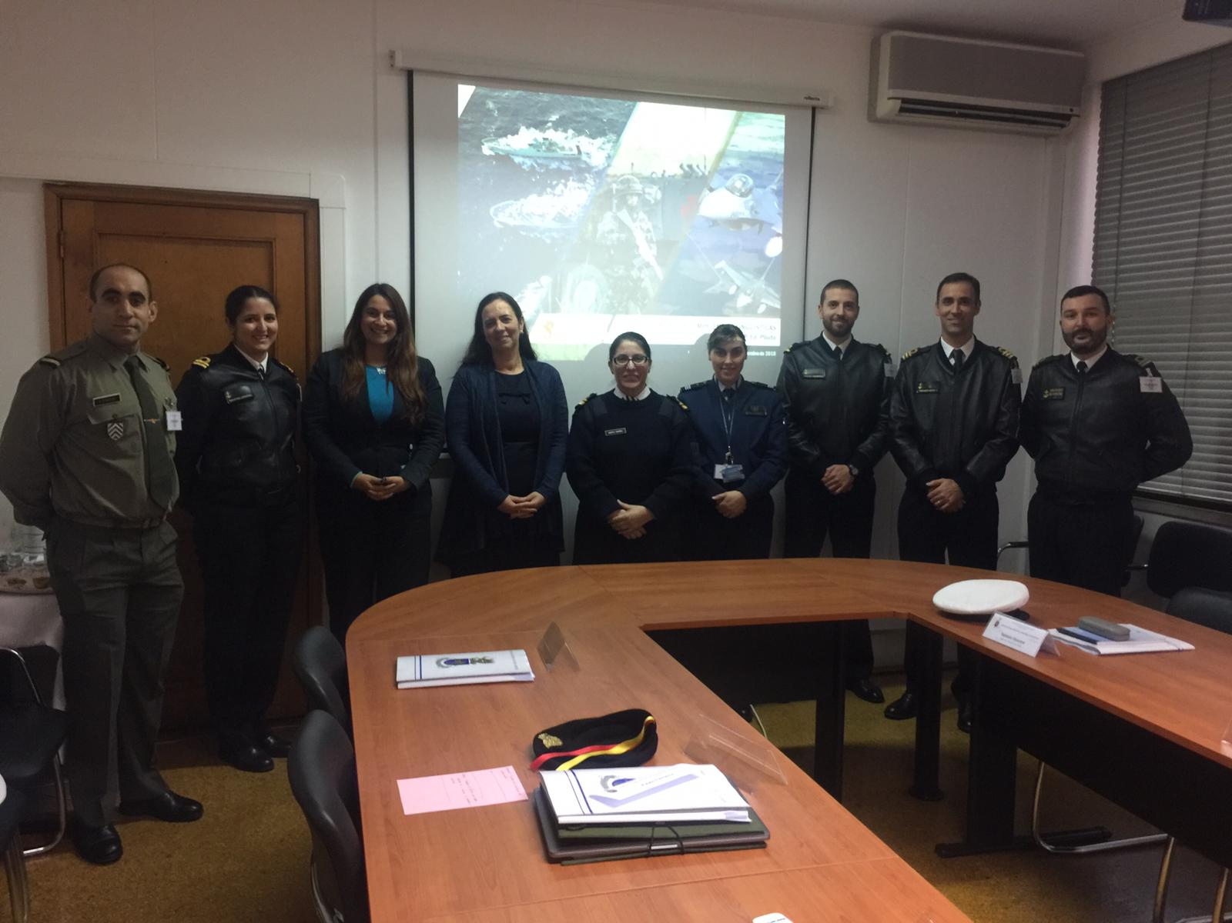
Opportunities and Initiatives
Workshop on Testing IAW with STANAG – 13.11.2018

Slide 15
Opportunities and Initiatives
Workshop on Testing IAW with STANAG – 13.11.2018
9 participants ( Defense Staff Lab and 3 services)
6 hours
General approach to Testing IAW STANAG 6001
Familiarization with the descriptors
Analysis of items (receptive skills)
Analysis of interviews and written assignments
Based on BILC Language Standards and Assessment Seminar, PLTCE, 2017

Slide 16
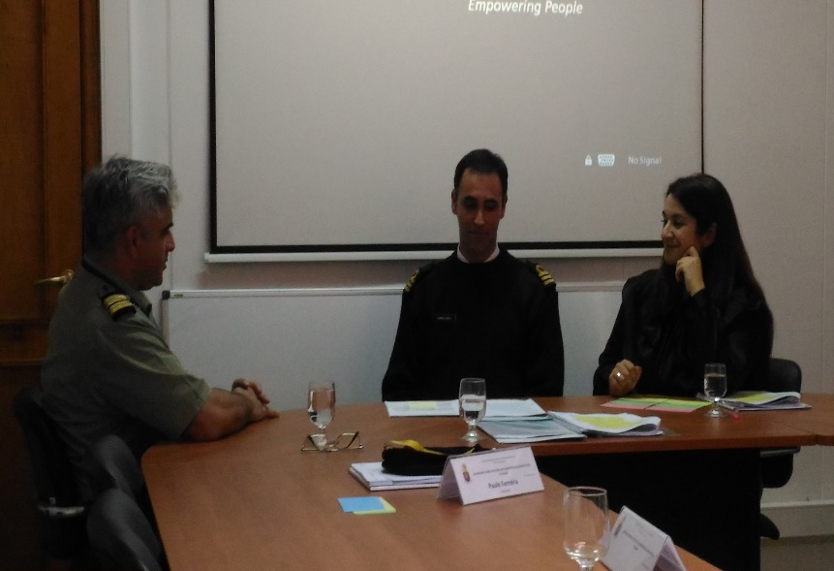
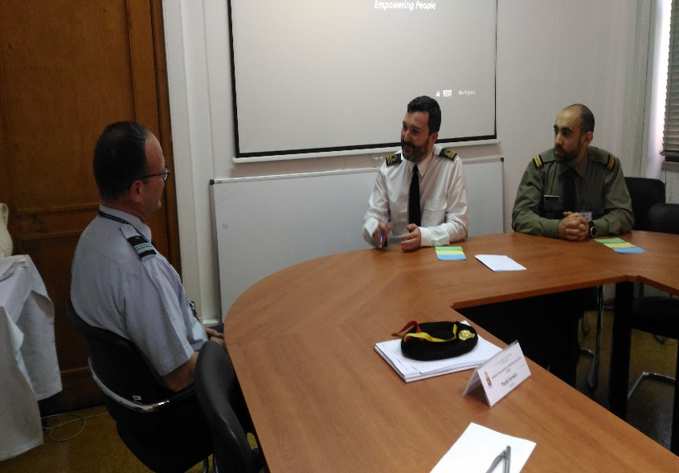
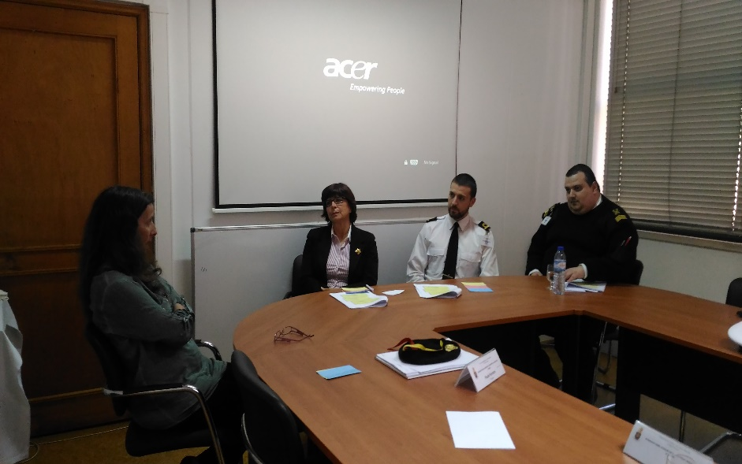
Opportunities and Initiatives
Workshop on Testing IAW with STANAG – 28.03.2019

Slide 17
Opportunities and Initiatives
Workshop on Testing IAW with STANAG – 28.03.2019
7 participants (Defense Staff Lab, Navy and Army)
6 hours
Focus on Speaking
Analysis of interviews
Preparation of OPI protocols
Mock interviews
Based on BILC Language Testing Seminar, PLTCE, 2019

Slide 18
Thank you
mcgabriel@emgfa.pt

