Slide 1
Klik om presentatie te starten

Slide 2
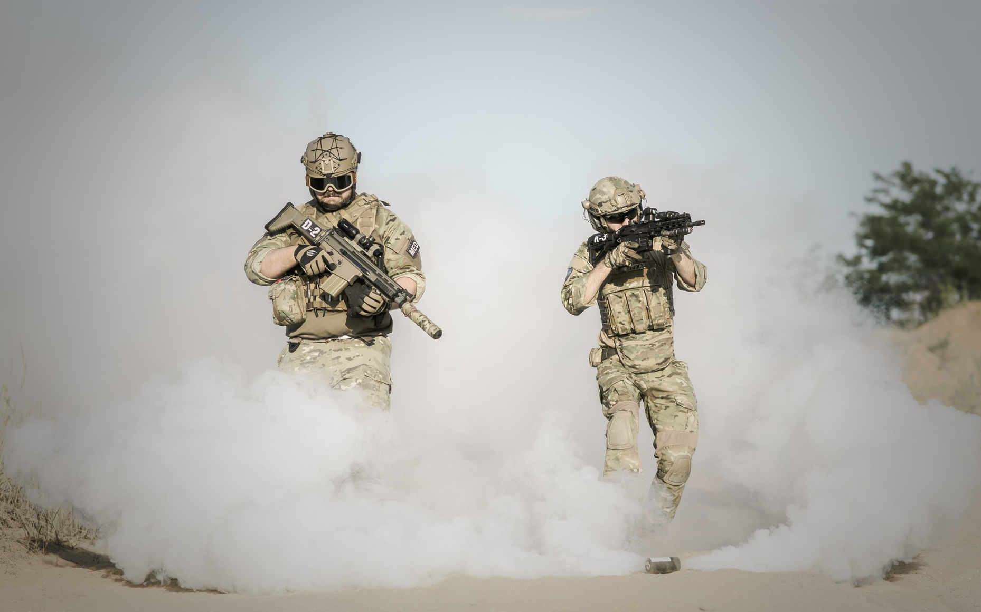
How to select military content?
a ‘Dutch’ experiences

Slide 3
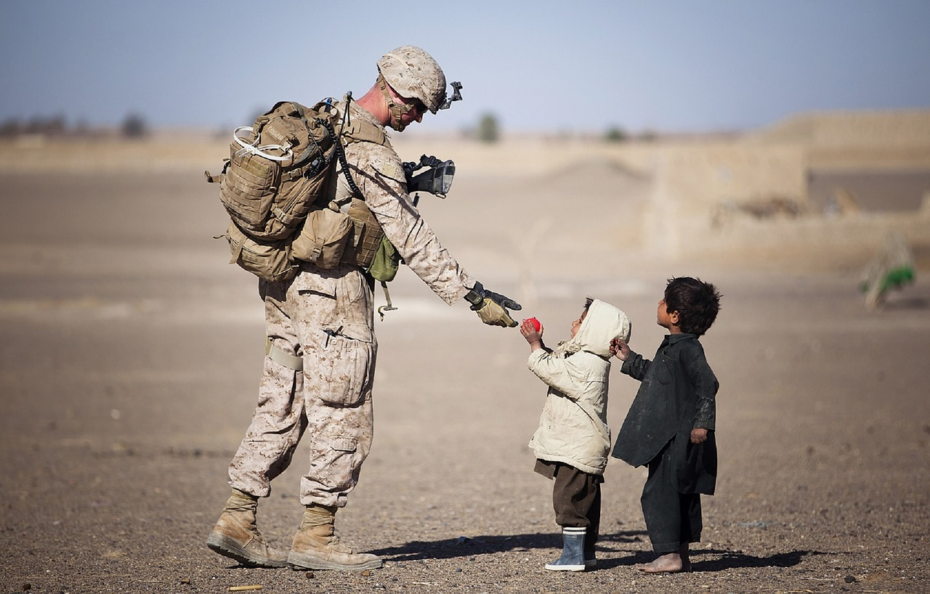
Contents
What is Netherlands Defence Language Centre?
What is its defence framework and its educational philosophy?
How does the DLC select content?

Slide 4
Defence Language Centre
Professional language skills
Language support; translators and interpreter pool management
Policy advice and realisation
Language authority for the entire MOD

Slide 5
Commanding Officer (1)
Business Support (3)
Program Management (4)
Educational Team 1 (17)
Educational Team 2 (12)
Translations (8)
Operational Interpreter Deployment (3)
DLC-teams

Slide 6
Defence Language Centre
Realizes Language Education/Courses
Realizes training support to (operational) units
Realizes translations for the entire MOD
Realizes registration, recruitment, selection and deployment of interpreters

Slide 7
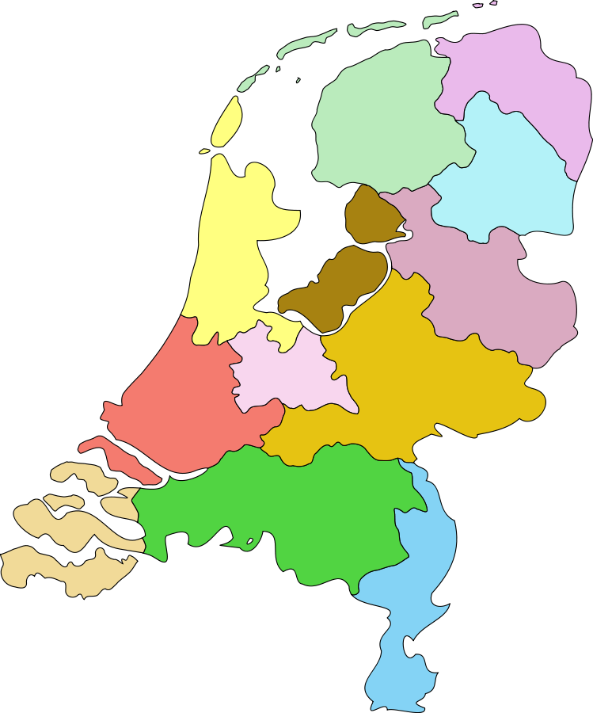
Den Helder
Breda: RMA
FMS
Language courses
Den Helder: RIN
NLBEOPS
Ermelo: RMS French
Russian
Nieuw Milligen: AOCS
Woensdrecht: RMSAF
Ermelo
Nieuw Milligen
Woensdrecht
Breda

Slide 8
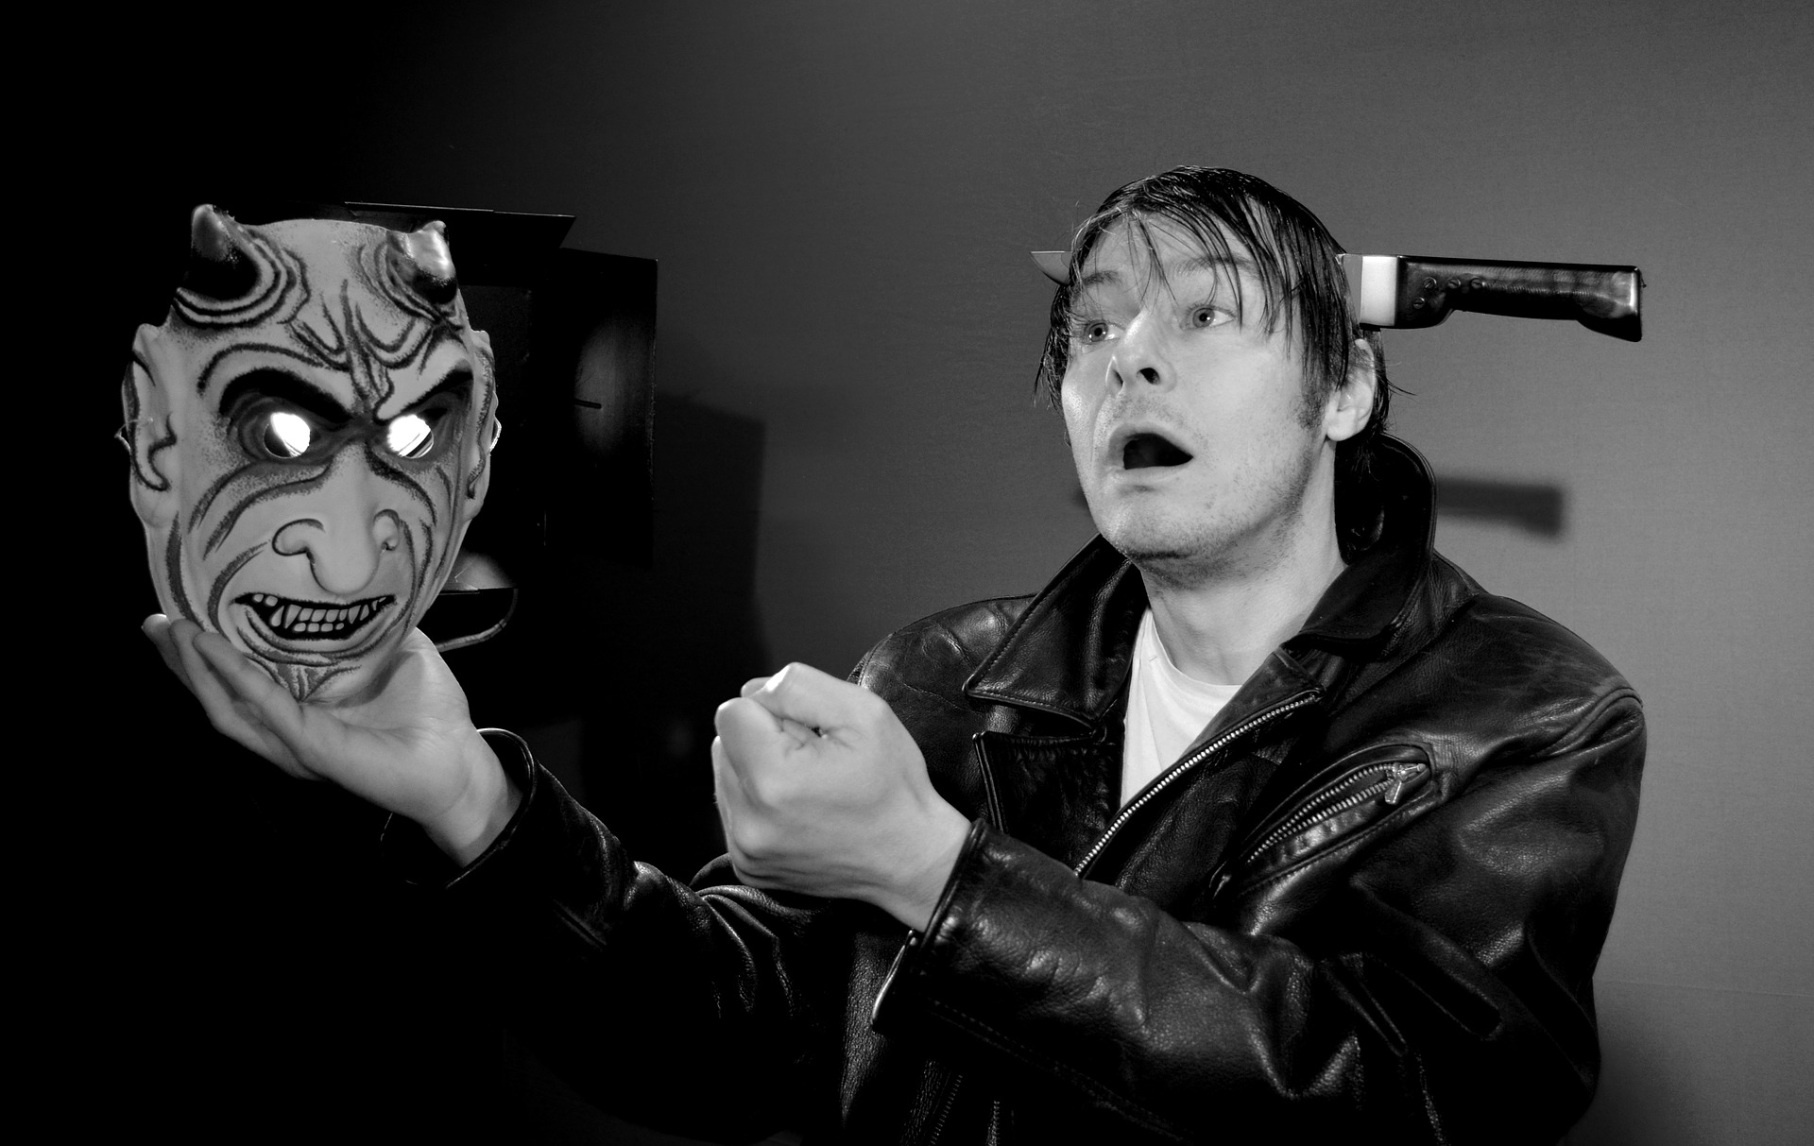
Multiple Actors
Tactical level:
Operatives, SMEs, SRIs
instructional, learning and educational designers
Operational level:
training school staffs
(branch specific) knowledge centres,
Strategic level:
Service heads (Head of (e.g. Army) Personnel, Head of Operations, etc,
policymakers
Joint defence education knowledge centres

Slide 9
Top Down:
Q: What is defence policy (HR, T&E, language)?
A: function oriented, task-based, just in time-just enough.
A: HR-language policy: input criteria = previous education output. Follow-up: no formal career language tests
Q: What is the branch-specific educational design?
A: Varies, yet all branches are realizing a qualification framework (QF) defining core tasks.
Insert generic language skills levels supplemented with core tasks in QF.

Slide 10
Bottom up:
Interview operatives, SMEs, SRIs
Analyse documents: manuals, doctrine, orders, lessons-learnt.
Combine with preferred didactics, student/teacher time availability.
Combine with top down outcome.
Execute-> plan, do, act, check, etc.

Slide 11
Negotiate with SMEs, SRIs on themes and tasks:
instructions, radio procedures, navigation, ship structures, etc.
Select tasks that personnel should be able to perform in L2/(L3).
can send messages IAW NATO standard prowords, can indicate any navigational direction of a ship.

Slide 12
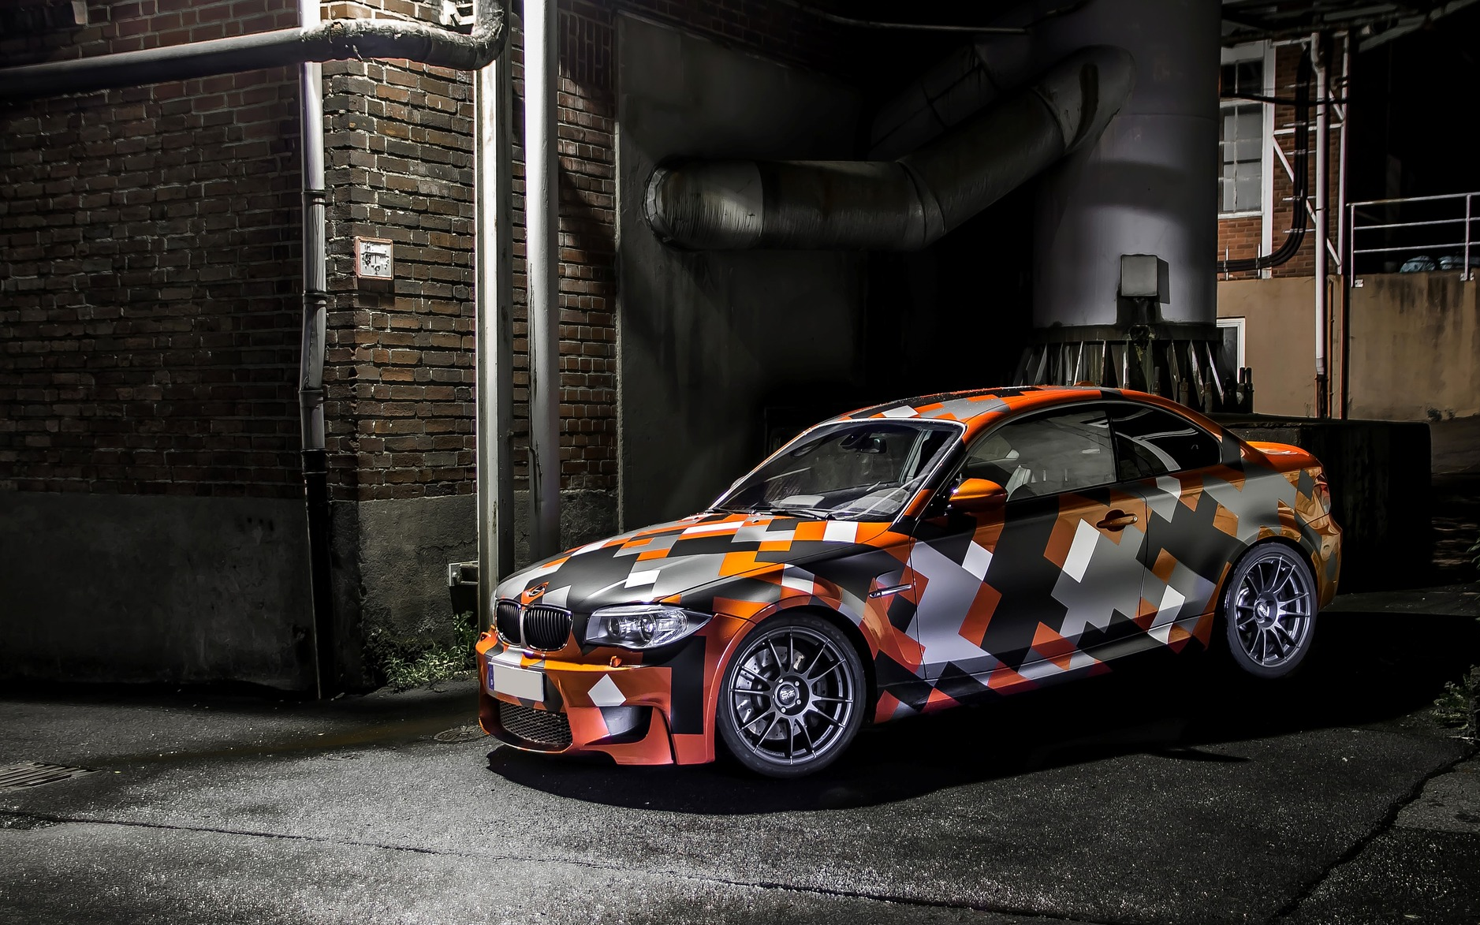
Needs in motion
Needs vary (depends on who is asking)
Mandate not always clear (selection is unwanted)
Unrealistic needs; set by non-experts
Often generic STANAG levels only (lack of SME agreement)

Slide 13
Haves in motion
Training time and trainer availability; vary
Educational design; develops, changes

Slide 14
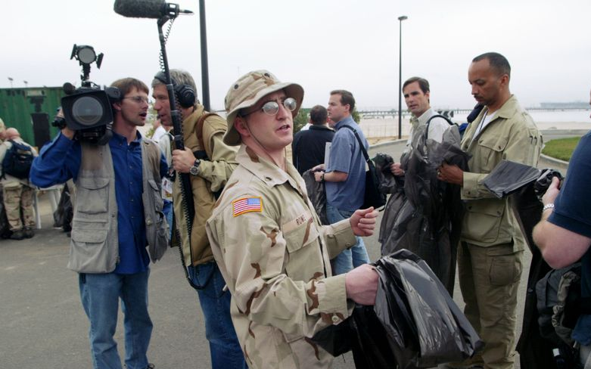
Task-based approach: from situational to interactional authentic

Slide 15
What is a task-based?
Linguistic skills develop through communicative activity. It is NOT a prerequisite for engaging in it. Any task comprises a cognitive challenge.
Criteria for task-based communicative activities: authentic, activating, meaningful

Slide 16
Issues with task based L1 = L2
Language user is not necessarily identical to a language learner
Tasks are more than just language. Tasks are primarily cognitive and secondarily linguistic.
effective, yet not always efficient

Slide 17
Situational authentic yet insufficiently efficient/effective
Efficient language development asks for focused rather than natural language development.
Authentic military tasks are especially from the perspective of the professional soldier cognitively challenging. Form is secondary.

Slide 18
Language user vs language learner
Task-based language training (TBLT) aims to reconcile both roles by finding the right balance in attention to task and attention to form.

Slide 19
Tips & trics
Which language functions are necessary to realize the steps in the cognitive process to accomplish the task?
Creating a suitable task rubric is the essential skill in transforming situational authentic tasks into interactional authentic and focused tasks.
Feedback/(self)reflection is essential (autonomous learner and teacher meet).

Slide 21
Einde van de presentatie

