Slide 1
Using technology to modernize foreign language teaching, testing and maintaining language proficiency at LNAF Language School

Slide 2
Presentation Outline
Brief History
Writing
ILIAS
Technology in Maintaining Language Proficiency
VBS 3

Slide 3
Brief History
2010 – Specialized writing course
2013 – 2016 Getting acquainted with ILIAS
2017 – STANAG 6001 testing in ILIAS
2017 - Virtual Battlespace 3 (VBS3)

Slide 4
ILIAS
Administrative: booking time in laboratories and course feedback
Information about the course
Course materials
Homework
Blogs

Slide 5
Course on Military Terminology

Slide 6
Folders, Files, and Links

Slide 7
Homework Folder

Slide 8
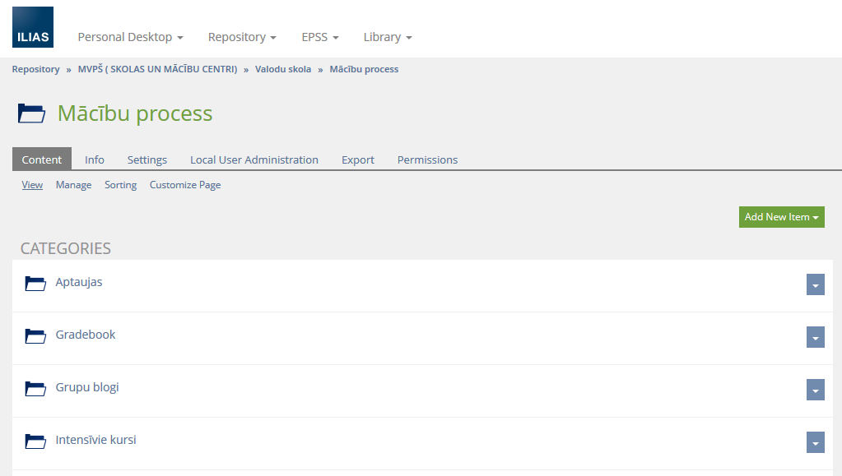
Group Blogs

Slide 9
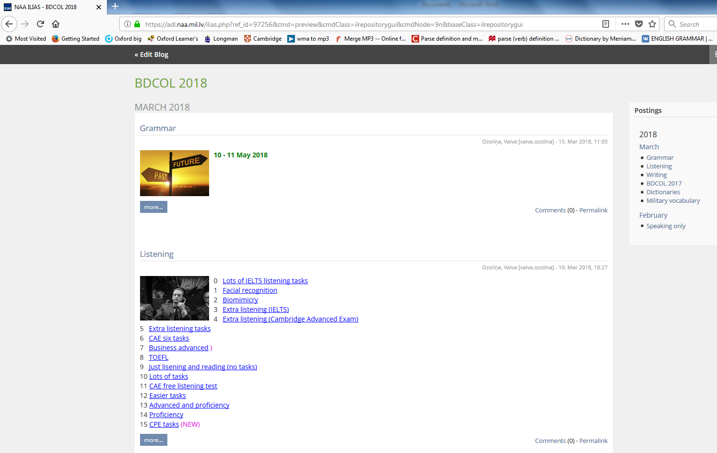
Blogs - Interface

Slide 10
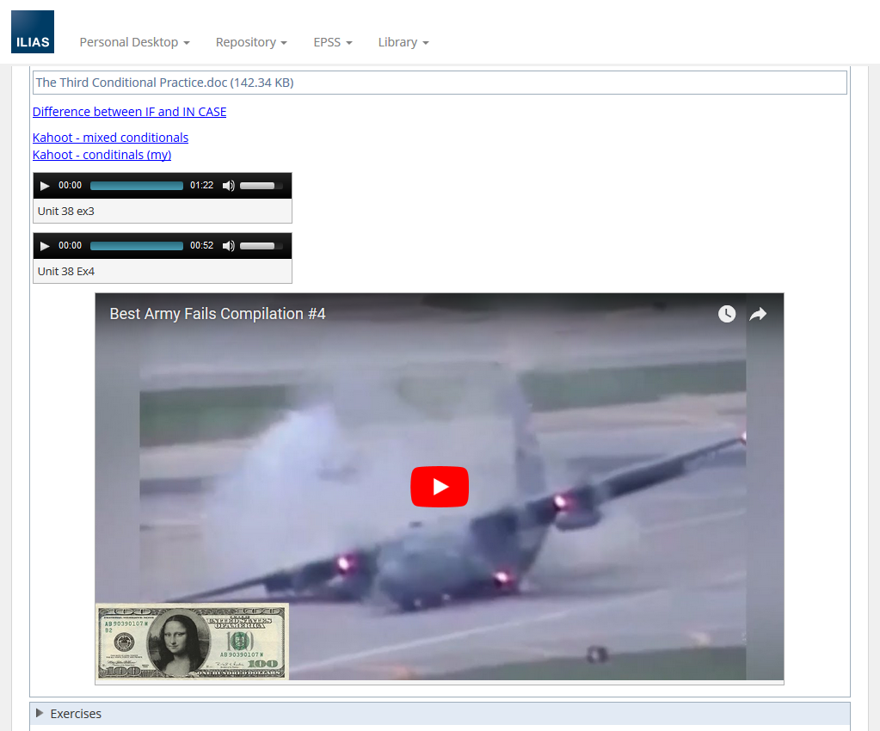
Blogs - Audio and video files

Slide 11
Blogs - Hyperlinks

Slide 12
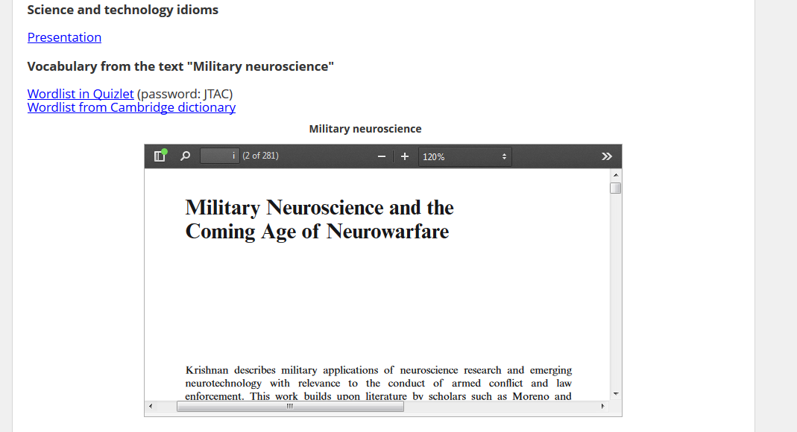
Blogs - Pdf documents

Slide 13
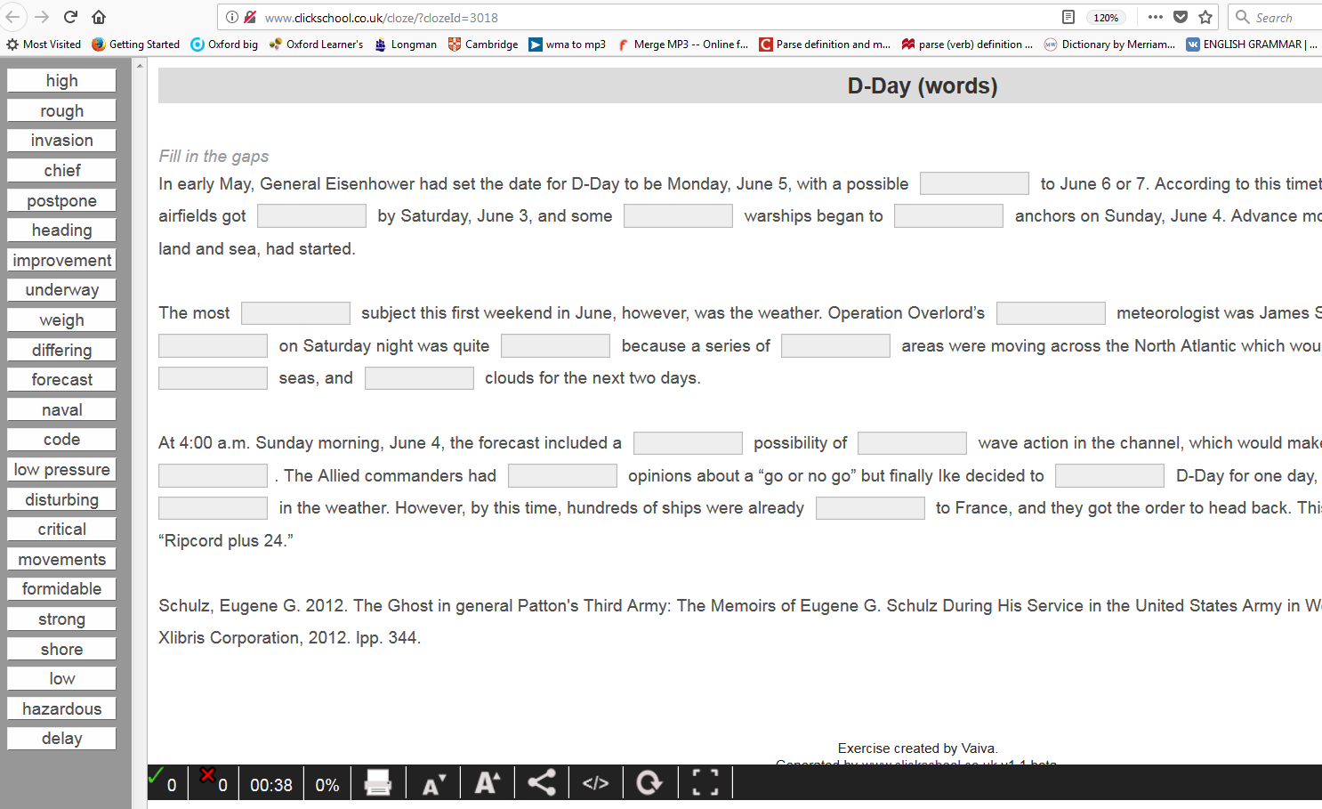
Blogs - Cloze exercises tool clickschool.co.uk

Slide 14
Blogs – multiple choice exercises

Slide 15
Blogs – cloze and drop-down

Slide 16
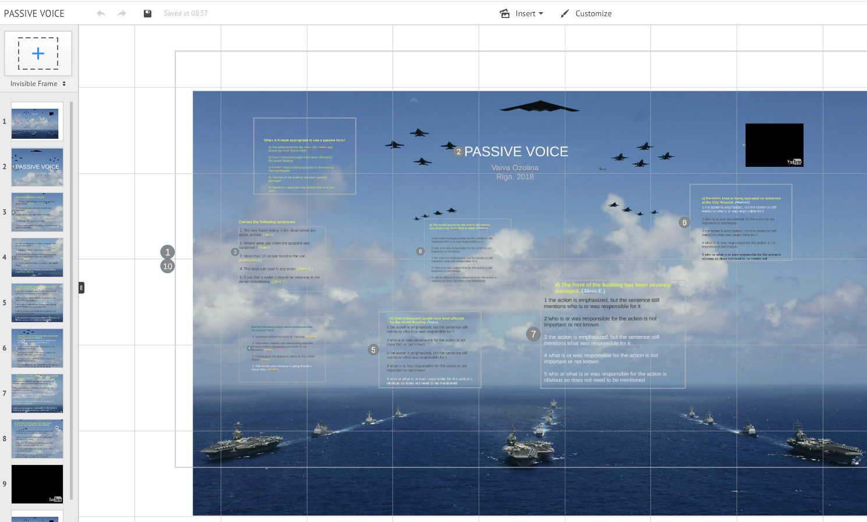
Blogs - Presentation tool prezi.com

Slide 17
Blogs - Presentation tool prezi.com

Slide 18
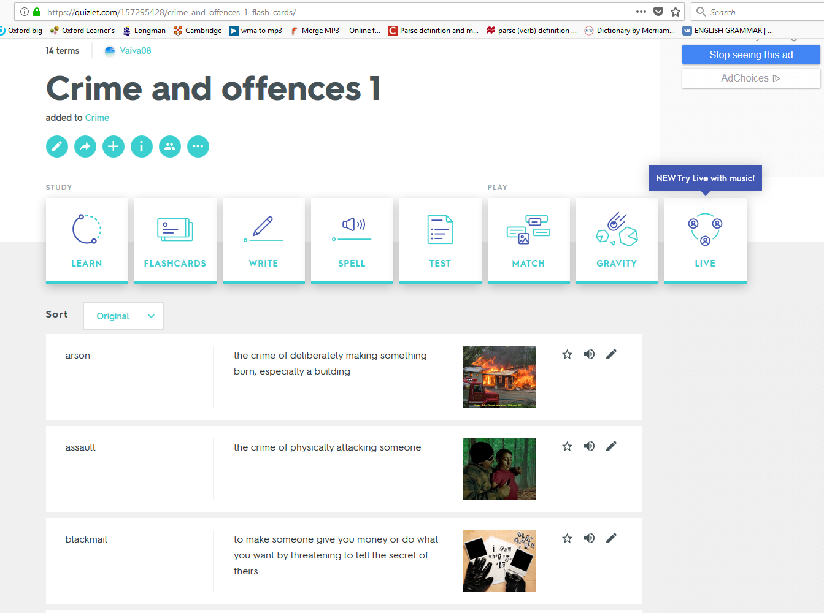
Blogs - Quizlet

Slide 19
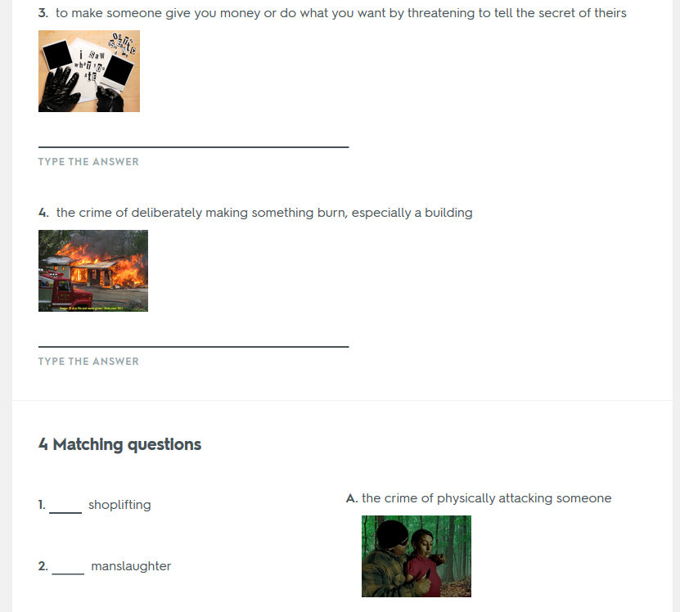
Blogs – Quizlet Test

Slide 20
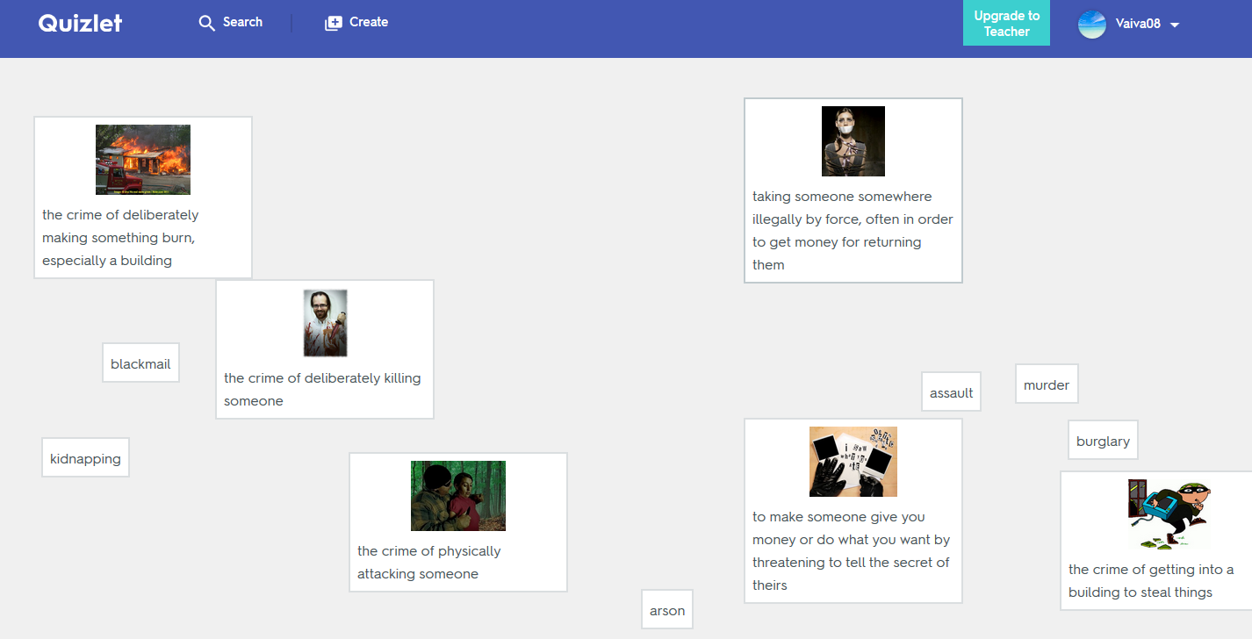
Blogs – Quizlet matching task

Slide 21
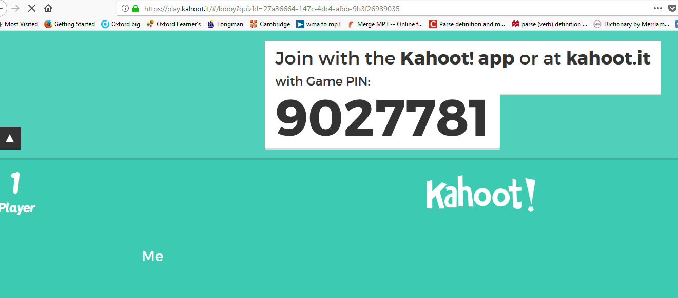
Blogs – Game based learning platform kahoot.com

Slide 22
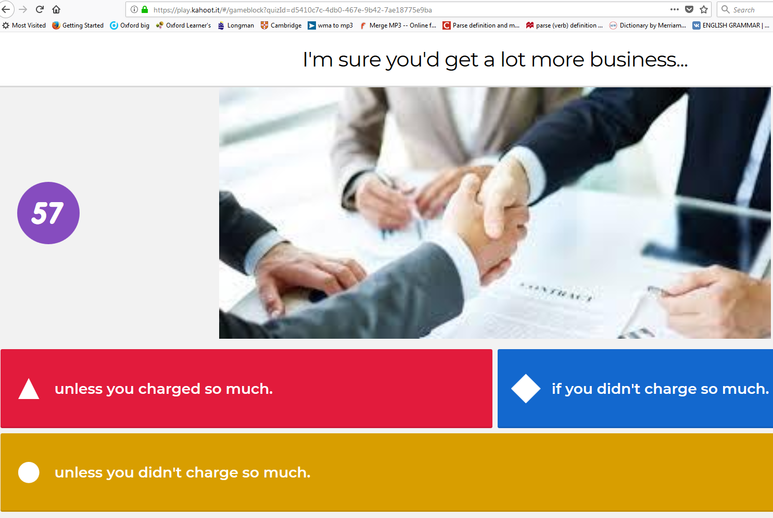
Blogs – example platform in kahoot.com

Slide 23
Maintaining language proficiency
Links
agendaweb.org (all 4 language skills)
lingvaleo.com (games, listening, online learning courses)
commonlit.com (all level reading and listening)

Slide 24
Maintaining language proficiency
Entertaining mobile apps
5555tests (all level grammar tests with explanations)
Fun Easy Learn English (enlarges vocabulary by practicing 6000 commonly used English words, especially suggested for beginners)

Slide 25
Virtual Battlespace 3 (VBS3)
VBS3:
a computer based program conducting virtual training
a wide range of military scenarios
students can consolidate knowledge and skills about the map reading, terrain analysis, movement controls, weapons handling & marksmanship, and radio procedures.

Slide 26
Virtual Battlespace 3 (VBS3)
Activities offered:
navigate with a map and compass in terrain;
identify different terrain features (natural or man-made);
move their character on foot or vehicle and reach the required destination place;
adjust body movements to cross different obstacles;
demonstrate basic interaction with local people in order to collect information about the enemy;
detect signs of enemy threat or activity and send a radio report (SITREP/ FIREREP);
select the corresponding type of weapon and fire at (static) targets;
call in for MEDEVAC (in case of emergency)
etc.

Slide 27
Virtual Battlespace 3 (VBS3)

Slide 28
Virtual Battlespace 3 (VBS3)

Slide 29
Virtual Battlespace 3 (VBS3)

Slide 30
Thank you very much for attention
Questions?

