Slide 1
How Accurate Are Self-Assessments of Second Language Proficiency?
BILC Conference
Vienna, Austria
14 – 19 May 2017
Ray Clifford, BILC Senior Advisor

Slide 2
Justifications for Using Self-Assessments
Self Assessments (such as “Can Do” statements)
Cost less to produce than a test.
Can be administered in less time than a test.
Eliminate problems with cheating.
Don’t require test security procedures.
Increase learner motivation.
Help develop self-regulated, autonomous learners.
“No one knows better what you know than you do.”
Notes:
As opposed to exams which test a small sample of their language.

Slide 3
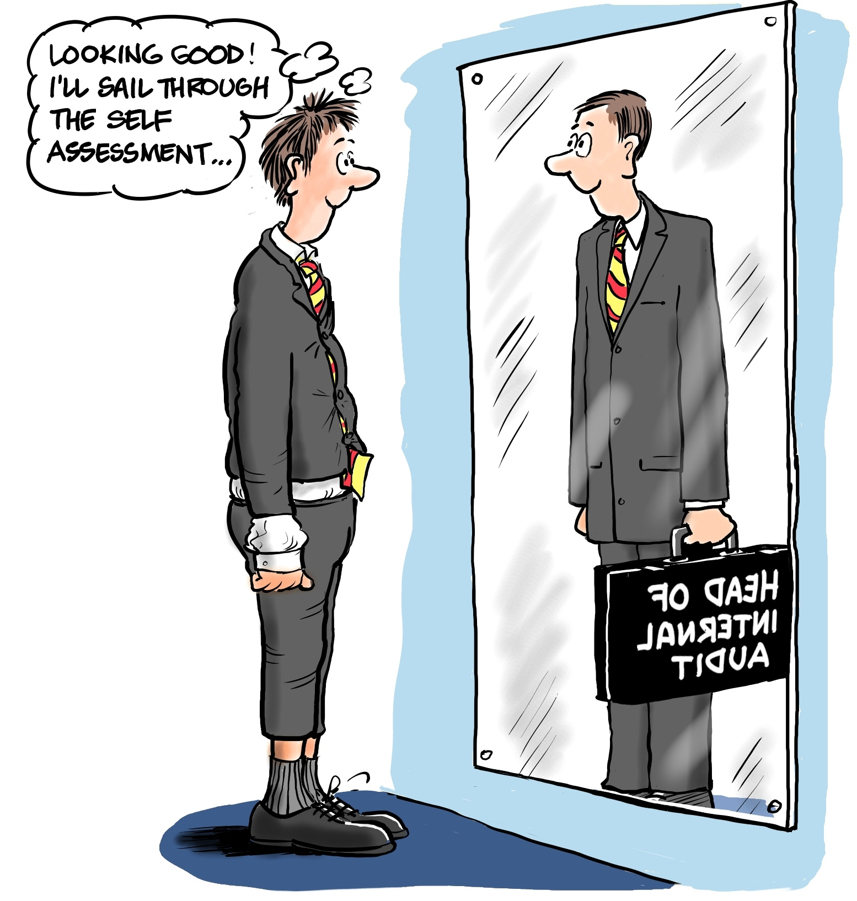
Disadvantages of Self-assessment
People may know what they know, but they don’t know what they don’t know.
People are notoriously bad at self-assessing.

Slide 4
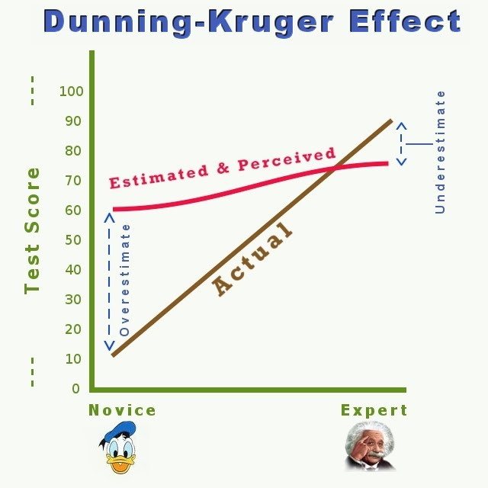
Ehrlinger, J., Johnson, K., Banner, M., Dunning, D., & Kruger, J. (2008).
Why the Unskilled Are Unaware: Further Explorations of (Absent) Self-Insight Among the Incompetent.
Organizational Behavior and Human Decision Processes, 105(1), 98–121. http://doi.org/10.1016/j.obhdp.2007.05.002

Slide 5
The Dunning-Kruger Effect Hits Language Testing Officers from Two Directions
Test takers may have unrealistic impressions of their abilities.
“But I am the best speaker of English in my unit!
Organizations are unaware of the impact a low level of language proficiency can have on job performance.
“But s/he has to have a “3” proficiency profile to be sent to this assignment, and no one else is available.

Slide 6
Being pounded from both sides can make you feel like quitting!

Slide 7
3 Ways to Help Language Learners Rate Themselves More Accurately
Remind learners that STANAG 6001 measures real-world proficiency -- not classroom abilities.
Create real-world “Can Do” statements.
For each “Can Do” statement, replace the traditional Yes/No response option with a range of ability options.

Slide 8
3 Ways to Help Language Learners Rate Themselves More Accurately
Remind learners that STANAG 6001 measures real-world proficiency -- not classroom abilities.
Create real-world “Can Do” statements.
For each “Can Do” statement, replace the traditional Yes/No response option with a range of ability options.
All of these strategies were applied in a research project completed this year by Maria M. Summers, a graduate student, at Brigham Young University.
Her study involved 93 learners of English. (41 males; 52 males)

Slide 9
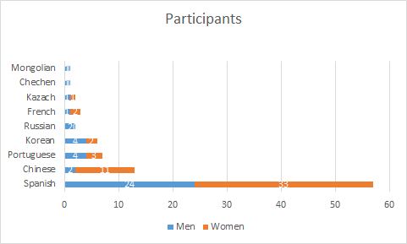
Notes:
-97ew students starting their first semester at the Brigham Young University English Language Center
-Languages spoken as first languages: Spanish (57), Chinese (13), Korean (6), Portuguese (7), Russian (2), French (3), Kazakh (2), Chechen (1), Mongolian (1).
- 40 males and 53 females with various backgrounds and at all levels of proficiency in English participated in the study.

Slide 10
3 Ways to Help Language Learners Rate Themselves More Accurately
Remind them that STANAG 6001 measures real-world proficiency -- not classroom abilities.
Create real-world “Can Do” statements.
For each “Can Do” statement, replace the traditional Yes/No response option with a range of ability options.
All of these strategies were applied in a research project completed this year by Maria M. Summers, a graduate student, at Brigham Young University.
Her study involved 93 learners of English. (41 males; 52 males)

Slide 11
A Student’s View of STANAG 6001, Level 3
High academic goals are set and learner outcomes are defined.
Teachers present as much of the textbook as time allows.
4.
1.
2.
3.
Students are assessed on some of the content that was taught.
Developers include examples of the most important goals in a textbook.
STANAG 6001, Level 3 communication tasks, contexts, topics, grammar, text types, culture, pronunciation, etc.
Textbook
Teaching
Test

Slide 12
How Students Should View STANAG 6001, Level 3
2a.
Course developers sample from the Level 3 real-world domain areas to create a textbook.
1.
Textbook
Set instructional goals and define expected learner outcomes.
Teachers adapt text materials to learners’ abilities, diagnose learning difficulties, adjust activities and add supplemental materials to help students apply new knowledge and skills in achievement settings, constrained performance areas, and in real-world competency scenarios.
STANAG 6001, Level 3 communication tasks, contexts, topics, grammar, text types, culture, pronunciation, etc.
3.
Teacher
Assessment specialists use an independent sample of the real-world Level 3 domain areas to create proficiency assessments that are not in the textbook.
2b.
Students
4.
Test
Students practice, expand, and then demonstrate their unrehearsed, extemporaneous proficiency across a broad range of real-world settings that go beyond the textbook.

Slide 13
As a reminder, every “Can Do” statement in the research project included a preface similar to this:
“How confident are you that you could
do the following tasks
about work [or some other real-world topic ]
without time to prepare
or reference tools such as a dictionary?”

Slide 14
3 Ways to Help Language Learners Rate Themselves More Accurately
Remind them that STANAG 6001 measures real-world proficiency -- not classroom abilities.
Create real-world “Can Do” statements.
For each “Can Do” statement, replace the traditional Yes/No response option with a range of ability options.
All of these strategies were applied in a research project completed this year by Maria M. Summers, a graduate student, at Brigham Young University.
Her study involved 93 learners of English. (41 males; 52 males)

Slide 15
The project used real-world can do statements.
I can list the activities I do at work every day.
I can talk about what my daily routine is at work.
I can talk about work-related challenges such as accomplishing a difficult task.
I can evaluate and hypothesize about potential consequences of a change in policy in the workplace.
[Level 0+, Work]
[Level 1, Work]
[Level 2, Work]
[Level 3, Work]

Slide 16
3 Ways to Help Language Learners Rate Themselves More Accurately
Remind them that STANAG 6001 measures real-world proficiency -- not classroom abilities.
Create real-world “Can Do” statements.
For each “Can Do” statement, replace the traditional Yes/No response option with a range of ability options.
All of these strategies were applied in a research project completed this year by Maria M. Summers, a graduate student, at Brigham Young University.
Her study involved 93 learners of English. (41 males; 52 males)

Slide 17
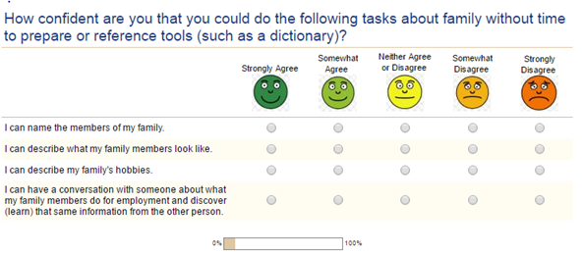
The study had 5 possible levels of response.

Slide 18
Results of the study
The person reliability on the self assessments was:
r = 0.91
r² = 0.83
The correlation between actual ability and the self ratings was:
r = 0.44
r² = 0.19
The process was 83% reliable but only 19% accurate?

Slide 19
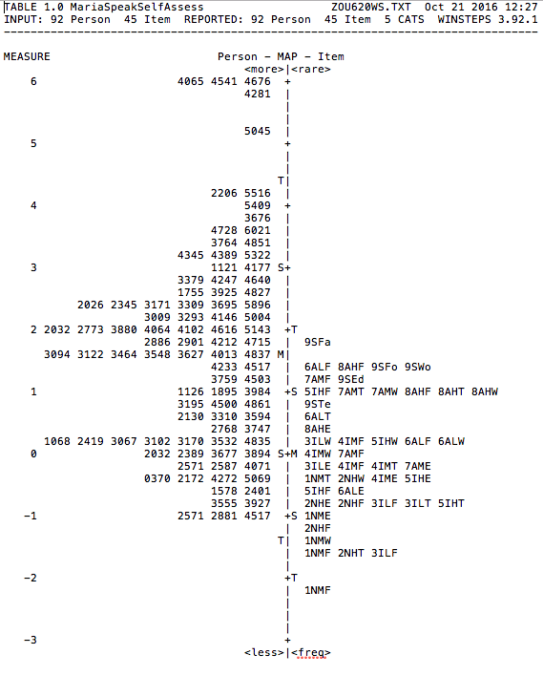
Speaking: Self Ratings versus Item Difficulty Levels
Person Reliability = .91
Learners’ self ratings were statisticsally reliable – but they were not accurate!
Notice that the average beginning learner thought that s/he could do all of the STANAG 6001 types of speaking tasks – including all of the Level 3 tasks.
Learners ratings
Items with targeted levels from
0 through 3
Average self rating
Notes:
It tells us a little bit that the items may not be functioning the way we want it to. Ex: 6ALF
Lowest ability at the bottom, highest ability at the top (people) Items on the right the highest is 6ALF but the students self-assessed a lot higher (over assessed). If we flip it to the side we see a normal distribution with the persons’ self-Assessment.
Probability: If they are on the same line they have a 50% probability that they get it right. For lower items,, they have a higher probability that they will get it right. For higher items, the probability that they will get it right is lower.

Slide 20
Again, Dunning and Kruger were right!

Slide 21
Conclusion
More than half of the learners rated themselves as Level 3 speakers.
Self ratings are not reliable enough to use for placement or other high stakes purposes.

Slide 22
Might there be a more accurate way to do self ratings?
Lately I’ve been offering a different type of self assessment to students who are wondering what their level of proficiency might be.
It tries to improve the accuracy of self ratings by providing more detail.
Note: This method has not yet been validated, so you can help me validate it.

Slide 23
Might there be a more accurate way to do self ratings?
Lately I’ve been offering a different type of self assessment for students wondering what their level of proficiency might be.
It tries to improve rating accuracy by providing more detail.
This method has not yet been validated.
Copies are now being distributed.
Would you like to try this new approach?

Slide 24
This detailed rating sheet uses the format displayed below.
Rate Yourself: What is your speaking proficiency level?
 | For STANAG 6001 Proficiency Levels 0 to 3
Characteristics | 0+ | 1 | 2 | 3
Complexity of my communication exchanges
My automaticity and skill transfer level
Accuracy of the language I produce
My self-monitoring ability
Topics and cultural content I have mastered
My supporting knowledge
My active vocabulary

Slide 25
Read the directions and rate yourself. (Or if you’d prefer, rate a colleague.)
Rate Yourself: What is your speaking proficiency level?
 | For STANAG 6001 Proficiency Levels 0 to 3
Characteristics | 0+ | 1 | 2 | 3
Complexity of my communication exchanges
My automaticity and skill transfer level
Accuracy of the language I produce
My self-monitoring ability
Topics and cultural content I have mastered
My supporting knowledge
My active vocabulary

Slide 26
Ratings of a Typical “School Learner”
Rate Yourself: What is your speaking proficiency level?
 | For STANAG 6001 Proficiency Levels 0 to 3
Characteristics | 0+ | 1 | 2 | 3
Complexity of my communication exchanges |  | X
My automaticity and skill transfer level |  | X
Accuracy of the language I produce |  |  | X
My self-monitoring ability |  |  | X
Topics and cultural content I have mastered |  | X
My supporting knowledge |  | X
My active vocabulary |  |  | X

Slide 27
Ratings of a Typical “Street Learner”
Rate Yourself: What is your speaking proficiency level?
 | For STANAG 6001 Proficiency Levels 0 to 3
Characteristics | 0+ | 1 | 2 | 3
Complexity of my communication exchanges |  |  | X
My automaticity and skill transfer level |  |  | X
Accuracy of the language I produce |  | X
My self-monitoring ability |  | X
Topics and cultural content I have mastered |  |  | X
My supporting knowledge |  | X
My active vocabulary |  | X

Slide 28
Was your overall rating accurate?
Did the more detailed rating approach make it easier to assign yourself a global proficiency rating?
Did the “non-compensatory” interpretation of the detailed ratings generate a more realistic global rating?
Might the rating process be even more accurate if the final STANAG 6001 rating were only revealed after the component ratings had been completed?
Should the rating process be automated?

Slide 29
If you would like to experiment with this alternate approach to self assessment, you are invited to do so.
Thank you for your interest in the topic of self-assessment
– and beware of The Dunning-Kruger Effect!

