Slide 1
SG2 – Ideas for a JTAC-specific language course
WHO
WHAT
HOW
WHY NOT…?

Slide 2
SG2 – Ideas for a JTAC-specific language course
Jurgita KUZAITE
Sophie NORMANDIN
Ana Carina LAGARES OVERGAAG
Fernando VALENCIA FEIJDOO
Peggy GARZA
Nadège BERCKMANS
WHO

Slide 3
SG2 – Ideas for a JTAC-specific language course
2022 national practices survey
2023 JTAC WG survey
Training gap identified for JTAC unique language tasks
WHAT

Slide 4
SG2 – Ideas for a JTAC-specific language course
Shared practices and national issues
The ICAO rating scale
HOW

Slide 5
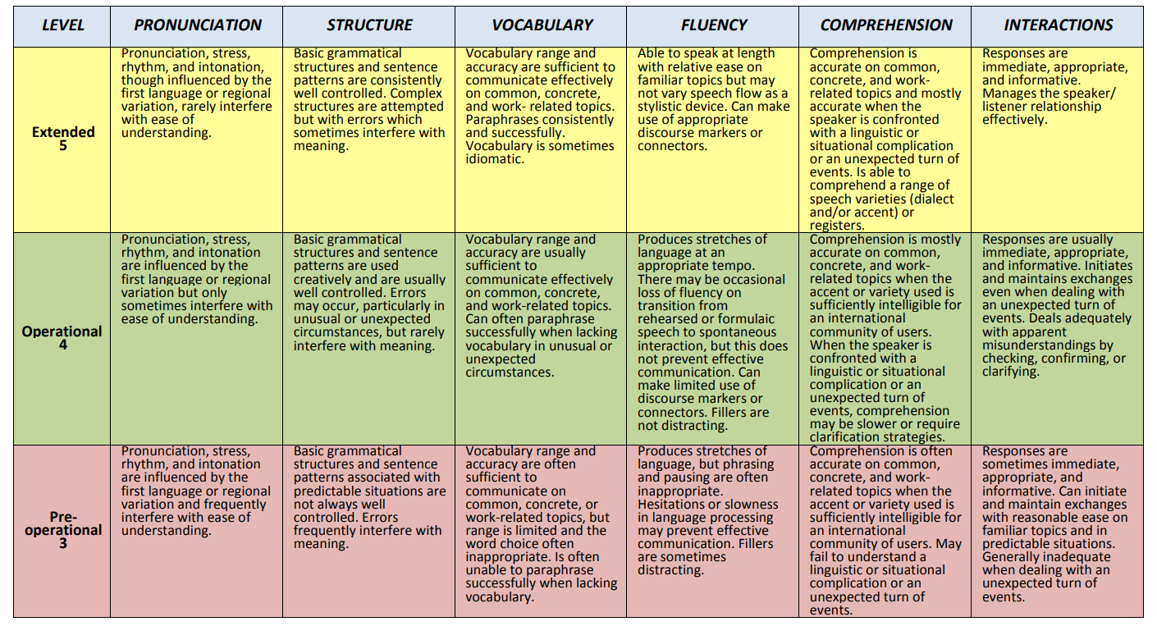
SG2 – Ideas for a JTAC-specific language course
ICAO Language Proficiency Rate Scale

Slide 6
SIMILARITIES
Holistic descriptors
Scoring by skill
National responsibility to create a test IAW the standards
DIFFERENCIES
4 skills vs 2 skills
Length of exam validity (reassessment procedures)
ESP testing vs proficiency testing

Slide 7
SG2 – Ideas for a JTAC-specific language course
Suggestions for a JTAC-specific language course :
Target audience
Future JTACs
Entry requirements
Functional level - SLP 2222 in English
Course length
4 weeks?
Content, topics, and learning objectives
WHY NOT…?

Slide 8
SG2 – Ideas for a JTAC-specific language course
Professional Topics | Learning objectives
Aircraft identification | Use aircraft identification vocabulary (Visual AirCraft Recognition and Manufacture Designation System methods) identify any aircraft efficiently using the vocabulary adapted to a given situation
Tactical communications | Perform a precise target talk-on IAW message procedures (FIDO, 9-line, CAS check-lists) Give a detailed and accurate description of the target and environment Give clear, precise and concise directions/instructions and provide coordinates Understand and be able to use phraseology Use communication strategies (rephrasing, describing, paraphrasing…) understand lower or poor quality radio messages Understand and be able to use acronyms and brevities
Weapons systems | Give information and details about weapons systems, armament, ammunition
Tactical environment | Understand and use vocabulary related to topography, vehicles, housing buildings and facilities
Operations planning | Ask questions, ask for clarification Actively participate to a briefing Read authentic JTAC-related documents Report on a mission

Slide 9
SG2 – Ideas for a JTAC-specific language course
Exit test
a mix between 2 different scales (ICAO and STANAG 6001)
ICAO for Speaking and Listening
Reading and Writing (ESP)
Instructors
A team between Language teachers and SMEs
Other Suggestions/Recommendations
Get authentic material from JTACS
Consult with the national JTACs
Launch a curriculum development workshop
WHY NOT…?

Slide 10
SG2 – Ideas for a JTAC-specific language course
Exit test
a mix between 2 different scales (ICAO and STANAG 6001)
ICAO for Speaking and Listening
Reading and Writing (ESP)
Instructors
A team between language teachers and SMEs
Other Suggestions/Recommendations
Get authentic material from JTACS
Consult with the national JTACs
Launch a Curriculum Development Workshop
WHY NOT…?

Slide 11
SG2 – Ideas for a JTAC-specific language course
WHO
Jurgita KUZAITE
Sophie NORMANDIN
Ana Carina LAGARES OVERGAAG
Fernando VALENCIA FEIJDOO
Peggy GARZA
Nadège BERCKMANS
WHAT
HOW
WHY NOT…?

