Slide 1
Study Group # 1: Familiarization with STANAG 6001 for Non-Specialists
Peggy Garza, Associate BILC Secretary
Branka Petek, Slovenia
Gerard Seinhorst, Netherlands

Slide 2
Study Group # 1: Familiarization with STANAG 6001 for Non-Specialists
Description & Outcome | Non-language specialists in NATO staff positions should be familiar with STANAG 6001 language proficiency levels in order to make informed decisions about SLPs and other matters relating to languages such as establishing policy on linguistic interoperability, determining capability targets for languages, and using English as an operational language within NATO, etc. While the STANAG 6001 Overview for Non-Specialists and the full STANAG 6001 descriptors can be used in promoting a common understanding and interpretation of the descriptors, it has become evident that non-specialists making these decisions remain uninformed. The goals of the Study Group are to: (1) propose a prototype e-learning module building on the existing BILC documents that will include samples of language at each proficiency level and explanations; (2) explore ways to make the Familiarization with the STANAG 6001 for Non-Specialists module readily available as a practical resource for non-specialists.
Room: “Castelo VI+VII”

Slide 3
Study Group #1 Participants
 | Participants | Country/Organization
1 | Peggy GARZA | USA/BILC Associate Secretary
2 | MA Gerard SEINHORST | Netherlands
3 | Branka PETEK | Slovenia
4 | Col. (ret.) Trayko STOYKOV | Bulgaria/BILC Chairman
5 | Colonel Valerii CHURKIN | NATO HQ SACT
6 | Philip TURNER | NATO/IMS
7 | Michael ADUBATO | NATO/ACO SHAPE
8 | Anna IVANOVA | Australia
9 | Maj Dražen MALEŠEVIĆ | Bosnia and Herzegovina
10 | Capt Jakov LJUBANIĆ | Bosnia and Herzegovina
11 | Irena Prpic DJURIC | Croatia
12 | Col Zsolt MIKUSI | Hungary
13 | Brig Gen Giovanni Francesco ADAMO | Italy
14 | Major Alessandra GIGLIOLI | Italy
15 | Anna SCATIGNO | Italy
16 | PhD Jelena KAZIMIANEC | Lithuania
17 | CAP Otilia MANSO | Portugal
18 | LTC Jerónimo Sergio CARACUEL MARTÍNEZ | Spain
19 | CF 3 Mariamma MARTIN | Sweden
20 | Lt Col Craig MULLEN | United Kingdom
21 | David OGLESBY | United States of America

Slide 4
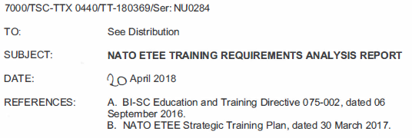
Excerpt from ETEE TRA Report
Findings *(para 8b - Languages)
Leadership at all levels are required to have awareness of the STANAG 6001, Language Proficiency Levels.
For Language appointed SMEs in the NCS, participation in the BILC Annual Conference, the BILC Annual Professional Seminar, and the STANAG 6001 Testing Workshop is strongly encouraged as part of their professional development programme.
Education in English communication is assumed a national requirement. For further professional development in English communication, several HQs offer additional internal education and training, e.g. HQ SACT’s Strategies for Writing Course.

Slide 5
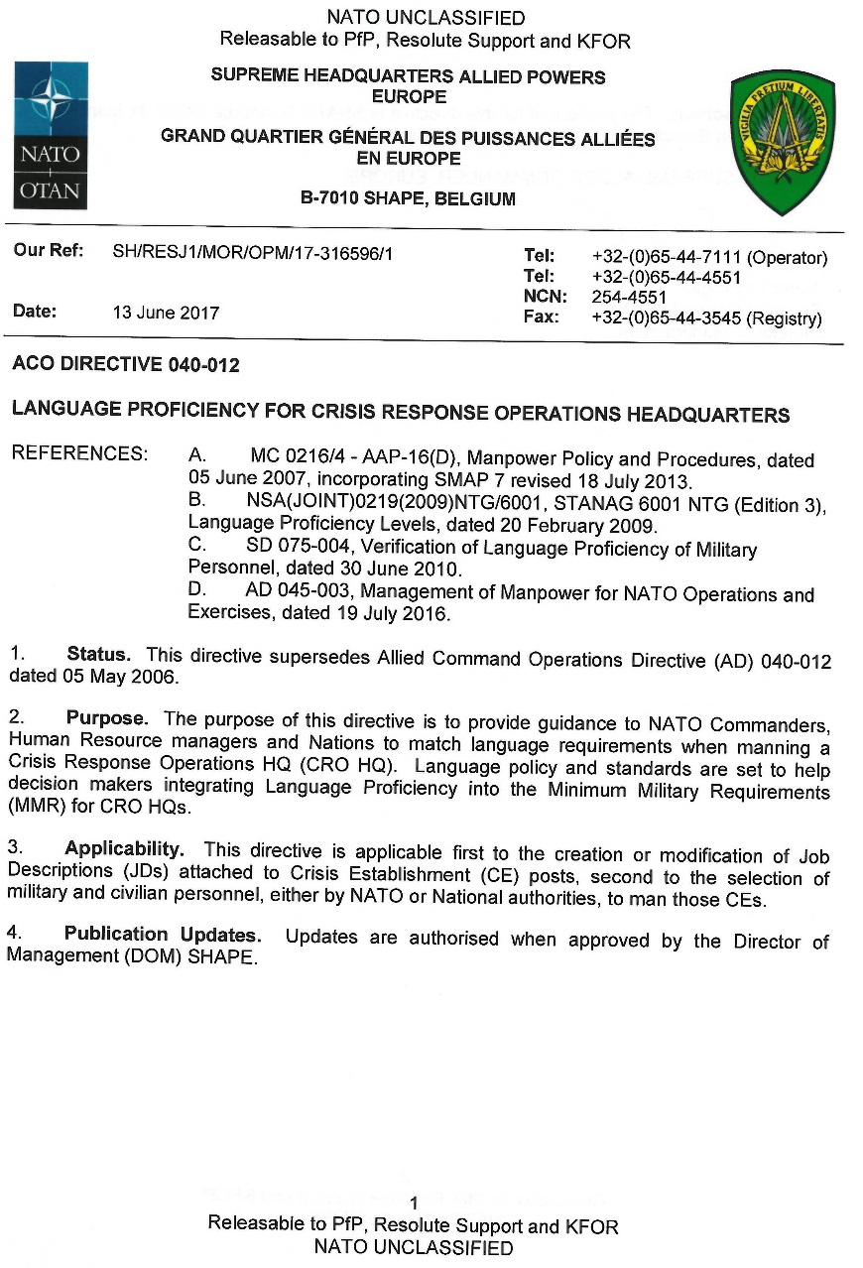
ACO Directive 040-012

Slide 6
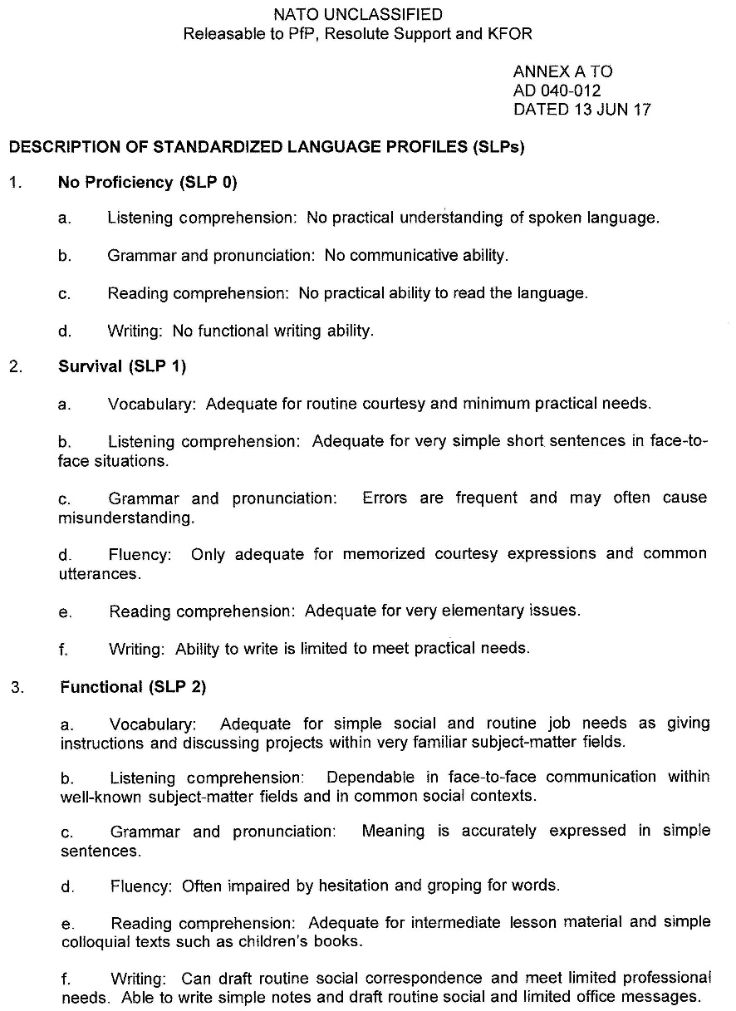
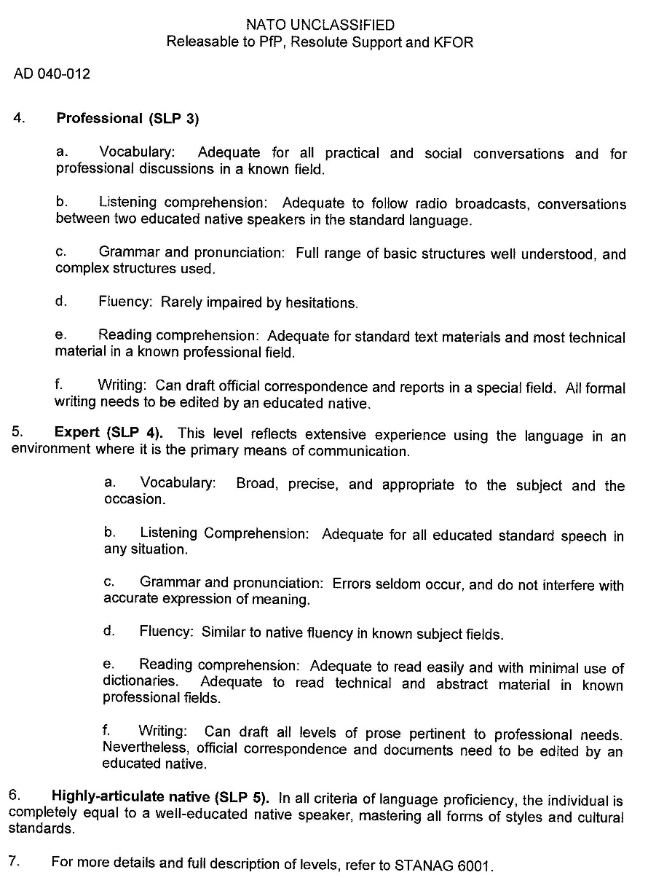
Annex A, Descriptions of Standardized Language Profiles (SLPs)

Slide 7
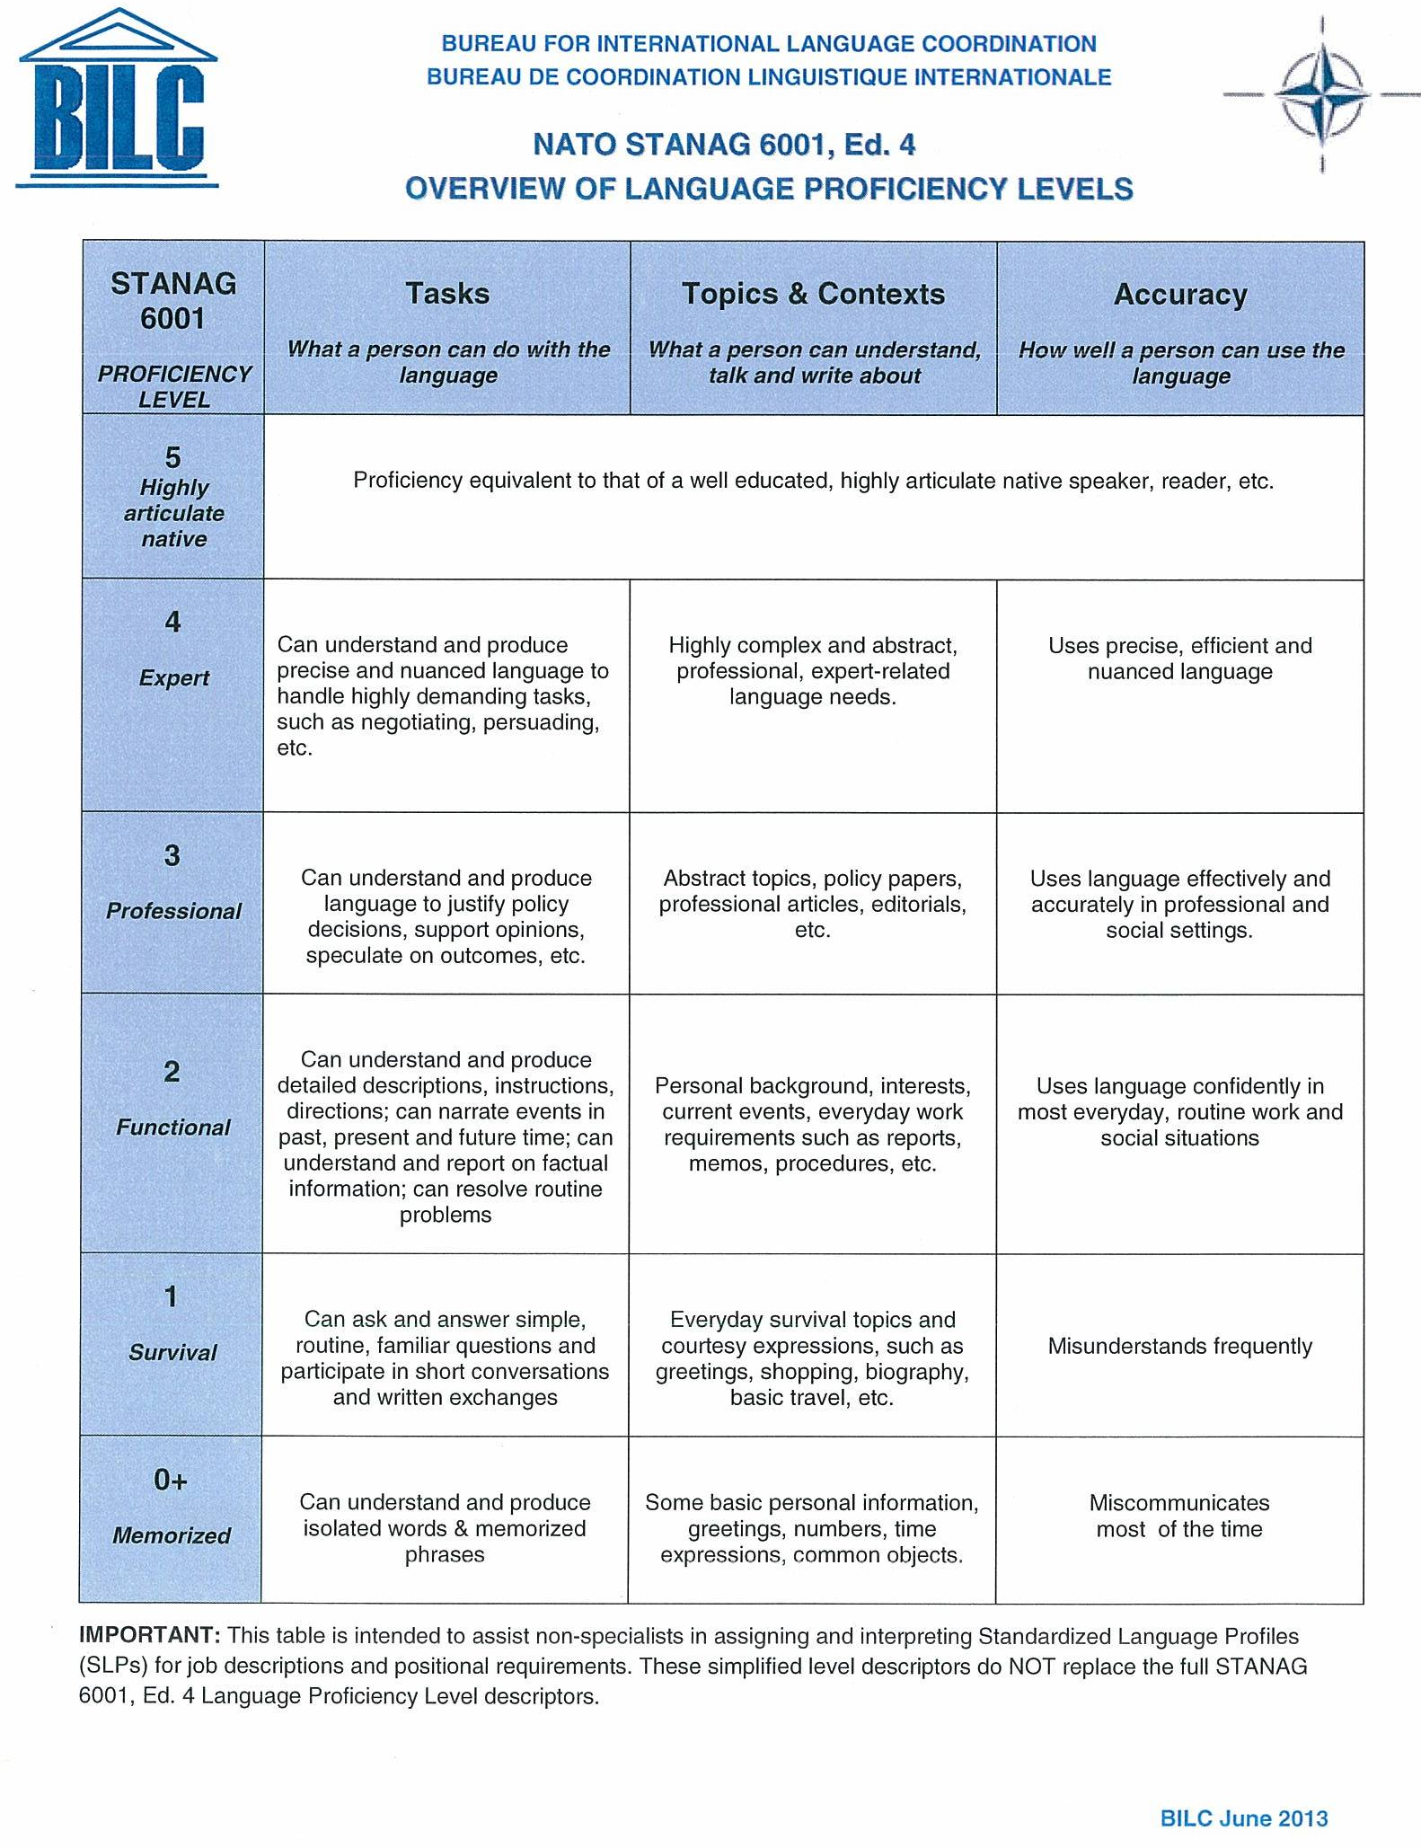
STANAG 6001 Overview for Non-Specialists

Slide 8
Study Group Considerations
ETEE Training Requirements Analysis (TRA) report
Annex A, ACO Directive 040-012
ACO action officer agreed that it wasn’t current and would welcome a replacement from BILC
Inquiry from Joint Fires Observer (JFO) SME
Tension between general language proficiency and English for occupational purposes
SLP 332+2
Specific purposes test?

Slide 9
Three Deliverables
Replacement for Annex A using STANAG 6001 Overview for Non-Specialists as a basis
Draft produced
Web-based interactive tool for conducting an informal Language Needs Analysis (LNA)
LNA/expert advice for Joint Fires Observer (JFO)
USA, Slovenia and Hungary participating nations

Slide 10
Way Ahead
Recommend that Study Group #1 become a Working Group
Plan
#1 Short-term: Finalize the new draft STANAG 6001 Overview for Non-Specialists
#2 Mid-term: Reach out to the JFO training centers in the USA, Hungary and Slovenia to offer expert assistance and a possible LNA
#3 Long-term: Collaborate via BILC SharP Moodle platform beginning with a review of the LNA questionnaires used at HQ SACT, Geilenkirchen and in Australia; Coordinate with e-learning specialists at the NATO School who have offered to provide technical assistance

Slide 11
Thank you to the members of Study Group 1 for your contributions and your willingness to continue with this work.
BILC is NATO’s advisory body for language matters. It is important to make our expertise known and available throughout NATO.

