Slide 1
HANDBOOK FOR CURRICULUM DEVELOPERS BASED ON STANAG 6001
STUDY GROUP 2

Slide 2
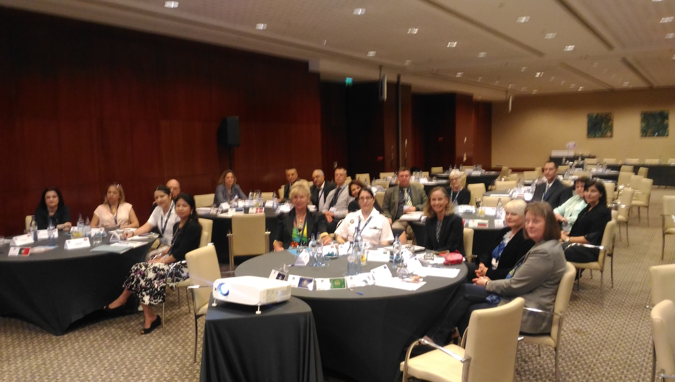

Slide 3
HANDBOOK CONTENT INTRODUCTION
IDENTIFYING GAP/ANALYSING NEEDS OR REQUIREMENTS (OVERALL AIM FOR DIFFERENT CLIENTS)
DESCRIBING TARGET LEARNER CHARACTERISTICS (ADULT MILITARY LEARNERS - TYPES OF CLIENTS)
OUTLINING PRINCIPLES AND STAGES OF CURRICULUM DESIGN

Slide 4
HANDBOOK CONTENT INTRODUCTION CONTINUED
DEFINING THE METHODOLOGY (COMMUNICATIVE, TASK-BASED, MILITARY ORIENTED CONTEXT, TRANSFORMATIVE/AUTONOMOUS LEARNING/TEACHING APPROACHES)
DEFINING COURSE TYPE “LEARNING/TEACHING ENHANCED BY TECHNOLOGY”

Slide 5
CHAPTERS
TEXT TYPOLOGY
STANAG CONTENT/TASKS/ACCURACY PER LEVEL (TOPICAL AREA RATIOS, CONTENT/TASKS PERCENTAGES PER SKILL/CLIENT NEEDS)
STRUCTURE OF MODULES (4 LESSONS + REVIEW LESSON)
SCAFFOLDING OF CONTENT/TASKS AND ACCURACY FROM LEVELS 0+ - 3
LISTING LESSON OBJECTIVES PER LESSON (TASKS TO BE TRAINED)

Slide 6
CHAPTERS CONTINUED
PROVIDING EXAMPLES OF ACTIVITIES (HOMEWORK PROJECTS) THAT PROMOTE LEARNER AUTONOMY
SAMPLE LESSONS AT EACH LEVEL (DIFFERENT LANGUAGES)
GRAMMAR PROGRESSION WITH SAMPLES IN DIFFERENT LANGUAGE CATEGORIES
INTEGRATING LANGUAGE FOR SPECIFIC PURPOSES (LEARNERS AS SMEs)
INTEGRATING TARGET CULTURE INTO CONTENT

Slide 7
CHAPTERS CONTINUED
FINDING AUTHENTIC CONTENT
CREATING/ADAPTING CONTENT FOR LOW PROFICIENCY LEVELS
EXTRACTING/SCAFFOLDING GRAMMAR POINTS FROM CONTENT
DEVELOPING ACTIVITIES FOR THE FOUR SKILLS
INTEGRATING LANGUAGE GAMES/VIDEOS/OTHER TECHNOLOGICAL TOOLS

Slide 8
CHAPTERS CONTINUED
PROVIDING ANSWER KEYS
DEVELOPING END-OF-MODULE TESTS
ADDING NOTES FOR TEACHER GUIDANCE
DEVELOPING FEEDBACK COLLECTION TOOLS FOR THE PILOTING STAGE

Slide 9
MORE IMPORTANT THAN THE CURRICULUM IS THE QUESTION OF THE METHODS OF TEACHING AND THE SPIRIT IN WHICH THE TEACHING IS GIVEN. Bertrand Russell

