Slide 2
“Language is the most complicated human behaviour” ”
WRITING is the “stepchild”…
Dr. Ray Clifford

Slide 3
Study Group Task
The Language Needs Analysis (LNA) of ACT positions performed by BILC, and reported on last year demonstrated that, among other findings, writing ability of incumbents was often well below expectations of the posts. Writing is a skill that requires specific training and attention, but in many training systems, insufficient time seems to be assigned to the development of this skill. The purpose of this Study Group is to discuss best practices in teaching writing as a general proficiency skill coupled with effective, specific-purpose content writing (NATO genre writing). The Study Group will outline a set of recommendations on how nations should approach the task of increasing students’ writing proficiency, and what strategies they could use to attain this goal. A variety of authentic writing samples gathered at ACT will be provided to participants beforehand, as well as the STANAG 6001 L2 and L3 writing descriptors, and LNA report recommendations.

Slide 4
PROBLEM AREAS
Deterioration of writing skills in L1
Writing L1 essays in L2 (cultural aspects, differing conventions)
L1 writer norms vs lingua franca norms (mutual understandabilitiy)
Artificial writing (training and results)
Different kinds of documents. (What should be taught? How?)
Formulaic writing (What proficiency level do I really need for job tasks?)

Slide 5
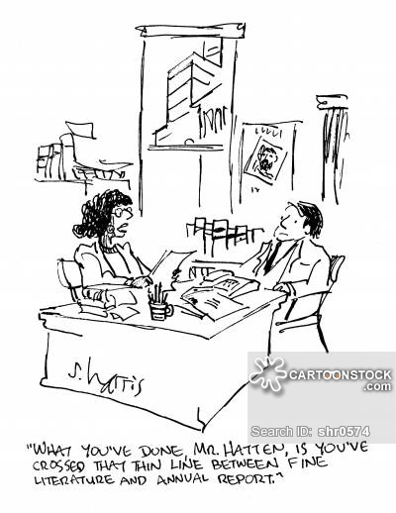

Slide 6
Role of writing in national language teaching programs
Very diverse, depending on student population and training objectives
Range from establishing basic writing proficiency to developing high level academic writing
Scholastic/scholarly abilities vs real life tasks

Slide 8
Sample of NATO docs - Writing at L3 required
Can write effective formal and informal correspondence and documents on practical, social, and professional topics. Can write about special fields of competence with considerable ease. Can use the written language for essay-length argumentation, analysis, hypothesis, and extensive explanation, narration, and description. Can convey abstract concepts when writing about complex topics (which may include economics, culture, science, and technology) as well as his/her professional field. Although techniques used to organize extended texts may seem somewhat foreign to native readers, the correct meaning is conveyed. The relationship and development of ideas are clear, and major points are coherently ordered to fit the purpose of the text. Transitions are usually successful. Control of structure, vocabulary, spelling, and punctuation is adequate to convey the message accurately. Errors are occasional, do not interfere with comprehension, and rarely disturb the native reader. While writing style may be non-native, it is appropriate for the occasion. When it is necessary for a document to meet full native expectations, some editing will be required. …………………………..Though content was FACTUAL

Slide 9
General proficiency vs NATO genre writing
Analysis of real life texts provided by ACT
Formulaic
Not ideal examples of good writing
Need to write clearly (referencing, general understandabilty, organization of texts)
L1 writers not necessarily at an advantage (unclear nuances, etc.)

Slide 10
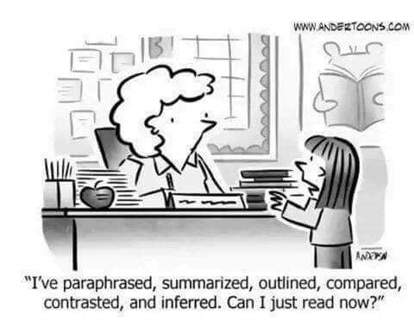

Slide 11
Ways to find solutions
Approach writing as a process : Identify what makes a piece of writing good? (Task, objective, target reader, genre, register, nuances…)
Clarity: avoid misunderstandings/ambiguity
Increase awareness of students (revise documents)
Develop linguistic tools (NOT just format)
Develop extralinguistic tools: Critical thinking, summarizing, mediation
Training teachers, writing coaches, editors how to correct and provide feedback to students
Encourage student reading

Slide 12
Recommendations
Approach writing as an iterive process:
Establish an ongoing cycle of individualized feedback
Self evaluation – peer evalution – teacher evaluation
Provide opportunities for revision and rewriting
Use of collaborative zones
Multi-stage writing (checking outlines, drafts, final)
Allot a lot more time for the writing process in course planning – the writing process is particularly time consuming

Slide 13
Specific Courses on Writing
L1, L2 (for general purposes) – writing well for any purpose contributes to skills development
Incorporating writing course in English in staff courses
NATO Writing Course – also for L1 writers

