Slide 1
STANAG 6001 CAT in Bulgaria –Technical and Equipment Requirements Lessons Learnt
Col. Petko Petkov
Lisbon, 21.05.2018

Slide 2
Why CAT
shows results immediately after testing;
reduces exposure of some items because examinees typically receive different sets;
faster than paper version;
no human interference during testing;
Notes:
Computer assisted testing (CAT) is the use of computers as an aid in the delivering, administration and scoring.
https://en.wikipedia.org/wiki/Computerized_adaptive_testing#Advantages

Slide 3
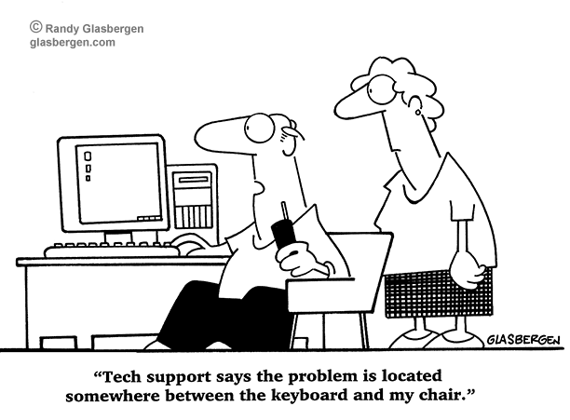
Types of CAT
Computer Assisted Testing (CAT)
Computer Adaptive Testing (CAT)
Piloted in: Canada, Romania, Latvia, FYROM
Notes:
Adaptive testing shows results faster and with less items used;
In BGR adaptive test is still in process of piloting

Slide 4
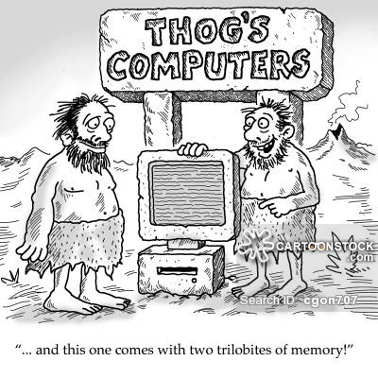
Technical challenges
creating equal and modern environment for all examinees – all the labs were upgraded 2016, new upgrade 2018;
All the computers with the same OS, version of players, the same headphones
Using the same browsers everywhere
Notes:
In Bulgaria Test team is traveling and deliver test on different locations

Slide 5
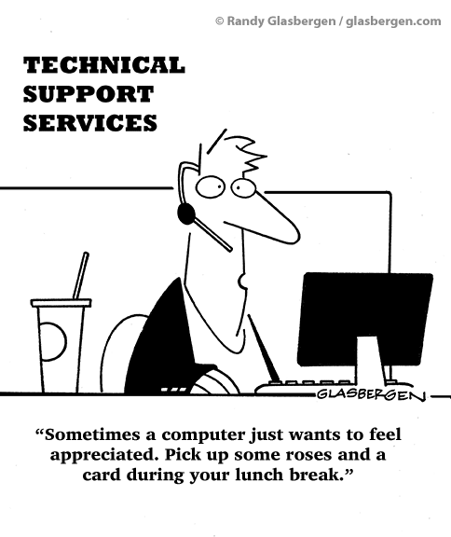
Some history
First version – a special laptop (server)
testing team could test only in one place - 2012
Secure;
Controlled;
Not very reliable – has single point of failure;
Second version – on server in NDA – 2015
Needs administrator;
Depends on upload speed of internet in NDA

Slide 6
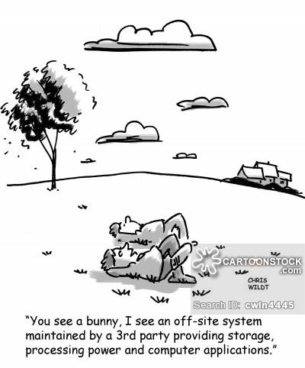
Some history cont.
Current situation – platform on virtual server
Pros
Hi-speed backbone access;
Can be used from different locations simultaneously;
24/7 accessibility;
Professional security and reservation;
Cons
Personal data and results stored somewhere in the cloud
From 2015 only CAT for R/L

Slide 7
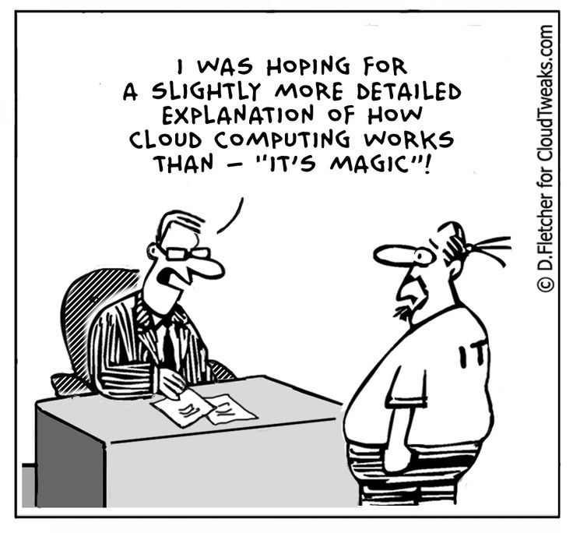
On site testing challenges
Fast and reliable internet access – done ☺
Updating computers the day before the exams – Microsoft issues major updates once in a month;
Making sure versions of browsers and players to be up to date;
All the computers are connected to internet
Notes:
MoD issued special procedure how labs to be prepared before the exam.

Slide 8
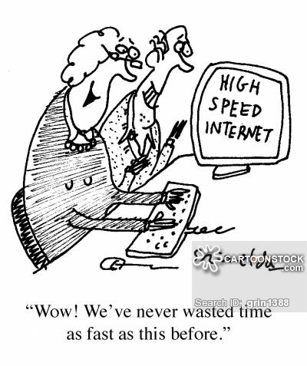
Internet connection problems
Having full access to internet could be tricky ☺
Possible solutions:
Firewall/router with access only to STANAG testing software IP address – need special equipment and personnel;
Restricted account only for testing;
Administrative measures;
Technical measures – Spelling corrector in Chrome is disabled by testing platform.

Slide 9
Questions?
Well to be perfectly honest, in my humble opinion, of course without offending anyone who thinks differently from my point of view, but also by looking into this matter in a different perspective and without being condemning of one's view's and by trying to make it objective, and by considering each and every one's valid opinion, I honestly believe that I completely forgot what I was going to say.

