Slide 1
Converting proficiency levels
from one language scale into another
Is it possible? And why not?
On the Portability of STANAG 6001 Language Certifications
Gerard Seinhorst
BILC Working Group on the Portability and Recognition
of STANAG 6001 Certificates
BILC Conference 2018
Lisbon, Portugal

Slide 2
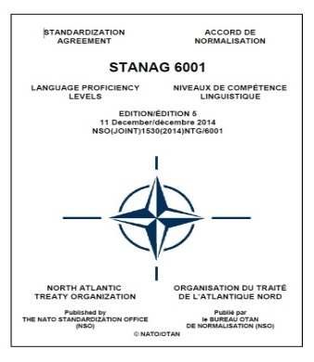
Introduction
Background
BILC Working Group
Common European Framework for Languages (CEFR)
and NATO STANAG 6001
Commonalities and differences
Problem areas
Conclusions and Recommendations

Slide 3
Background
Perceived need to convert STANAG 6001 scores/levels into CEFR levels, and vice versa
To recognize linguistic abilities of military personnel in civil society
To provide guidance to employers, trainers, non-language experts in defence organizations on how to interpret/evaluate CEFR qualifications
To identify competence gaps, thereby determine whether an individual is capable of undertaking a job requiring a given SLP, or additional language training is needed
Due to lack of any official correspondences, an array of different correspondence charts and conversion tables emerged

Slide 4
Background
BILC as advisory body was asked by NATO for expert opinion
BILC participation in four ACTFL-CEFR Alignment Conferences (2010-14)
Letter from BILC Chair to NATO/IS 2014
BILC Conference 2016 Riga – Study Group
The answer was…

Slide 5
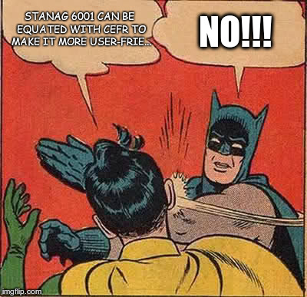

Slide 6
Background
BILC Conference 2016 Riga – Study Group
Conclusion:
Portability is a national issue, not a concern of NATO or BILC
BILC should provide guidance
Recommendation:
work towards full recognition of STANAG 6001 certificates in the civil world
How?
Establish a BILC Working Group focusing on
suggestions for a common STANAG 6001 certificate format to facilitate wider recognition
guidance for nations on the issue of equating different language scales

Slide 7
BILC Working Group
BILC Working Group on the Portability and Recognition of STANAG 6001 language certificates
language training and testing experts from 8 NATO nations
meeting in September 2016, Bled Slovenia
BILC Language Policy Recommendations
Acceptance of commercial STANAG 6001 language certificates
STANAG 6001 language certificate essential information
Longevity of STANAG 6001 language certificates
Portability of language certificates
“There are substantial technical issues that prohibit the accurate comparison of CEFR and STANAG 6001 language certificates”
From BILC Reply to DCOS/JFT, 2016
Accurate comparison of CEFR and STANAG 6001 certificates is prohibited by substantial technical issues!
Notes:
DCOS/JFT: Deputy Chief of Staff/Joint Force Training

Slide 8
Commonalities of the scales
Feature | CEFR | STANAG 6001
Serve as a common yardstick for reporting and comparing measures of foreign language competence
Describe language abilities on a scale from little or no ability to that of a highly proficiency language user
Divide the hierarchy of language development into stages via prose descriptions
Address listening, speaking, reading, and writing separately
Describe language competence in “Can-do statements”
In addition, there are similar statements in the level descriptors

Slide 9
Comparison of proficiency levels
F
V
Scale 1
Scale 2
E
D
W
C
X
B
Y
A
Z

Slide 10
Comparison of proficiency levels
F
V
Scale 1
Scale 2
E
D
W
C
X
For ease of comparison, levels with similar statements are considered commensurate in the ‘conversion tables’
B
Y
A
Z

Slide 11
Comparison of proficiency levels
F
V
Scale 1
Scale 2
E
D
W
?
C
X
B
Y
A
Z

Slide 12
Comparison of proficiency levels
F
V
Scale 1
Scale 2
E
?
D
W
?
What is the proficiency level of a student at Level W in terms of Scale 1?
We cannot know for sure.
C
X
B
Y
A
Z

Slide 13
Empirical findings
Swender et al. (2012)
Comparison of test scores on CEFR and STANAG 6001 reading tests of English
A CEFR Reading Level B1 can be anything between STANAG 6001 Level 1 and Level 2+
A STANAG 6001 Reading Level 2 can be anything from CEFR A2 to C1
Empirical studies by Buck et al. (2008) and Gratton & Di Biase (2013) confirm that no clear-cut correspondences between the two scales can be drawn

Slide 14
Issues
Comparison of level descriptors
Construct definition
Purpose and contexts
Assessment methodology
Quality assurance mechanisms

Slide 15
Issues
Comparison of level descriptors
Construct definition
Purpose and contexts
Assessment methodology
Quality assurance mechanisms

Slide 16
Purpose and contexts of use
Feature | CEFR | STANAG 6001
Primary purposes
promote language learning and learner autonomy
describe/assess spontaneous, real-world language competence for international (military) job requirements
check learners’ progress in developing communicative competence within a specific course of study
assess individuals’ general proficiency across a wide range of topics regardless of their course of study
Intended user
learners and teachers
end-users: employers, military commanders, personnel managers
Intended use
curriculum development and measuring step-by-step progress
accurate measurement of unrehearsed language competence for high-stakes purposes
Less suitable for
high-stakes testing
measuring small steps of progress in language learning

Slide 17
Issues
Comparison of level descriptors
Construct definition
Purpose and contexts
Assessment methodology
Quality assurance mechanisms

Slide 18
Language construct
STANAG 6001
Each level constitutes a distinct threshold
Each STANAG 6001 level describes a ‘floor’ and ‘ceiling’ of language performance
Can-do and cannot-do statements
CEFR
Only positively stated ‘Can-do’ statements
Boundaries between levels are deliberately kept vague
Accurate pinpointing of language ability on the scale is not its primary purpose

Slide 19
Issues
Comparison of level descriptors
Construct definition
Purpose and contexts
Assessment methodology
Quality assurance mechanisms

Slide 20
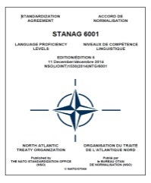
Test type
STANAG 6001 tests
are by definition general proficiency tests
are used for high-stakes purposes: employment,
deployment, promotion, course admission, proficiency pay
CEFR tests
may have many different purposes, ranging from high stakes proficiency exams to low-stakes placement tests
may be proficiency tests, achievement test, progress tests, diagnostic tests, job-specific (performance) tests, etc.
It is not possible to accurately assign STANAG 6001 / CEFR proficiency scores from tests that were designed to serve other testing purposes (Clifford, 2001)

Slide 21
STANAG 6001 test design and rating procedure
Strong emphasis on standardization of test design and protocols
Features of STANAG 6001 testing
Construct-based testing: each level represents a separate construct that is to be independently tested and scored
CTA Alignment: each level is defined by a unique set of requirements for Content, Task, and Accuracy. These requirements need to be aligned at each level
Ratable sample: a language performance is only ratable if it shows both the floor and ceiling of the candidate’s language ability, is sufficiently lengthy and covers a variety of topics
Non-compensatory rating: in order to be assigned a proficiency level, a test candidate must meet ALL the requirements for that level (threshold system)

Slide 22
CEFR test design and rating procedure
CEFR does not stipulate a particular testing methodology
The CEFR does NOT require any of these features
Construct-based testing: each level represents a separate construct that is to be independently tested and scored
CTA Alignment: each level is defined by a unique set of requirements for Content, Task, and Accuracy. These requirements need to be aligned at each level
Ratable sample: a language performance is only ratable if it shows both the floor and ceiling of the candidate’s language ability, is sufficiently lengthy and covers a variety of topics
Non-compensatory rating: in order to be assigned a proficiency level, a test candidate must meet ALL the requirements for that level (threshold system)

Slide 23
Implications
Non-ratable performance
In many instances, performances on CEFR tests are considered ‘non-ratable’ from the perspective of the STANAG 6001 assessment methodology
Compensatory scoring
Compensatory scoring leads to higher overall ratings
Using total scores (cumulative scores) allows candidates to compensate for weakness in one skill with strength in another skill, and to earn a sufficient overall score despite critical weakness in one or more traits.

Slide 24
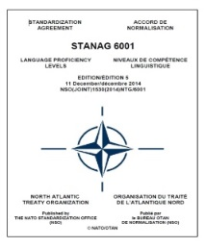
The threshold system
STANAG 6001: Pass
CEFR: Pass

Slide 25
The threshold system
STANAG 6001: Fail
CEFR: Pass

Slide 26
Issues
Comparison of level descriptors
Construct definition
Purpose and contexts
Assessment methodology
Quality assurance mechanisms

Slide 27
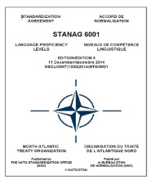
Quality mechanisms
Standardization requires a regulatory body
common interpretation of the level descriptors
consistency in assessment methodology
Custodian of STANAG 6001 is BILC
standardization efforts (seminars, workshops)
international cooperation, consultative visits
Benchmark Advisory Test
CEFR has no regulatory body
no mechanism for enforcing standardization of judgements
“a coherent interpretation of the CEFR is illusive”
no benchmark CEFR test
hundreds of different CEFR tests – very diverse in terms of their quality

Slide 28
Comparing test results and ratings
Assigned CEFR level
rating procedure
type of language
performance elicited
test tasks
test method
construct definition
test purpose & type
=
Assigned STANAG 6001 level
rating procedure
type of language
performance elicited
test tasks
test method
construct definition
test purpose & type

Slide 29
Comparing test results and ratings
Assigned CEFR level
rating procedure
type of language
performance elicited
test tasks
test method
construct definition
test purpose & type
=
Assigned STANAG 6001 level
rating procedure
type of language
performance elicited
test tasks
test method
construct definition
test purpose & type
ONLY IF
=
=
=
=
=
=

Slide 30
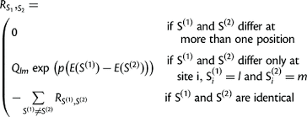
Put differently…

Slide 31
Conclusions
Accurate comparison of the two frameworks is not possible due to significant differences in their purpose, construct definition, delineation of the proficiency levels and testing system.
A specific crosswalk may be established for individual CEFR or STANAG 6001 tests, but any correspondences will only be applicable to the tests under consideration.
Due to the absence of a monitoring body, the quality of CEFR tests tends to vary greatly. This undermines the true value and meaningful interpretation of a CEFR certificate.
Any comparison will at best result in rough approximations, which are not helpful to either the employer or the individual.

Slide 32
BILC Recommendation
BILC strongly discourages conversion or recognition of test results acquired on a test based on one framework in terms of levels from another framework.
Retirees and future employers are better served by a proper, meaningful certification through a valid language test based on the appropriate language scale.
Nations are recommended to make funds or other means available for recertification if there is a need to formally recognize previously acquired language skills.
Ultimately, transferring STANAG 6001 ratings into civilian qualifications is a national responsibility, and not a concern of NATO or BILC.

Slide 33
Accurate comparison
of language levels
remains an illusion…

Slide 34
For more information
visit
www.whylanguagelevelsfromdifferentscalescannotbeconverted.com
or go the BILC website
www.natobilc.org
Thank you for your attention

Slide 35
List of works consulted
ALTE (Association of Language Testers in Europe). (2011). Manual for Language Test Development and Examining. Council of Europe: Language Policy Division. www.coe.int.
Buck, G., Papageorgiou, S., and Platzek, F. (2008). Exploring the Theoretical Basis for Developing Measurement Instruments on the CEFR. Presentation at the EALTA Conference, Athens, 2008.
Clifford, R.T. (2001). Opening Remarks. BILC 2001 Conference Report (Segovia, Spain), 17-39.
Clifford, R.T. (2012). It is Easier to Malign Tests Than It is to Align Tests, in: Tschirner, E. (ed.), Aligning Frameworks of Reference in Language Testing. Tübingen, Stauffenburg Verlag, 49-56.
Clifford, R.T. and Cox, T.L. (2013). Empirical Validation of Reading Proficiency Guidelines. Foreign Language Annals, 46, 1: 45-61.
Council of Europe (2001). The Common European Framework of Reference for Languages: Learning, teaching, assessment. www.coe.int/lang-CEFR.
Council of Europe (2009). Relating Language Examinations to the Common European Framework of Reference for Languages. www.coe.int.
Gratton, F. and Di Biase, M.J. (2013). Comparative Study between CEFR and STANAG – a case study conducted in two language institutes in Perugia, in: Proceedings of the XVI AICLU Conference at the University of Perugia (Italy), Perugia: Guerra Ed., 19-34.
Green, A. (2012). CEFR and ACTFL Crosswalk: A Text Based Approach, in: Tschirner, E. (ed.), Aligning Frameworks of Reference in Language Testing. Tübingen, Stauffenburg Verlag, 83-92.
Lowe, P. Jr. (2012). Understanding “Hidden Features” of the ACTFL Speaking Guidelines as an Intermediate Step to Comparing the ACTFL Guidelines and the CEFR for Speaking Assessment, in: Tschirner, E. (ed.), Aligning Frameworks of Reference in Language Testing. Tübingen, Stauffenburg Verlag, 93-106.
North, B. (1993). The Development of descriptors on scales of proficiency: perspectives, problems, and a possible methodology. NFLC Occasional Paper, National Foreign Language Center, Washington D.C.
North, B. (2014). The CEFR in Practice. Cambridge, UK: Cambridge University Press.
Saville, N. (2012). The CEFR: An Evolving Framework of Reference, in: Tschirner, E. (ed.), Aligning Frameworks of Reference in Language Testing. Tübingen, Stauffenburg Verlag, 57-70.
Saville, N. and Gutierrez Eugenio, E. (2016). The European Commission’s ‘Study on comparability of language testing in Europe’ (2015). Cambridge ELA Research Notes, 63: 3-12.
Swender, E., Tschirner, E. & Bärenfänger, O. (2012). Comparing ACTFL/ILR and CEFR Based Reading Tests, in: Tschirner, E. (ed.), Aligning Frameworks of Reference in Language Testing. Tübingen, Stauffenburg Verlag, 123-138.
Trim, J. (ed.). (2001). CEFR. Guide for Users. Strasbourg, Council of Europe. www.coe.int.
Trim, J. (2012a). Provo Address, in: Tschirner, E. (ed.), Aligning Frameworks of Reference in Language Testing. Tübingen, Stauffenburg Verlag, 19-22.

