Slide 1
Socio-Linguistic Insecurity
Senior French Officers learning English in Paris
Mrs Emilie Cléret
Head of the English Department and Director of Debate
Direction de l’enseignement militaire supérieur

Slide 2
Socio-Professional Profile
French
Senior Officers
Male
Caucasian
Catholic
Military Dynasty
Upper-Class
Higher Education
International Exposure
No Public Support

Slide 3
Linguistic Needs
No use of spoken language is necessary
Speaking English at a tactical level
Specking English at an operational and strategic level

Slide 4
Situations of Socio-Linguistic Insecurity
In the classroom:
Being a student vs being an independent achiever
Shifting from tactical level English to strategic level English
What have you done?
Teacher and teaching methods
Outside the classroom:
Total lack of immersion

Slide 5
Losing Linguistic Landmarks
Use of the word «student»
What’s up?
I am
Cultural references and idioms

Slide 6
Cricket Idioms
He didn’t play with a straight bat; that is just no
cricket!
Yep, despite enjoying good innings here…
He took that decision off his own bat.
It was definitely a hit for six for all of us.
Can we just draw stumps on this one? I just don’t think
there is any point talking about it.

Slide 7
Baseball Idioms
Is it a rain-check for David today?
No, he had said he was going to be late.
Ok, let’s get started. The outcomes here are way below
the Mendoza line. Have you got statistics or is it a
ball-park figure?
Here are the figures (…) Basically, we need a cleanup
hitter. We are down to the last out; it’s a hit or a miss.

Slide 8
After Drawbacks, Advantages
Environment and Profile:
Perfect learning environment for lower levels
Significant professional experience
Significant academic background
The language in itself:
Easily accessible
Not standardized

Slide 9
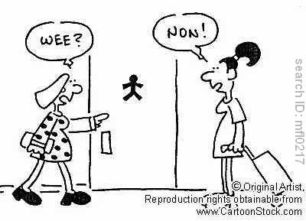
Reducing Drawbacks
Process to stream the officers into groups
Teaching team
How do you replace
immersion ?

Slide 10
How do you replace immersion?
Activities based on interaction
Networking
Debating
Study trips
Partnerships

Slide 11
Building on Advantages
Transformative Pedagogy:
Open architecture
Students involved in module design
It must be gradual
Willing suspension of disbelief

Slide 12
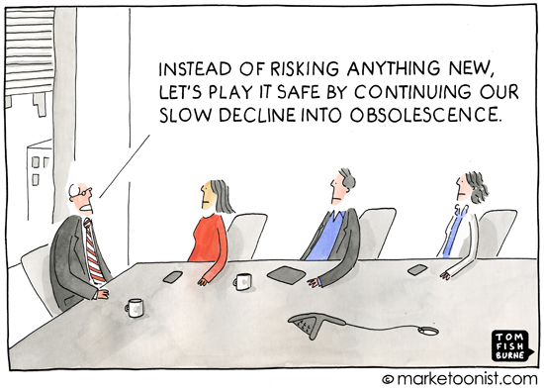

Slide 13
The End
Questions ?

