Slide 1
Study Group 3
Military Assistance with the
Language Problems related to
the Migrant Crisis

Slide 2
Background
Between summer 2015 and spring 2016
Austria was among the countries
most affected by the Migrant Crisis
Challenges:
The sheer number of migrants
Different languages/too few interpreters
Security issues/lack of registration
Accomodation/food
Overwhelming voluntary help
but also fear among the host population

Slide 3
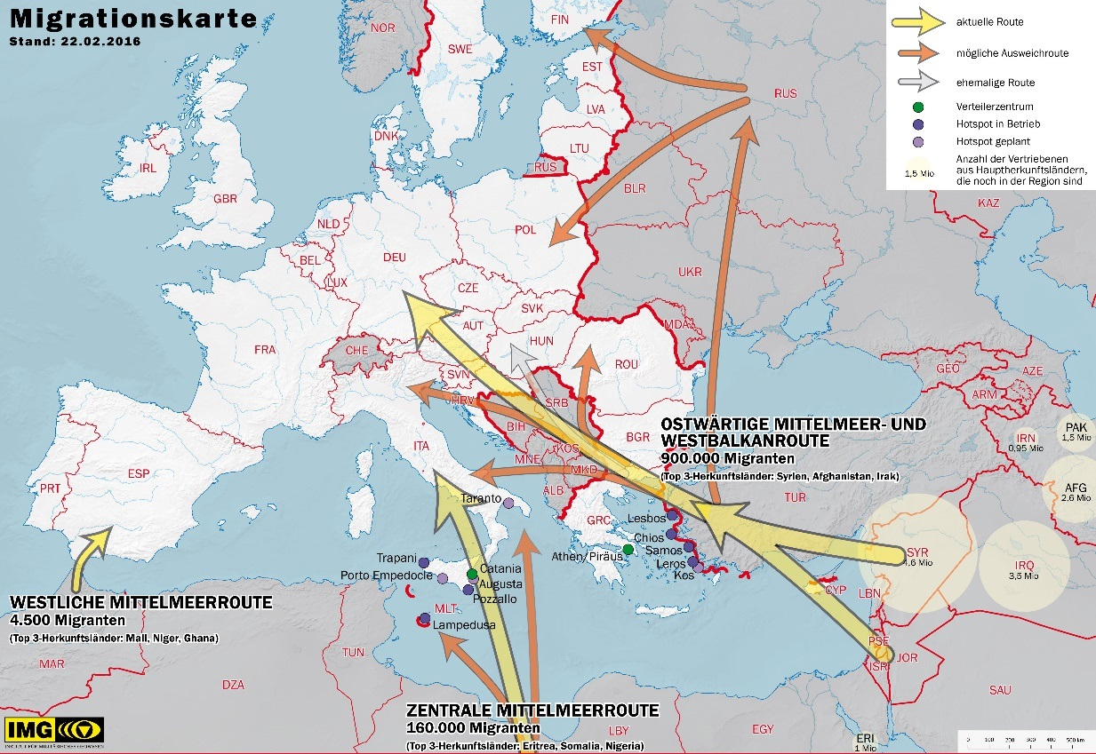
Situation in from
summer 2015 to
spring 2016
Nearly closed since
spring 2016
Enhanced use of the
central route since 2016

Slide 4
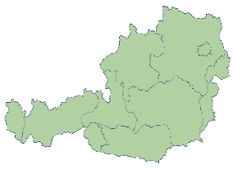
Phase 3: Arrival and Integration
Three Phases of Migration
Phase 2:
Flight and Transit
Phase 1 Expulsion
Phase 2 Flight and Transit
Phase 3 Arrival and Integration
Phase 1: Expulsion
Notes:
.

Slide 5
Study Group 3
Results of an Austrian National Symposium 2016
Communicative Competence
Necessity of Cultural Mediators
Use of Fact-oriented Language
Structural Multilingualism in Organisations
Providing Language Survival Booklets

Slide 6
Study Group 3
Participants
Peter Armbrust
Štefan Blahušiak
Dariusz Chrzaszsz
Thomas Fronek
Tomáš Kembicky
Zsolt Mikusi
Daire Roache
Wolfgang Zecha

Slide 7
Study Group 3
Military Assistance with the Language Problems
related to the Migrant Crisis
Experiences, Remarks, Expectations….:
Difference between refugees and job-seekers
Number of interpreters,
Observers of dialects to clarify the reasons and credibility of refugees
Maintain registration and control
Identification of the role of the military
National or even international challenges and tasks –
saving ressources
Should only the military learn languages
Military only as assistance to domestic emergency services
Military must be impartial
Assistance by former migrants very helpful, but tribal rivalries possibly imported (monitoring and listening only is also helpful)
Use of English if necessary

Slide 8
Study Group 3
Question to work on
How can military assistance
contribute to solving language-related problems?
Use of military translators
Recruits with a migration background
Provide central points (language interpreters)
Military psychologists
Mobile virtual comunications set (provided by military)
Language survival booklets and applications
Cimic ressources

Slide 9
Study Group 3
Question to work on
Which competencies should a cultural mediator have?
Cimic operators are trained as cultural mediators
Cultural training for all troops
Cultural awareness for all troops
Gender awareness

Slide 10
Study Group 3
Question to work on
What is the necessary content of a language survival booklet and
how should the structure of such a survival booklet look like?
Clarify the desired outcome of the booklet
Purpose
Information page(s)
Grafics
Targeted people/persons
Aim of the booklet
Terminology, words, (divided into topics)
Phone numbers, figures
Clear sequence of questions

Slide 11
Study Group 3
Results/Recommendations
National or even international challenges and tasks – saving ressources
Specified role of the military in advance
Use of CIMIC personnel as cultural mediators
Produse and use of tailored survival booklets
Employment of military translators, psychologists….
Employment of former migrants (in the military)
Gender and cultural awareness trainings
Continuing this Study Group in the next BILC event

