Slide 1
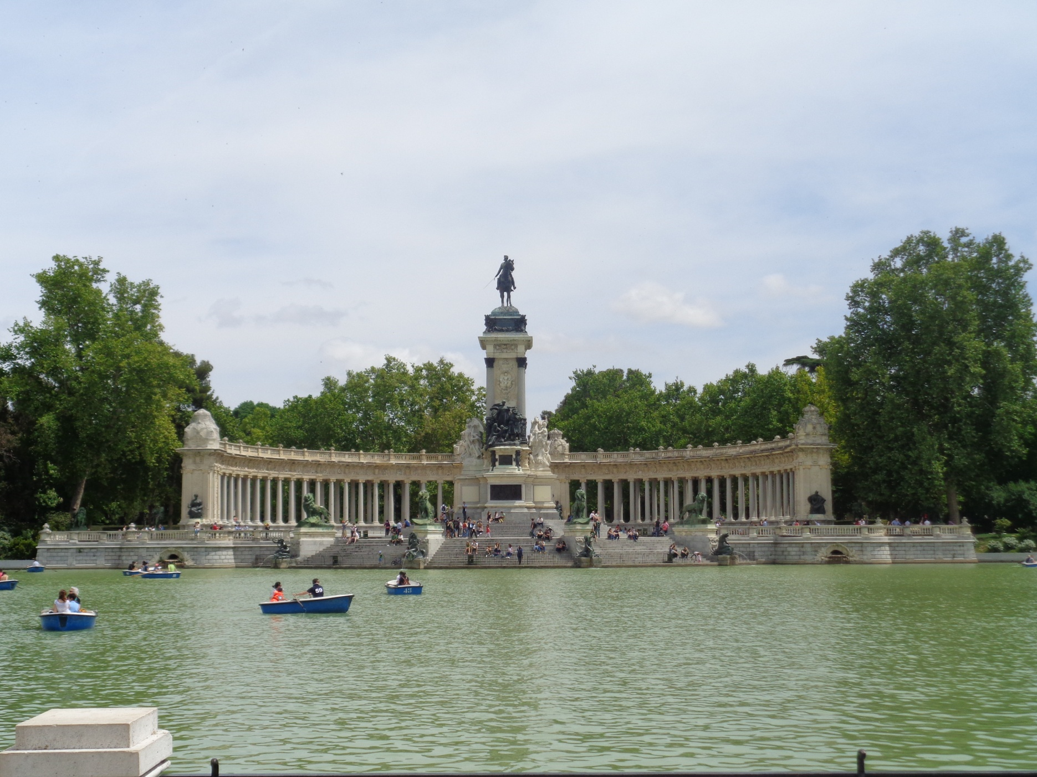
Study Group 1
Common Challenges Faced by Language Training Managers

Slide 2
Study Group 1
Common Challenges Faced by Language Training Managers
22 participants – 19 countries
Austria, Belgium, Bulgaria, Croatia, Denmark, Estonia, France, Georgia, Germany, Hungary, Latvia, Lithuania, Spain, Sweden, Jordan, Slovakia, Slovenia, United Kingdom, USA

Slide 3
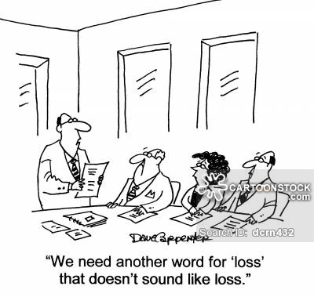
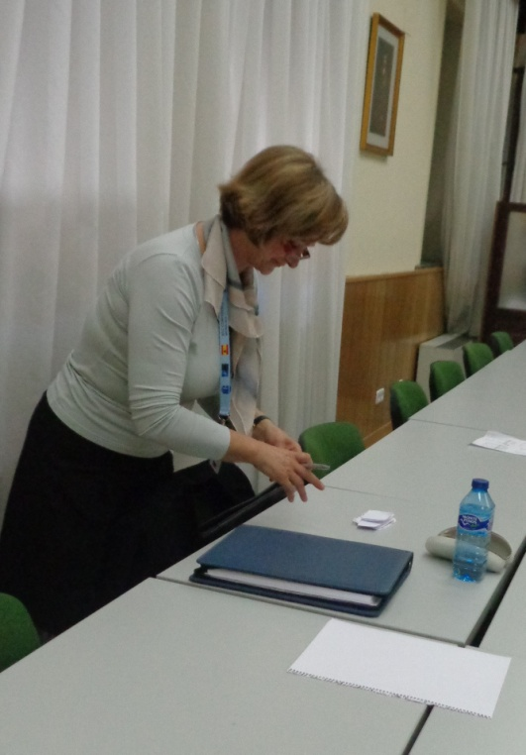
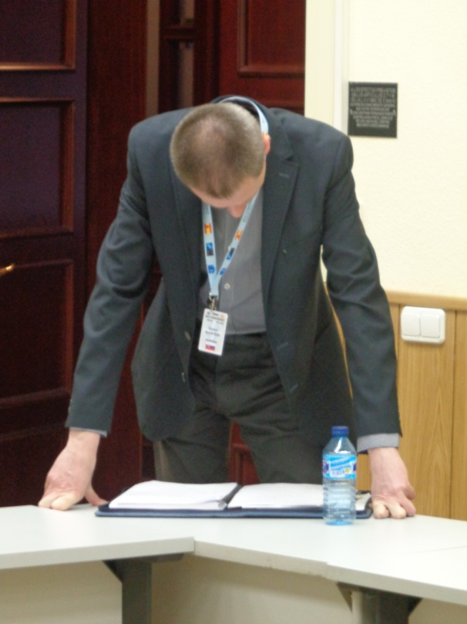
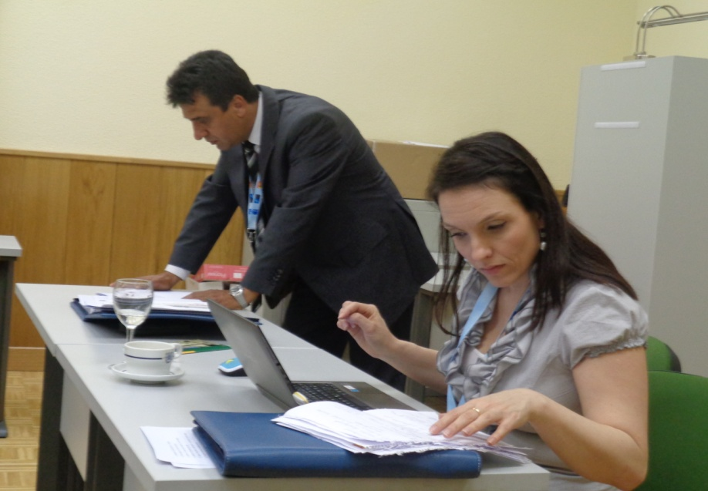
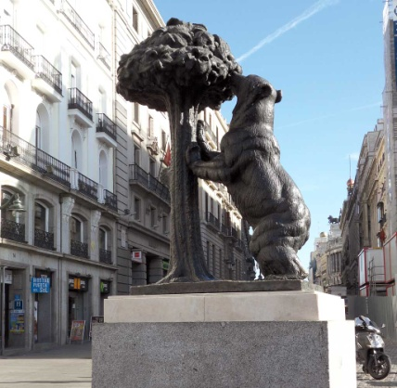
Study Group 1
Common Challenges Faced by Language Training Managers

Slide 4
Study Group 1
Common Challenges Faced by Language Training Managers
Subgroup 1.1 – Language Training Policy
Challenges: financial & infra & admin, downsizing, Supp. development, Teacher Trg; different understanding (DMP), different levels of responsibilities
Possible solutions: setting realistic goals, communication with stakeholders, giving and taking advices

Slide 5
Study Group 1
Common Challenges Faced by Language Training Managers
Subgroup 1.2 – Teaching Staff
Recruitment: military vs. civilian teachers: motivation, [mil.] training, mentoring
Qualifications: clear criteria for hiring (permanent vs. contracted Staff), cultural awareness

Slide 6
Study Group 1
Common Challenges Faced by Language Training Managers
Subgroup 1.3 – Organisation / Administration
place of Lng Inst: the higher the better
communication: with decision makers, within the organisation > “coordination group”
centralized vs. decentralized: pros & cons
flexibility: planning in balance with resources
availability of personnel for training: integrated language training in career courses (direct communication), blended learning
teaching Staff: different status

Slide 7
Study Group 1
Common Challenges Faced by Language Training Managers
Findings – Questionnaire
Two big groups: civilian vs military teachers 85:15%
Students per year: 10000 but one of org:20000
Status of teacher: more than 90 % permanent staff
Availability of teacher training: 100% but different options
Levels of subordination to MoD – from 2 to 5, vary even in one institution from course to course

Slide 8
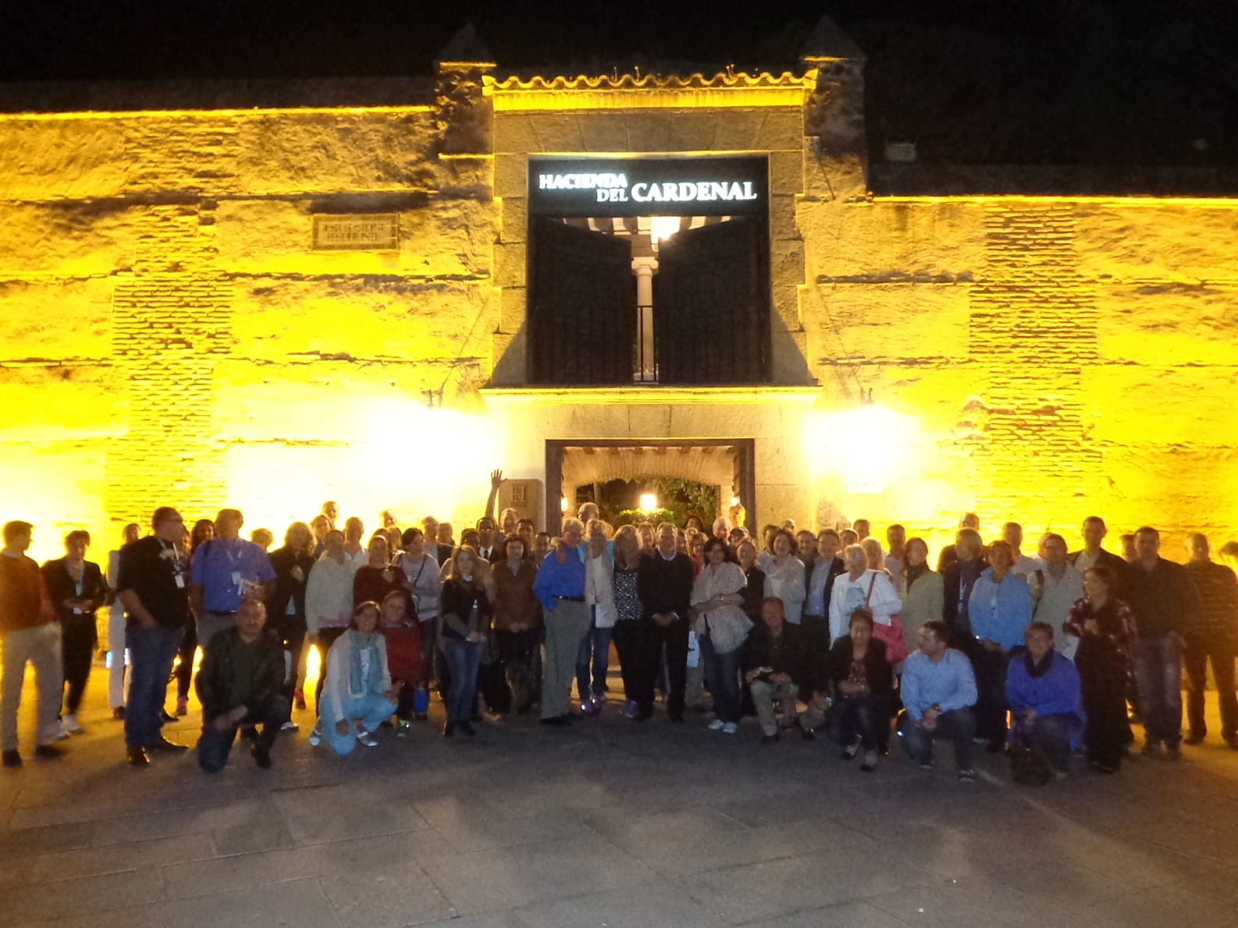
Any Questions?
Muchas gracias por todo!
Notes:
!

