Slide 1
Study Group 5
Forecasting Requirements:
From Needs Analysis to Long-term Planning

Slide 2
Group members
Baines Nikki Lee
Cleret Emilie
Cordon Scharfhausen Carlos
Curtis Fiona
Dali Khaoula
Hrebeniuk Mykhailo
Nummenpää Jari
Skilleås Hege
Proffitt Julia
Nuhic Nermin

Slide 3
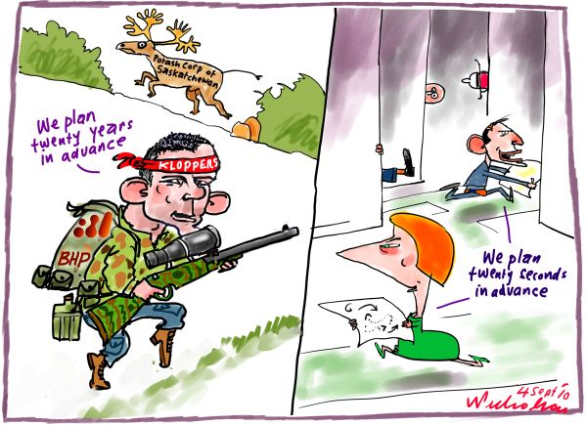

Slide 4
Overview
What are our Needs?
What do we mean by Long Term Planning?
What are the Challenges?
How can we do it better?

Slide 5
What are our needs?
External:
Combined and National Operations
Combined Joint Exercises
Alliances EU NATO
UN Peace support OPs
Defence engagement
Friends and allied cooperation
Humanitarian - Nepal Philippines etc
Joint course support for non English speaking nations
Internal:
Non-native speaker Nationals
Homeland Security
Defence of overseas territories
Economic

Slide 6
What do we mean by Long Term Planning?
What is long term?
What are we planning for?
Is linguistic capability strategic?
Linking linguistic ability to Human Resource Management
Management of personnel - individual planning
Different countries have different needs & funding varies again on the different countries.
Notes:
Means different things to different people and depends on circumstances – lots of factors
No, ít´s not just strategic – so used at all levels. Shouldnt look at it from one perspective. All about maintaining the capability.

Slide 7
What are the Challenges?
Balancing Stakeholder needs
Cultural differences – International and Internal
Lack of common methods for long term language planning
The difficulty of the language plays a great role in the long term planning. Some languages are easier & others harder, Chinese for ex.
Assumptions
Shrinking time allocated for language training in tight educational programmes
Needs analysis and long term planning mean different things to different countries
Different countries have different methods to identify needs, if any
Defence needs are often different to single service needs
The effects of decisions made today may not be seen for many years
Political time frame vs Delivery time frame
Different countries have different needs & funding varies again on the different countries.
Making long term planning flexible enough to cope with emerging requirements
Notes:
Medium or short term: react to changing events or changing scenarios that require other Lang. Competencies such as Farsi Bambara

Slide 8
How can we do it better?
Best Practice – structured approach?
Regional Cooperation
Banking and sharing of evidential research
More support for NATO countries, meetings with decision makers, to convince them how important language learning and testing is
Realistic Goals
Notes:
Bundesprachenammt and Mali or French foreign legion would be an amazing resource if given appropriate teaching, translating and interpretation Training
Nordic Bodies Nordefco
Banking of research eg on BILC website

Slide 9
