Slide 1


ITALIAN AIRFORCE
AVIATION ENGLISH TRAINING CENTER
TAILORING METHODOLOGIES
FOR BETTER LEARNING
COL. STEFANO GENSINI
23 MAY 2016

Slide 2
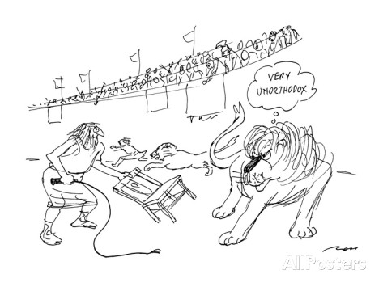
ITALIAN AIRFORCE

Slide 3
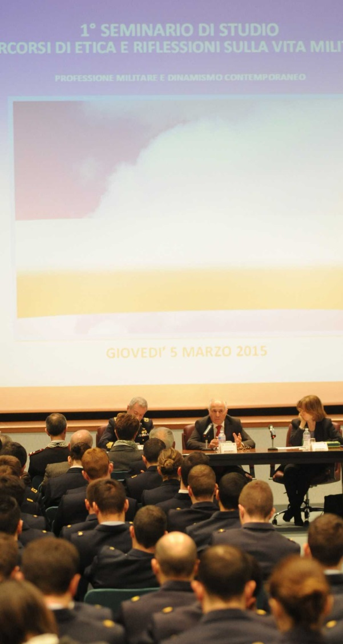
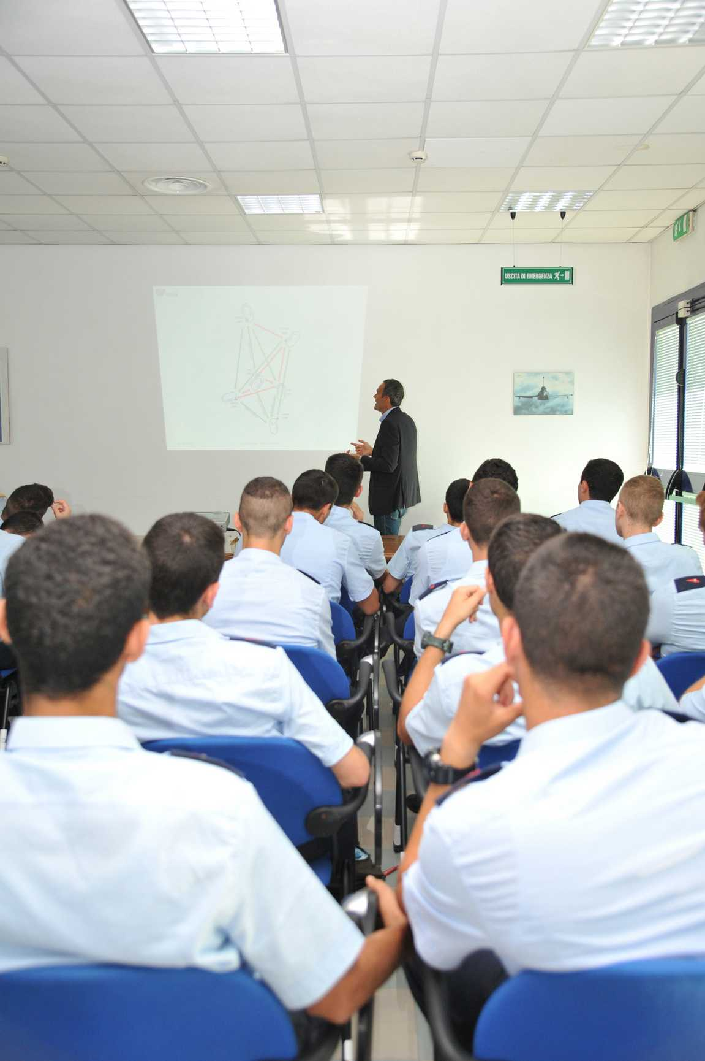

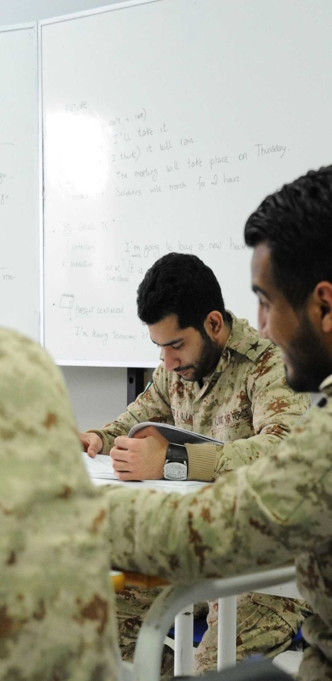
ITALIAN AVIATION ENGLISH TRAINING CENTER
Loreto
ITALIAN AIRFORCE

Slide 4

AGENDA
TRANSFORMATION FROM ELT TO ESP
TAILORING AVIATION ENGLISH
GAMIFICATION AND ROLE PLAY
CONCLUSIONS
ITALIAN AIRFORCE

Slide 5
AGENDA
TRANSFORMATION FROM ELT TO ESP
TAILORING AVIATION ENGLISH
GAMIFICATION AND ROLE PLAY
CONCLUSIONS
ITALIAN AIRFORCE

Slide 6
TRANSFORMATION: FROM ELT TO ESP
YEARS 2007-2012
12 WEEKS
ELT
ITALIAN AIRFORCE
1/22

Slide 7
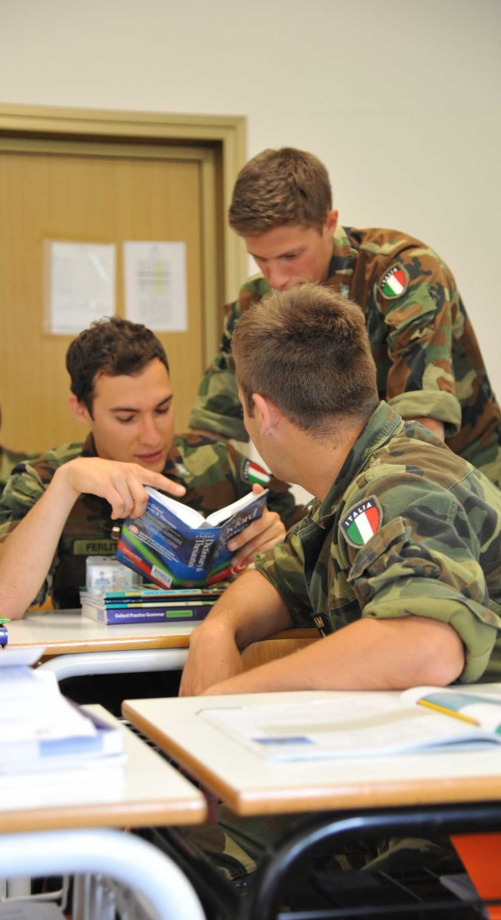
TRANSFORMATION: FROM ELT TO ESP
METHODS
STYLES
SCHOOLS
SPEEDS
ITALIAN AIRFORCE
2/22

Slide 8

TRANSFORMATION: FROM ELT TO ESP
METHODS
STANDARD
STYLES
SCHOOLS
SPEEDS
ITALIAN AIRFORCE
2/22

Slide 9

TRANSFORMATION: FROM ELT TO ESP
METHODS
LEARNING
STYLES
SPEEDS
ITALIAN AIRFORCE
3/22

Slide 10
TRANSFORMATION: FROM ELT TO ESP
METHODS
TAILORING
LEARNING
STYLES
SPEEDS
ITALIAN AIRFORCE
3/22

Slide 11
TRANSFORMATION: FROM ELT TO ESP
YEARS 2007-2012
12 WEEKS
ELT
ITALIAN AIRFORCE
4/22

Slide 12
TRANSFORMATION: FROM ELT TO ESP
YEARS 2012-2013
4 WEEKS
ELT
ELT
ELT
ITALIAN AIRFORCE
5/22

Slide 13
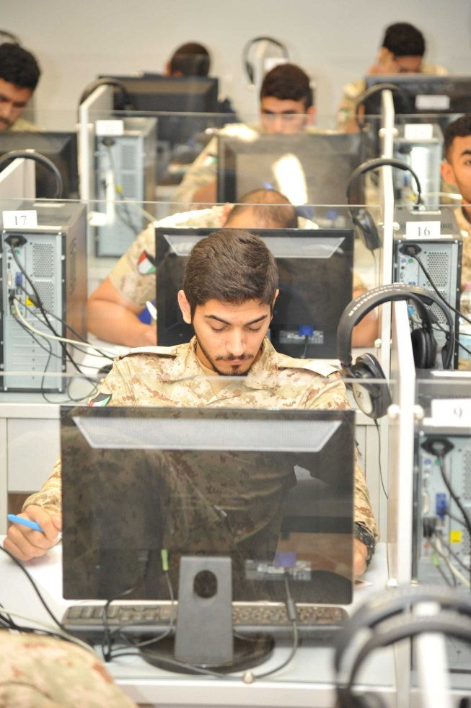
TRANSFORMATION: FROM ELT TO ESP
THE MODULAR APPROACH
STARTER
E-LEARNING
ELEMENTARY
PRE-INTERMEDIATE
INTERMEDIATE
RESIDENT
UPPER-INTERMEDIATE
ADVANCED
ITALIAN AIRFORCE
6/22

Slide 14
TRANSFORMATION: FROM ELT TO ESP
YEARS 2012-2013
ELT
ELT
ELT
ESP
ITALIAN AIRFORCE
7/22

Slide 15
TRANSFORMATION: FROM ELT TO ESP
YEARS 2014-2016
ELT
ELT
ELT
ESP
ESP
ESP
ITALIAN AIRFORCE
8/22

Slide 16
TRANSFORMATION: FROM ELT TO ESP
TO SUIT SPECIFIC NEEDS OF A PROFESSION
ESP
ELT
DEVELOPMENTS IN THE FIELD OF LINGUISTICS
EDUCATIONAL PSYCOLOGY
ITALIAN AIRFORCE
9/22

Slide 17
TRANSFORMATION: FROM ELT TO ESP
ESP
AN «APPROACH»
RATHER THAN A «PRODUCT»
HUTCHINSON AND WATER (1987)
ITALIAN AIRFORCE
10/22

Slide 18
TRANSFORMATION: FROM ELT TO ESP
WORKING DAY PERIODS
TEACHER
CENTERED
STUDY
APPROACH
STUDENT
CENTERED
STUDY
APPROACH
08.00
13.30
14.30
16.30
ITALIAN AIRFORCE
11/22

Slide 19
AGENDA
TRANSFORMATION FROM ELT TO ESP
TAILORING AVIATION ENGLISH
GAMIFICATION AND ROLE PLAY
CONCLUSIONS
ITALIAN AIRFORCE

Slide 20
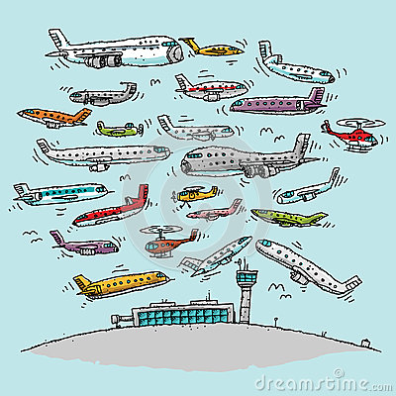
TAILORING AVIATION ENGLISH
ELF
AE
ESP
ITALIAN AIRFORCE
12/22

Slide 21
TAILORING AVIATION ENGLISH
ELF
AE
ESP
ITALIAN AIRFORCE
12/22

Slide 22
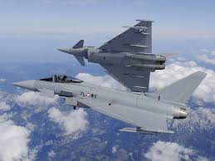
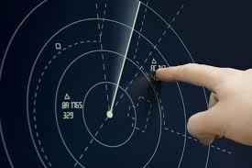
TAILORING AVIATION ENGLISH
ESP
AE
PIL
AE
ATC
AE
MAN
ITALIAN AIRFORCE
13/22

Slide 23
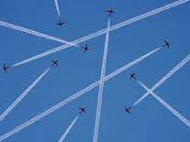
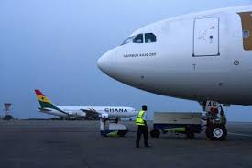
TAILORING AVIATION ENGLISH
AUTHENTIC MATERIALS
AE
PIL
AE
ATC
AE
MAN
PURPOSE-RELATED ORIENTATION
SELF-DIRECTION
CARTER (1983) STREVENS (1988)
BOJOVIC (2006) GATEHOUSE (2001)
ITALIAN AIRFORCE
14/22

Slide 24
AGENDA
TRANSFORMATION FROM ELT TO ESP
TAILORING AVIATION ENGLISH
GAMIFICATION AND ROLE PLAY
CONCLUSIONS
ITALIAN AIRFORCE

Slide 25
GAMIFICATION AND ROLE PLAY
ELT
ESP
ITALIAN AIRFORCE
15/22

Slide 26
GAMIFICATION AND ROLE PLAY
TEACHING AS A CONTINUUM
ELT
ESP
DUDLEY-EVANS AND ST. JOHNS, (1998)
ITALIAN AIRFORCE
16/22

Slide 27
GAMIFICATION AND ROLE PLAY
REAL
EXERCISE
ELT
ESP
ITALIAN AIRFORCE
17/22

Slide 28
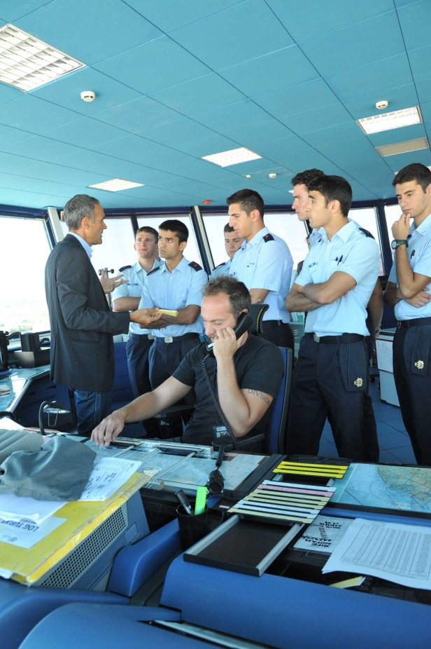
GAMIFICATION AND ROLE PLAY
AVIATION ENGLISH EXERCISE
A PROBLEM-SOLVING
TRIAL
A BASIC- COMMUNICATION
STRATEGY
A REAL LIFE LEARNING
EXPERIENCE
ITALIAN AIRFORCE
18/22

Slide 29
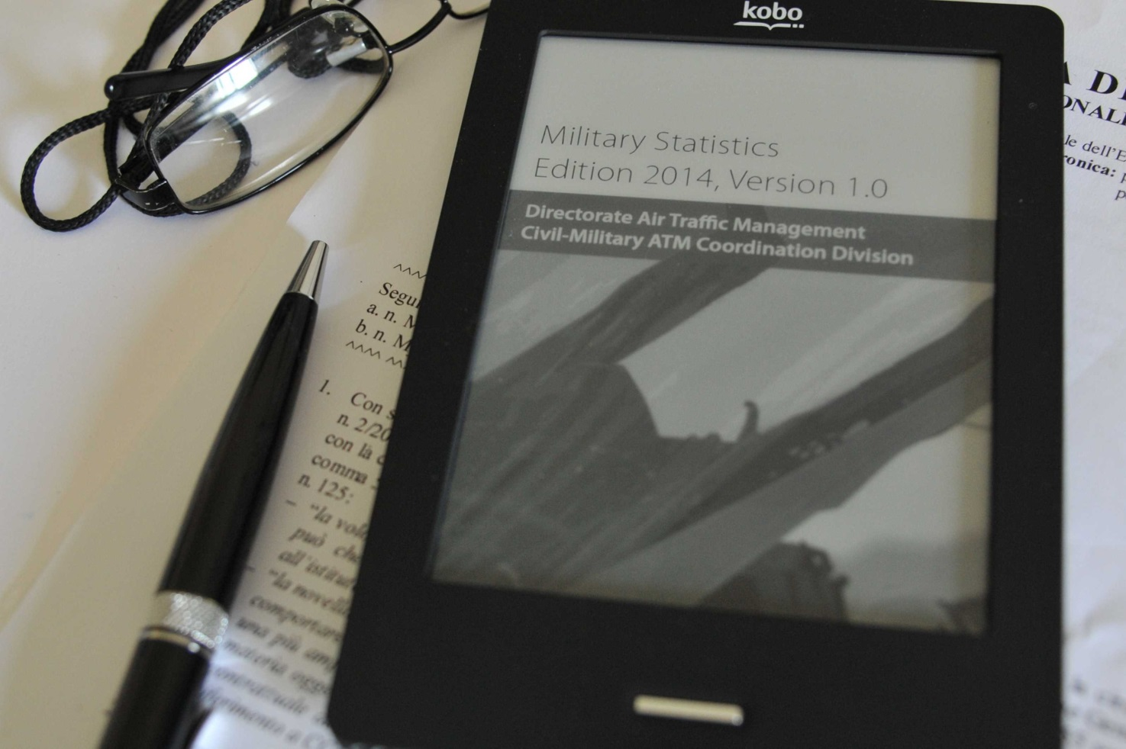
GAMIFICATION AND ROLE PLAY
AVIATION ENGLISH EXERCISE
CREATION
PRODUCTION
MAINTAINING
CLOSURE
DORNEY (2001)
ITALIAN AIRFORCE
19/22

Slide 30
AGENDA
TRANSFORMATION FROM ELT TO ESP
TAILORING AVIATION ENGLISH
GAMIFICATION AND ROLE PLAY
CONCLUSIONS
ITALIAN AIRFORCE

Slide 31
IT AE TRNG CENTER - FUTURE PROGRAMS
MODERNIZED TEACHING
INTERNATIONAL OFFER
GLOBAL NETWORKING
ITALIAN AIRFORCE
20/22

Slide 32


AVIATION ENGLISH TODAY: NEW PERSPECTIVES
LORETO: 08-09 JUNE 2017
DAY 1 | AVIATION TODAY - INTERNATIONAL POLICY
 | EASA
 | EUROCONTROL
DAY 2 | TEACHING AVIATION ENGLISH TODAY
 | TRAINING CENTERS
 | RESEARCH FACULTIES
ITALIAN AIRFORCE
21/22

Slide 33
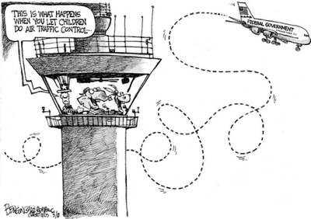
ITALIAN AIRFORCE
22/22

Slide 34
“I WANT TO BECOME A PRIVATE PILOT !!!!!”
ITALIAN AIRFORCE
22/22

Slide 35
QUESTIONS ?
ITALIAN AIRFORCE

