Slide 1
Digital Learning Environment
Armine Abrahamyan
Chief of the English Language
Center of the Armenian
Peacekeeping Brigade

Slide 2
The Voice of the Active Learner

Slide 3
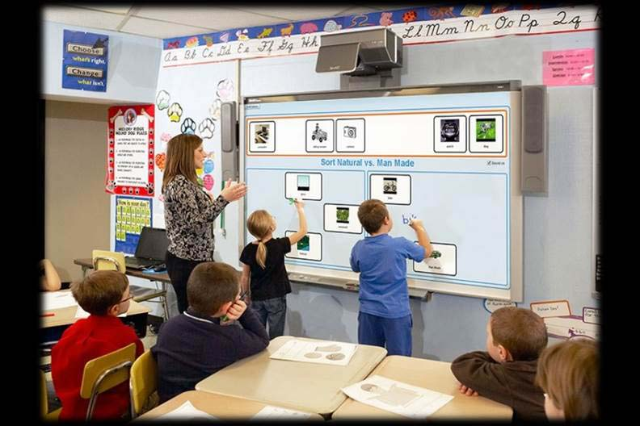
Digital learning environment

Slide 4
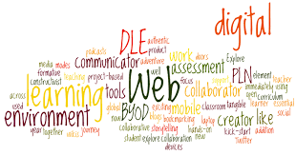
What is DLE?
A DLE (digital learning environment) is a classroom
learning environment where students develop
academic and 21st century skills.

Slide 5
Top technologies that affect the world of education
The Mobile-Learning (M-Learning)
Using Photos
Audio recordings
Apps
E-books

Slide 6
Tablet and Laptops

Slide 7
Videos Why use videos to teach ESL students?
it’s fun and adds a change of pace
it’s good for visual learners
it helps bring a subject to life
the language in videos is usually more natural
the language is set in a realistic context
students hear natural pronunciation, stress and intonation
it can make a lesson memorable
it can be a great way to practice a wide variety of language skills

Slide 8
Massive Open Online Courses(MOOCs)
A MOOC is a platform where students or teachers
can participate in a live online course through the internet.
Khan Academy
Future Learn
Coursera
EdX

Slide 9
Webinars
A Webinar is a seminar or a workshop delivered
through the Internet. They are normally recorded for
future viewing.
http://americanenglish.state.gov/ae-webinars

Slide 10
Research
The U.S. Department of Education’s Evaluation of Evidence-Based Practices in Online Learning: A Meta-Analysis and Review of Online Learning Studies of more than 40 studies found that (mostly higher ed.) “students who took all or part in classes online performed better, on average, than those taking the same course through traditional face-to-face instruction.”

Slide 11
Research
A study by the National Survey of Student Engagement reported that the online-learning experience yielded deeper use of “higher-order thinking, integrative learning, and reflective learning.”

Slide 12
The Impact of Digital Learning on Student Engagement, Grades, and Retention Rates

