Slide 1
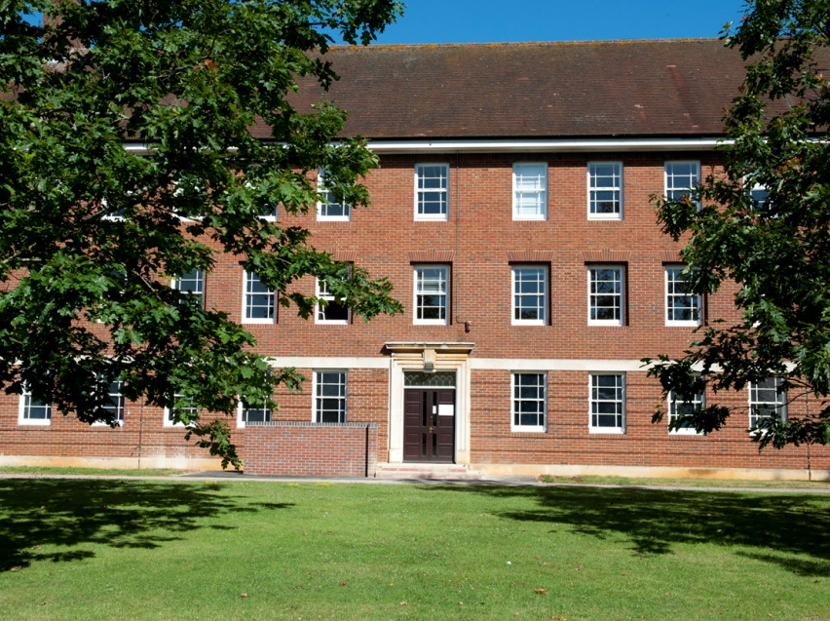
Developing use of Technology
How the Defence Engagement School is Evolving
NATO BILC Conference – Lisbon, May 2018
Capt Henry R Williams

Slide 2
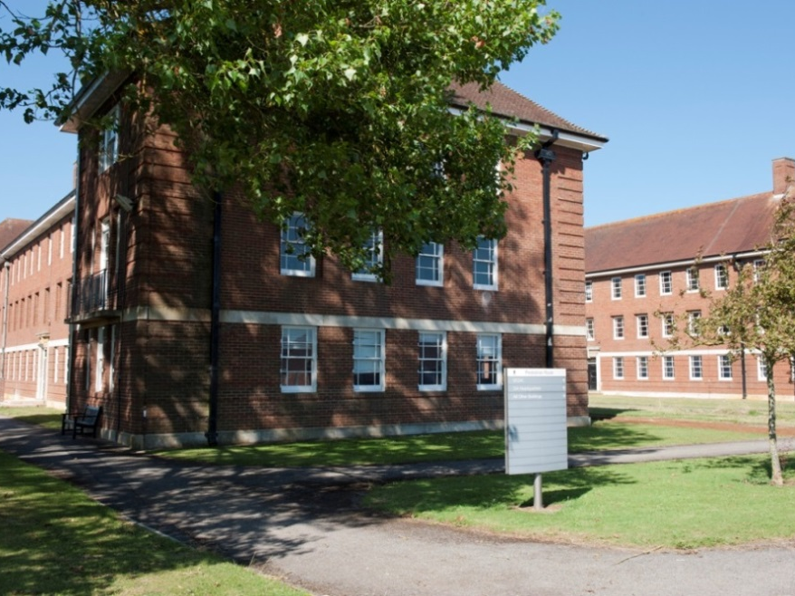
Scope
Overview
– New Structure
– DCLC
Changing Approach to TEL
– What we have done to change
– What the future looks like
Notes:
Aim of presentation – to highlight the issues we have had in bringing technology to learning. We’ve seen changes to the school over the previous few years.

Slide 3
Defence Engagement School (DE Sch)
Role. To provide professional Defence Engagement military education, force generation, preparation and training
DCLC Mission:
Provide English, foreign languages and culture training, in order to enhance the UK’s Defence and Security capability, and to contribute to Defence Diplomacy
Two elements of UK Language:
Delivery (DCLC)
Requirements and Assessment (DRACL)
Merging 3 Schools:
International Section
Defence Centre for Languages and Culture
Defence Attaché and Loan Service Centre
Notes:
Shrivenham in South West of England (Wiltshire)
DE Sch project initiated Aug 17
International Section: Delivers international and UK based strategic leadership and management courses
DCLC: Delivers foreign and English language training and education
DALSC: Delivers force generation preparation and training to Defence Attachés. Loan Service training in development

Slide 4
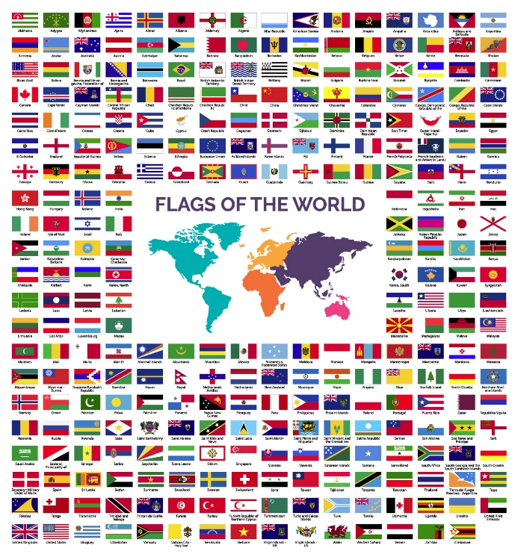
Defence Engagement School (DE Sch)
Four Core Languages
French
Spanish
Russian
Arabic
Many other languages
/ diverse group
35 languages assessed at last Assessment
English Language Wing
Training Support Cell
Notes:
Some bespoke language taught 1-to-1. Less frequent languages (Mandarin, Dutch, Swahili etc)
Bespoke – 2 staff for all other languages. ELW 2017: 318 students, 85 countries
No course design team
Challenges – for TSC (with few staff) to gain conformity / consistency across wide number of languages (some of which only come around once every 2/3 years). And general language, not role-specific.

Slide 5
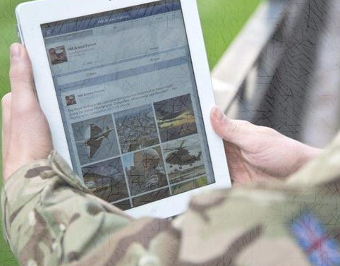
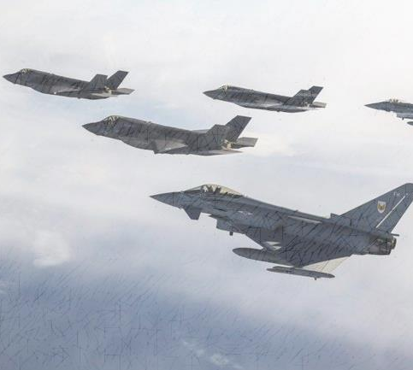
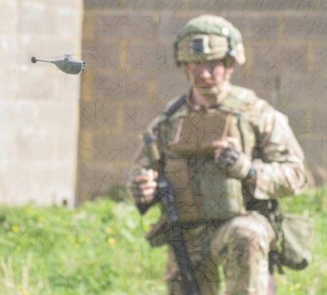
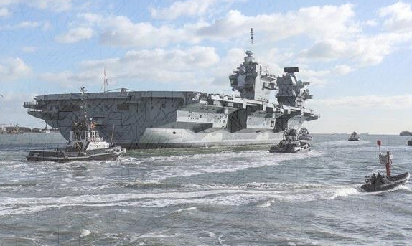
The Aim of Technology
To enhance, not replace
To do things we cannot do without it
Specifically – Speaking and Listening results
Mobile Self-Study – “anywhere/anytime”
User Friendly – for all, not just technically minded people

Slide 6
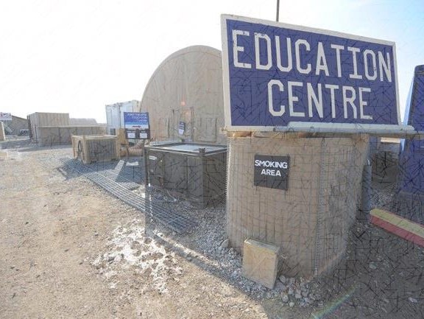
So we looked at other schools…
Conducted Study into ‘Best Practice’
Visited Universities
Questioned our students & staff
Notes:
What are we trying to improve? What do others do which may be transferable to DCLC?

Slide 7
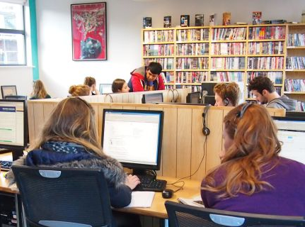
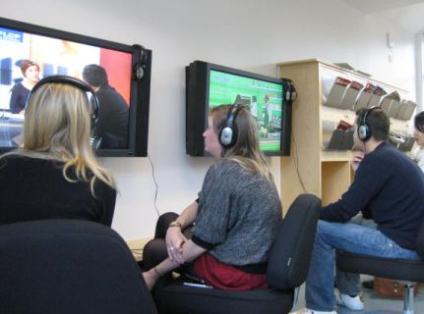
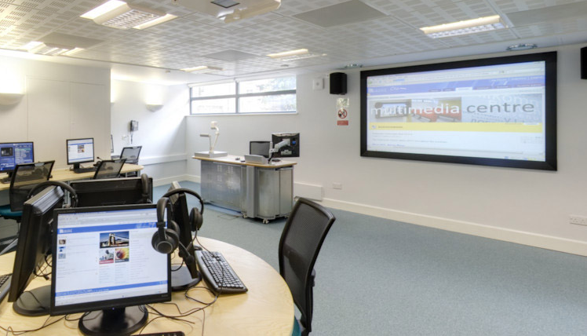
What we found…
TEL Centred
Mixed-Media Approach
Learning Space
Student Freedom
Sharing Good Practice
User Friendly – for all, not just tech people
Notes:
Trends I discerned
Multi-Media Approach

Slide 8
Fluent-Forever
Linguisticator
Lindsay Learns Language
Notes:
Duo lingo
Busuu
Babbel
Memorise
AnkiApp
Tinycards
Brainscape
Quizlet

Slide 9
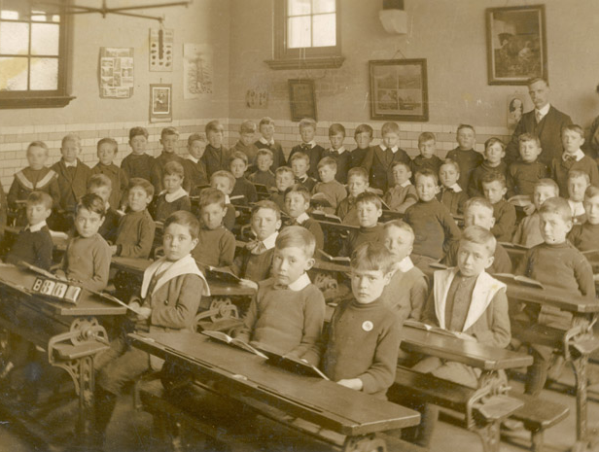
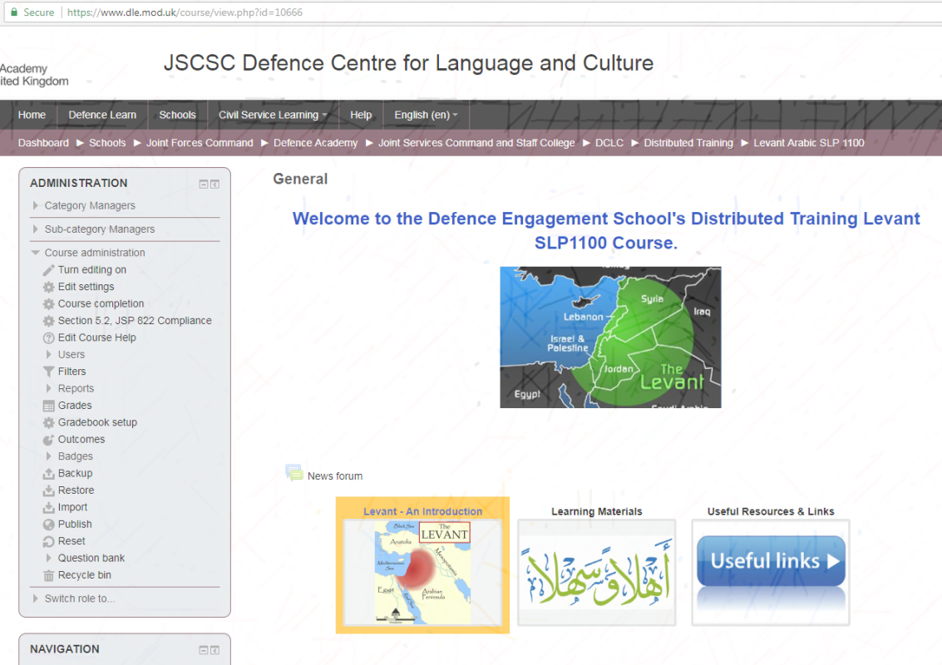
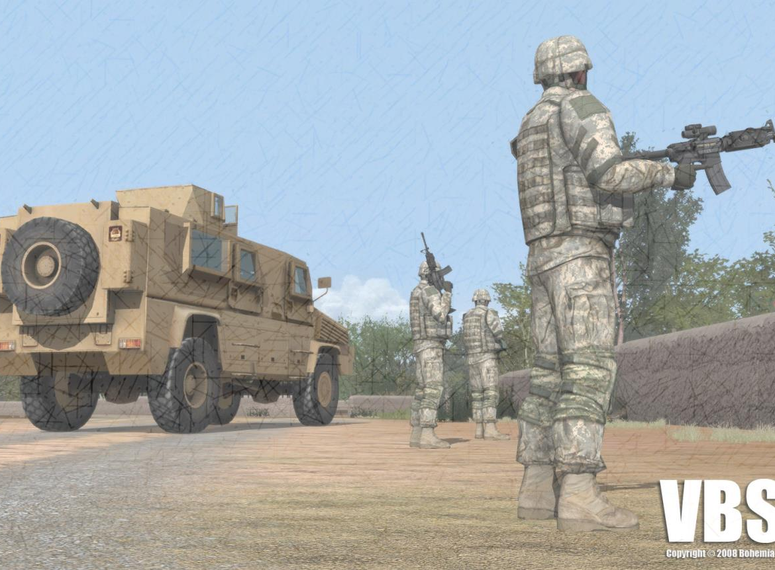
What we’re now doing
Mixed-media focus
TEL Working Groups
Use of VLE
Language Lab facility

Slide 10
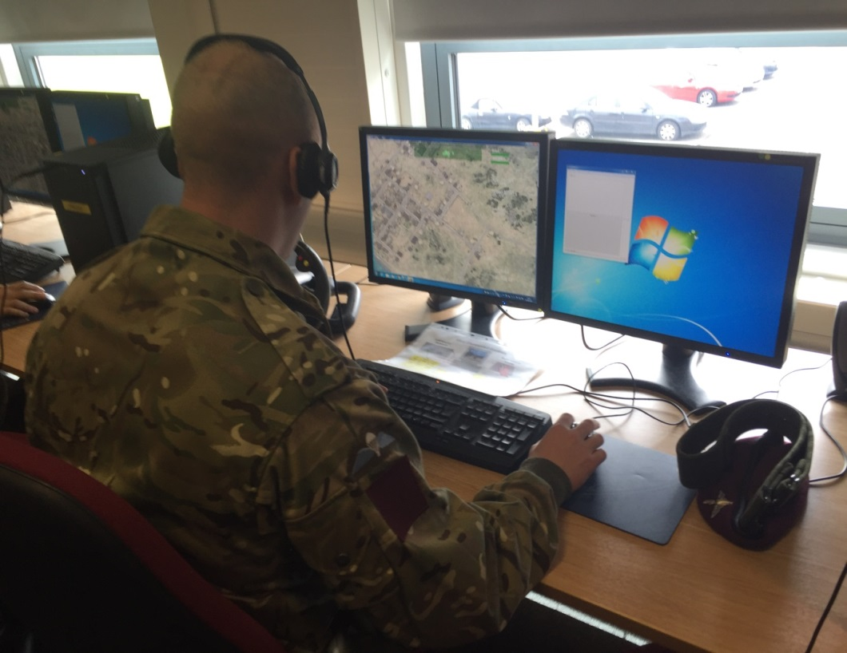
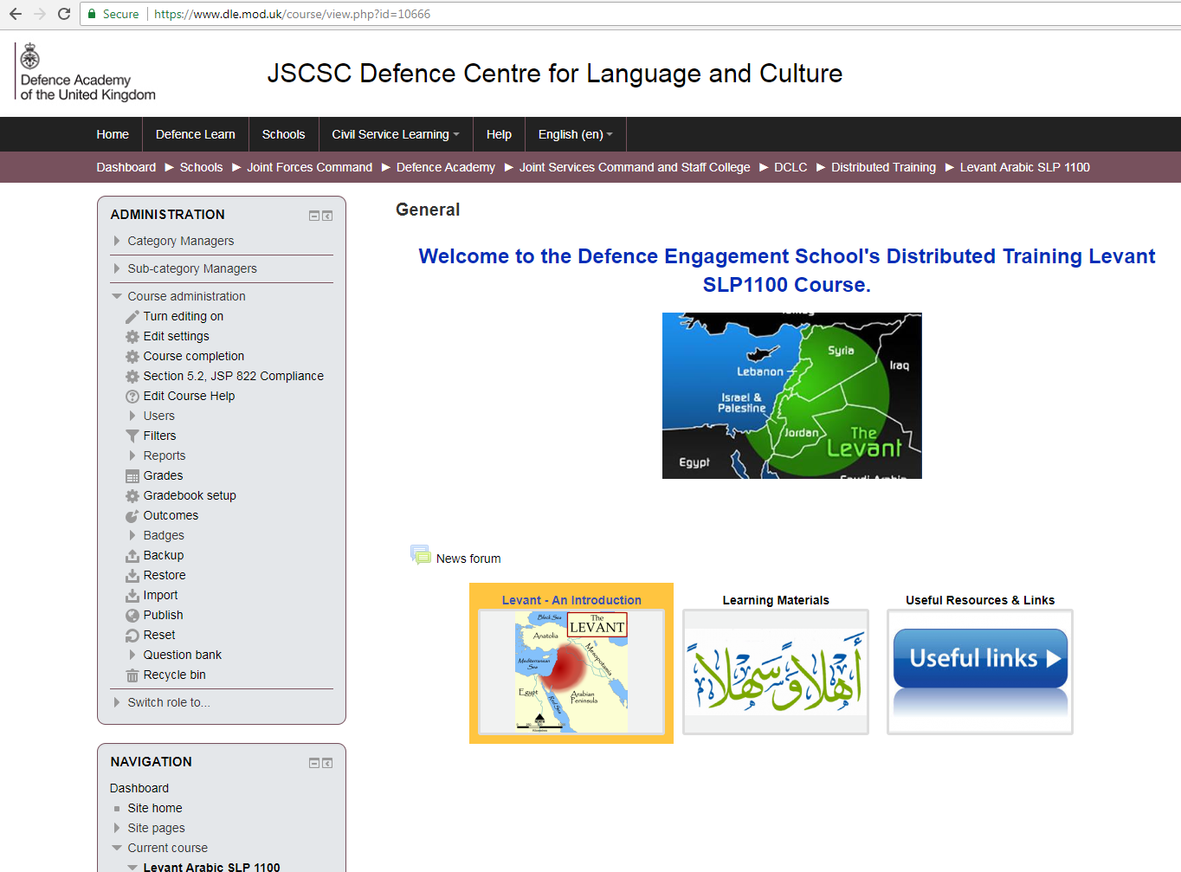
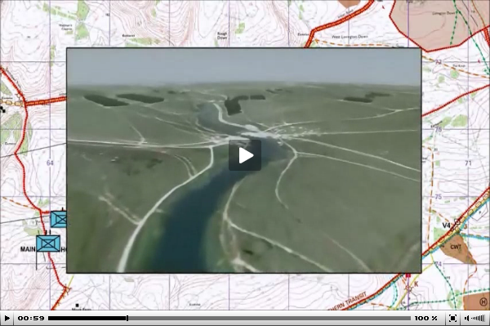
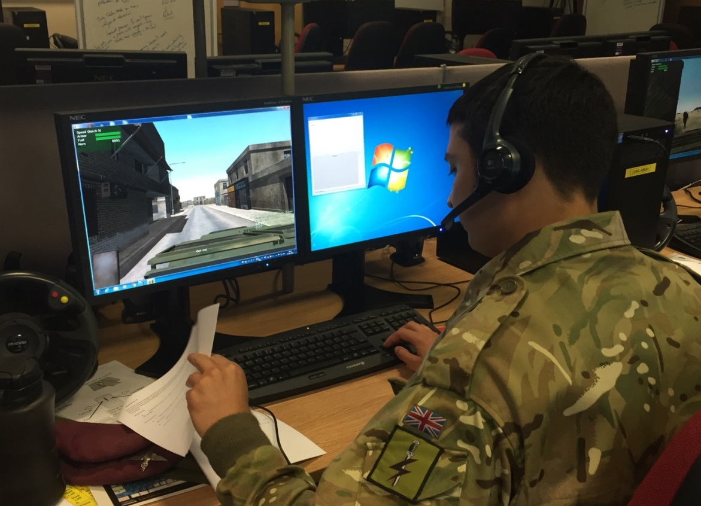
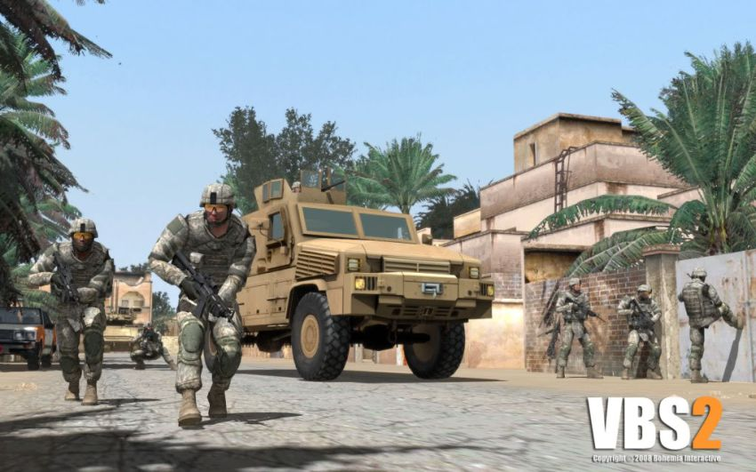
Simulation Scenarios

Slide 11
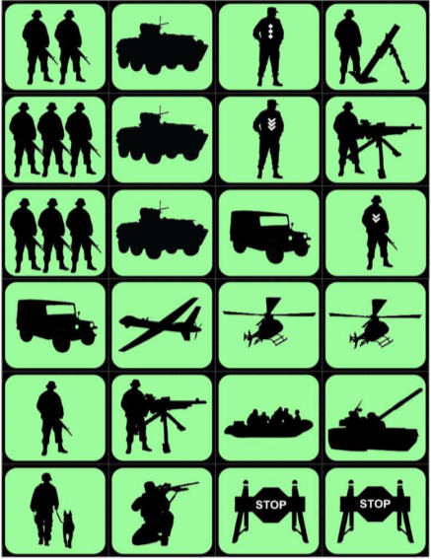
Matrix Gaming
Notes:
Not all about using technology

Slide 12
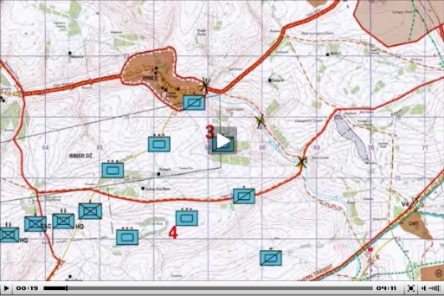
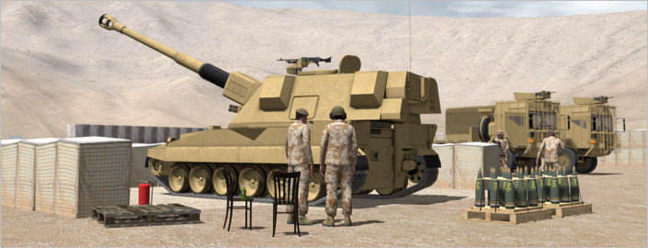
Modelling and Simulation

Slide 13
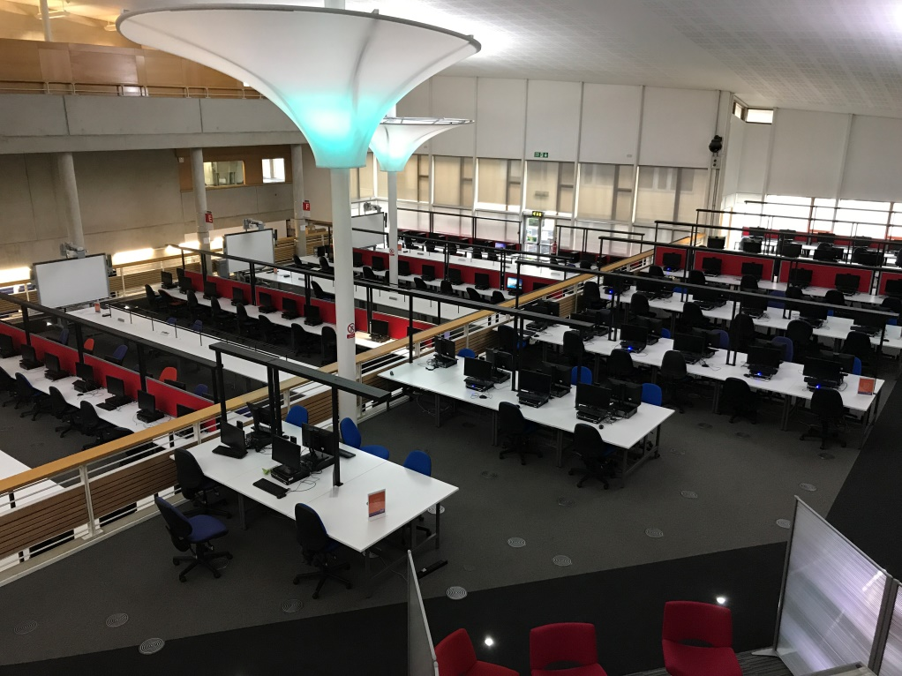
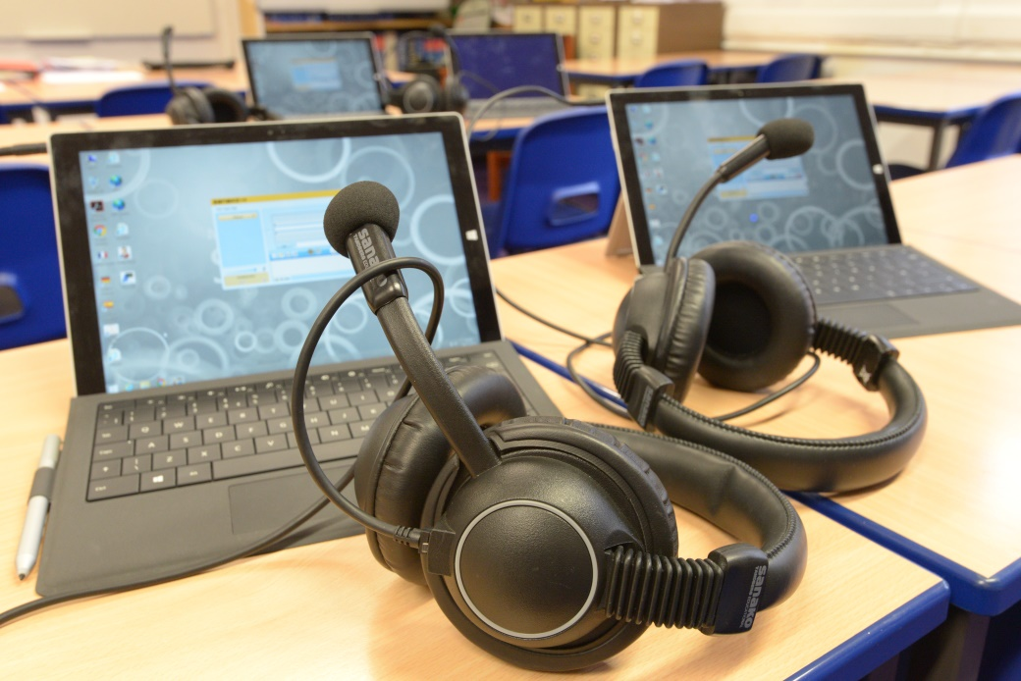
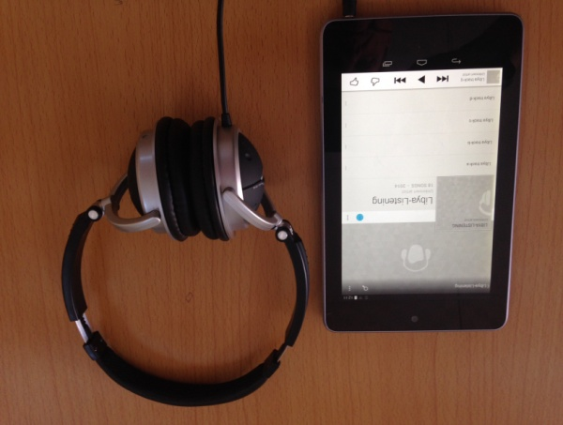
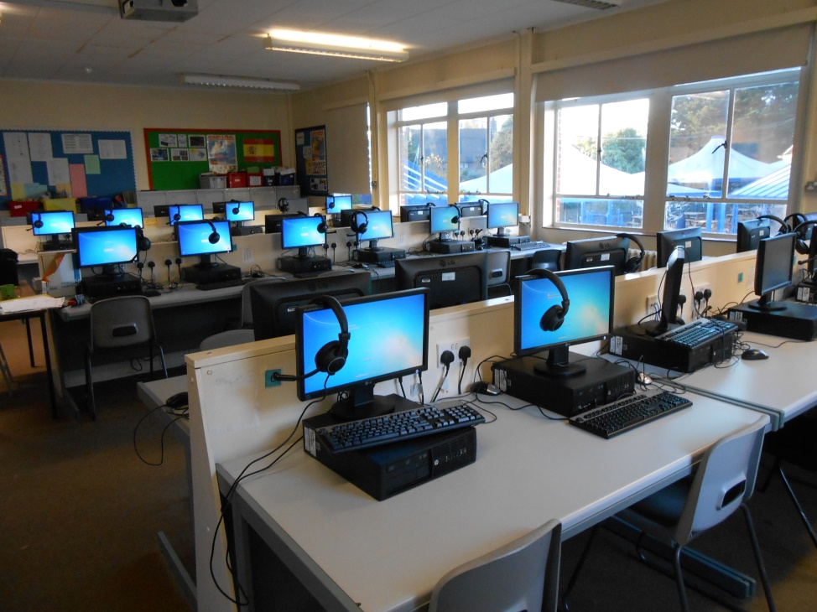
The Future for DE School?
Small Classes
Traditional Language Lab Facility?
(Large Classes
Many Terminals)
Mobile Facility
Notes:
What it’s not going to look like. And what it may likely to look like.

Slide 14
Summary
Evolving Process of Change
– To improve student performance
– To empower teaching staff
Mixed Media Approach
– Not forced, but encouraged
– No over-reliance on Technology

Slide 15
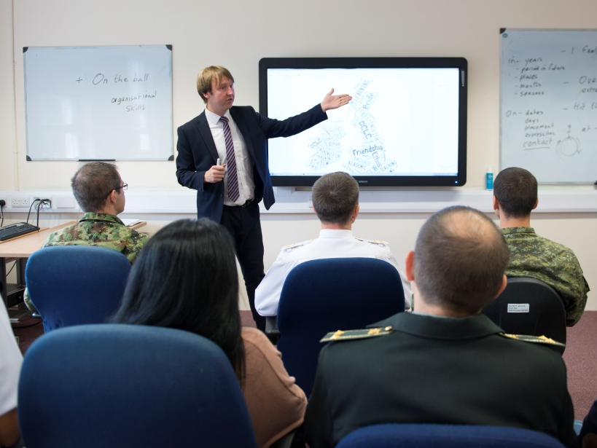
Any questions?

